Slide 1
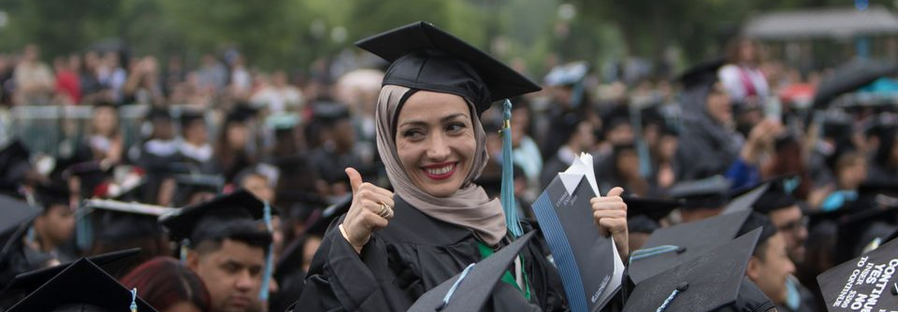


How to apply to the
Live Your Dream Awards

Slide 2



What is a Live Your Dream Award?
Cash award to an eligible woman to spend on anything that helps support education

Slide 3



Eligibility Requirements
Applicants must:
Be enrolled in or has been accepted to a vocational/skills training program, high school equivalency or an undergraduate degree program
Be primary financial provider for yourself and your dependent(s)
have financial need

Slide 4
Eligibility Requirements
Applicants must not:
Have a graduate degree
Be a Soroptimist member, employee of SIA, or immediate family of either
Have previously received a Soroptimist Women’s Opportunity Award or Live Your Dream Award

Slide 5

Eligible Programs:
  High school equivalency
  Associate's degree
  Bachelor's degree
  Certificate programs
  Vocational training

Slide 6
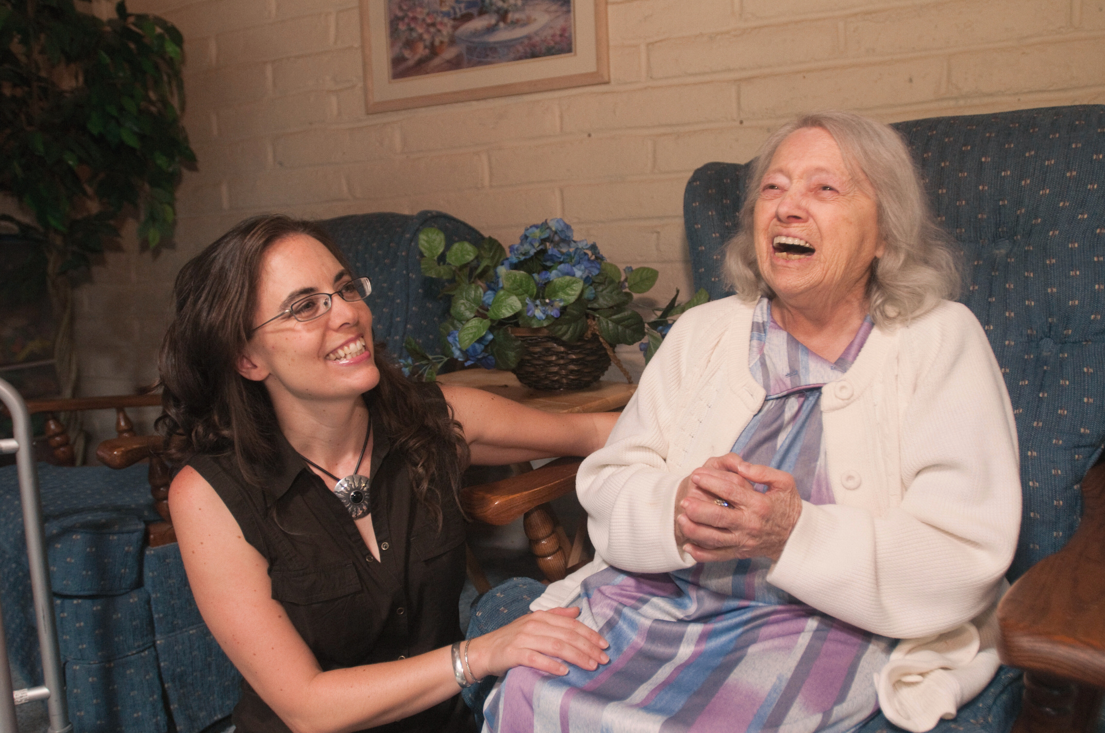
Eligible Dependents:
  children, even those over 18 years old
  partners
  parents
  siblings

Slide 7

https://youtu.be/cl37l4JiXKo?si=X-sJqMqxAgvyv5M2

Slide 8

https://bit.ly/lydaapply

Slide 9
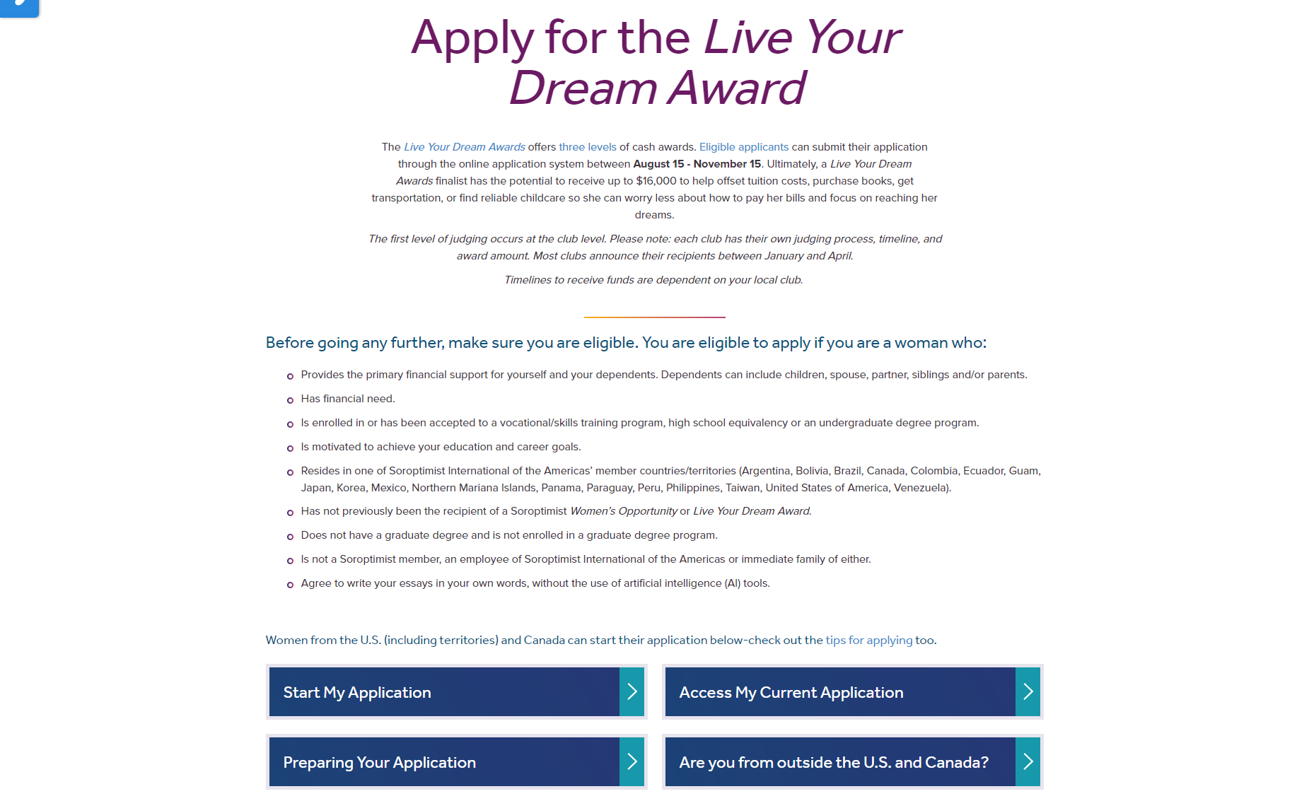

Slide 10
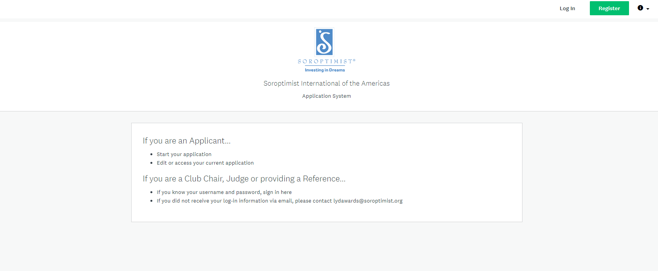
To begin: Click on “Register”

Slide 11
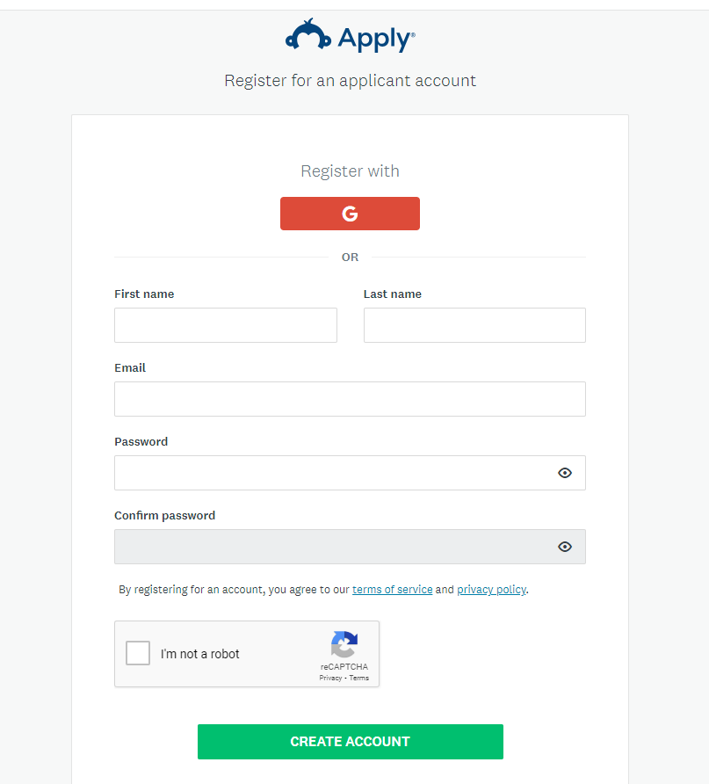
Create an account by registering with this information.
Click here

Slide 12
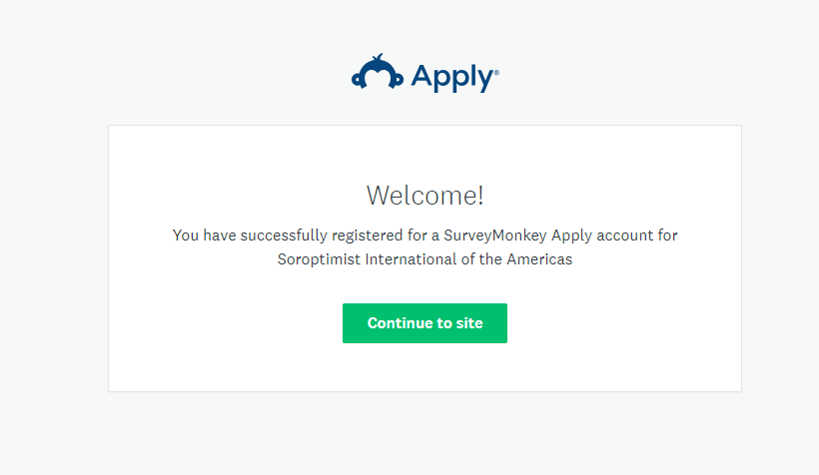
You will see this window to let you know that you have registered successfully.
Click “Continue to site”

Slide 13
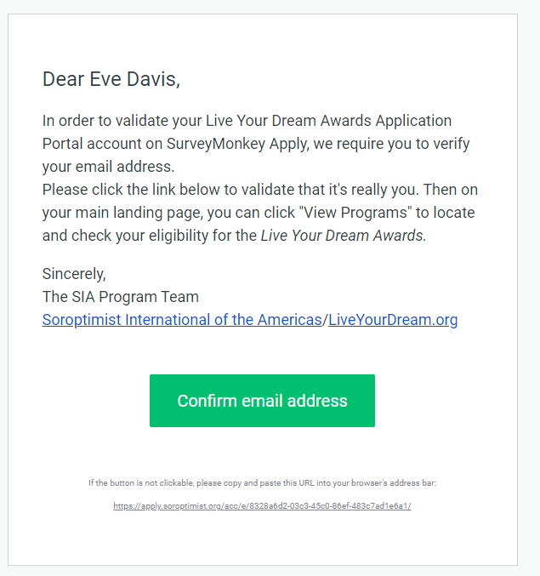
You will receive an email to confirm your email address
Click
“Confirm email address”

Slide 14
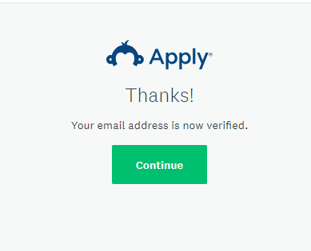
After confirming your email address, you will see this window.
Click “Continue” to access your account

Slide 15
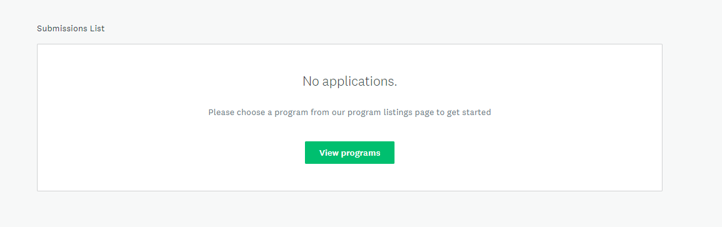
Click “View programs”

Slide 16
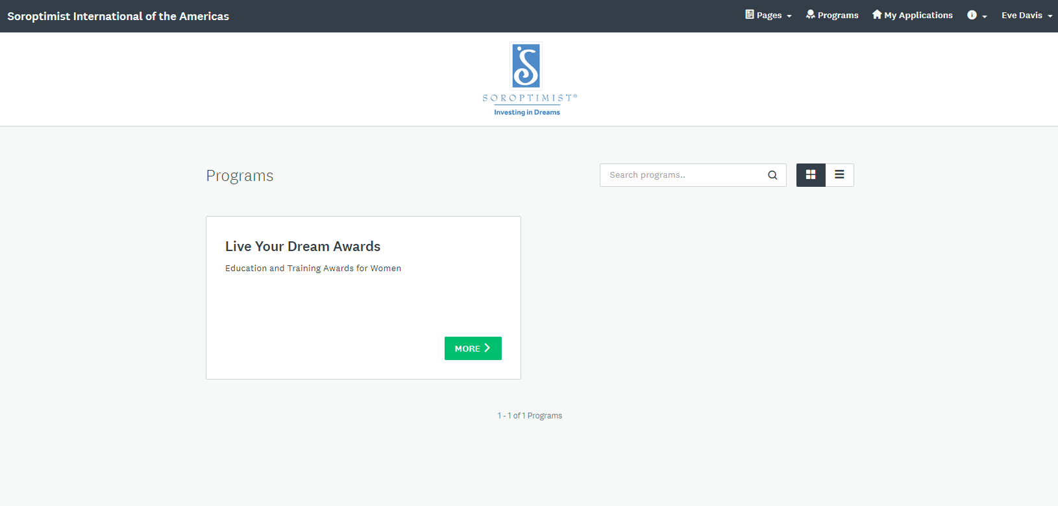
Click
“View Programs”

Slide 17
Click “MORE”

Slide 18
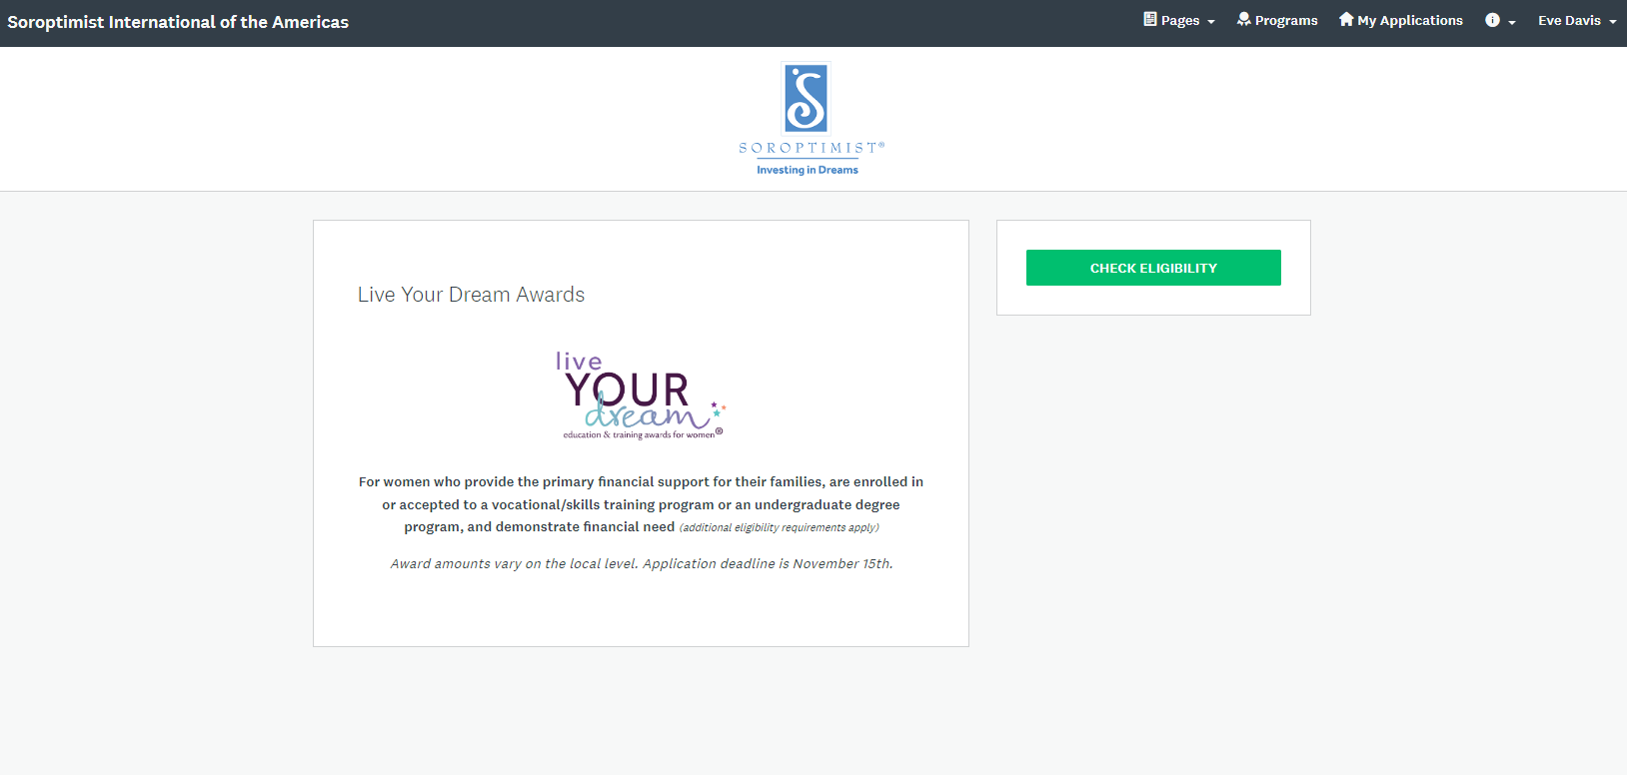
Click “Check Eligibility” to fill out the eligibility form.

Slide 19
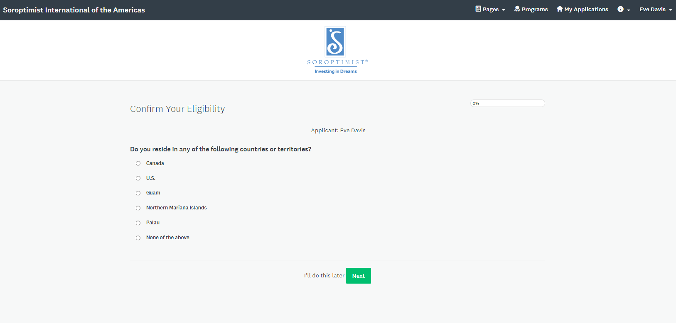
Select your country

Slide 20
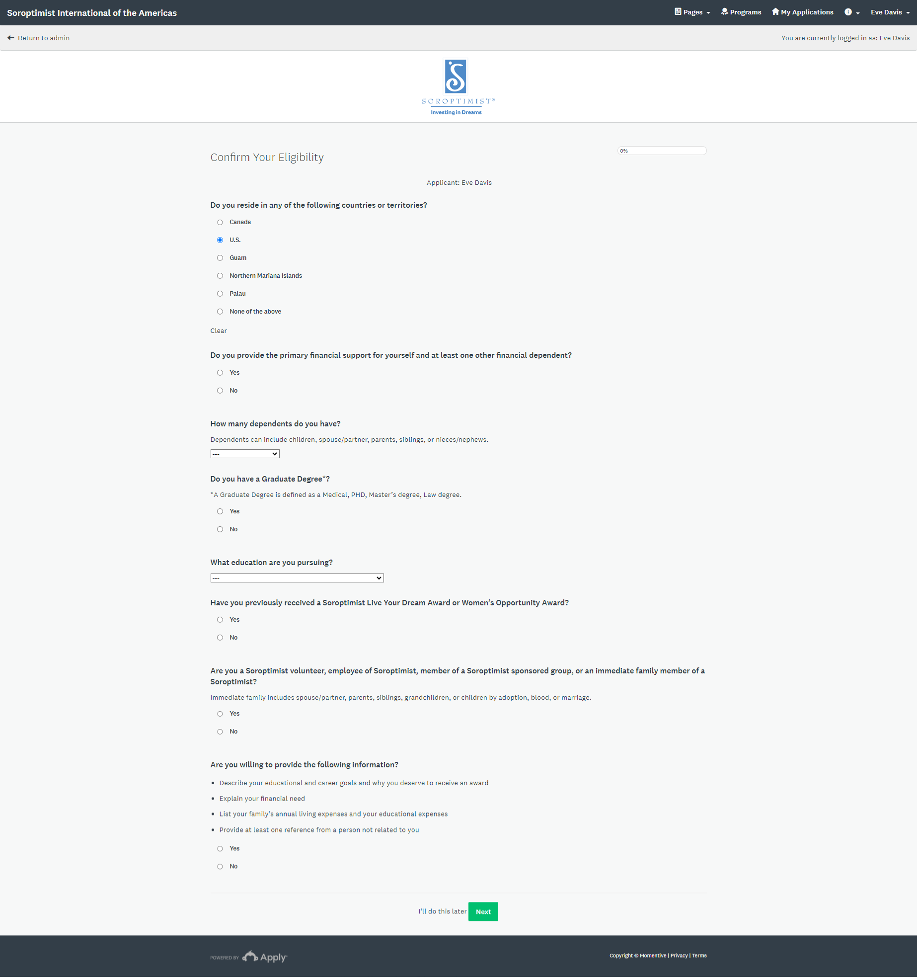

Slide 21
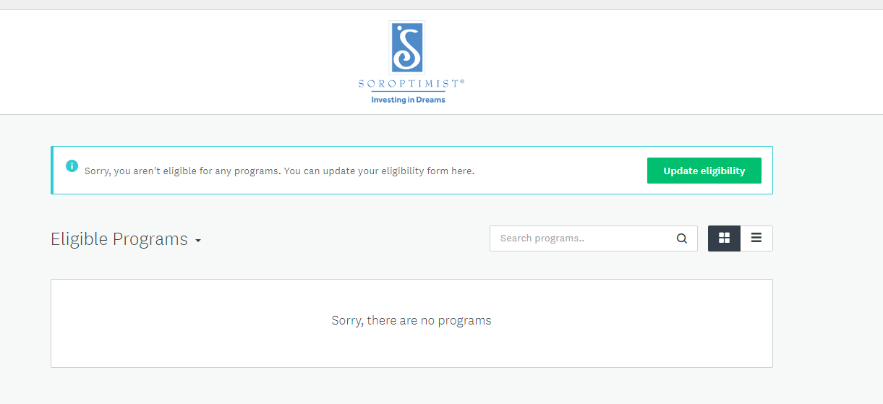
If you think you received this in error, click “Update eligibility”

Slide 22
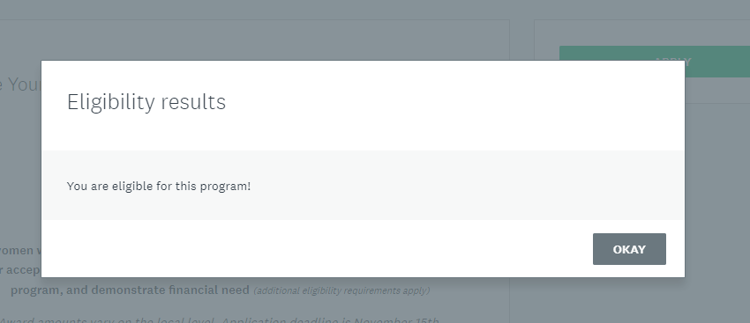
Click “OKAY” to continue
If you are eligible, you will see this pop-up window.

Slide 23
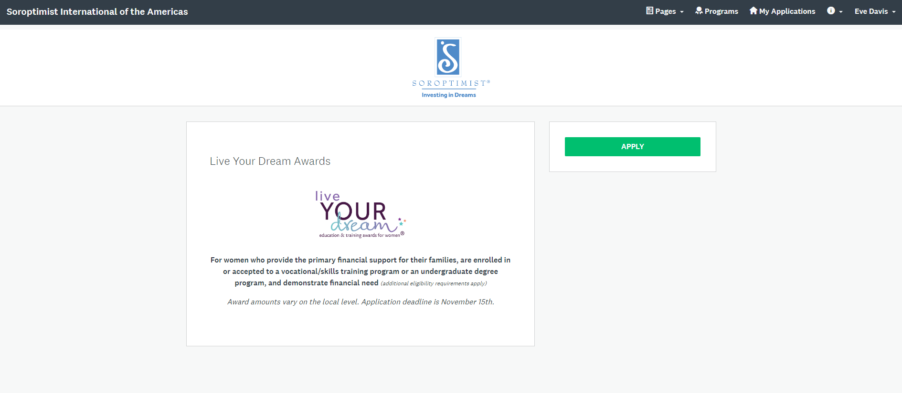
Click “APPLY”

Slide 24
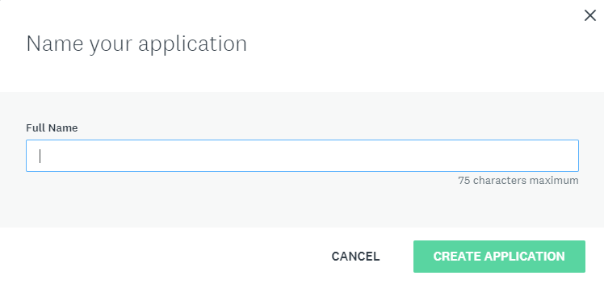
Click
“CREATE APPLICATION”
Type your full name

Slide 25
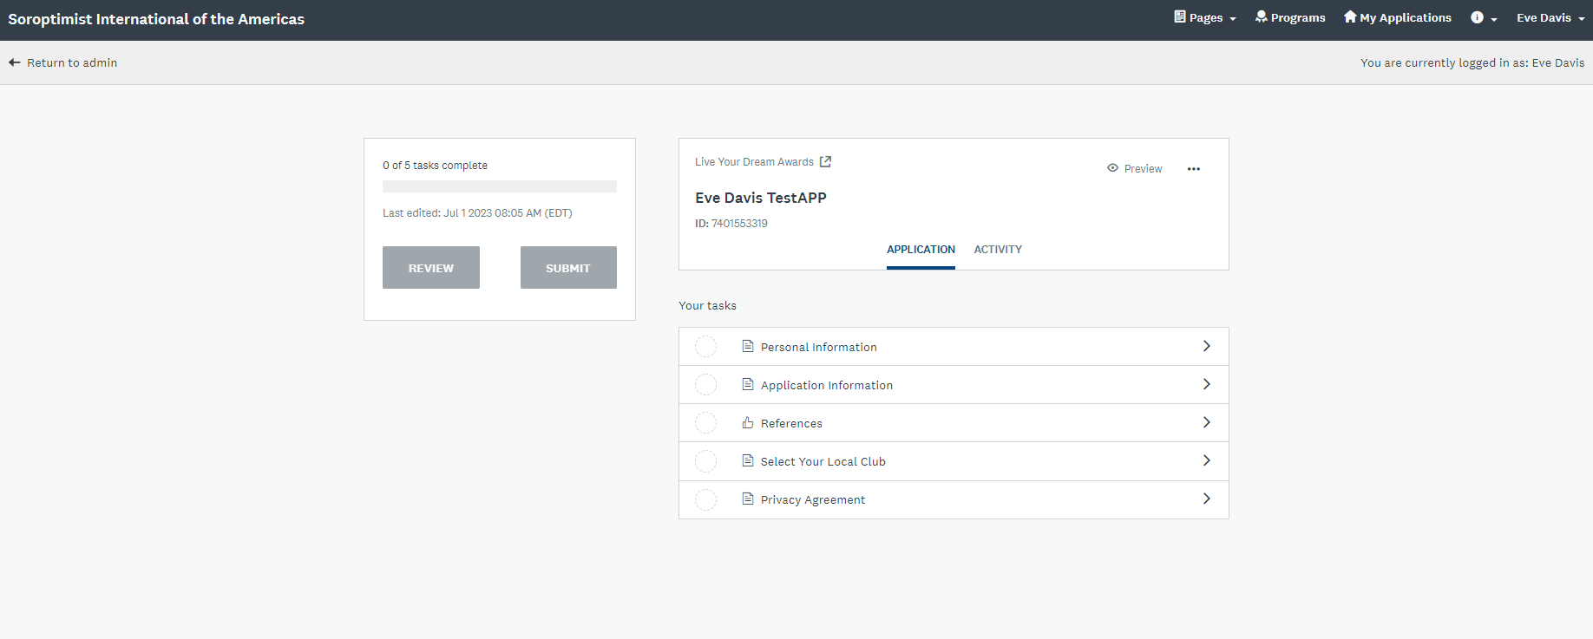
Here is your application account DASHBOARD

Slide 26
Here is your application account DASHBOARD

Slide 27
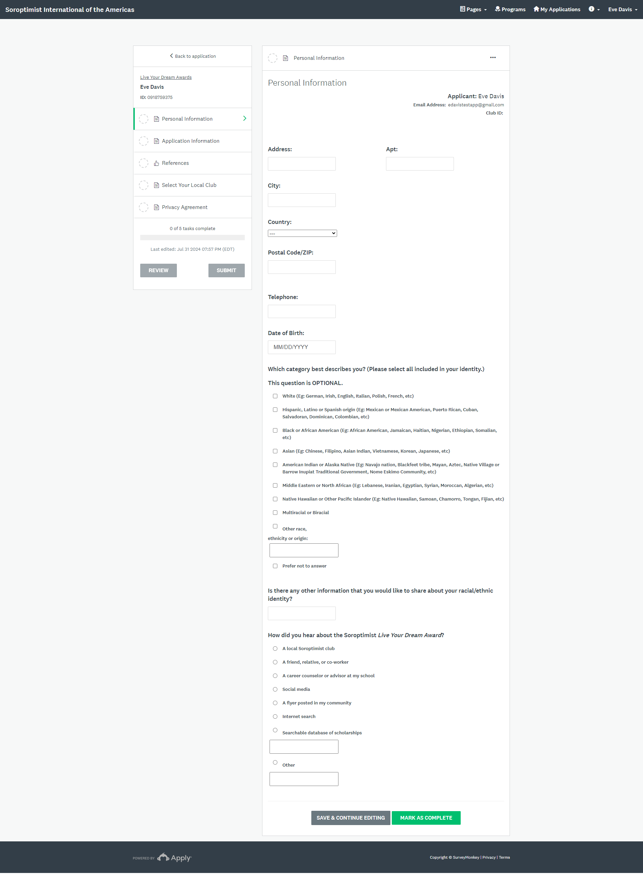
Personal Information
Basic information
Optional
How did you hear about us?

Slide 28
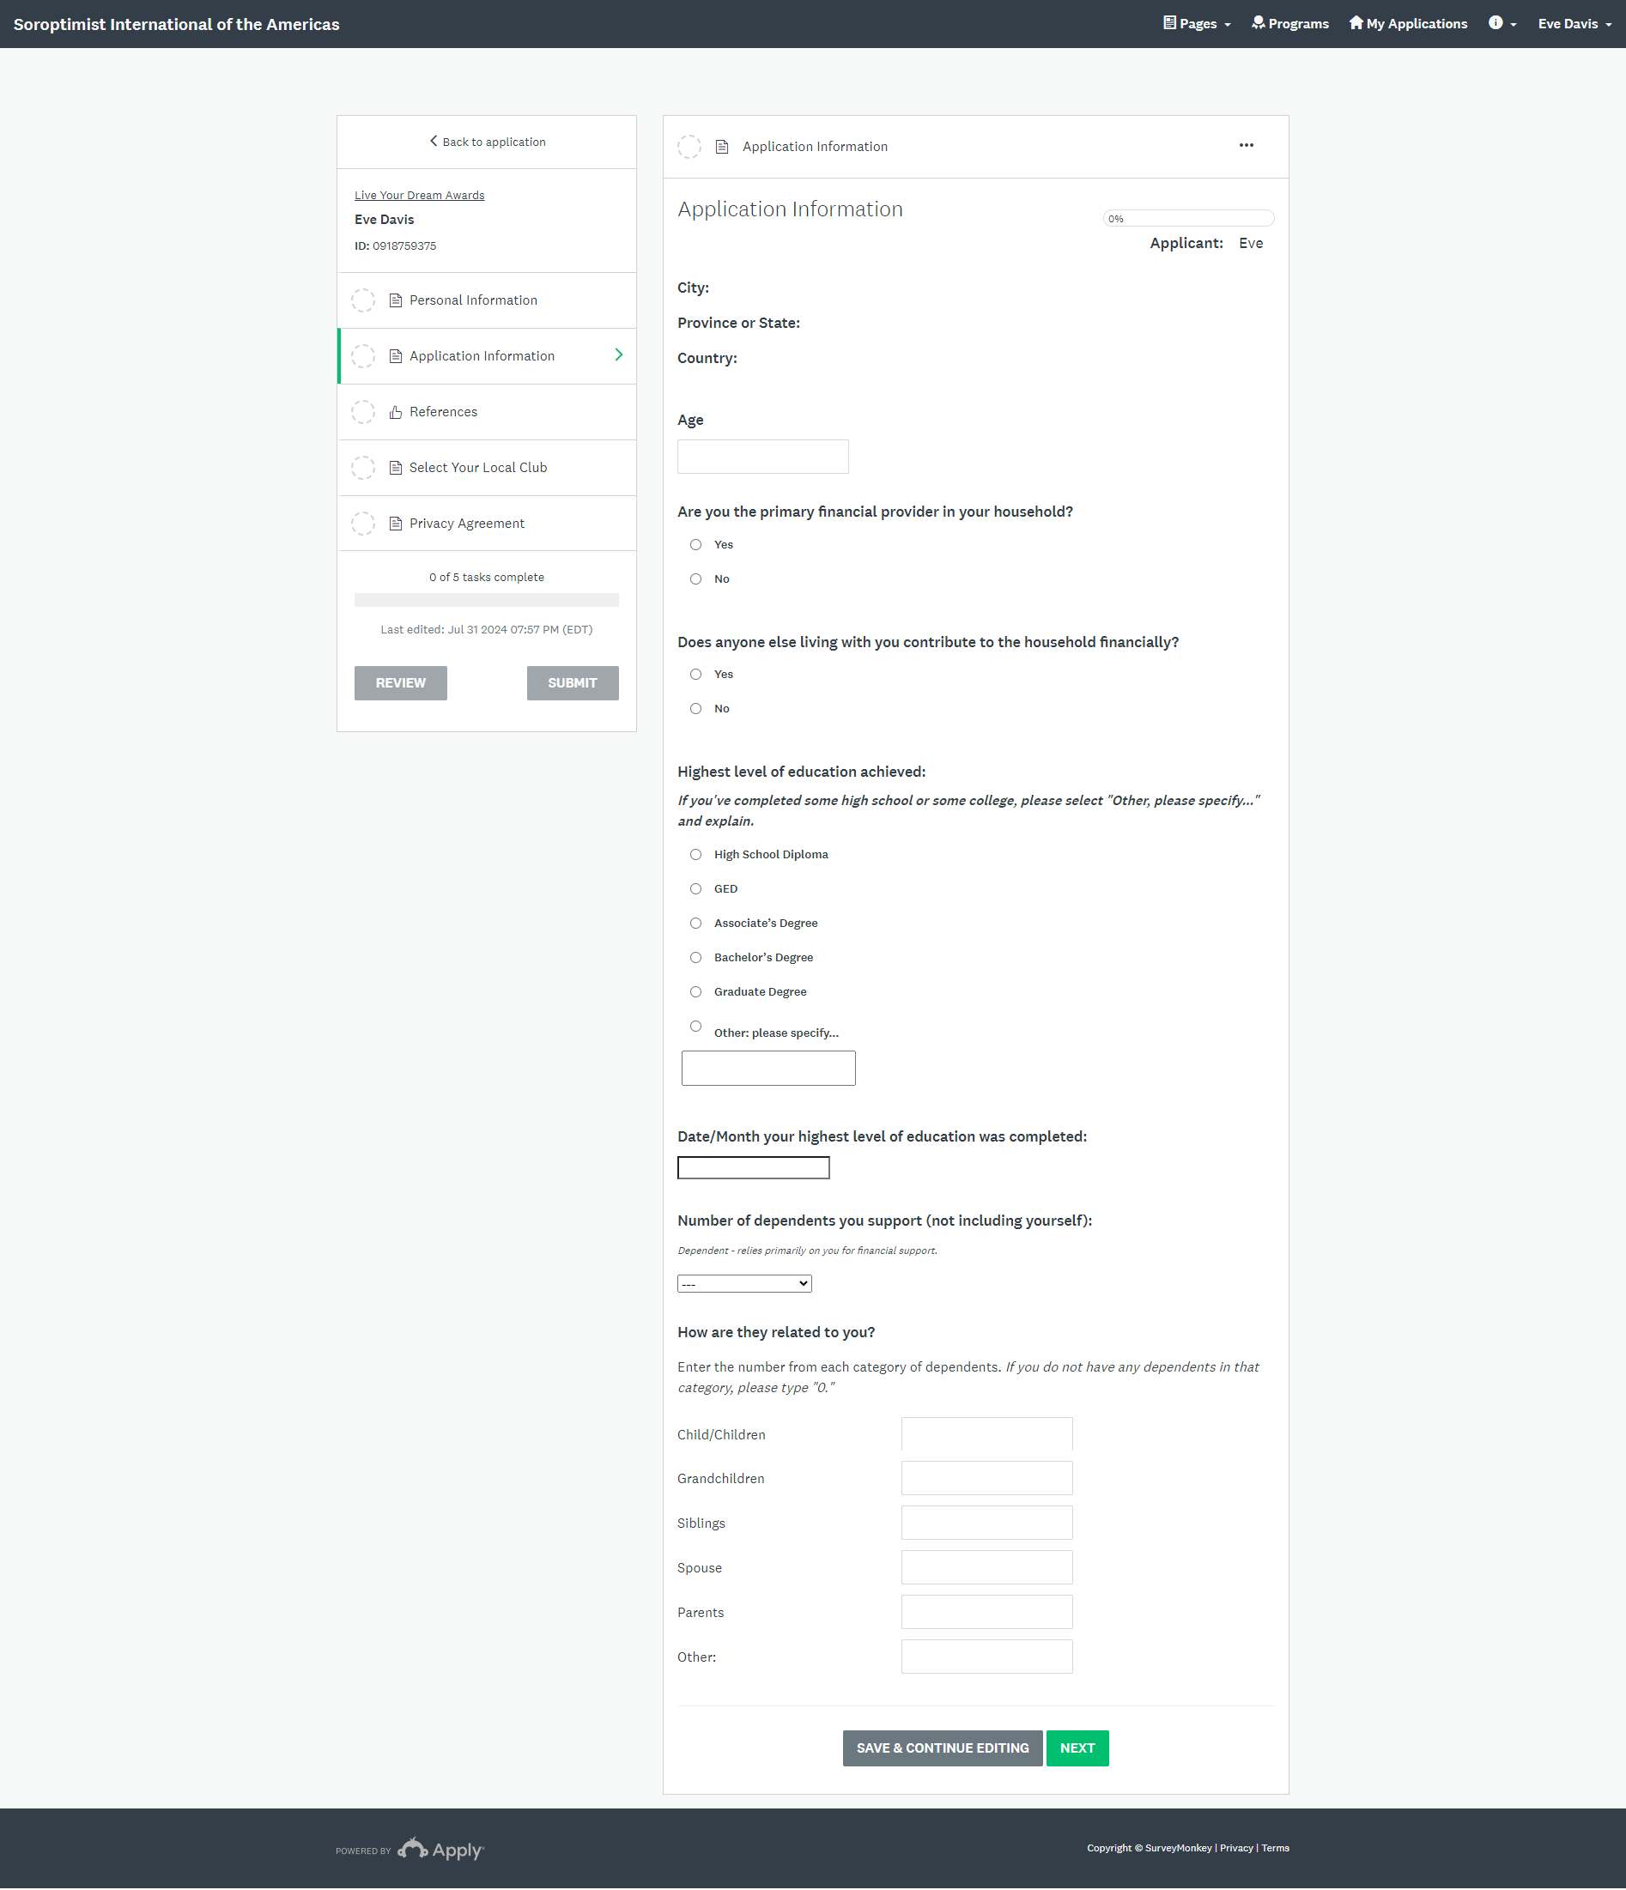
Application Information
If you are NOT the primary financial provider, you will NOT be eligible
If someone in the household is contributing, you will be asked what relation that person or persons is or are to you.
How did you hear about us?

Slide 29
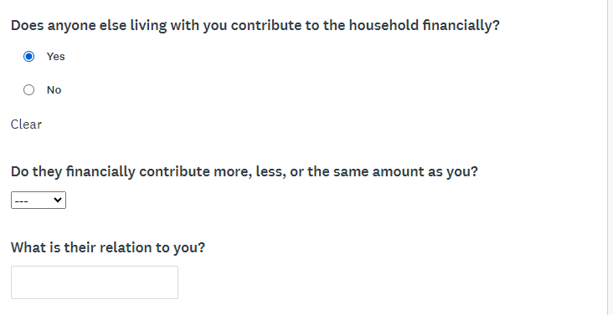
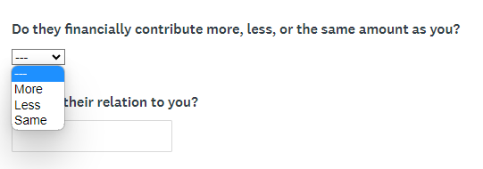
If you select “Yes” the following questions will appear

Slide 30
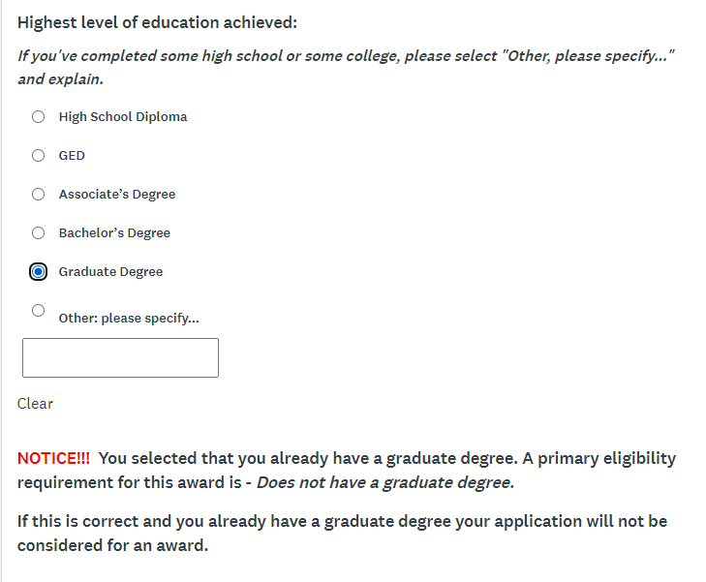
Highest Level of Education
If you select “Graduate Degree” you will see this NOTICE!!!!

Slide 31
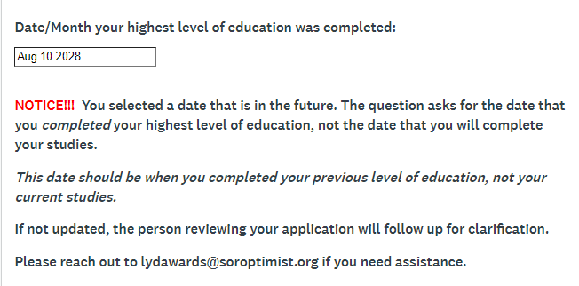
If you selected a date in the future, you will see this NOTICE!!!!

Slide 32
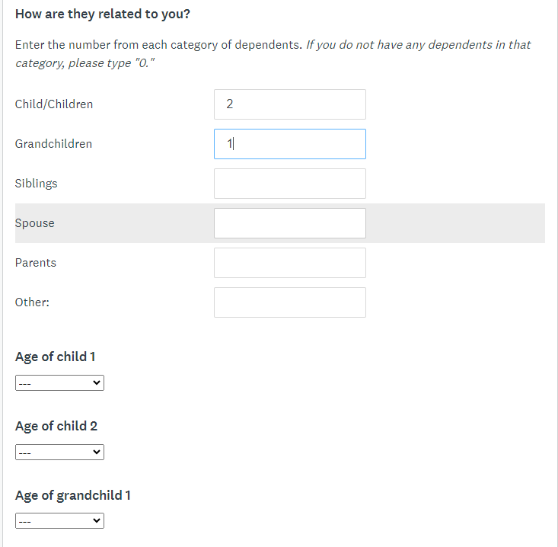
Dependents
The number entered here will match the number of sections asking for the age(s) below.

Slide 33
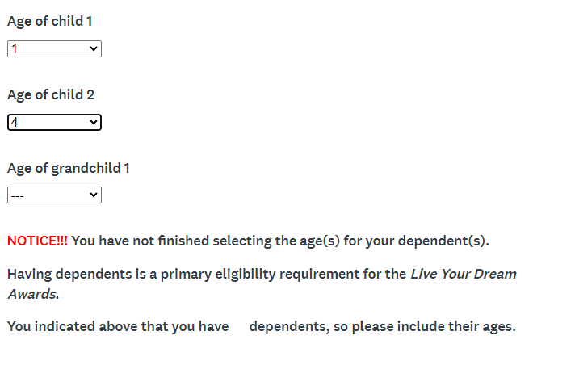
Please be sure to select the ages of all dependents shown or this NOTICE will appear.

Slide 34
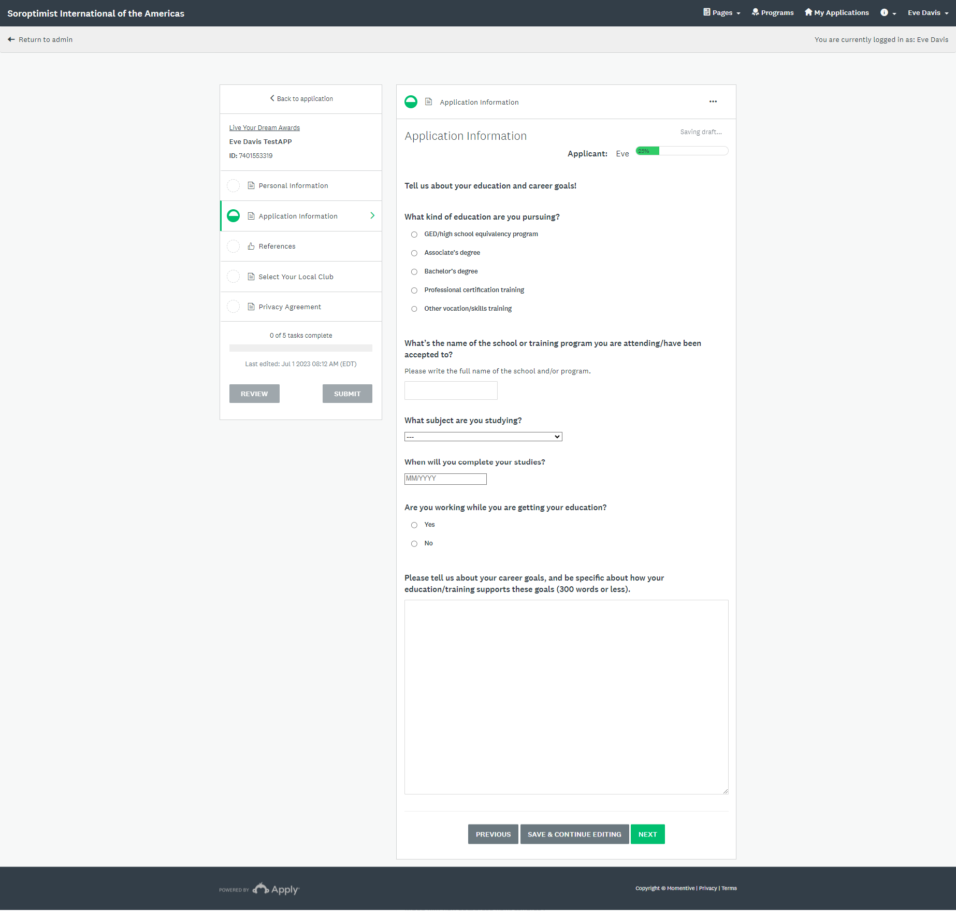
Tell us about the education that you are pursuing

Slide 35
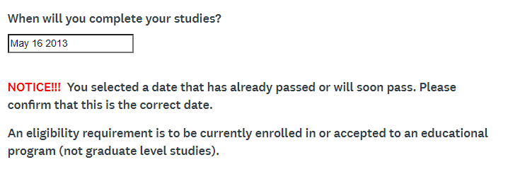
If you selected a date in the past, you will see this NOTICE!!!!

Slide 36
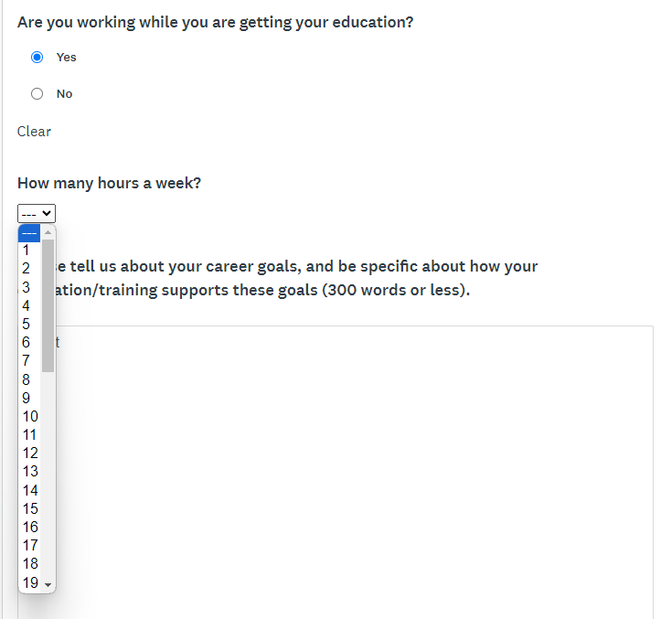
If you select “Yes” then you will be asked how many hours you work a week.

Slide 37
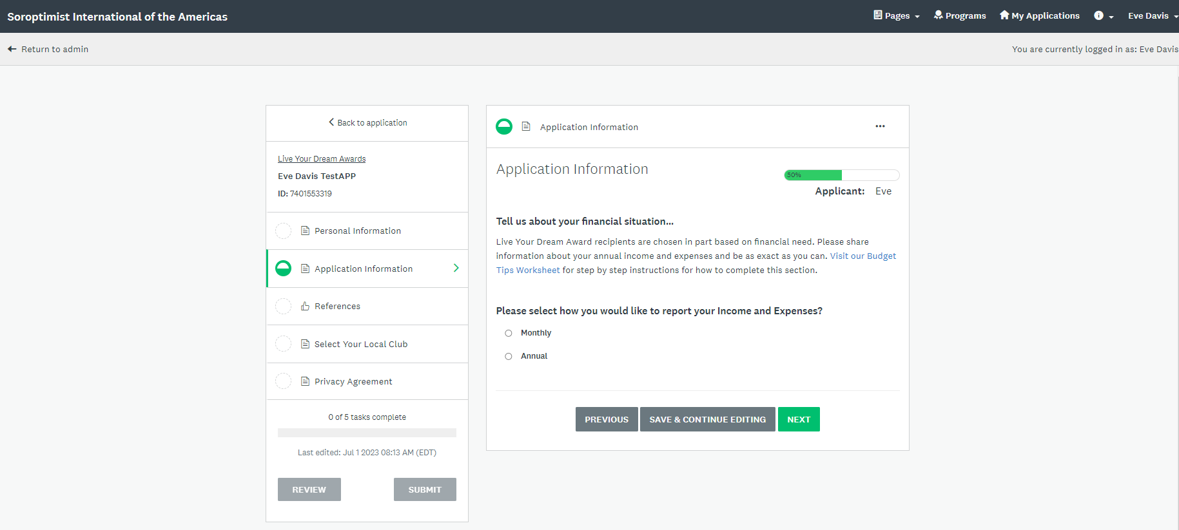
Budget Section
Select how you would like to report your income and expenses:
Monthly or Annual.

Slide 38
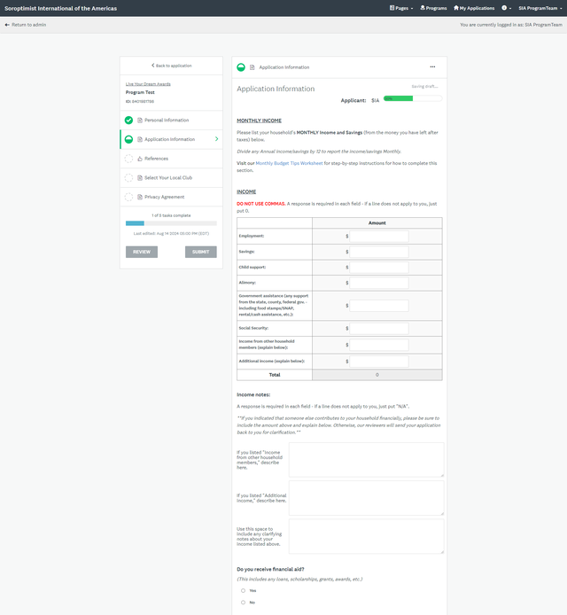
Income
Please do NOT leave any boxes blank.
Explain any 0’s below.
The system will calculate for you and determine your total expenses.
Do you receive financial aid?
Choose “Yes” or “No”

Slide 39
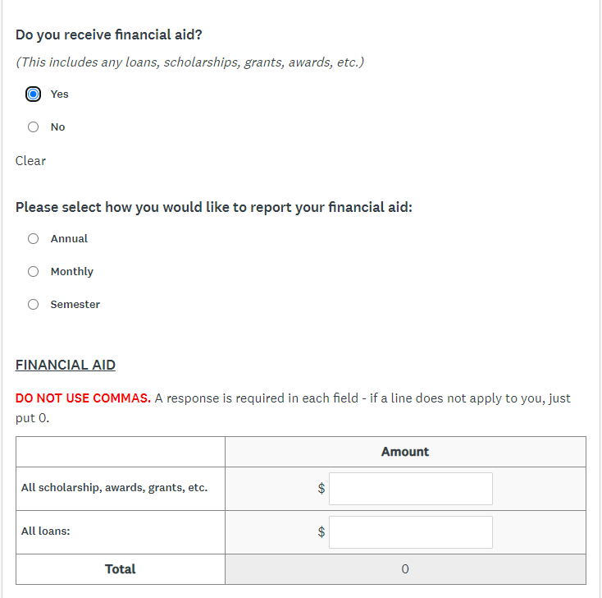
Financial Aid
If you selected “Yes,” you will be asked to select how you would like to report your financial aid.

Slide 40
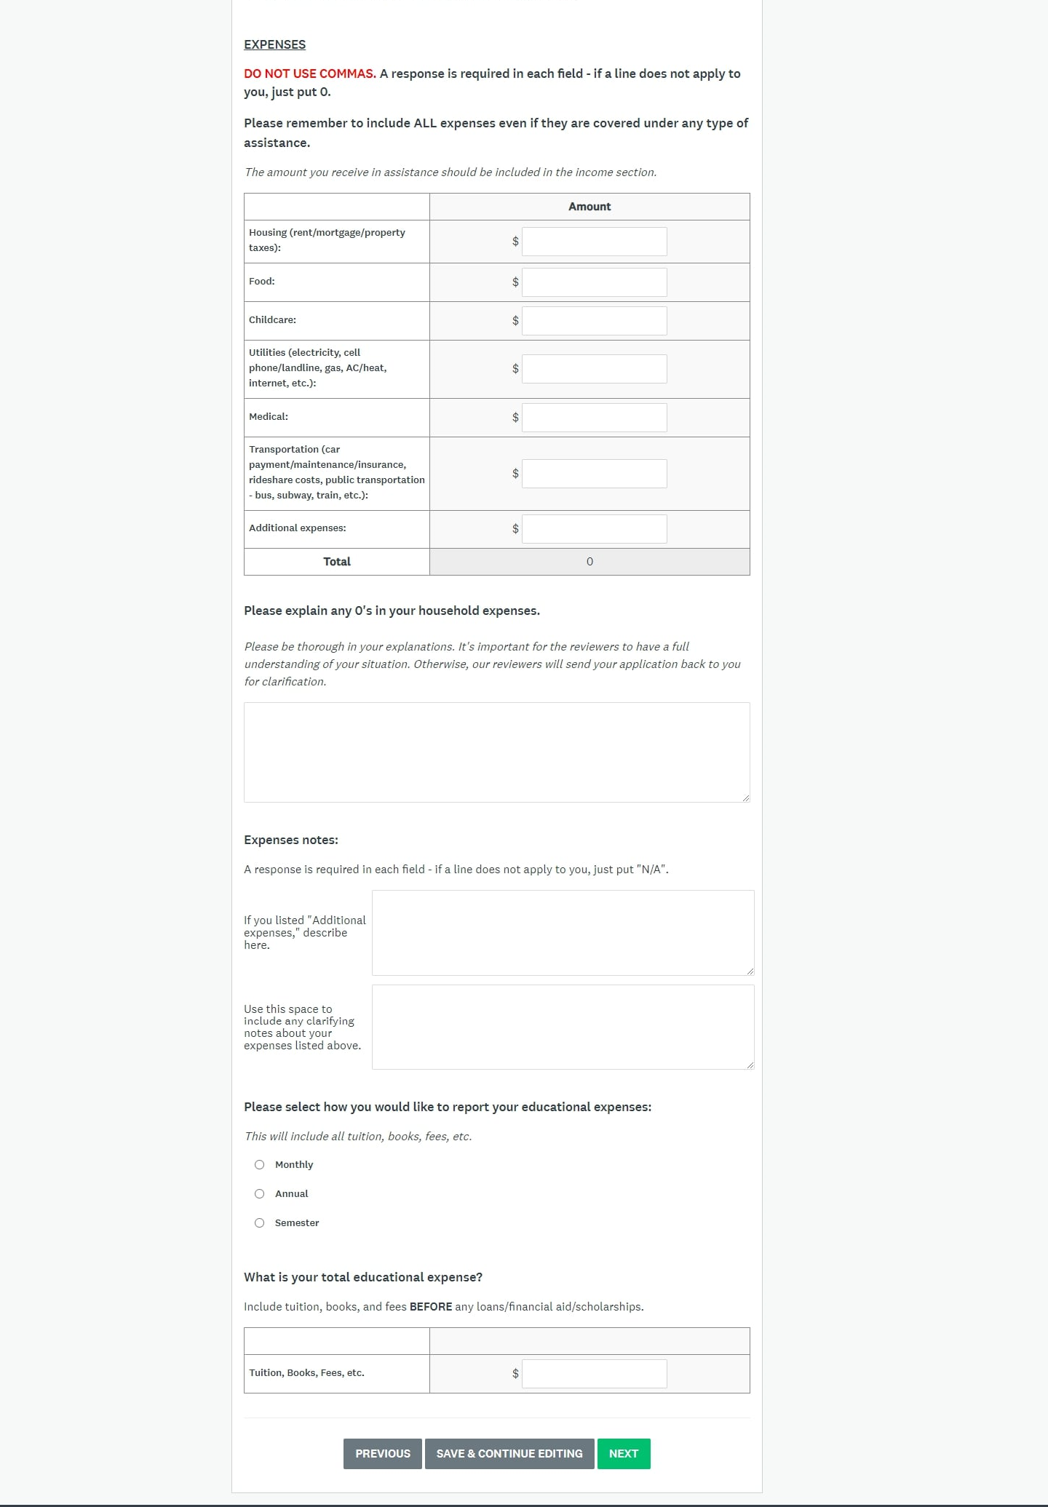
Expenses

Slide 41
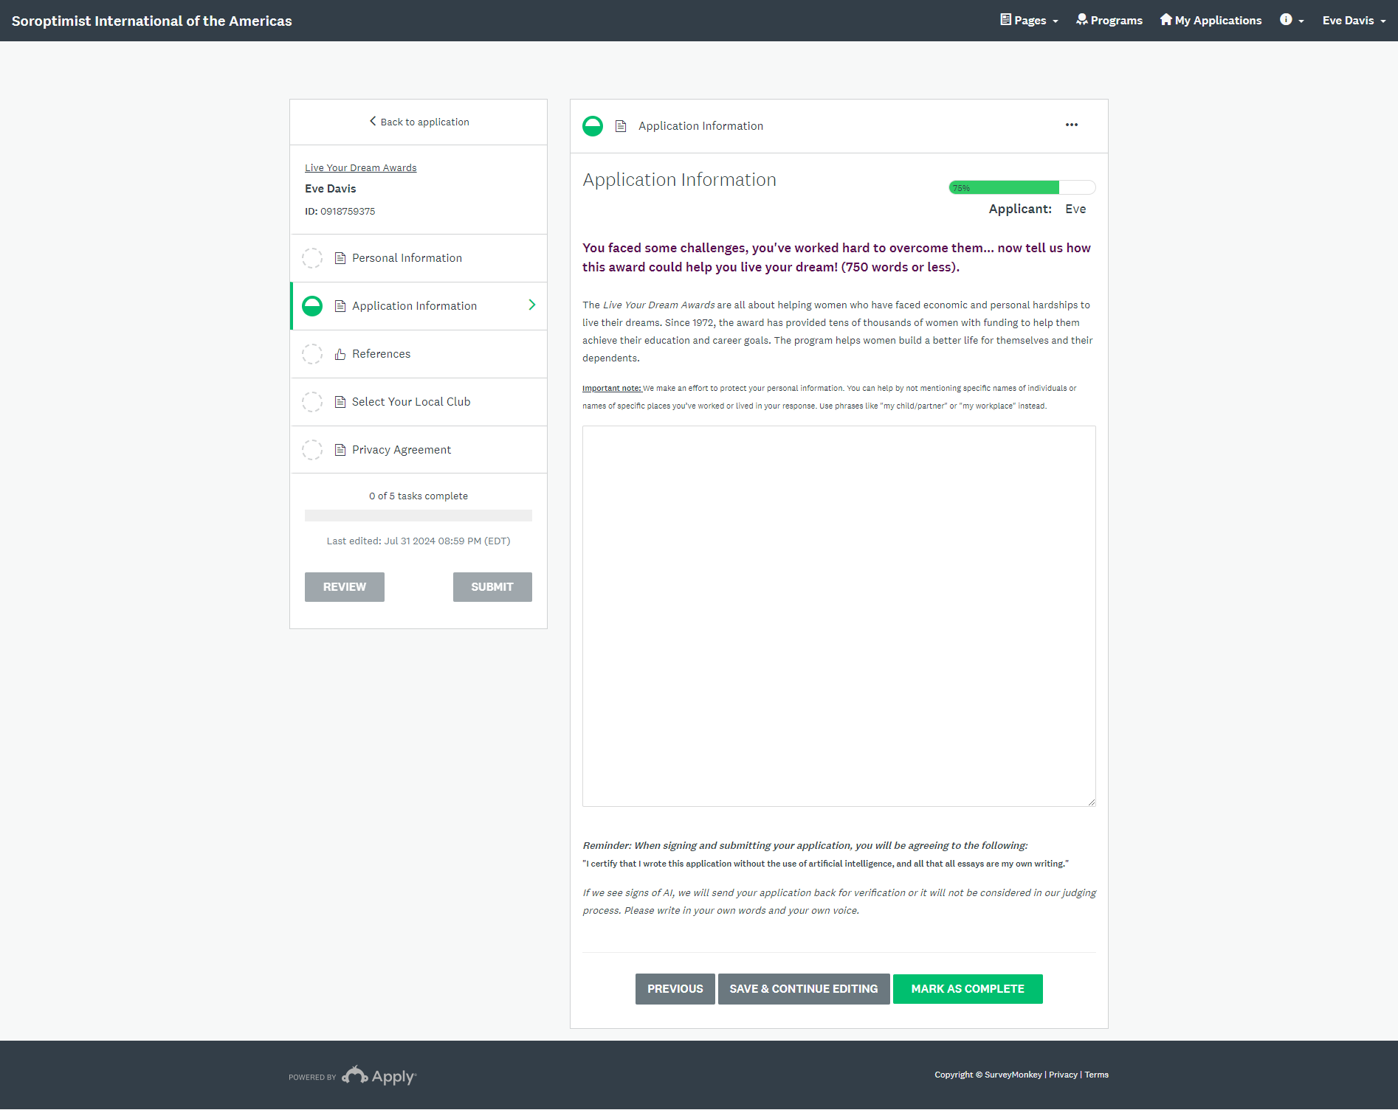
Written Section
Tell your story.
Don’t use AI, use your own voice!

Slide 42
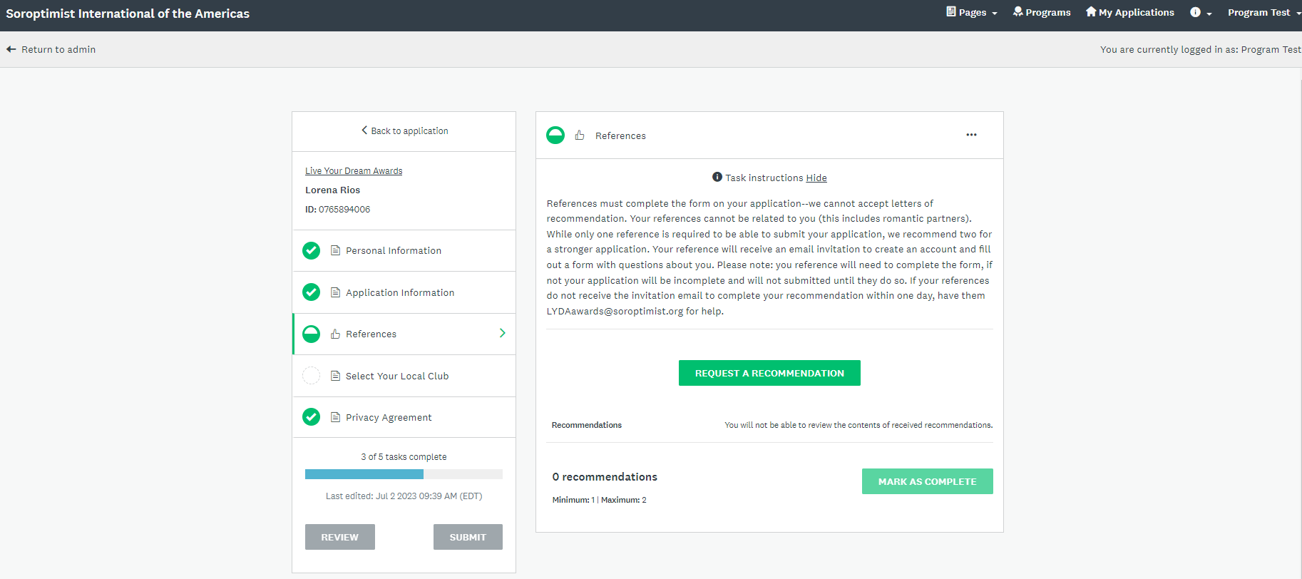
References
We only accept references through the online recommendation form.
No emails or letters of recommendation will be accepted.

Slide 43
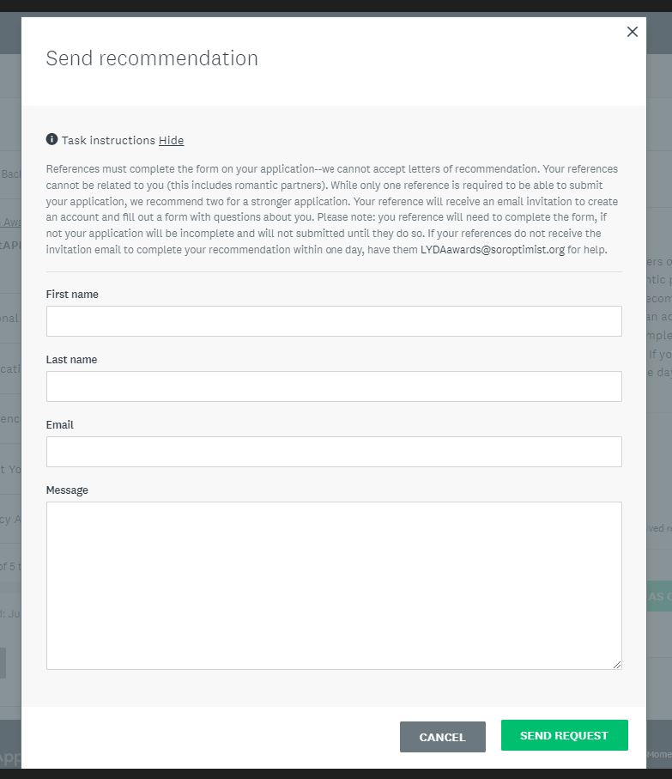
References
After you click “SEND REQUEST,” your reference will receive an email notifying them of the request.
You will receive an email when they have accepted your request.
You will receive another email after they have submitted their recommendation.

Slide 44
Let your reference know to search their inbox for the invitation email:
If they do not receive it, please ask them to check their spam/junk folders.
If they still do not receive the email, please have them contact lydawards@soroptimist.org .
Subject: “Request for recommendation
Sender: lydawards@soroptimist.org

Slide 45
References
After you click “SEND REQUEST,” your reference will receive an email notifying them of the request.

Slide 46
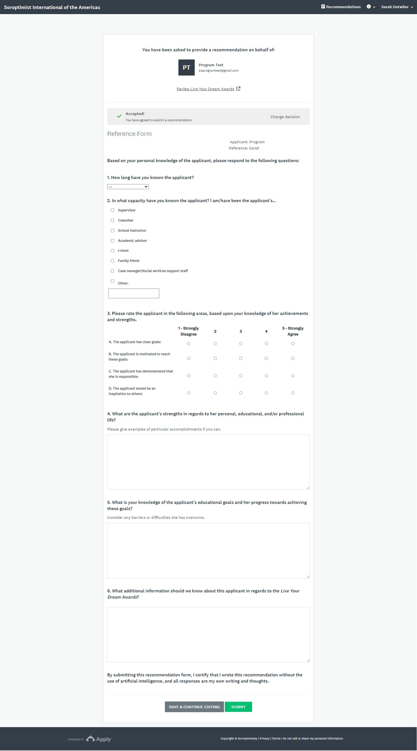
Online Recommendation Form

Slide 47
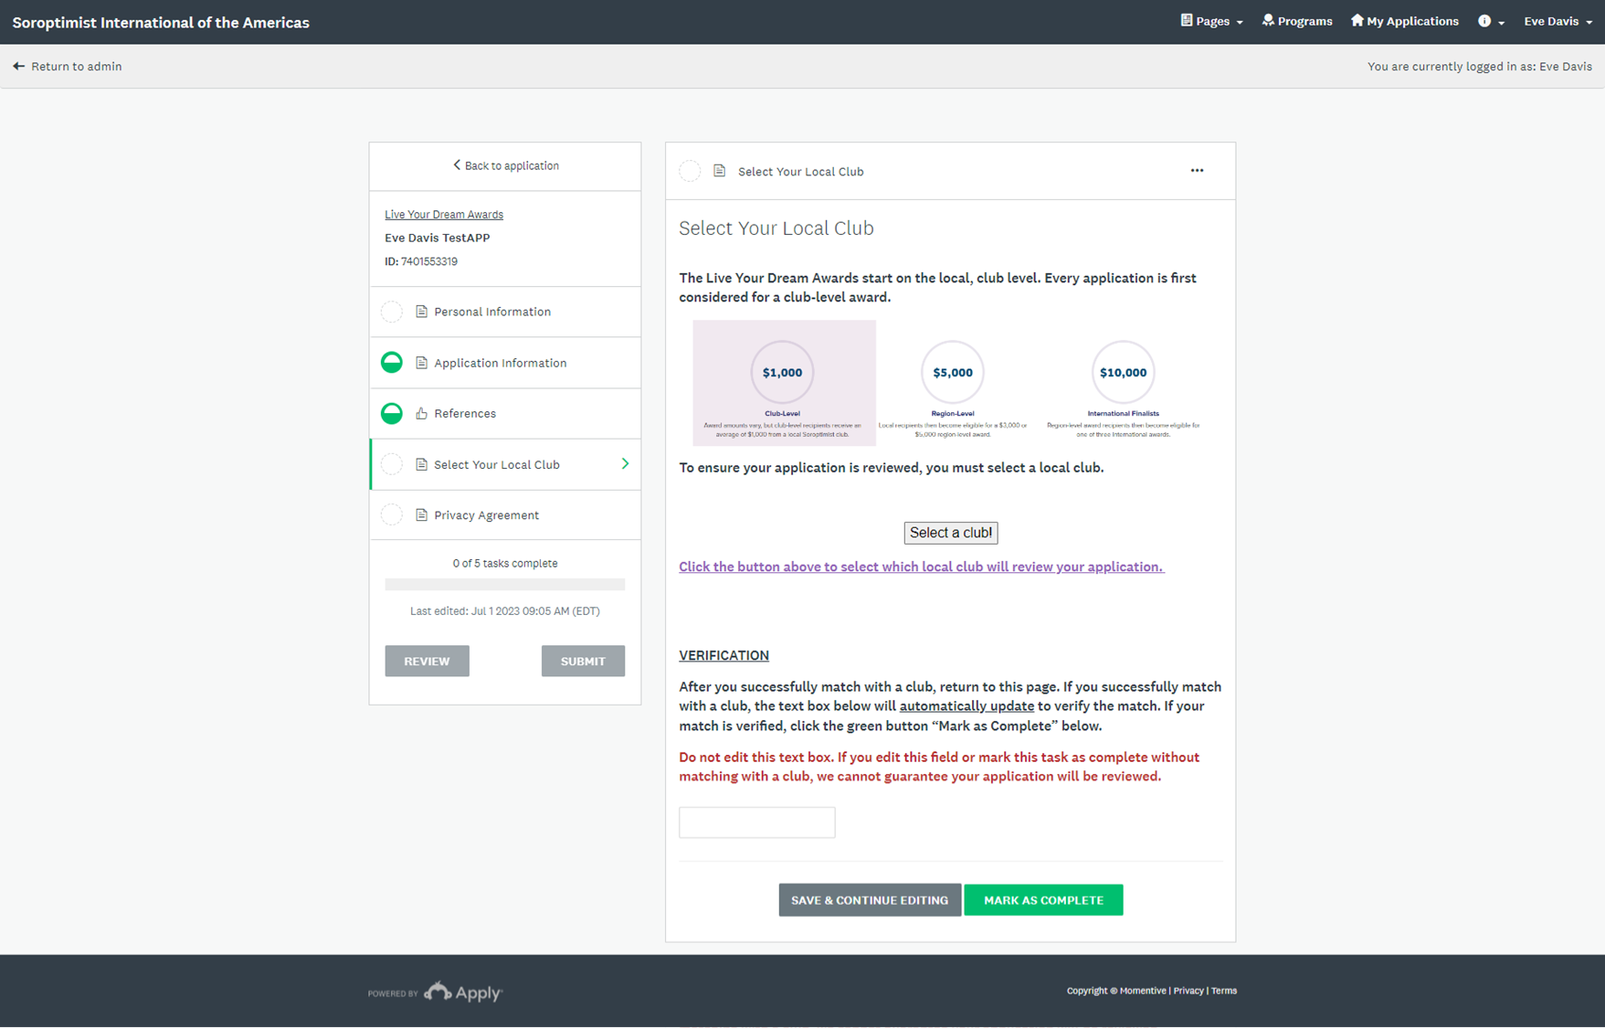
Select Your Local Club
Click
“Select a club!”

Slide 48
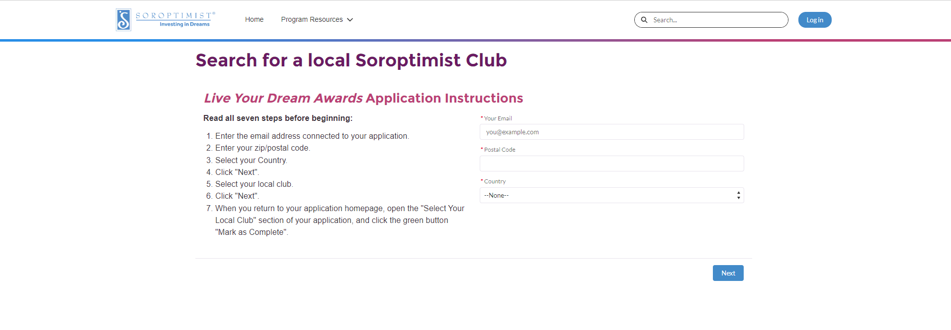
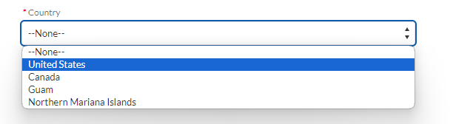
Select Your Local Club –
A new tab will open to this page:
Make sure to use the same email address that you used with your application
Select your country from the drop-down menu

Slide 49
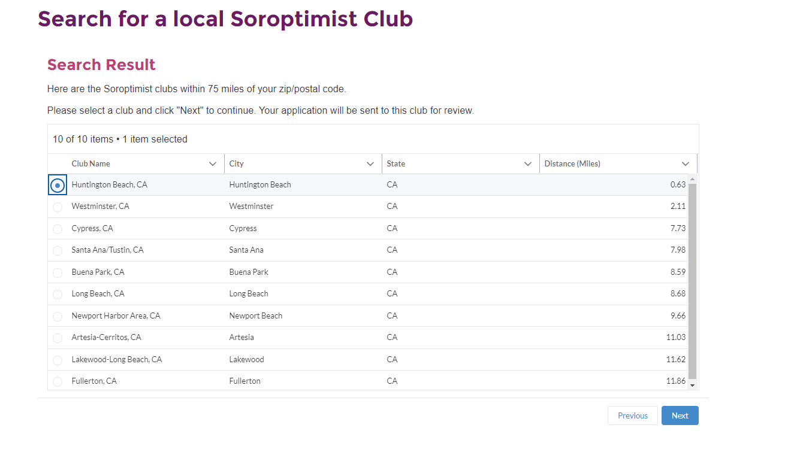
Closest local clubs to your zip code:
Select a club and click “Next”

Slide 50
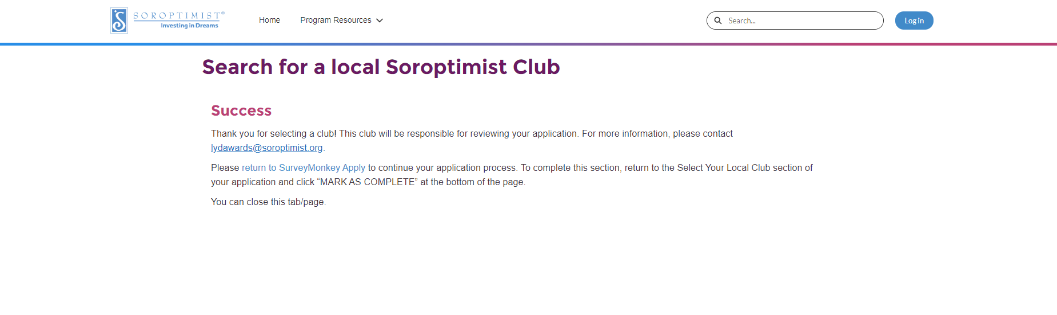
If you have successfully selected a club, you will see this page:
Click here to return to your application.
You can now close this tab!

Slide 51
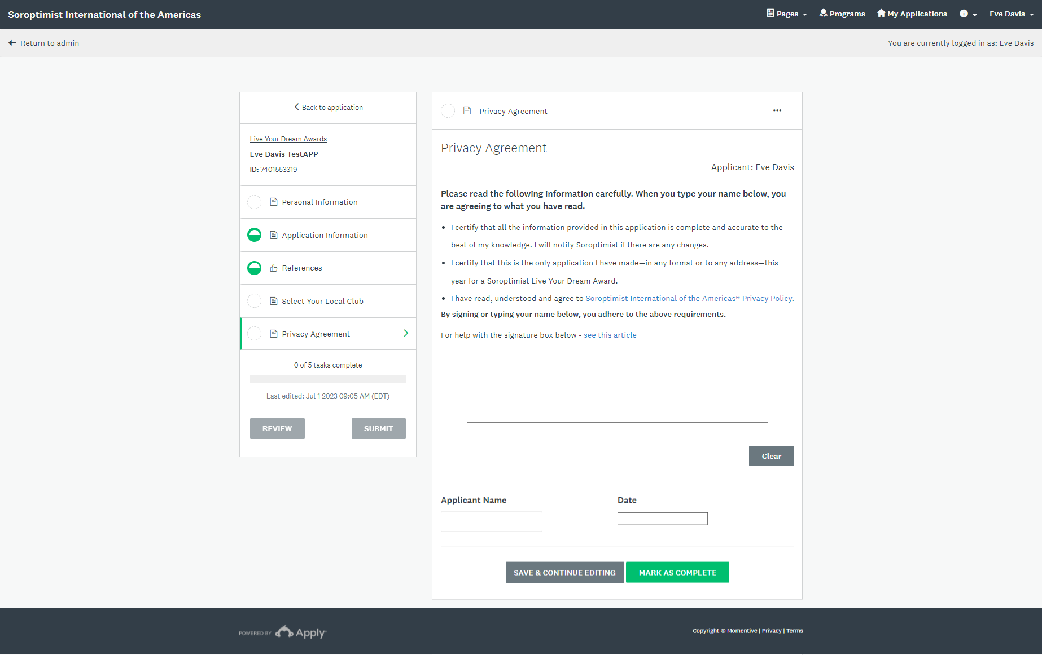
Privacy Agreement
Sign here by clicking and dragging your mouse
Type your name and add the date

Slide 52
Track your progress on the left side of your screen
Section is complete
To complete each section, click “MARK AS COMPLETE”
In progress
Not yet started
You will not be able to submit until all sections are complete

Slide 53
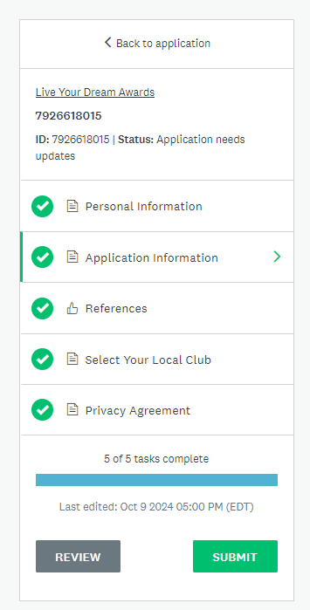
Ready to submit?
When all tasks are complete, the submit button will be green and you can submit your application!

Slide 54


Application Deadline
November 15

Slide 55

Contact us with any questions!
Name
Email Address
Phone Number

