Slide 1
NAME
Notes:
My name is XXXX and I’m happy to be meeting with you today to talk about the Dream Big Campaign- a campaign to help us reach our 2021-2031 Big Goal of investing in the dreams of a half million women and girls through access to education.

Slide 2

Dreaming Big
Dream Big Campaign:
Raising $15 million to support our Big Goal – Together!
Notes:
Today, I want to share with you how our $15 million Dream Big Campaign will support the success of our Big Goal – both locally and globally.
Serving half a million women and girls in ten years and raising $15 million will take a lot of effort. Luckily, none of us must do it alone. Our team is made up of 27,000 members and even more supporters around the world!

Slide 3

Bright Past, Brilliant Future
Notes:
A century ago, a group of forward-thinking women united in strength and determination and created an organization committed to unlocking the power of women and girls worldwide. That organization continues through us – today – with our local work in our clubs and in our contributions to our global collective impact.

Slide 4

It’s Time to Spark Change
Notes:
Even now, 100 years later, our mission of providing women and girls with access to the education and training they need to achieve economic empowerment is as critical as ever.
As we move into our second century, it’s time to spark change within our organization—uniting once again in strength and determination to transform the lives of more women and girls than ever before!

Slide 5
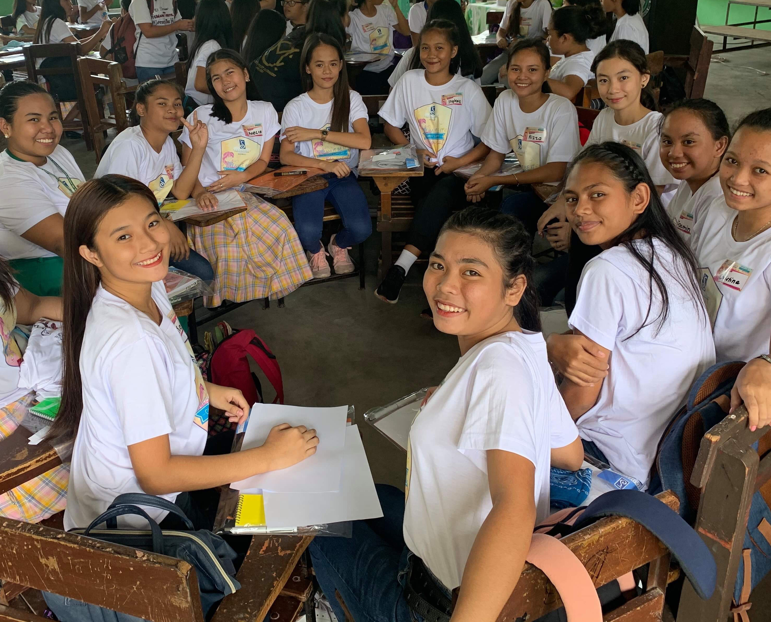
The Path We’ve Traveled
2021-2031
BIG GOAL
To invest in the dreams of a half million women and girls through access to education
Notes:
For the past ten years we have worked together towards the goal of increasing our collective impact. At the same time, members, leaders, and staff were imagining our next big goal:
to invest in the dreams of a half million women and girls through access to education.

Slide 6

This is Our Legacy
Serve four times the number of women and girls we are currently serving.
Notes:
We’ve set our sights high, committing, over the first decade of our next century, to reach four times the number of women and girls we currently serve.
And we will not stop there—because it is vital for this growth to be sustainable for decades to come. This is our legacy—our chance to make history—many women, united by one mission, for countless dreams.

Slide 7
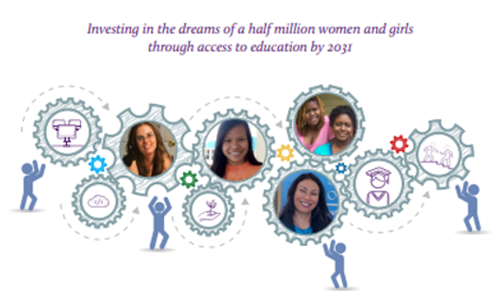
Dream Big Campaign
Notes:
With this goal in mind, we launched the Dream Big Campaign in September at the 100th Anniversary Celebration.
The campaign is scheduled to run until August of 2023 with an ambitious goal of raising $15 million dollars – funds that are necessary to reach our next Big Goal.

Slide 8

Audacious Goals
Big Goal
Dream Big
Notes:
These are audacious goals, both our goal to raise $15 million dollars in two years and our goal to reach half a million women and girls in the next ten years. But we all know what an incredible impact helping women and girls realize their dreams can have on their families, their communities, and the world.

Slide 9





Sustainable Development Goals
Notes:
We know we’re on the right path. Our mission directly supports five of the UN’s Sustainable Development Goals. And in the words of the UN Secretary-General Antonio Guterres…

Slide 10
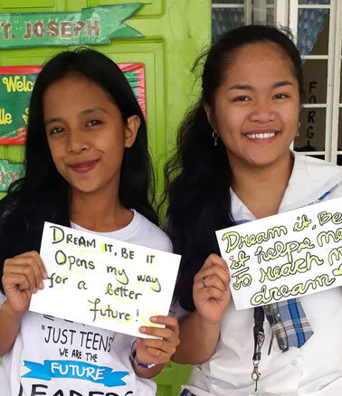
Our Accelerated Action
“We will not achieve the Sustainable Development Goals if there is no accelerated action to empower women economically. We know that women’s participation in all spheres of life, including in the economy, is essential to sustainable and durable peace and to the realization of human rights.”
UN Secretary-General Antonio Guterres
Notes:
“We will not achieve the Sustainable Development Goals if there is no accelerated action to empower women economically. We know that women’s participation in all spheres of life, including in the economy, is essential to sustainable and durable peace and to the realization of human rights.”
Our Big Goal and Our Dream Big Campaign is our commitment to taking accelerated action.

Slide 11
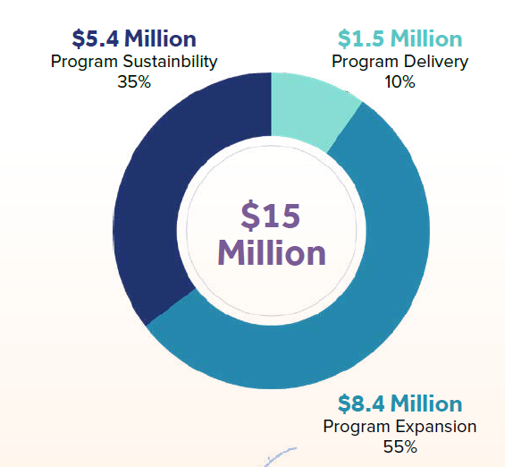
What is the Dream Big Campaign?
Modernize our organization
Provide support to clubs
Engage more people in our mission
Notes:
So what exactly is the Dream Big Campaign?
Our Board of Directors set a $15 million goal to support the tireless efforts of clubs to grow their impact. They recognized the importance of investing in our organization and in our greatest asset – our members and clubs. And they recognized the importance of doing this TODAY to ensure the future success of our efforts to serve the women and girls who need us most. The projects we will fund fall into three categories:
Program Expansion
Program Delivery
Program Sustainability
The carefully researched and developed projects are the result of input from members and leaders. They will help to modernize our organization and provide support to clubs in their program, fundraising and membership recruitment efforts. They will also engage more people in our mission.

Slide 12
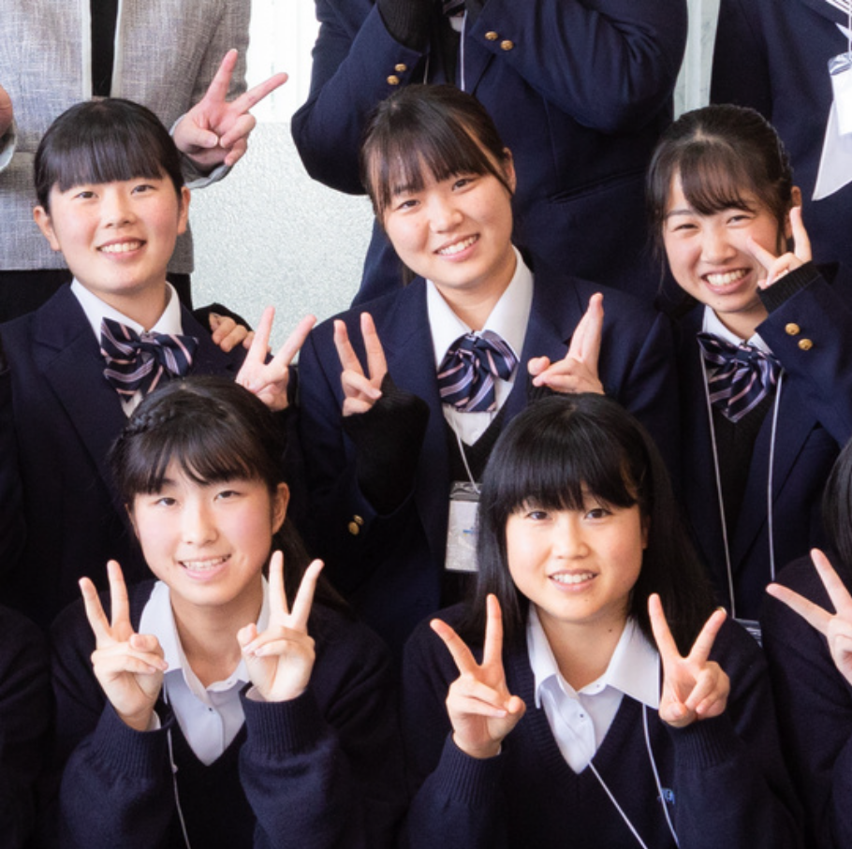
Make an Impact Today
Notes:
The Dream Big Campaign is different than SIA’s typical fundraising. Year to year, SIA raises funds to support our annual program needs – like funding Live Your Dream Awards. Giving to SIA’s annual fund is important and supports our efforts today.

Slide 13

Investment in the Future
Invest in our Future
Notes:
The Dream Big Campaign is an investment in our future. The projects the campaign funding will support are all about reaching half a million women and girls in the next ten years, and setting us up to be successful far beyond that. While it is important to take care of the now, we also need to look towards our future. This will be accomplished by expanding our program impact and providing more support to our members and clubs.

Slide 14
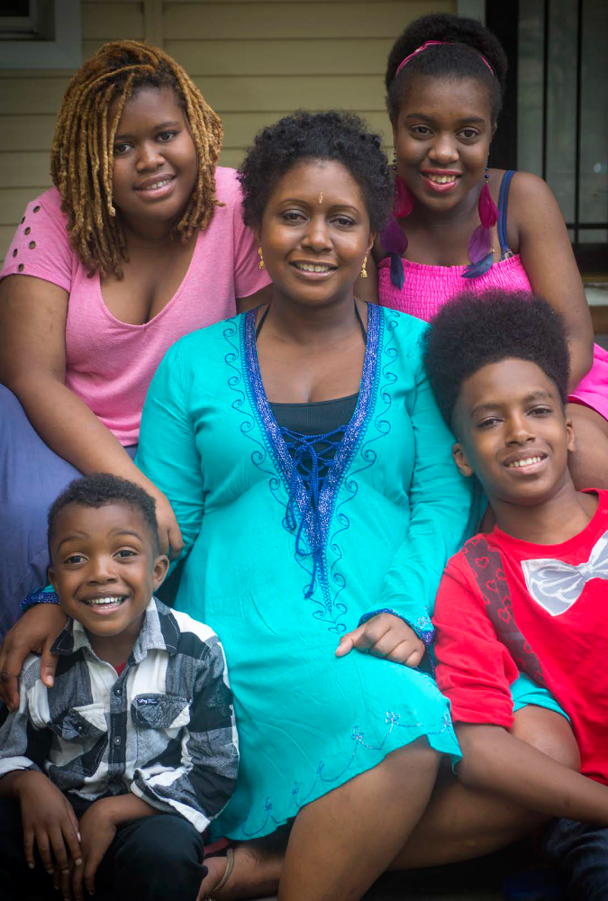
How will this help me?
Financial support
Leadership development
Volunteer training
Increased public awareness
More supporters
Increased financial support
New opportunities to engage your community
Notes:
An important question people raised during the quiet phase of the campaign was, “Why is this campaign important to me, as a member, and to my club?”
The practical impact of this campaign will appear as we progress through the ten-year time frame of our goal to reach a half million women and girls, including:
financial support for clubs to deliver impact locally.
leadership development and volunteer training for members.
increased visibility of our programs which will help clubs to attract more constituents and supporters.
Growing financial support from outside the organization so clubs can focus on their mission-related work; and
new opportunities to engage community members in our goals.

Slide 15
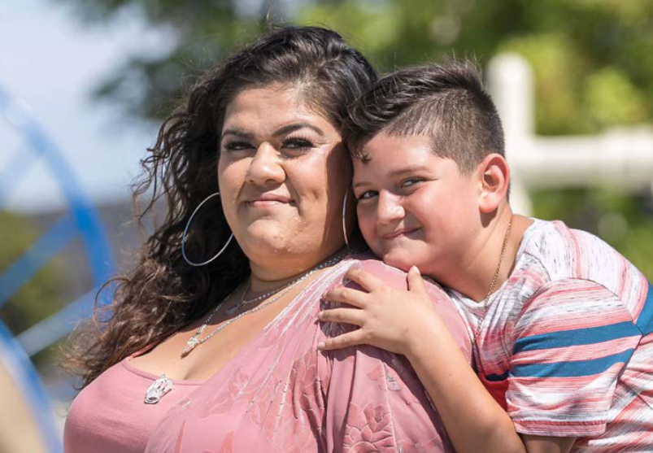

Program Resources to Help
Soroptimist Club Grants
Big Goal Accelerator Projects
Soroptimist Forward
Program Resources on the SIA website
Notes:
Our deep commitment to the Dream Programs is one of our greatest assets. Clubs have a special role in serving more women and girls in their local communities to help quadruple our impact. There are program resources available to support these efforts including:
The re-launch of Soroptimist Club Grants to support local mission-focused work. The re-launch of these grants was made possible by early donations to Dream Big!
The launch of our Big Goal Accelerator Projects that count the work of clubs and regions beyond the Dream Programs that are supporting our Big Goal. This includes a new tool to allow clubs to submit reports for those projects.
Our Soroptimist Forward resources which are helping clubs to deliver our impact in our new environment.
And, of course all the resources available on the SIA website to assist clubs in delivering both the Dream Programs and Big Goal Accelerator Projects.

Slide 16
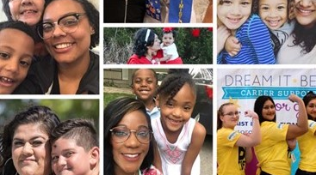
Making a Commitment to OUR Organization
Notes:
These next few years are so important for Soroptimist, and we will continue to ask a lot of our members. At this very important moment in the history of our organization, the Dream Big Campaign creates a special opportunity to give a gift over and above your support of our current impact. Or an opportunity to inspire members who have never given a gift in the past. Now is the time to make that commitment to OUR organization.

Slide 17
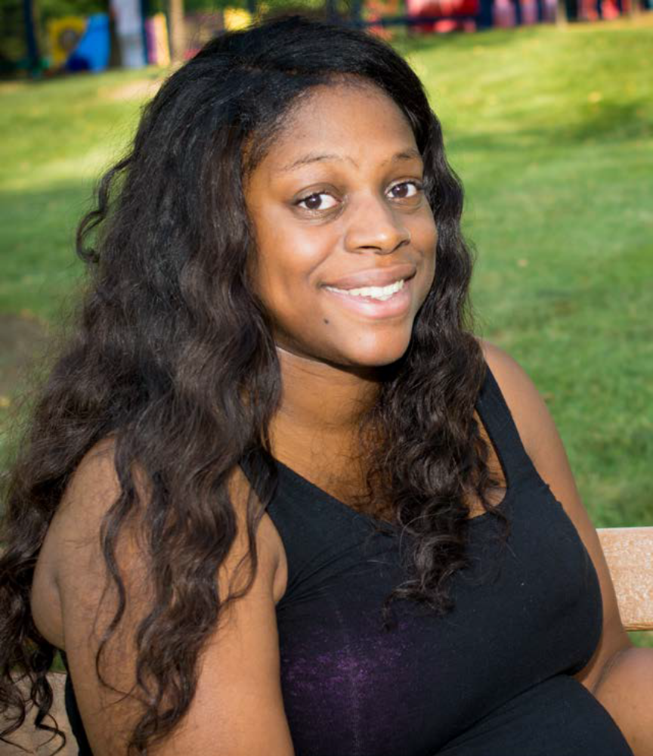
Making a Gift
One time gift
Monthly giving
Commemorative Gift
Pledge
Notes:
Of course, while we raise funds for our future, we will need to continue to raise the funds to support our annual program impact. If you are able to give to both, that is fantastic. If, you are only able to give to one, we encourage you to continue your support of our annual impact.
We want to give you every opportunity to support this new campaign. There are a few paths you can take to give during the campaign:
You can make a one-time gift via an online donation or the donation form
Or you can set up a recurring monthly gift designated specifically to Dream Big
You can make a commemorative gift to the Dream Programs to remember or honor a loved one.
You can also pledge to the campaign and payments can be made annually, bi-annually or quarterly - which will allow you to spread your gift over a period of time that is convenient for you.

Slide 18

Club, Region and Corporate Support
Notes:
We will also need the support of clubs and region and they can donate to the Dream Big Campaign by making contribution through the SIA website or through designating a gift on the Club Giving form.
Community or corporate partners can give by connecting with the Fund Development team at SIA.

Slide 19

Donor Recognition
All contributions to the Dream Big Campaign are recognized through Laurel Society!
Notes:
All donors will be recognized on the campaign website, in the SIA donor honor roll and all individual contributions will be recognized through the Laurel Society.
And of course, we wouldn’t be Soroptimists if there wasn’t a beautiful new pin involved.

Slide 20



Donor Recognition
Recognition
is
Cumulative
Notes:
The first level of recognition for individuals giving $100 or more is a commemorative Dream Big campaign pin.
A crystal DREAM pin is available for donors reaching gifts of $2,500 and greater.
Recognition is cumulative throughout the whole campaign so as you give, you will reach new levels with recognition benefits like convention registration and private event invitations.
Clubs and regions also receive recognition as they give including website badges and being recognized at convention.

Slide 21

Questions and Discussion
Notes:
What questions do you have for me about the campaign and our efforts to reach half a million women and girls in the next ten years?

