Slide 1

From Learning to Leadership:
Introducing SIA’s New Region Education Chair Role
SOROPTIMIST INTERNATIONAL OF THE AMERICAS, INC
Notes:
Good morning/afternoon, everyone.
I’m <<insert your name>>, our Region’s first-ever Region Education Chair! I’m excited to introduce this new role that SIA is launching this year: the Region Education Chair.
As SIA continues to strengthen member engagement and leadership development across the federation, we recognize that learning plays an important role in helping our members, clubs, and regions succeed.
The Region Education Chair is being introduced to help us make a stronger connection between learning, leadership, and the member experience.

Slide 2


Why This Role Matters:
Strengthening Learning. Strengthening Leadership
IMPORTANT!
Notes:
Organizations don't become stronger by chance; they become stronger by intentionally developing their people.
As SIA continues to grow and evolve, we recognized an opportunity to create a more connected and intentional approach to leadership development across the federation.
The Region Education Chair was created to help bridge the gap between headquarters, regions, and clubs by ensuring that educational opportunities reflect the real needs of our members.
We know that our members have different experiences, different levels of leadership experience, and different needs.
A new club president may need something very different from a longtime club leader. One region may need help developing emerging leaders, while another may be looking for ways to make club meetings more engaging.
We want our education and training to reflect those realities.
That's why this role is so important.
The Region Education Chair will help us better understand what members and clubs need to learn, where they need support, and what educational opportunities can help them become more effective leaders and create more meaningful member experiences.

Slide 3

What Will the Region Education Chair Do?
Work in Progress
Notes:
The Region Education Chair will serve as a connector between clubs, regions, and SIA headquarters.
We will:
Listen to clubs and members to identify learning and leadership development needs.
Look for trends and common challenges across the region.
Help promote SIA's educational opportunities.
Conduct workshops or presentations when appropriate.
Provide feedback to SIA on educational content and strategies.
Collaborate with region leaders, club leaders, other region chairs, and SIA staff.
Help evaluate whether the education we provide is meeting members' needs.
This role isn't simply about delivering training.
It's about helping us make sure we're providing the right learning to the right people at the right time.

Slide 4

Advancing SIA's Strategic Plan:
Education as a Strategic Driver
Strategic Plan
Notes:
The Region Education Chair directly supports SIA's strategic priorities related to engagement and leadership development.
Two important strategies are:
Preparing our members to be effective leaders and
Providing a quality and engaging member experience.
Education is one of the ways we accomplish both.
When members have the knowledge, skills, and confidence to lead, our clubs become stronger.
And when members have opportunities to learn, connect, and grow, they are more likely to have a meaningful experience within Soroptimist.

Slide 5
We Need to Hear from You
What do
you NEED?
Notes:
But here's the most important part: We can't develop meaningful learning experiences if we don't know what you need.
That's why we have developed an Education and Training Needs Assessment for clubs and members.
We want to hear directly from you.
Think about your experience in your club and region.
What do you need help with?
What leadership skills would you like to strengthen?
What challenges is your club facing?
What do new club leaders need to know?
What would make your club meetings, programs, or member experience better?
And perhaps most importantly: What do you wish you had been taught before taking on a leadership role?

Slide 6

What Will Happen with Your Feedback?
ASSESS AND IDENTIFY NEEDS
DESIGN MEANINGFUL LEARNING EXPERIENCES
DEVELOP
IMPLEMENT
EVALUATE
Notes:
Your responses will help your Region Education Chair identify themes and trends across the region.
Those insights will then be shared with SIA.
Together, the Region Education Chairs and SIA staff can use that information to plan, develop, promote, and deliver learning experiences that respond to the evolving needs of our members.
And this won't be a one-time exercise.
We want to create an ongoing cycle of learning and improvement:
We'll continue to ask:
Did this learning experience meet the need?
Was it useful?
Did members apply what they learned?
What additional support is needed?
What should we do differently next time?

Slide 7
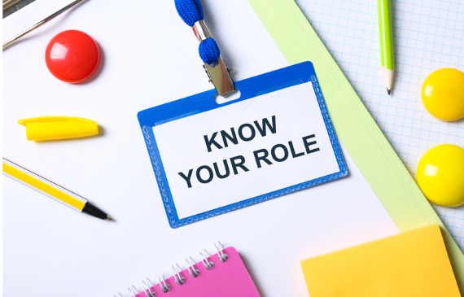
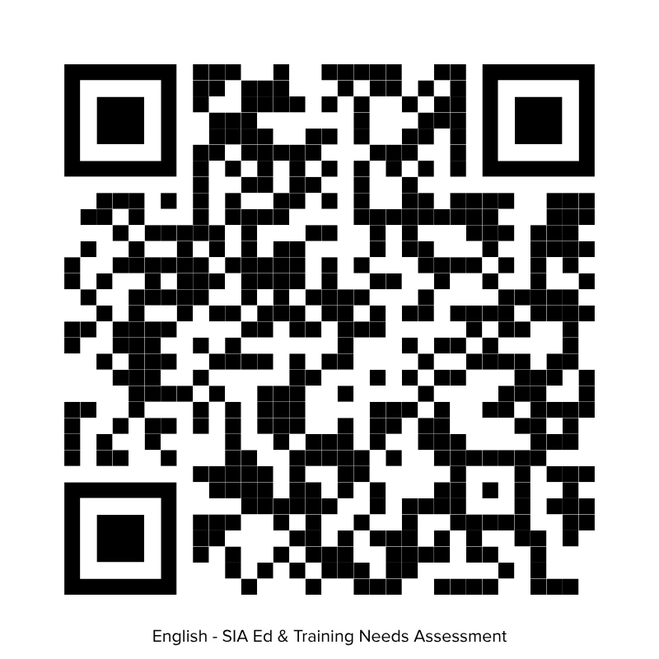
Your Role in This Process
KNOW
YOUR ROLE
Notes:
Here is a QR Code for the Education and Training Needs Assessment. I encourage everyone, not just club officers, to participate.
Whether you're a new member, an experienced club leader, or someone who has served in multiple leadership positions, your perspective matters.
We don't want to make assumptions about what members need.
We want to hear from you.
Your feedback will help us create learning experiences that are relevant, practical, engaging, and connected to the realities of our clubs and regions.

Slide 8
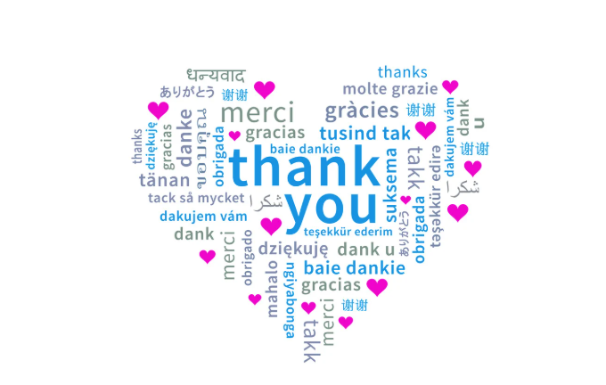
Thank You!
Contact us if you have follow-up questions:
<<Insert Your Name>>, <<Insert Your Region>> Region Education Chair
<<insert your email address>>
OR
Iesha D. Brown, SIA’s Chief Impact and Engagement Officer
iesha@soroptimist.org
Notes:
The introduction of the Region Education Chair is an exciting step forward for SIA.
This role creates a pathway for us to move from learning to leadership, and from leadership to stronger clubs and more engaged members.
Your Region Education Chair will be an important partner in that process, but they can't do it alone.
We need you to tell us what you need to learn, what challenges you're experiencing, and what would help you and your club succeed.
So, please take the time to complete the Education and Training Needs Assessment.
Your voice will help shape the learning experiences we develop today, and the leaders we develop for tomorrow.
Thank you.

