Slide 1


Empowering a Culture of Philanthropy
2024-2026 SIA Region FunDRAISING chair training
Notes:
Ilana: On behalf of the Fund Development department at SIA, I am happy to welcome you to the Region Fundraising Chair Training. My name is Ilana Hirsch and I am the Associate Director of Fund Development. I will serve as your staff liaison for the 2024-2026 Biennium. Erica Cheslock, our Director of Donor Relations, and I look forward to sharing information with you today that we hope will both encourage and support you as leaders in your region. When one of us is successful, we are all successful!

Slide 2

Agenda
Fund Development Team structure and responsibilities
How funds support Soroptimist’s local and global impact
Fundraising strategy, best practices, and ideas
How Region Fundraising Chairs can be supportive of our collective goals
2024-2026 SIA Region Fundraising Chair Training
Notes:
Ilana: In today’s training, we want to help you champion fundraising in your region and support your region’s fundraising by:
Reviewing all the teams supporting fundraising at SIA and their roles.
Giving you a review of Soroptimist’s local and global impact. We will talk about how contributions and dues, as well fundraising initiatives that are supporting and making an impact today and, in the future, as we reach strive towards our 2031 Big Goal.
Talking through Soroptimist’s year-round, multi-channel fundraising strategy, along with some best practices from the fundraising sector.
And, finally, providing you, as Region Fundraising Chairs, with some specific and actionable ideas about how you can support Soroptimist’s fundraising goals and our shared impact.

Slide 3
Who We Are
Region Fundraising Chairs
MaryLen Hajduk – North Atlantic
Chikao Hatta – Japan Chuo
Marie Kennedy – Southern
Kathy McCullough – North Western
Kaoruko Nishie – Japan Nishi
Iracema Lourdes Peloso Gabardo – Brazil
Janine Andrade – Camino Real
Ann Bryant – Sierra Nevada
Deborah Case – Golden West
Mei Guei Chen Gu – Taiwan
Sang Ran Chung – Korea Region
Keshala Fernando-Dissanayake – Eastern Canada
Susan Frankel - Midwestern
Linda Gillis – Sierra Pacific
Felie Go – Philippines
Annie Esther Gomez Gonzalez – Mexico/Centro America
2024-2026 SIA Region Fundraising Chair Training
Notes:
Ilana: Meet your 2024-2026 Region Fundraising Chairs
(ask everyone to say their name and region)

Slide 4
Who We Are
Region Fundraising Chairs
Sue Rea – South Central
Ann Rutledge – Peaks to Plains
Midori Sakamoto – Japan Minami
Misako Sato – Japan Kita
Sue Simpson – Desert Coast
Sandra Sterling-Weicker – Western Canada
Joy Swank – Founder
Yukie Tanaka – Japan Higashi
2024-2026 SIA Region Fundraising Chair Training
Notes:
Ilana: Meet your 2024-2026 Region Fundraising Chairs Continued

Slide 5
Who We Are
SIA Fund Development Staff
Kymberlie Adams - Chief Global Marketing & Development Officer
Erica Cheslock, CFRE – Director of Donor Relations
Ilana Hirsch, MBA, MS – Associate Director of Fund Development
Karen Rauppius – Manager, Marketing and Fund Development
brooke todd – Fund Development Coordinator
2024-2026 SIA Region Fundraising Chair Training
Notes:
Ilana: Let’s start with brief staff introductions. My name is Ilana Hirsch and I am the Associate Director of Fund Development. I focus on creating fundraising strategies for Individual Giving, Corporate partnerships, and fundraising campaigns that support our global Dream Programs. I will be working closely with the Region Fundraising Chairs, who are our volunteer leaders focusing on raising funds to support our global mission.
Erica: Thanks Ilana. My name is Erica Cheslock and I am the Director of Donor Relations at SIA. I work closely with Ilana and the Fund Development team to raise annual funds for our programs, including individual, major, planned and club gifts. I collaborate with both the Fundraising Council and Donor Relations Task Force, who are our volunteer leaders focusing on raising funds to support our global mission.
Ilana: In addition, Erica and I are a part of a collaborative team consisting of Kymberlie Adams, Chief Global Marketing and Development Officer, Karen Rauppius, Manager of Marketing and Fund Development, and brooke todd, Fund Development Coordinator within the Global Marketing and Development team.

Slide 6
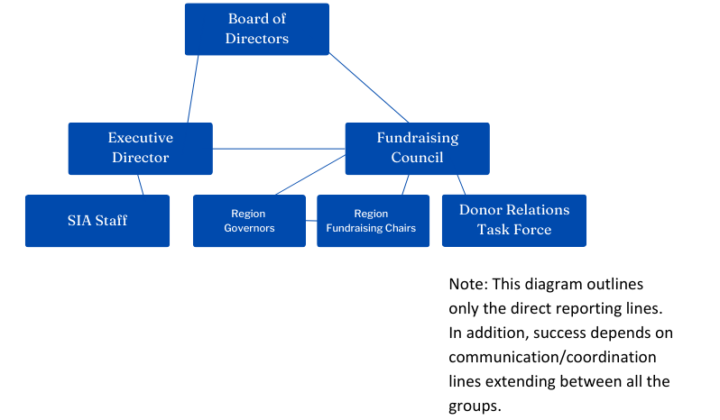
Fund Development Team
2024-2026 SIA Region Fundraising Chair Training
Notes:
Ilana: Our team has seven different groups from the board of directors to the SIA staff. First, we have the Board of Directors. The board has the ultimate responsibility to ensure we have the resources to achieve the strategic goals they set.

Slide 7
Board of Directors
Make gifts of personal significance
Ambassadors
Share their stories
Share their responsibility with fund development volunteers
2024-2026 SIA Region Fundraising Chair Training
Notes:
Ilana: They do this by modeling the way with gifts to the organization of personal significance. They are also our ambassadors and spokespeople for our mission and impact, sharing their Soroptimist why and encouraging others to give generously to support our impact.
The board of directors can share their responsibility for fund development, but not delegate it. They share the responsibility with the other groups that make up the Fund Development Team.

Slide 8
Fundraising Council
Committee of the Board
Responsible for Annual Fund
Club & Individual Giving
Liaison with Region Fundraising Chairs
2024-2026 SIA Region Fundraising Chair Training
Notes:
Ilana: Next is the Fundraising Council. This is a committee of the board and is responsible for strategies to meet annual giving revenue goals through club and individual giving. As you know, the FRC has a close relationship with you, the Region Fundraising Chairs, to build support for contributions. Each Fundraising Council member is assigned to regions to support the chairs.

Slide 9
Donor Relations
Task Force
Current focus on US only
Training & experience
Gifts of > $5,000
Always consulted when gift of $5,000 or more is possible
2024-2026 SIA Region Fundraising Chair Training
Notes:
Erica: Next, we have the Donor Relations Task Force. This task force is currently based in the United States and is responsible for identifying, cultivating, soliciting, and stewarding donors capable of making a major gift ($5,000 and above). The members are trained and experienced in soliciting larger gifts and should be consulted when there is a potential for a major gift.

Slide 10
Governors
Holds the key leadership position within the region
Serves as the main link between our federation board, headquarters staff, and clubs
Ensures the region strengthens and supports clubs
2024-2026 SIA Region Fundraising Chair Training
Notes:
Ilana: Next, our Region Governors. These region leaders are the main point of connection between the federation board of directors, headquarters staff, and the clubs within their region. They work to ensure that all the clubs have the support and resources they need to carry out the SIA mission.

Slide 11
Region Fundraising Chairs
Appointed by Region Governors
Promote financial support via club and individual giving
Understand annual campaigns
Connecting donors and supporters
2024-2026 SIA Region Fundraising Chair Training
Notes:
Ilana: Next, we have you, the Region Fundraising Chairs, who are appointed by the region governors. You are responsible for promoting financial support for the Dream Programs through individual and club contributions. In a recent Governors survey, region fundraising chairs were the most visible fundraisers in the region and the people the governors go to first when they have questions. You need to stay informed about annual campaigns and be knowledgeable about connecting donors and supporters to key members of the Fund Development team.

Slide 12
SIA Staff
Carry out board direction
Focus on annual campaigns
Plan & execute strategy
Support the fund development volunteers
Assigns prospects
May manage donor portfolio
2024-2026 SIA Region Fundraising Chair Training
Notes:
Erica: And lastly, the SIA Staff. We are responsible for carrying out the board’s strategic direction for the annual and long-term fund development goals of the organization. We do this through planning and execution of strategy in support of the annual fund and other campaigns. We are responsible for ensuring the board and fund development volunteers have the education, support and resources they need to achieve their fundraising goals. We also act as a clearinghouse for potential donors and supporters and assign prospects to the appropriate team members. In addition, several of the staff maintain our own portfolio of prospective donors.

Slide 13
The Culture of Philanthropy
Valuing and prioritizing fundraising
Recognizing that fundraising enables the organization to put our mission in motion
Fostering a collaborative environment where fundraising ideas and strategies are openly shared
"Fundraising isn't just about raising money; it's about sustaining the heartbeat of an organization, fueling its mission, and empowering its impact."
2024-2026 SIA Region Fundraising Chair Training
Notes:
Ilana: Now, let's talk a bit about Soroptimist's culture of philanthropy.
According US based fundraising coach, Joe Garecht:
“A culture of philanthropy is a non-profit culture that values and prioritizes fundraising. Non-profits that have such a culture in place offer the development team the support and resources they need to succeed and recognize that fundraising enables the organization to do everything else that it does. Without fundraising, there is no money for programs, staff, overhead, or anything else.
The best fundraising organizations in the world don’t compartmentalize their fundraising… they see fundraising as integral to everything they do. The fund development team interacts regularly with (and are seen as equals by) the program team, and everyone works together to make sure both programs and fundraising succeed.”
This is what we hope that you, as the incoming Region Fundraising Chairs, will help us build at SIA. Our goal is to empower you to see yourself as a part of the impact from fundraising efforts. This Culture of Philanthropy will be key as we work together to achieve our 2031 Big Goal!

Slide 14
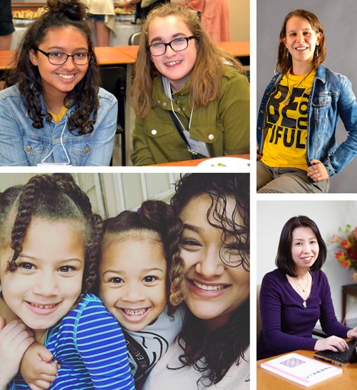
2021-2031 Big Goal
Together we can…
2024-2026 SIA Region Fundraising Chair Training
Notes:
Erica: A part of empowering a culture of philanthropy involves speaking positively about our 2021-2031 Big Goal and what it will take to achieve it. Will you imagine with me for a moment?
Imagine what a half million women and girls living on their own terms could do for our world.
Imagine a Soroptimist where our members have the resources they need to deliver programs to 500k women and girls
Imagine that all members have the support and resources they need to help us to reach more women and girls in their local communities.
This is our Big Goal.
Ilana: Thank you for the work you do in your region to help us reach our 2021-2031 Big Goal. Without Soroptimist leaders like you, and all of our members who work tirelessly every day towards our mission, we would not be able to make the global impact that we do. Thank you for accepting the call to leadership for not only the members in your region, but for the women and girls we serve.
Now we'll take some time to talk about how contributions and dues are used at Soroptimist.

Slide 15






Contributions and Dues
CONTRIBUTIONS
Live Your Dream Awards
Resource Development
DUES
Member Services & Translations
Governance & Administration
Technology
International Partnerships
2024-2026 SIA Region Fundraising Chair Training
Notes:
Ilana: One of the most common questions, we are asked by members is “What do our dues and donations to Soroptimist International of the Americas go toward?”
Our individual and club contributions fund our global Dream Programs and their expenses, including resource development. This includes LYDA for newly chartered clubs, awards for women who don’t live near a club, and federation level awards. Each year thousands of women apply for a Live Your Dream Award but are not within 75 miles of a Club. These women still apply and are eligible for a Federation Award. Additionally, top Live Your Dream Awards recipients from each region are eligible to be chosen to receive an additional federation award. Contributions also cover materials for Dream It, Be It and ongoing work to provide relevant program content for our members and clubs.
Erica: Membership dues pay for the administrative costs, governance, and overall operating expenses associated with running the organization. Dues do not fund the Live Your Dream Awards, Dream It, Be It or Soroptimist Club Grants. They do fund things like member services which includes leadership development opportunities such as the Governors Roundtable and the upcoming club operations training; as well as club recruitment tools and translations for our non-English speaking members so that they may participate fully in the life and leadership of our organization.

Slide 16

Your Involvement in Today’s Impact
Local and Global Impact
Club and Region Fundraising
Individual and Club Support
LiveYourDream.org
Corporate and Foundation Support
2024-2026 SIA Region Fundraising Chair Training
Notes:
Erica: Clubs and members are hard at work in their communities fundraising, building public awareness, and investing in women and girls through the Dream Programs. This local impact- stories of women and girls who have been uplifted through the Live Your Dream Awards and Dream It, Be It, happens in clubs all throughout our organization. When we unite all the local efforts of our over 1,200 clubs throughout our federation we are able to see our collective impact.
Financial support raised each year through annual contributions, from both individuals and clubs, is dedicated to funding our Dream Programs- the Live Your Dream Awards and Dream It, Be It TODAY. Annual support is put to work right away to meet the immediate needs of women and girls through the Dream Programs.
Ilana: LiveYourDream.org has also helped our organization to grow our nonmember donor base. As individuals who are interested in our mission learn more about how they can advocate for our work on LYD.org, they are becoming repeat donors and part of our growing base of supporters. We are continuing to build wonderful corporate and foundation partnerships with companies who find out about us through LYD.org. The online platform is also helping us to grow and support impact!

Slide 17
Club Fundraising Ideas
Online Trivia or Bingo Nights
Give back night at local restaurant
Themed dress-up day at work
Birthday Fundraiser
Walk for Women peer to peer fundraiser
2024-2026 SIA Region Fundraising Chair Training
Notes:
Ilana: Now, let’s brainstorm some unique fundraising ideas to boost our efforts and engage the community with the work of our clubs:
Virtual Fundraisers, Partnering with Restaurants, Themed Dress-Up Day at Work, Birthday Fundraisers, or create a Walk for Women Fundraiser.
Encourage your club to explore these ideas and get creative with fundraising. Look at what other clubs or local organizations are doing for inspiration. Find what resonates best with your network and have fun with it!

Slide 18
Feeling Comfortable Fundraising
Asking for money is not the only way you can be an active part of the fundraising process
Open the door and make introductions
Stewardship of Donors
2024-2026 SIA Region Fundraising Chair Training
Notes:
Ilana: Let’s dive into ways we can feel comfortable fundraising.
The top 3 reasons why people do not like to fundraise:
1. Many view this as a negative experience… sort of like begging
2. The fear of rejection
3. They think that soliciting gifts is the only way to participate in fundraising
Did you know- Asking for money is not the only way you can be an active part of the fundraising process?
Open the doors and make introductions. By making an introduction for SIA staff to make the direct ask or join you on a donor call.
Stewardship of donors is another role the region fundraising chairs can assist in. This is as simple as picking up the phone and making a call to say thank you to a member in your region or sending a quick email expressing gratitude for their support.
You have a powerful sphere of influence.. Leverage it in support of your regions! Share your why.. People intrinsically like to give, and many don’t because they are never asked directly.

Slide 19
Fundraising Strategy: Peer to Peer Fundraising
Use the power of personal networks and stories to expand reach and impact
Personalize stories to resonate with your network of donors
Incorporate an activity to get more engagement!
Did you know you can create a peer to peer fundraiser in FundraiseUp?
2024-2026 SIA Region Fundraising Chair Training
Notes:
Ilana: How you can help expand our reach and impact using personal networks and stories.
Peer to Peer fundraising efforts have become increasingly popular to not only increase the reach of our fundraising efforts, but to introduce our organization and initiatives to non-members. It’s essential to share our mission and the positive changes we’ve achieved. For instance, share your “Why” with your networks, a testimonial from a LYDA recipient, or personal story that motivates you to be a Soroptimist.
Next, Tailor them to resonate with the interests of your donors. To increase recognition, leverage local media, community events, and social media to boost visibility.
Also, collaborate with SIA HQ to gain broader exposure within the organization.

Slide 20
Support SIA
Fundraising Goals
Speak Positively
Share Your Soroptimist Why
Time on Agendas
Connect with Fundraising Council
Like and Share on Social Media
Open Your Network
Engage Your Club in SIA Initiatives
2024-2026 SIA Region Fundraising Chair Training
Notes:
Ilana: Empowering a culture of philanthropy is something all of us can do that will help SIA reach our fundraising goals year over year. Here are some practical, actionable things you can do to help. First and foremost, speak positively about fundraising. Avoid talking about fundraising as a “necessary evil” and instead talk about how it is integral to everything we do and is key to our shared success. One way to do this is to share your personal Soroptimist “Why?” in order to inspire other members to give by showing why and how you’re invested in Soroptimist’s work.
Another important way you can champion and celebrate fundraising is to ensure that fundraising has time on agendas at Region Conference and other large meetings. This is a great way to promote and educate members about fundraising initiatives and why they are key to the success of our Dream Programs.
Erica: You can also connect with the Fundraising Council and other fundraising leaders throughout the year. Make sure that you have the resources and training they need, so that you feel empowered to share fundraising messages with the Clubs throughout the Region. If there is something they need or an idea they have, please reach out to the staff so we can offer our support too.
Ilana: And it may sound like a small thing, but another way you can help is to share Soroptimist and LiveYourDream.org social media messages on the Region’s social media pages or your own personal social media and encourage others to do the same. This is a great way to spread the word to members, as well as introduce non-members to the amazing work Soroptimist is doing locally and globally.
Sharing our messaging on your personal social media is also a great way to start introducing your network to Soroptimist and/or LiveYourDream.org. Who do you know that might want to join Soroptimist or donate to the Dream Programs through LiveYourDream.org? The fund development teams would love to meet these individuals and help you connect them with our work!
These are just a few ideas about how you as Region Fundraising Chairs can help us reach our fundraising goals. Please reach out to us with any other ideas you have!

Slide 21

RFC Resources
Fundraising Council Members
District and Region Meeting Presentations
RFC Info Document
Monthly and District/Region Meeting Reports
Forms and other resources
Laurel Society Recognition
https://www.soroptimist.org/for-clubs-and-members/region-chair-resources/fundraising-chairs.html
2024-2026 SIA Region Fundraising Chair Training
Notes:
Ilana: Now let's talk about some of the resources that are available to you as a Region Fundraising Chair to support your work:
As mentioned earlier, your assigned Fundraising Council member will be your closest ally in helping you with your role. Be on the lookout for a communication from a Fundraising Council member in September.
SIA provides presentation content for both district and region meetings so that you can share on topics relevant to philanthropy with members in your region. These are posted on the Region Fundraising Chair page of the website twice a year.
You already received a Key Info Document as a new Region Fundraising Chair. This is a great place to look for high level information about our giving programs and fundraising.
SIA staff provides reports to help you fundraise, recognize members in your region, and help them reach a new Laurel Society level. These reports are typically uploaded to the RFC webpage on the 15th of each month for all gifts the previous month. We also provide reports for in-person meetings and you will receive information on that soon for the upcoming district meetings.
Downloadable enrollment forms for Laurel Society, Stargazers, Club Giving and Laurel Legacy are also available on this page.
Finally, we want to help you recognize members in your region who reach new Laurel Society levels. A printable certificate is available for presentation at club and region meetings.

Slide 22
QUESTIONS?
Notes:
Ilana: Now, we will take a few moments to answer questions you may have. Please use the 'raise hand' feature and we will call on you. While we may not have time for every question, please be sure to put any questions that don't get answered in the chat and we will follow up with you after this training.

Slide 23

GET IN TOUCH
Kymberlie@soroptimist.org
Erica@soroptimist.org
Ilana@soroptimist.org
brooke@soroptimist.org
Or
development@soroptimist.org
2024-2026 SIA Region Fundraising Chair Training
Notes:
Thank you all so much for joining us today to talk about working together to build a culture of philanthropy and reach our fundraising goals. We will be sending you a copy of this presentation following the meeting, as well as posting it on the Region Fundraising Chair page.
Please also mark your calendars for October 14 from 8-9pm eastern for a fully translated meeting with the Fundraising Council.
If you have any questions, please feel free to reach out to us via email. Our email addresses are provided on the screen.
As always, thank you for all that you do.

Slide 24
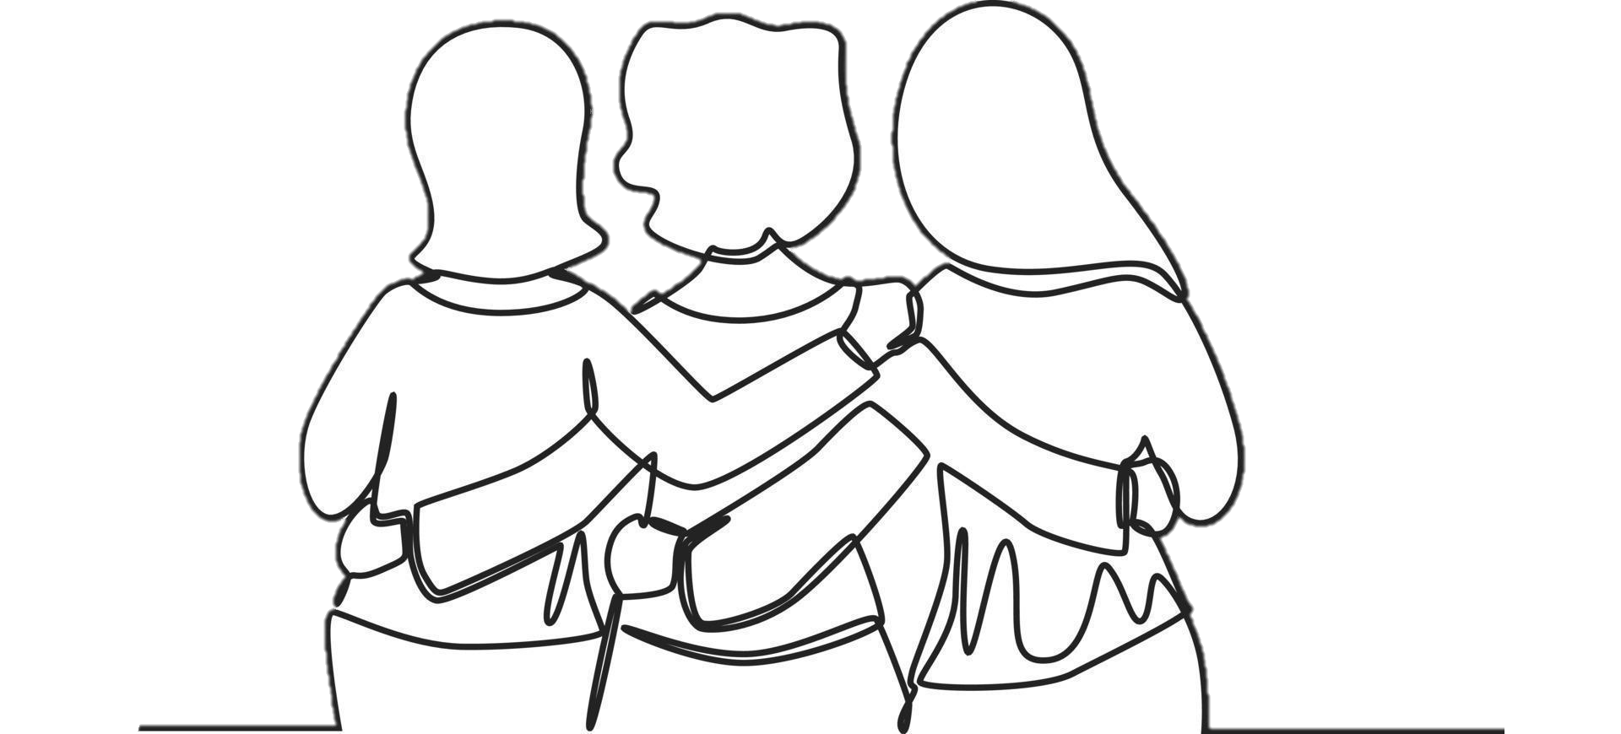
THANK YOU!
“It’s not how much we give, but how much love we put into giving.” – Mother Teresa

