Slide 1


SOROPTIMIST INTERNATIONAL OF THE AMERICAS, INC.®
Inspiring Stories: Stories from Soroptimist Fundraising Events
2025 District Meeting
<Insert Region> Fundraising Chair
Notes:
Hello, I’m [Your Name] and I’m excited to be here with you today to share inspiring stories from just a few regions that represent our Soroptimist federation. These examples highlight how clubs have successfully tackled fundraising challenges and engaged their communities.
As we explore these examples, I hope to spark your inspiration on how you can create similar fundraisers in your own local community. We’ll discuss the importance of community partners, collaboration, and securing sponsorships, all of which can amplify our impact.
Let’s discover how we can all learn from each other!

Slide 2
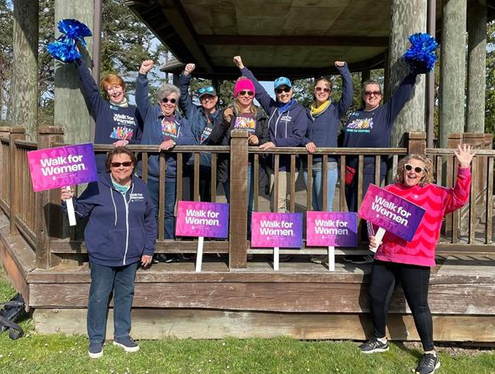
Objectives
Learn about successful club fundraising events from regions throughout SIA.
Gain insights on how to make your club’s fundraiser more successful.
Understand how to engage donors and your community through fundraising events.
SIA | 2025 | Inspiring Stories: Stories from Soroptimist Fundraising Events
Notes:
Today, you will learn about successful club fundraising events from various regions throughout SIA. You’ll gain insights on how to make your club’s fundraiser more successful. Finally, we want to understand how to engage donors and your community through fundraising events. Building those connections is key to our mission.
Let’s dive in and get inspired!

Slide 3
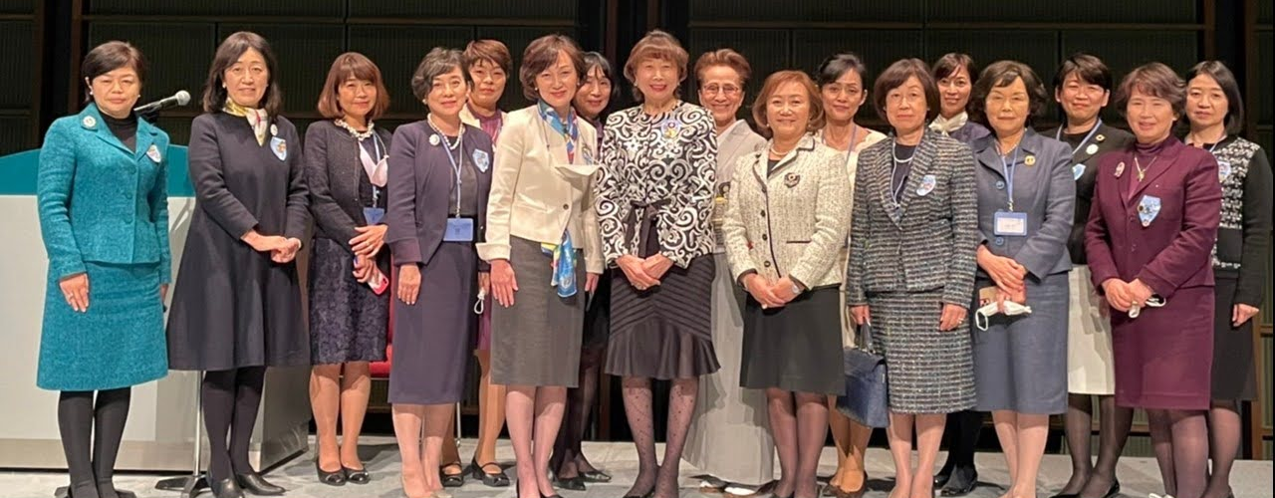
Fundraising Example from Japan Kita Region
YOSE: an entertainment hall featuring rakugo, manazai, magic, music, etc.
SIA | 2025 | Inspiring Stories: Stories from Soroptimist Fundraising Events
Notes:
In the Japan Kita Region, SI Asahikawa has brought joy and entertainment to its community through charity vaudeville performances. For years, they have hosted YOSE events a vibrant showcase of rakugo, manzai, magic, and music.

Slide 4
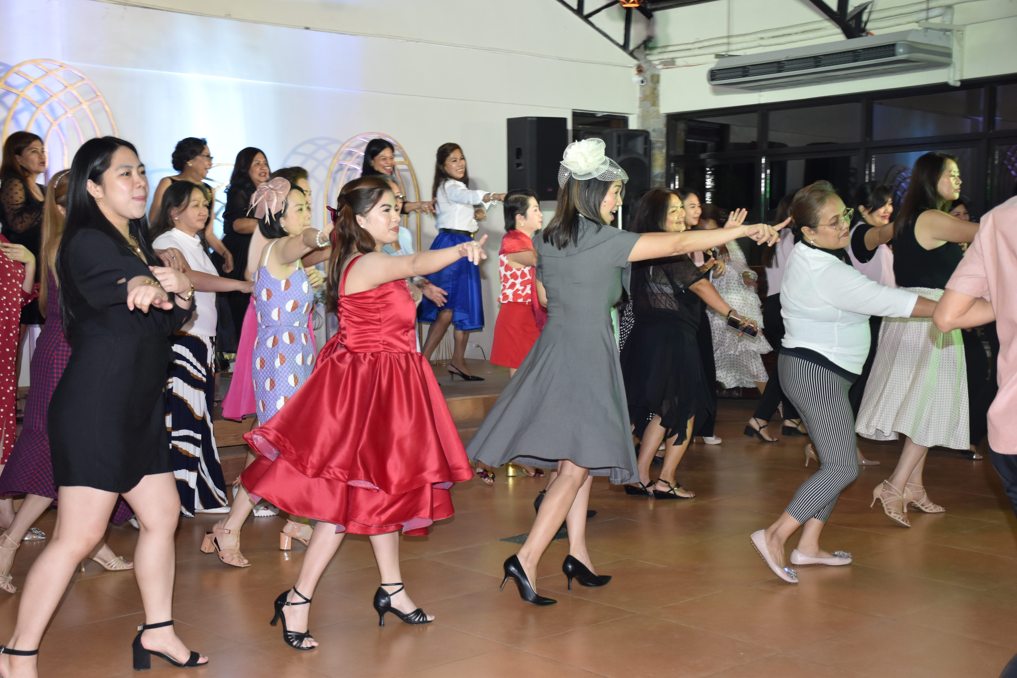
Fundraising Examples from Philippines Region
Ballroom Dance
Raffles
Garage Sale
Live-Selling on Facebook
SIA | 2025 | Inspiring Stories: Stories from Soroptimist Fundraising Events
Notes:
Meanwhile in the Philippines, several clubs organize fundraising efforts that truly reflect the spirit of community. From car raffles to ballroom dances, these events have raised between $1,000 to $2,000 directly supporting our mission.
To motivate participation and recognize success, clubs introduced the Governors Annual Club Awards (GACA) rewarding those with outstanding fundraising achievements and attendance. This helped foster support and encouraged more members and clubs to participate in fundraising events. They recognize their success by acknowledging generous contributions during events helping to strengthen relationships with partners.

Slide 5
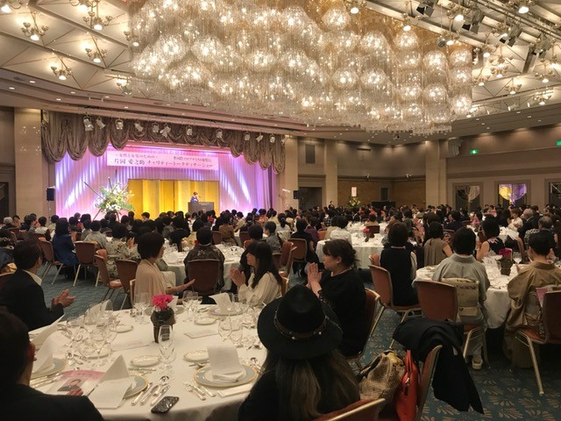
Fundraising Example from Japan Minami Region
Golf tournament – $1,025 USD
Dinner/Lunch shows - $3,850 USD
Bazaar/Goods Sales – $105 USD
Movie Events –$782 USD
Concerts - $361 USD
SIA | 2025 | Inspiring Stories: Stories from Soroptimist Fundraising Events
Notes:
The Japan Minami Region conducts many fundraisers and have found strength in collaboration and creativity. Clubs have organized various events like golf tournaments and dinner shows recognizing the importance of engaging their local community to raise awareness and funds. Their fundraisers average from $361 to $3,850 USD.
Despite challenges such as declining membership and an aging population, they are committed to fostering partnerships, collaboration with community partners and other clubs to share resources and further their impact.
This slide displays some highlights of their fundraising efforts. These diverse initiatives demonstrate how creativity and collaboration can lead to meaningful contributions.

Slide 6
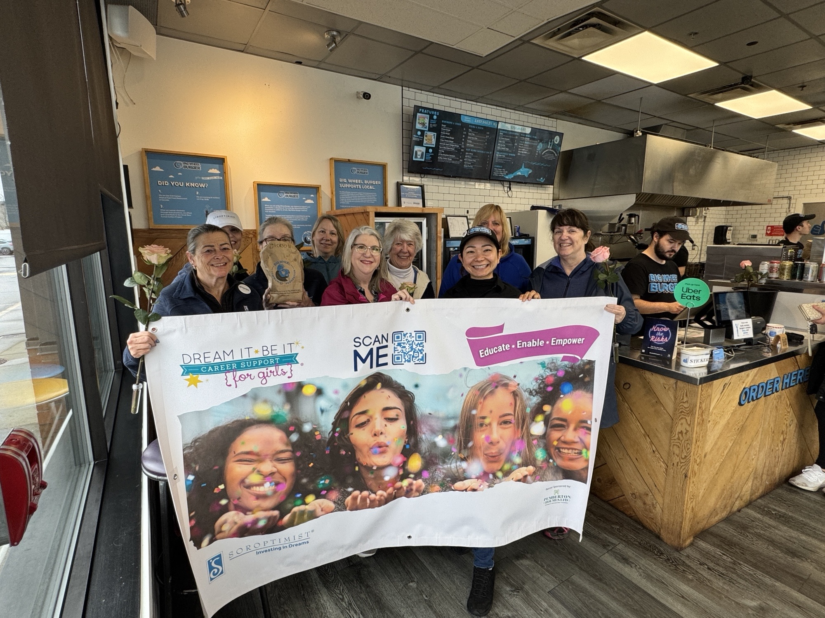
Fundraising Example from Western Canada Region
Walk for Women 2025:
Awareness campaign- clubs shared
“Why I Walk” posts on social media.
Soroptimist of Victoria Westshore
partnered with Big Wheel Burger to
assist with fundraising efforts.
SIA | 2025 | Inspiring Stories: Stories from Soroptimist Fundraising Events
Notes:
In the Western Canada region, Walk for Women, an annual opportunity available to all clubs during the month of March, turned into both an awareness and fundraising initiative. Along with materials provided by Soroptimist headquarters, clubs came together to walk during the month of March and shared personal stories of “Why I Walk” on social media to raise awareness of our mission.
Soroptimist of Victoria Westshore organized a short 2.5 km walk partnering with local businesses like Big Wheel Burger. This resulted in a donation of $2 for every feature burger sold throughout March, a perfect example of how partnerships can amplify awareness and funds.

Slide 7
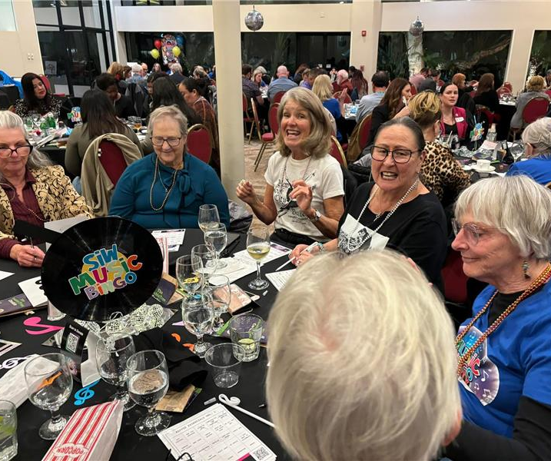
Fundraising Example from Desert Coast Region
Music Bingo Party from SI Whittier
Net profit: $73,000
164 participants
Advertised through club website, posters, chamber events, and social media.
SIA | 2025 | Inspiring Stories: Stories from Soroptimist Fundraising Events
Notes:
Let’s look at our final example: the Music Bingo Party hosted by SI Whittier of Desert Coast Region.
This event was held last year and generated a net profit of $73,000 USD and had 164 attendees who came together for a night of fun and community engagement.
To promote the event, they used a variety of channels, including their club website, posters, chamber events news, and social media. This comprehensive approach helped them effectively reach potential participants and drive attendance.
Some key recommendations to their success includes:
- Starting early with sponsorship requests to ensure securement necessary funding.
- Developing comprehensive sponsorship packages that include invitation letters, levels of sponsorship, and clear information about our mission.
-Encourage buy-in from all members to foster a sense of ownership and commitment to the event.
- Don’t be afraid to try something new; innovation can lead to even greater success.
- Make sure to utilize our members' resources—many generously contributed their time and skills, providing the MC, auctioneer, and DJ at no cost.

Slide 8

Effective Strategies
Engaging posters and flyers
Corporate advertising and sponsorships
Partnership with other organizations
Social Media
Recognition and celebration
SIA | 2025 | Inspiring Stories: Stories from Soroptimist Fundraising Events
Notes:
Let’s look at more effective strategies to enhance our fundraising efforts.
First, create posters and flyers to promote fundraisers. You can also post events on Facebook.
Next, It’s essential to promote corporate sponsorship and advertising opportunities to increase financial support.
Also consider partnering with similar organizations or nearby clubs to amplify attendance, awareness, and resources.
Utilizing social media to share our stories and mission moments can help drive attendance to our events. Resulting in more funds raised,
increased awareness, and potential new members.
Lastly, recognizing and celebrating the contributions of our members and sponsors during events encourages ongoing support.

Slide 9

Effective Strategies - Retention
Future appeals for donations
Recurring gifts and pledges
Communications regarding volunteer opportunities
Event invitations (i.e., LYDA celebrations,
DIBI workshops)
Promotions for future fundraising opportunities
SIA | 2025 | Inspiring Stories: Stories from Soroptimist Fundraising Events
Notes:
As you focus on enhancing event participation and retention, one key strategy is to create a segmented group specifically focused for event participation. By forming this dedicated group, you can engage individuals who are interested in events more effectively.
Using this segmented list, you can send personalized communications tailored to their interests. This can include:
Future appeals for donations
Opportunities for recurring gifts and pledges
Information about volunteer opportunities
Invitations to events like your LYDA celebrations and DIBI workshops
Promotions for upcoming fundraising initiatives
By continuing to engage supporters in our meaningful work, we not only strengthen our relationships with donors, but we also improve the retention of event attendees. This personalized approach is crucial for building loyalty and trust, ultimately leading to increased funds for our initiatives.
Through these efforts, we can create a more engaged and committed community that supports our mission.

Slide 10

Event Poster Examples
Event details
Online information and ticket purchasing
Consistency with SIA branding guidelines
Enhance visibility
soropt.link/eventflyertemp
SIA | 2025 | Inspiring Stories: Stories from Soroptimist Fundraising Events
Notes:
It’s essential to include key event details such as the event name, date, time, and location prominently on all marketing materials. This ensures that potential attendees have the information they need at a glance.
You should also incorporate a clear call to action, directing people to your event/club website for online ticket purchases or more information about the event. This makes it easy for them to engage with your club.
It’s crucial that all promotional materials align with SIA branding. Consistency in our branding not only strengthens our identity but also builds trust with our donors. The SIA headquarters marketing team has templates and tools
available to facilitate this. These resources help ensure our promotional materials are professional and effective.
Creating engaging content that captures attention and drives interaction across social media platforms can also boost your club’s visibility. On this slide you’ll see a flyer example from the Marketing Team at SIA HQ. Using the link below, you’ll be able to access a template to help create a flyer for your next event.
By implementing these strategies and creating strong promotional materials, you can maximize your outreach and ensure the success of your events.

Slide 11
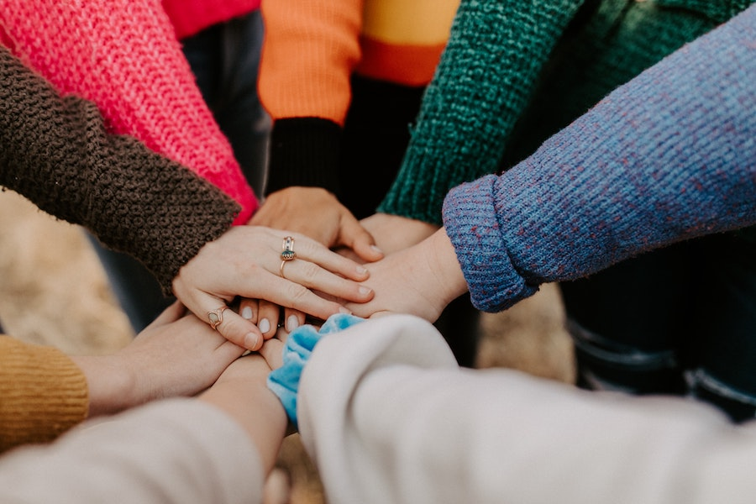
Let's Share!
Inspiring Stories from Several Regions
Japan: Engaging performances
Philippines: Creative fundraising initiatives
Canada: Awareness campaigns and partnerships
Desert Coast: Community engaging initiatives
Let’s Share!
What fundraisers have worked well for your club?
SIA | 2025 | Inspiring Stories: Stories from Soroptimist Fundraising Events
Notes:
These stories from Japan Kita and Minami, the Philippines, Western Canada, and Desert Coast Regions are just a few examples of the diverse ways Soroptimist clubs engage their communities and fundraise for our mission. Whether through entertaining performances, innovative fundraising strategies, community engaging activities, or awareness campaigns, each region contributes uniquely to our mission of empowering women and girls.
As we share these experiences, let us draw inspiration and ideas to elevate our own fundraising efforts in our communities.
Now, I’d love to hear from you! Does anyone want to share a fundraising initiative that’s worked well for your club?

Slide 12

Contact Me
GET IN TOUCH
<Insert Region> Fundraising Chair <Insert Name and Email>
Or
development@soroptimist.org
Notes:
Please reach out to your region fundraising chair, or SIA Fund Development staff with any questions you may have. They are here to help!
Thank you!

