Slide 1


SOROPTIMIST INTERNATIONAL OF THE AMERICAS, INC.®
Your Voice Matters!
Soroptimist Member Experience Survey Results & Discussion
Fall 2025
Notes:
Hello, I’m (NAME), your region membership chair. I know you may recall receiving a survey from SIA headquarters about your satisfaction as a member of the federation, and some of you took the time to complete it and send your feedback—thank you to those who did!
Today we will be looking at the results of the survey, reviewing the conclusions and action steps that SIA is taking, and discuss how we can strengthen membership at the club and region level. Remember the title of this presentation is “your voice matters”—because it DOES! We want to hear what you think of this information and how we should proceed. I will share your thoughts anonymously with SIA’s membership department.

Slide 2

Membership Satisfaction Survey
2,631 members responded to the survey.
Respondents were represented across age groups, length of membership, and all regions.
Because of the survey length, we will not be reviewing every data point today.
SIA | FALL 2025 | Your Voice Matters
Notes:
The survey was emailed to all members with an email address in the database, a total of 18,672 members.
2,631 members responded to the survey, which is about 11% of our total membership. Respondents were represented across age groups and length of membership.
We received responses from every region—however, over 70% of responses were from the US and Canada, so there is an opportunity to enhance engagement in Latin America and Asia.
Something you may remember if you did the survey is that it was very long—over 100 questions! SIA will streamline things the next time this survey is deployed in 2027. Because of the survey length, we will not be presenting every piece of data from the survey today. The satisfaction rates today will be rounded up or down to the nearest whole number to make it easier for me as the speaker to share the information verbally. Additionally, if the numbers shared do not equal 100%, I am just not sharing the % of members who responded “neutral” to save time and focus on the key metrics.

Slide 3
Key Results
76% rated their overall experience with SIA positively.
91% said they would recommend SIA membership to a friend.
SIA | FALL 2025 | Your Voice Matters
Notes:
76% rated their overall experience with SIA positively. While only a small portion expressed any dissatisfaction (4%), 20% were neutral.
91% said they would recommend SIA membership to a friend. This indicates a strong sense of loyalty to the organization and is worth celebrating!

Slide 4
Areas Measured
Club Leadership & Staff
Leadership Development
Language Accessibility
Marketing & Communications
Program & Mission
Fund Development & Donors
SIA | FALL 2025 | Your Voice MAtters
Notes:
Questions were asked in more detail about member satisfaction in the following areas:
Club Leadership & Staff
Leadership Development
Language Accessibility
Marketing & Communications
Program & Mission
Fund Development & Donors

Slide 5
Areas of Strength
Dream Programs & contributions
Best for Women E-Newsletter
Club leaders are champions of the mission
SIA | FALL 2025 | Your Voice Matters
Notes:
Here’s where SIA is doing a good job and members expressed higher rates of satisfaction.
72% of respondents reported being satisfied with how the Dream Programs contribute to their member experience.
80% of donors are satisfied with how their contributions to Soroptimist’s Dream Programs are used, and just 1% are dissatisfied.
80% were satisfied with Best for Women E-Newsletter. Only 1% were dissatisfied.
Club leaders scored 84% satisfaction from members for being champions of the mission of SIA.

Slide 6

Areas of Improvement
Website/portal
Awareness of Big Goal
Club leader knowledge of club roadmap
SIA | FALL 2025 | Your Voice Matters
Notes:
We did identify some areas where improvements can be made. Many of them have a theme of lack of awareness, understanding, or use of existing resources by members.
57% were satisfied with SIA’s website. 17% were dissatisfied, mostly because they could not find what they were looking for or struggled to pay dues on the portal.
66% of respondents were satisfied with the 2031 Big Goal while 21% were neutral. 9% stated they were unaware of the 2031 Big Goal, highlighting an opportunity to enhance communication and education regarding this initiative though just 4% were dissatisfied.
Respondents scored club leaders 67% satisfaction for their ability to clearly communicate organizational goals on the strategic plan and/or club roadmap.

Slide 7

Areas of Improvement
15% were dissatisfied when contacting SIAHQ
Low awareness of #SIALeadtoAchieve and on-demand webinars
SIA | FALL 2025 | Your Voice Matters
Notes:
26% contacted SIAHQ in the last year. Of that group, 70% were satisfied with the service they received. 15% were dissatisfied with the most common reason being that they called or emailed and did not receive a response. This is a definite area of improvement that SIAHQ has flagged and is working on.
Of the leadership development opportunities and events that SIA offers, #SIALeadtoAchieve scored the highest for “not applicable” (for members who did not participate) at 72% and had the lowest satisfaction score of 49%. On-demand webinars had 52% “not applicable” score and 66% satisfaction.
Interpretation and translation services received scores of 67% and 70% satisfaction respectively, noting that some interpreters were not prepared, did not know our terminology, or provided inaccurate translations for their region.

Slide 8
Action Plan
Develop and share a yearly SIAHQ activities report.
Articulate all membership benefits.
Promote & resources widely.
Share a blog post introducing the SIA board and staff annually with staff contact info.
Increase connection between membership and SIAHQ staff.
Clarify the value of membership
SIA | FALL 2025 | Your Voice Matters
Notes:
While overall satisfaction and likelihood to recommend a friend are strong, SIA is committed to showing our members that they see, hear, and value your concerns even if they cannot address every one of them. It will not happen immediately for many items, but we hope to see these changes in the next year.
Here are some of the survey conclusions from the data above as well as open-ended comment themes and next steps:
SIA sees from the comments and results that the value of membership needs clarification, so they are suggesting the following:
Develop a yearly SIAHQ report (not the annual report) that shares what SIAHQ staff did for members this year in terms of tactical progress towards objectives and operational work to support members.
All membership benefits should be articulated clearly and promoted often in our existing communication platforms, including networking, community building, and relationships in addition to our mission. These include existing pillar resources (especially for fundraising and membership), club administration tools, webinars, Soroptimist UpliftHER, and #SIALeadtoAchieve. They should also all be reviewed and updated regularly for quality and accuracy.
Create and share a blog post introducing the SIA board and staff annually. Include contact information for staff so that members can resolve their issues more directly.
Consider ways to increase connection between membership and SIAHQ staff, like the ability for clubs to request a SIAHQ staff member to virtually attend a club event.

Slide 9
Action Plan
Consider paid ads to promote membership recruitment and new donors.
Continue to improve the club chartering process.
Review/improve membership resources.
Continue examining SIA’s event model to reduce event costs.
New Region Education Chairs!
Too much is asked of members
SIA | FALL 2025 | Your Voice Matters
Notes:
To address the feeling that too much is asked of members, SIA is suggesting the following:
Consider the use of paid ads on social media to promote membership recruitment and new donors.
Continue the work to improve the club chartering process so new members have a clearer understanding of the organization.
Review existing membership resources and make improvements, particularly with regards to the new member funnel.
Continue the work of examining SIA’s overarching event model for ways to reduce event costs for members and the organization.
In the next biennium, partner with the Region Education Chairs to encourage clubs and regions to rely on SIAHQ as the primary provider of role specific, club operations, and leadership development training.

Slide 10
Action Plan
Club roadmap training and administrative guidance.
Consider bite-sized ways to provide information and amplify existing resources.
Confusion about leadership roles
SIA | FALL 2025 | Your Voice Matters
Notes:
Additionally, open-ended feedback indicated that there is confusion about leadership roles. SIA is planning to do the following:
Create training resources about the club roadmap and review club administration guidance for new leaders so that they know what is expected and can do their duties well.
Consider bite-sized ways to provide information and amplify existing resources, such as a regular social media/Best for Women series where each pillar promotes resources and information in digestible, short posts.

Slide 11
Action Plan
An evergreen resources section of BFW to help members find things.
Committee of members for user testing for future technology project.
Continue to enhance the member portal experience.
Improve technology experience
SIA | FALL 2025 | Your Voice Matters
Notes:
While SIA is in a transitional space with the website and database, they are considering the following ways to improve member experiences with technology:
An evergreen section of Best for Women to link to various resources by pillar area and language to help members more easily locate required resources.
Engage a committee of members during discovery and user testing for future technology projects such as the Member Resource Library to improve the rollout of that resource.
Continue work plan to enhance the existing member portal experience.

Slide 12
Action Plan
Review translation and interpretation quality.
Testing of all extensions and voicemails.
Increasing first touch resolution.
Consider monthly Open Office Hours on Zoom.
Consider if members can provide staff with insights into their cultures.
Improve member care
SIA | FALL 2025 | Your Voice Matters
Notes:
Finally, SIA is committed to improving the experience of members who need assistance from headquarters by taking the following steps:
Review translation and interpretation quality to ensure all members can participate fully in our offerings and ensure each event has a survey question about interpretation quality.
Phone systems should be assessed and tested to ensure that all extensions are current and lead to active staff members and voicemail inboxes so no calls go unresolved for lengthy periods of time due to being misrouted.
Continue to work on increasing first touch resolution for member care calls and emails.
Consider adding standing monthly Open Office Hours for members to receive assistance with the portal or accessing resources with staff on a Zoom call.
Consider if SIA volunteer leaders can provide staff with training and insights into their cultures so we can learn more to address feedback about being too US-centric.

Slide 13
Action Plan
Member Leader Code of Conduct.
Promote Best for Women as the primary news source from SIA.
Promote Big Goal Accelerator Projects to align non-mission focused projects.
Plan training on club operations.
Enhance local experience
SIA | FALL 2025 | Your Voice Matters
Notes:
Of course, while SIA can take action, the local experience for members within their own club, district, and region is a key driver of their satisfaction.
Continue the existing work plan for the Member Leader Code of Conduct to reduce civility issues at the local level and provide more structure to address them.
Ensure Best for Women is promoted as the primary news source from SIA so that new and existing members know to turn to it for events and resources. Communicate that it is available on the blog for those who do not wish to read it via email.
Partner with club and region program chairs to promote Big Goal Accelerator Projects to align non-mission focused projects, as new members join for our Dream Programs and mission.
Develop and provide training on club operations, such as planning effective meetings, governance training, and role training.

Slide 14
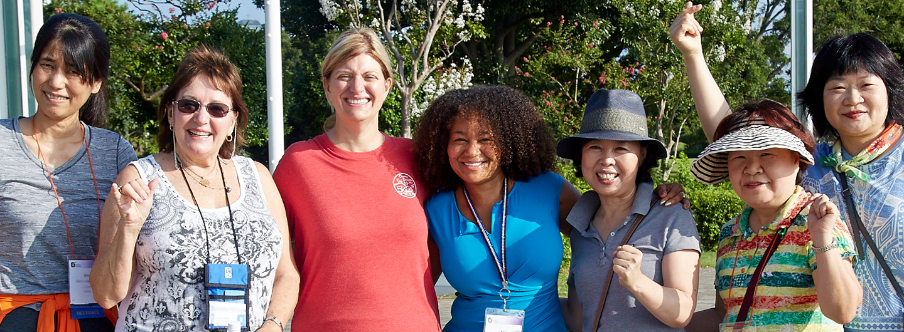
What do YOU think?
SIA | FALL 2025 | Your Voice Matters
Notes:
So what do you think? Did you draw any other conclusions from the information shared?
What do you think is missing?
How can we overcome some of the areas that have low awareness from members?
(take answers)
What do you think your club can do differently on the local level or within our district/region to make sure every member has a positive experience with Soroptimist?
(take answers)

Slide 15

What can YOU do?
What can you commit to
to improve your club?
SIA | FALL 2025 | Your Voice Matters
Notes:
I’d like to encourage everyone to take a moment and write down some ideas for what your club or even you personally can do to improve the Soroptimist experience. Listening to a new member’s ideas, helping someone navigate their new leadership position, or making sure other members know to read Best for Women for all the latest news and information are all small ways that you can help increase retention and make Soroptimist the best it can be! Thank you!

