Slide 1


Presented by:
NAME, REGION, PROGRAM CHAIR
Reaching Higher: Engaging more women and girls for the BIG GOAL
2024 Region meeting
Notes:
Hello, I’m (NAME AND TITLE).

Slide 2




INCREASE the number of WOMEN and GIRLS your club can reach
Dream Programs
Big Goal Accelerator Projects
x 500,000
empowered to live their dreams
2024 SIA Region Meetings
Notes:
As you know, all Soroptimists in our SIA federation are working together on a common Big Goal until 2031: we will invest in the dreams of half a million women and girls through access to education. Today we’ll explore some ways to increase the number of women and girls your club can reach through the Dream Programs and Big Goal Accelerator Projects.

Slide 3


How can we work DIFFERENTLY and reach
MORE women and girls?
How can we work DIFFERENTLY and reach
MORE women and girls?
2024 SIA Region Meetings
Notes:
We will need to work differently and focus on reaching MORE women and girls through access to education and economic empowerment. We need every club to dedicate themselves to increasing the number of women and girls we reach through the Dream Programs and Big Goal Accelerator Projects. But how?

Slide 4
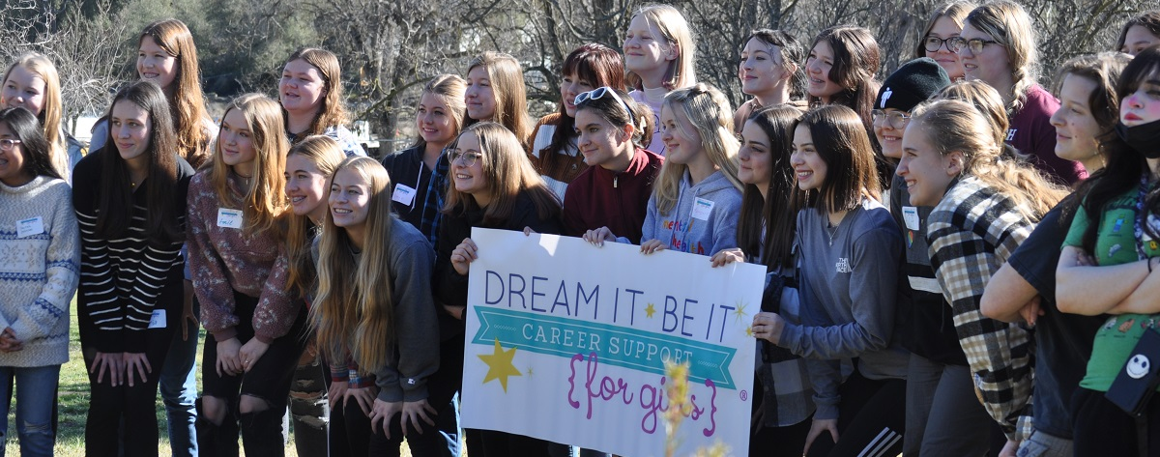
Start a Dream It, Be It project!
2024 SIA Region Meetings
Notes:
START a Dream It, Be It project.

Slide 5
Why?
Start a Dream It, Be It project!
Impact many girls with lower cost per girl
Engage potential new members & supporters with volunteer opportunities
40%
Clubs already participating
60%
Clubs with potential to participate!
2024 SIA Region Meetings
Notes:
Only 40% of our clubs are doing DIBI or supporting another club’s project. That means there’s so much Soroptimist sisterhood power being left on the table! This is the number one way your club can help if you’re not already involved in the program. Dream It, Be It projects can impact many girls with a much lower cost per girl reached than other projects like a scholarship. It’s also a great way to engage potential new members or supporters by having them volunteer in your project—they can see the hands-on impact and change Soroptimists make and want to join themselves!

Slide 6
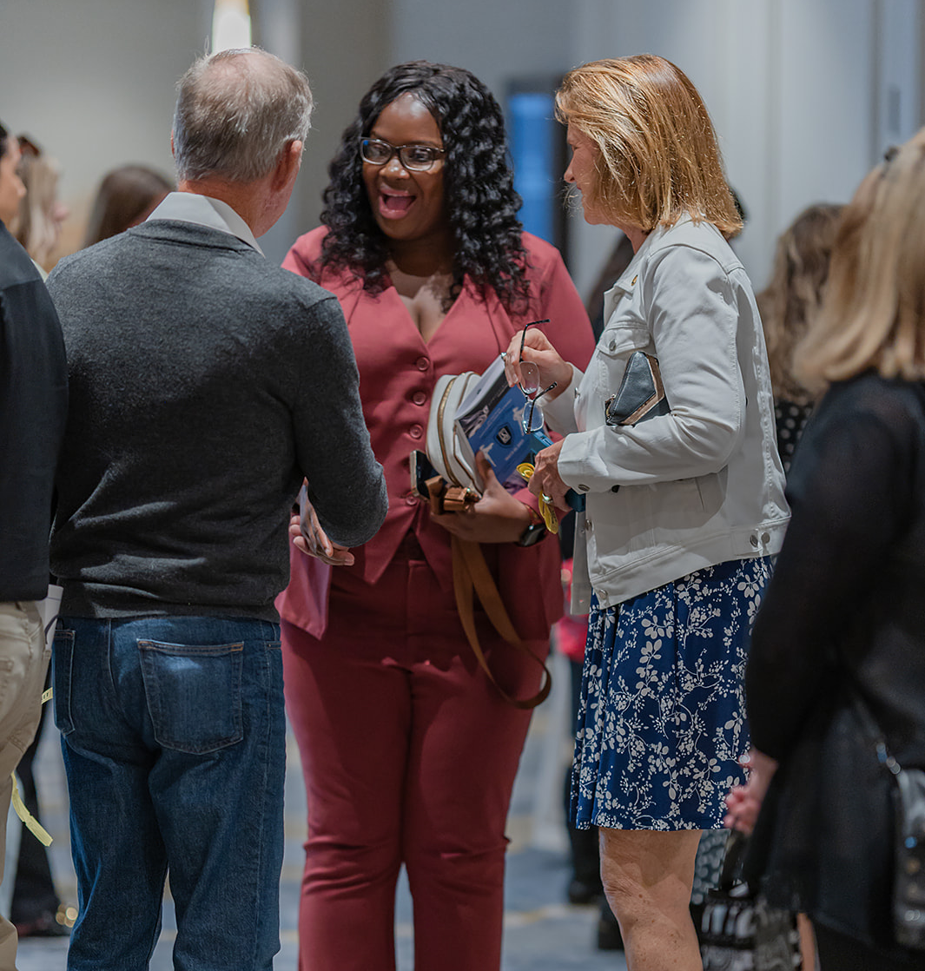
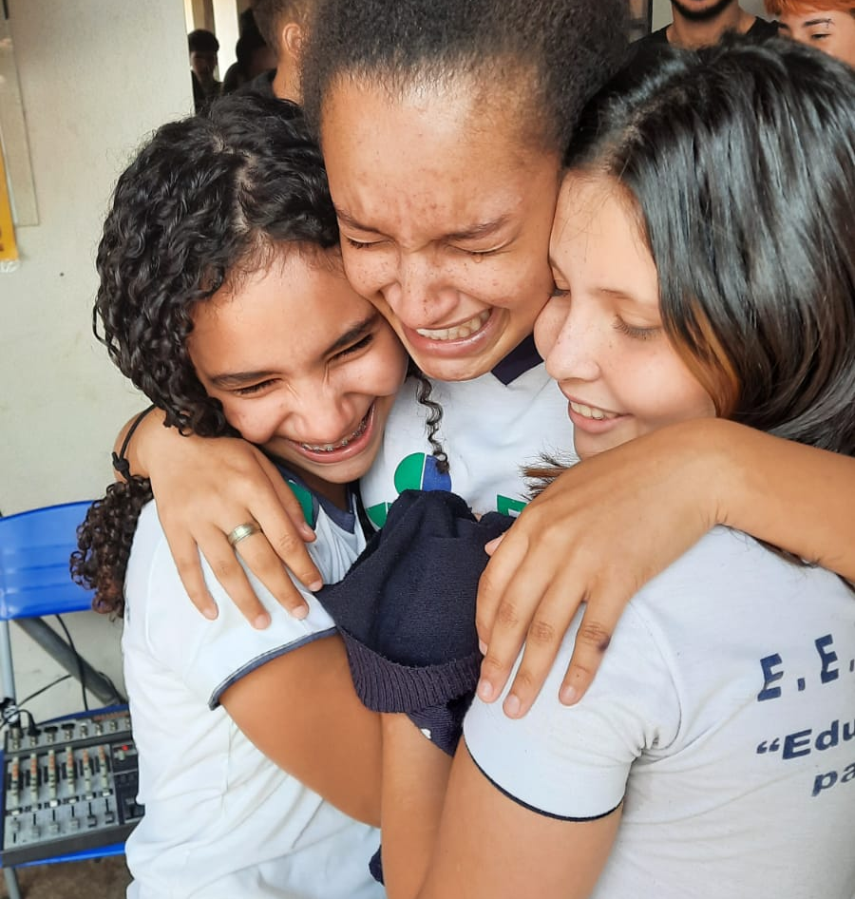
How can you EXPAND?
New partnerships
Explore funding sources
  Apply for a Soroptimist Club Grant!
Provide incentives for girls to bring a friend
Make your program fully accessible
  Food
  Transportation
2024 SIA Region Meetings
Notes:
If your club is already doing Dream It, Be It, consider how you can expand your reach: new partnerships, providing incentives for girls to bring a friend to a session, ensuring that your program is fully accessible by offering food and is close to transportation. If your club needs additional funds to expand your program, apply for a Soroptimist Club Grant or explore other funding sources to support your projects.

Slide 7


INCREASE IMPACT
Give MORE awards!
  Shift funds towards more awards
  Ask local businesses or individuals to sponsor an award
2024 SIA Region Meetings
Notes:
You can also expand your impact through the Live Your Dream Awards. First, ensure that your club has sufficient funds to give more awards and if you need to, consider shifting funds in the budget to support that or asking local businesses/individuals to sponsor an award. You may be pleasantly surprised!

Slide 8
Publicity
More applications!
Share
applications with nonprofits or schools
Host
application workshops
Connect
with other clubs
who have applications to share
Help women apply
Share applications between clubs
Create personal contacts
Expand your reach
More awards!
2024 SIA Region Meetings
Notes:
Publicity is key in reaching more women to apply—share applications with nonprofits or schools that reach our target demographic for the award, and make sure you have a personal contact there to help get the word out. Host application workshops at these organizations to help women apply and answer any questions so they feel supported.
Finally, consider expanding your reach! Connect with local clubs who have abundant applications and ask them to share applications with your club, so more women receive an award. In the US/Canada, reach out to SIA headquarters for additional applications—they receive hundreds each year from women who are not local to a club and have ambitious dreams for their futures!

Slide 9


INCREASE IMPACT through
Big Goal Accelerator Projects
Choose PROJECTS that reach
a LARGE NUMBER of WOMEN and GIRLS
2024 SIA Region Meetings
Notes:
Many of the tips previously shared also apply to Big Goal Accelerator Projects but a key tip with Big Goal Accelerator Projects is to choose projects that will reach a large number of women and girls. For example, if your club can either buy two laptops for two low-income girls to attend college or can host a class on interview and job skills for 50 low-income girls, the class would have a larger reach in numbers. Another great project to consider is providing menstrual products directly to low-income schools, foster care facilities, shelters, community colleges, and other organizations in your area. You may have to estimate the number of beneficiaries with this kind of project, but it’s an easy way to reach potentially thousands and to help those women and girls stay in school and attend work.
Of course, if your club has a project you love doing that doesn’t reach a large audience, you do not have to stop doing it! We’d just encourage you to think outside the box about how you can reach more women and girls through that project.

Slide 10


Public Awareness:
SHARING STORIES
Communication is key!
  Participant must be comfortable with how her story is shared
  Make sure she is empowered!
  Use respectful language
  Highlight strengths
Use person-first language
The experiences do not define them!
Example:
    An awardee “experienced domestic violence”
    A “battered woman”
Always have the participant review and make edits!
Show that you value her voice!
X
2024 SIA Region Meetings
Notes:
A key component in reaching more women and girls is your public awareness and sharing stories of program participants, which can be very compelling. Communication is key in sharing the stories of women and girls—not just for strong storytelling, but also to ensure that the featured participant is comfortable with how her story is shared. While some people find sharing about their obstacles empowering, others may find it difficult or even feel belittled, especially if the words used to share their story are not respectful or do not highlight their strengths.
Unless you’re quoting a participant, avoid using words like “victim,” or “addict.” Person-first language can be a great way to show that the circumstances they experienced do not define them—for example, saying an awardee “experienced domestic violence” versus calling her a “battered woman.” You should always have the participant review any materials that you will use that share their story and allow them to make any edits they wish to make—this will show them that you value their voice.

Slide 11

It’s related!
We want everyone to have a positive experience for:
  Your club’s reputation
  Our global brand
  The dignity of each participant!
Participants will help spread the word!
2024 SIA Region Meetings
Notes:
While it may seem unrelated to reaching more women and girls, imagine how it would feel to have personal information shared about yourself without the chance to review it, or to feel pressured to talk about very difficult things that you may have experienced to a room full of strangers. You wouldn’t recommend applying for that education award or attending that program to your friends, would you? Word spreads fast in the social media age, and it’s important that anyone interacting with Soroptimist programs has the best experience possible for your club’s reputation, our global brand, and the individual dignity of each participant.
SIA has a resource to help celebrate award recipients respectfully that we will share with you—many of those tips apply to any program participants your club is working with.

Slide 12

Be open to
new tactics!
Try partnering again
Reach out to a new contact
Talk to other clubs
2024 SIA Region Meetings
Notes:
Don’t forget: Just because you tried something once and it wasn’t successful doesn’t mean it won’t be this time! Try partnering again. Reach out to a new contact at a school. Talk to other clubs to see what works for them. Keep an open mind to new tactics!

Slide 13

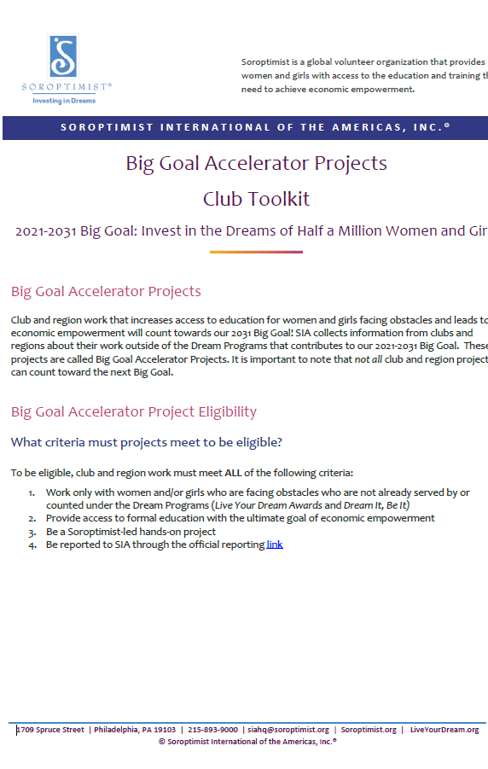
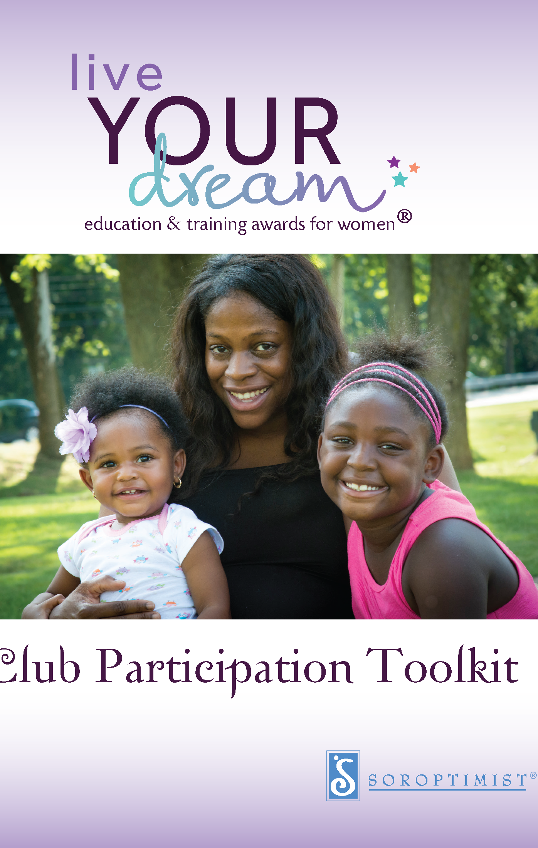
Use the resources!
2024 SIA Region Meetings
Notes:
An important thing to remember as we work on this Big Goal is that there are tools, resources, and people to help. You’re not alone!
I, as your region chair, and your SIA headquarters staff are always here to assist if you have questions or need ideas on how to expand your club’s Dream Programs or Big Goal Accelerator

Slide 14
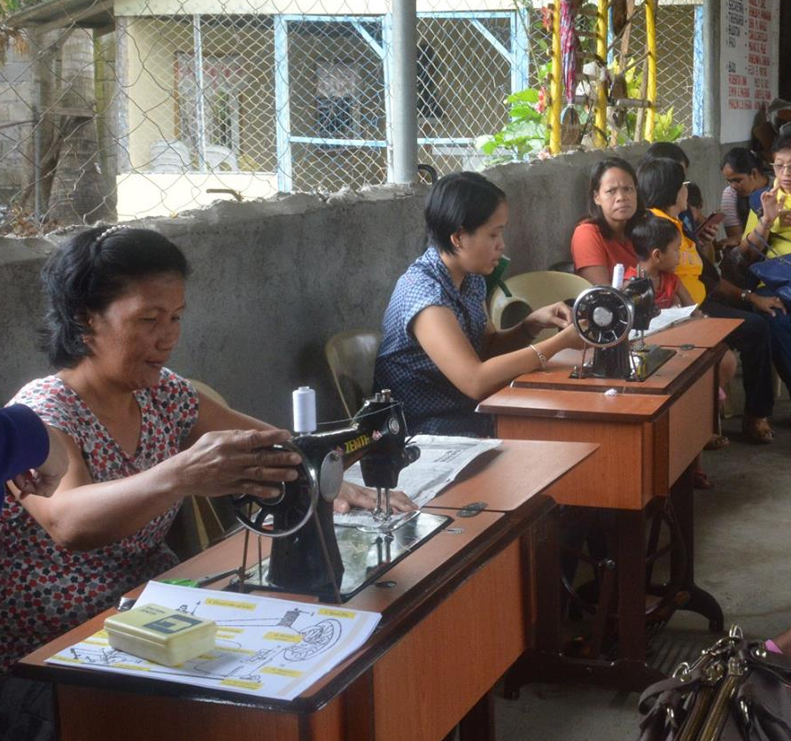

Need
FINANCIAL SUPPORT for a
BIG GOAL ELIGIBLE PROJECT?
Apply for a SOROPTIMIST CLUB GRANT!
March
1
2024 SIA Region Meetings
Notes:
If your club is looking for financial support for a Big Goal eligible project, apply for a Soroptimist Club Grant for Education and Economic Empowerment. These funds could help support your club as you reach more women and girls through access to education!

Slide 15



Help us increase the global impact of our programs!
2024 SIA Region Meetings
Notes:
Think of all the women and girls throughout our federation whose lives could be improved by access to education. Think about how your club could play a key role in their amazing future achievements and increasing the global impact of our programs.

