Slide 1


SOROPTIMIST INTERNATIONAL OF THE AMERICAS, INC.®
Community Outreach for the Live Your Dream Awards:
Recruiting Applicants Effectively
PRESENTER NAME, PRESENTER TITLE
Fall 2025
Notes:
Hello, I’m (NAME) and I’m excited to be sharing with you today about something VERY important but also that can be VERY fun: recruiting Live Your Dream Awards applicants.

Slide 2

Everyone can help recruit!
SIA | FALL 2025 | Recruiting Applicants Effectively
Notes:
Recruiting can be everyone’s job! This is not just limited to the Live Your Dream Awards club chair or committee members—We all have opportunities to connect women with this amazing award in our daily lives.

Slide 3



How to Recruit Applications
Talk about it!
Be a representative & raise awareness!
SIA | FALL 2025 | Recruiting Applicants Effectively
Notes:
Step number one is: talk about it! Are you at the doctor’s office? Ask if you can put up a poster in the waiting room or leave a stack on the table. The staff could be potential eligible applicants, or they may know someone else who is. You never know until you ask! And bonus, you are also raising local awareness for your club, which can help with membership and donations!
It’s important to remember—you never know if you’re talking to someone who can help your club reach more applicants! So always be ready to share information about Soroptimist and your club’s Live Your Dream Awards program. You’re a representative of your club and can always raise awareness.

Slide 4
Know the Basics
Eligibility requirements
Application requirements
How to apply
Deadline: November 15
Questions? Contact lydawards@soroptimist.org
SIA | FALL 2025 | Recruiting Applicants Effectively
Notes:
You don’t need to be an expert, but it’s a good idea to know the basics of the award before you recruit:
Applicants must be women residing in an SIA territory who are the primary financial provider for themselves and at least one dependent. They must be currently enrolled in or accepted into an education program below a Master’s degree.
The application asks for basic information, personal essays about the applicant’s goals and dreams, financial information, and must be accompanied by at least one completed reference form from someone the applicant is NOT related to by blood or marriage.
Women can apply on the online application system if they are in the US and Canada, or they can apply with a PDF application.
The deadline to submit a complete application is November 15.
If you get asked a question you don’t know how to answer, you can always take the person’s contact information or tell them to email SIA headquarters to connect with the staff there at LYDAwards@soroptimist.org

Slide 5
Make a list of organizations to contact
Local schools (community colleges, universities, adult education centers, vocational/training schools)
Community/recreation centers
Charitable organizations
Homeless shelters & transitional housing programs
Domestic violence shelters
Food banks
Women’s health centers
Community health clinics
Childcare or daycare facilities
Government public assistance offices
Welfare-to-work programs
Employment agencies
Local job/career fairs
Addiction recovery & rehabilitation centers
Organizations working with women and girls
Libraries
Places of worship
Think about who you already know!
SIA | FALL 2025 | Recruiting Applicants Effectively
Notes:
Where can you recruit, besides your doctor’s office? Anywhere people gather!
Make a list of organizations that you can contact about distributing applications, hanging posters, and helping spread the word to eligible potential applicants.
Here are some ideas to help get you started:
Local schools, like community colleges, universities, adult education centers, vocational or training schools
Contact financial aid offices and reach out to school counselors or advisors
Community/recreation centers
Charitable organizations, especially those working with women and low-income families
Homeless shelters and transitional housing programs
Domestic violence shelters
Food banks
Women’s health centers
Community health clinics that provide free medical services to low-income persons
Childcare or daycare facilities
Government public assistance offices
Welfare-to-work programs
Employment agencies
Local job/career fairs
Addiction recovery and rehab centers
Organizations working with women and girls like the Girls Scouts, Girls Who Code, Girls on the Run, etc.
Libraries
Places of worship
Clubs have reported they have the most success receiving completed applications when they have a personal contact with the organizations where they are recruiting.
If you have connections with anyone at any of these organizations, consider reaching out personally to help open the door—maybe you know a professor at the local community college who can introduce you to their financial aid office, or someone at your house of worship runs a group for single moms and you could speak about the Live Your Dream Awards at their next meeting.

Slide 6

PRO-TIP:
Develop personal contacts and direct relationships.
SIA | FALL 2025 | Recruiting Applicants Effectively
Notes:
A key to success is developing direct relationships with local colleges. A good place to start is with the financial aid director, counselors, and administrators of programs that serve the demographic of women who are eligible for the Live Your Dream Award.
These relationships take time to build and go beyond putting posters around campus. Take the time to make phone calls and personal campus visits. Keep track of who you contact and follow up with them. Introduce these new contacts to the Live Your Dream Awards program and collaborate to hold information and sessions. Establishing these connections will make it easier each year, as the more familiar the school is with the program, the more they can help spread the word and recommend potential applicants, as well as help them through the application process.
It may involve more work to develop these kinds of relationships, but they will be extremely beneficial for everyone in the future.
Also, putting more effort into recruiting applicants in your local communities will likely bring you better quality applicants.

Slide 7
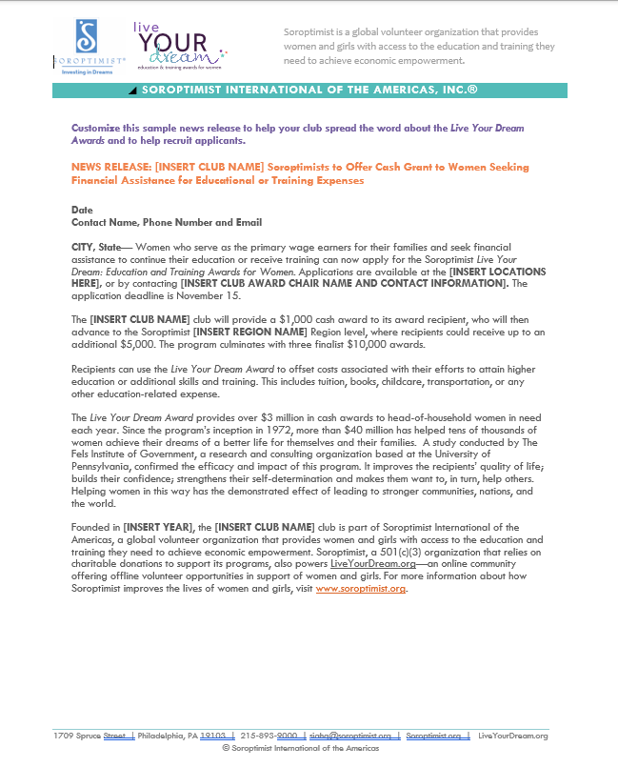
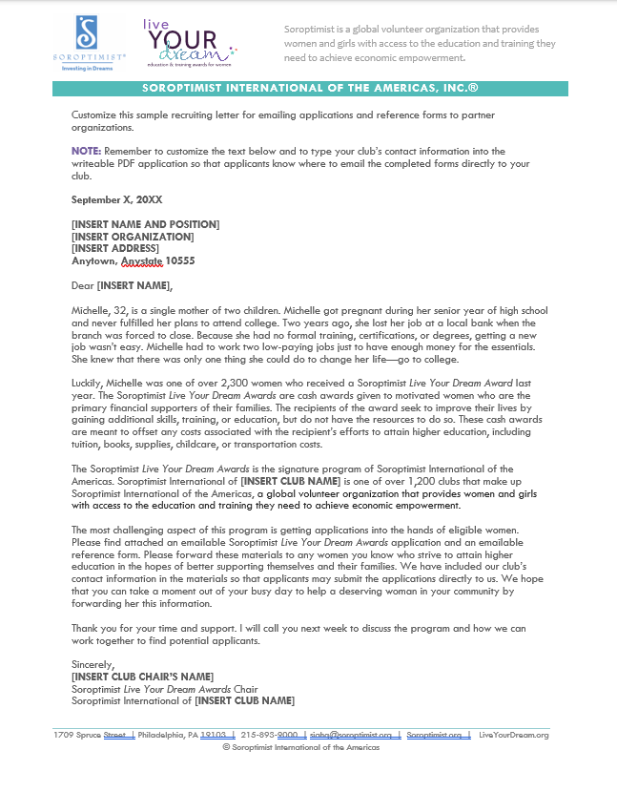
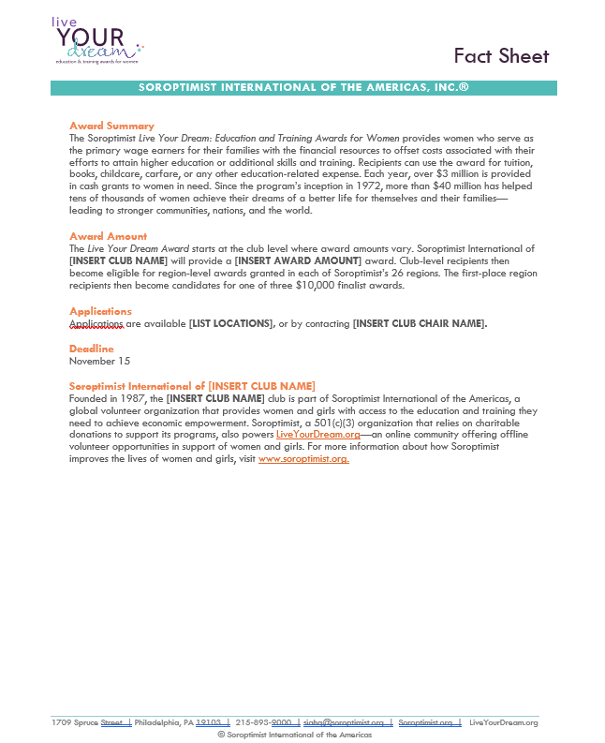
Customizable Templates
Outreach Script
Sample News Release: Seeking Applicants
Sample Recruiting Letter
Fact Sheet
Download, edit, and send!
SIA | FALL 2025 | Recruiting Applicants Effectively
Notes:
English:
Use the downloadable templates, which can be found linked in the club toolkit and on the Live Your Dream Awards Recruiting Applicants page of the SIA website, to help you introduce yourself and the Live Your Dream Awards program to schools, organizations, and potential applicants.
You can use the outreach script for a phone script or sample email text, or the more formal Sample Recruiting Letter when introducing yourself to a local community organization. You can also to use the Sample News Release for Seeking Applicants to connect with local media – both online and physical news sources – to promote the Live Your Dream Awards. They can help you get the message out to possible participants and potentially attract new members, supporters, or donors!
Other Languages (for translation):
Use the downloadable templates, which can be found linked in the club toolkit and on your language’s translated resources page of the SIA website, to help you introduce yourself and the Live Your Dream Awards program to schools, organizations, and potential applicants.
You can use the Sample Recruiting Letter when introducing yourself to a local community organization or the Sample News Release for Seeking Applicants to connect with local media – both online and physical news sources – to promote the Live Your Dream Awards. They can help you get the message out to possible participants and potentially attract new members, supporters, or donors!

Slide 8


Promote with Customizable
Poster & Graphic
SIA | FALL 2025 | Recruiting Applicants Effectively
Notes:
Promote on community bulletin boards in places like churches, daycares, community recreation centers, grocery stores, the DMV, or transportation center/bus stops by posting the Live Your Dream Awards poster. Download the poster from the website and add your club’s name, contact information, and any other helpful information for the applicant.
Use the customizable Canva template for recruiting applicants to share spread the word on social media. The link to access the template also includes instructions for customizing the template.
Consider social media ads—you can target users to your area and certain age range, genders, etc. It could be a worthwhile use of funds to get more applicants or program participants!
If your club doesn’t have the budget for social media ads, research local Facebook groups in your community or other platforms that may have possible program participants and applicants and share information there.

Slide 9
Still not enough applications?
Expand your search to include surrounding communities
Share applications with other Soroptimist clubs
  Contact your region to help facilitate this!
Request Non-local Applications from SIA headquarters
SIA | FALL 2025 | Recruiting Applicants Effectively
Notes:
If your club is having difficulty recruiting applicants, you can expand your search to surrounding communities, particularly areas that do not have Soroptimist clubs. Communication and the distribution of applications can be handled online. Phone calls are a great way to personalize communication and connect beyond the virtual sharing of the application and reference form.
Another great way to expand your search is through other Soroptimist Clubs. Clubs with excess applications can share them with clubs in need of more applications. Your region chair can help facilitate this by connecting clubs. This will also help ensure that more applicants can be considered for the award, and we can potentially award more women.
SIA headquarters receives hundreds of applications each year from applications over 75 miles from a club, so they’re always happy to share applications, which will give these applicants a better chance of being selected for an award. Clubs can request applications through the Non-local Application Request form.

Slide 10
Takeaways
What can your club take from this workshop?
How can every member get involved?
SIA | FALL 2025 | Recruiting Applicants Effectively
Notes:
Before we wrap up, I’d like to encourage everyone here to write down answers to two questions:
What can your club take from this workshop?
How can every member get involved?
Time permitting, share some answers from attendees.

Slide 11
THANK YOU!
Name
Your Title
Contact
SIA | FALL 2025 | Recruiting Applicants Effectively
Notes:
Thank you for your time today!

