Slide 1


Reaching the Big Goal Together
BEST PRACTICES
PRESENTER NAME, PRESENTER TITLE
Notes:
Hello, I’m (NAME AND TITLE) and I’m excited to share the Impact pillar presentation with you today. We’re going to be discussing ways that we can all increase the number of women and girls that our clubs reach through the Dream Programs and Big Goal Accelerator Projects. We will also hear some exciting ideas from clubs who qualified for the Best in Federation awards last year and what made their programs so successful.

Slide 2
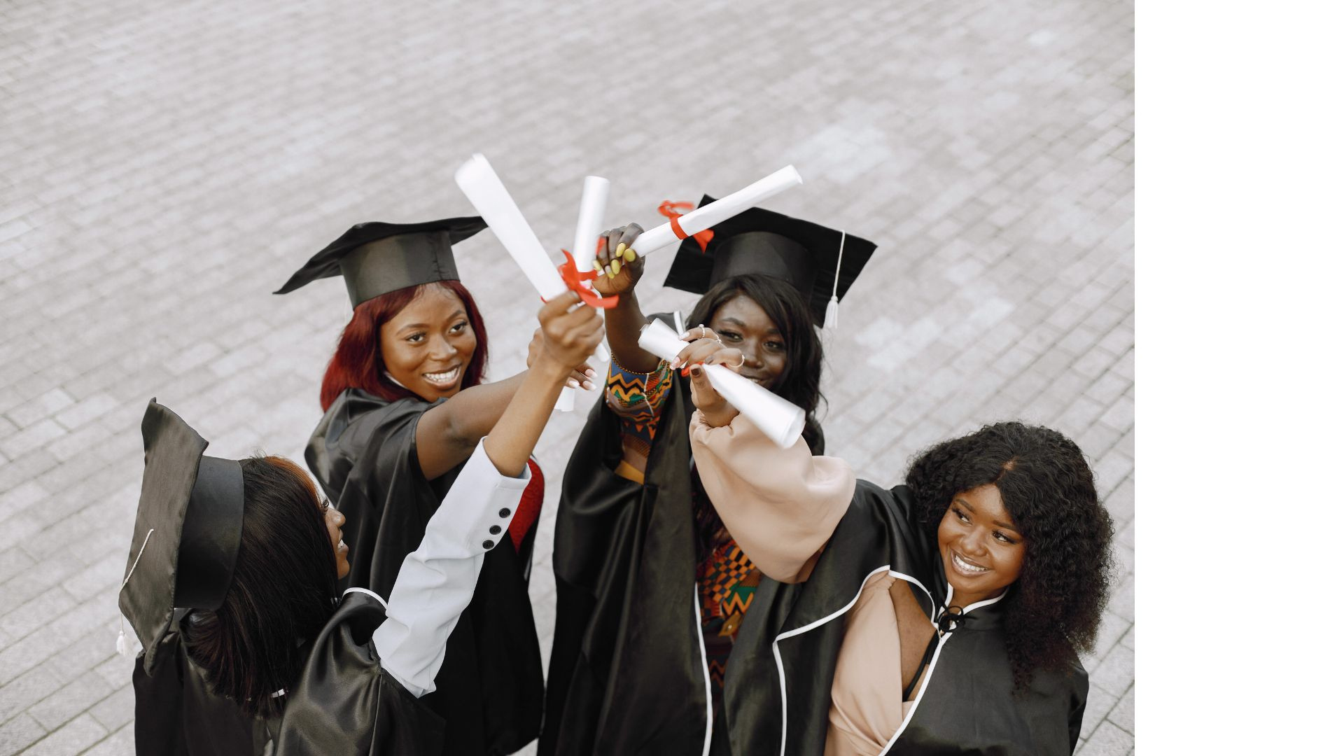

What is the
BIG GOAL?
2025 SIA REGION CONFERENCE
Notes:
What is the Big Goal?
(take answers from the audience—consider giving out a sticker, pen, or other small prize for correct answers)

Slide 3
End of 2023/2024 Club Year:
18.6% accomplished!
93,085 women and girls reached (since 2021)
Progress towards the
BIG GOAL
To reach the BIG GOAL:
406,915 more women and girls
2025 SIA REGION CONFERENCE
Notes:
Our Big Goal is to invest in the dreams of half a million women and girls through access to education by 2031. As of the end of our 23/24 club year, we are 18.6% of the way to that number, having reached 93,085 women and girls since 2021. Just 406,915 to go!

Slide 4




What percentage do we need to increase each year?
Live Your Dream Awards and Big Goal Accelerator Targets
2020
2021
2022
2023
2024
2025
2026
2027
2028
2029
2030
2031
2025 SIA REGION CONFERENCE
Notes:
Back in 2020, SIA headquarters crunched the numbers to see how much we’d need to increase our impact by each year for each of our programs to reach the Big Goal by 2031. These targets may change over time if we’re doing better than planned or moving slightly behind schedule, but they serve as a good road map to guide us toward achieving our Big Goal.
Does anyone know the percentage we need to increase each year to hit our Live Your Dream Awards and Big Goal Accelerator Project targets?
(take answers from the audience—consider giving out a sticker, pen, or other small prize for correct answers)

Slide 5



Annual Increases to reach the
BIG GOAL
Live Your Dream Awards
Big Goal
Accelerator Projects
10%
10%
30,000 Recipients
150,000 Participants
2025 SIA REGION CONFERENCE
Notes:
In order to reach our Big Goal on time, we need to increase the number of women receiving a Live Your Dream Award by 10% each year, as well as the number of women and girls reached by Big Goal Accelerator Projects by 10% annually. That means that approximately 30,000 women will receive a Live Your Dream Award in that time frame, and about 150,000 women and girls will participate in Big Goal Accelerators.

Slide 6

What percentage do we need to increase each year?
Targets for Dream It, Be It
2020
2021
2022
2023
2024
2025
2026
2027
2028
2029
2030
2031
2025 SIA REGION CONFERENCE
Notes:
For Dream It, Be It, we need to increase by what % each year? This one is a little tricky because it changes halfway through the Big Goal period!
(take answers from the audience—consider giving out a sticker, pen, or other small prize for correct answers)

Slide 7

Annual Increases to reach the
BIG GOAL
Each year until 2026/2027
Each year until 2031
25%
15%
320,000 girls by 2031!
2025 SIA REGION CONFERENCE
Notes:
To reach our Big Goal on time, we need to increase the number of girls reached by Dream It, Be It by 25% each year until 26/27 when it will slow down to a 15% annual increase.
That means approximately 320,000 girls will get to experience Dream It, Be It by 2031!

Slide 8

We can accomplish this TOGETHER with our Soroptimist sisters
Let’s learn HOW!
Notes:
Of course, with numbers this large, no one club or member or even region can do it alone. Together with our Soroptimist sisters across the globe, we are all doing our part to change the lives of women and girls through access to education and economic empowerment. And today, we’re going to learn some ways that we can do exactly that.

Slide 9




TIPS:
Open mind
Try again!
Positive attitude
2025 SIA REGION CONFERENCE
Notes:
An important thing to keep as you consider all of these tips is an open mind! If your club has tried something before and it wasn’t successful in reaching more women and girls, that doesn’t mean it won’t be if you try again! A positive attitude and trying new things could help push us over the threshold to achieving our Big Goal.

Slide 10

Start a Dream It, Be It Program!
Engage new members, local businesses, and other supporters.
Most importantly, reach more GIRLS!
2025 SIA REGION CONFERENCE
Notes:
As you saw in the numbers previously, we have the power to reach so many girls through Dream It, Be It. So if your club doesn’t have a Dream It, Be It project, that would be the first suggestion. Dream It, Be It projects can impact many girls with a much lower cost per girl reached compared to other projects like a scholarship—the average cost of the last three years to clubs for providing Dream It, Be It was just $20 per girl.
These projects also provide a powerful tool for engaging interested new members, local businesses, or other supporters as volunteers.

Slide 11
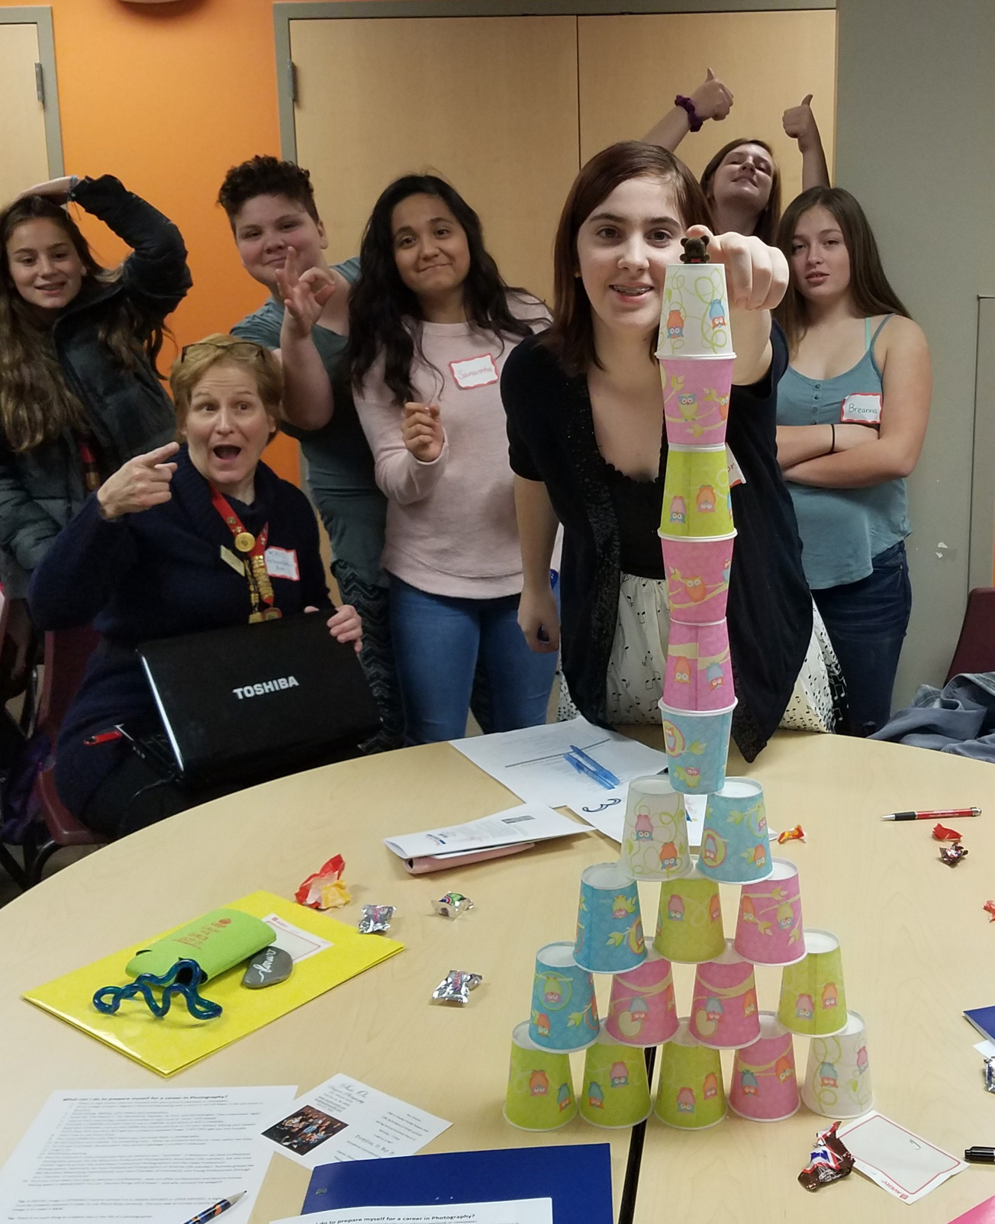

Expand Existing Projects
Run the program more than once a year
Connect with new schools or nonprofits
Provide incentives for girls to bring a friend
Create a planning committee with past participants
Ensure your program is fully accessible (provide food and transportation)
Soroptimist International of Fond du Lac, WI
(Midwestern Region)
2025 SIA REGION CONFERENCE
Notes:
If your club is already participating in Dream It, Be It, consider how you can expand your reach. Could you run the program more than once a year? Could you connect with a new school or nonprofit in your community to reach more girls? Could you provide some incentives for girls to bring a friend to a session, like a gift card or raffle tickets for a basket of items they might like? Perhaps you can have a planning committee of past participants to plan the next round, ensuring that the program is relevant, meaningful, and fun for their peers? Are you ensuring that your program is fully accessible by offering food and being close to transportation or in a location that’s no trouble for the girls (at their school or facility)?

Slide 12




Tips: Starting New Partnerships
Connect with school officials
Start with
YOUR CLUB
Do any members know someone?
...or know someone who knows someone?
Get to know POTENTIAL PARTNERS
What are their concerns?
How can you address them?
Think outside the box!
2025 SIA REGION CONFERENCE
Notes:
Connecting with school officials can sometimes be difficult, and getting your foot in the door to start a partnership might feel impossible. But start first with your club—consider if anyone in your club knows someone (or knows someone who knows someone!) who is connected to your local school or school district.
If you’re able to connect with an administrator or school guidance counselor who is interested but has reservations, do your best to understand what they are and if there is anything you can do to ameliorate those concerns. For example: Do they want to do Dream It, Be It but they don’t have transportation if girls stay after school? Can your club offer to provide bus passes or even pay for a bus driver to transport the girls home safely? Think outside the box!

Slide 13
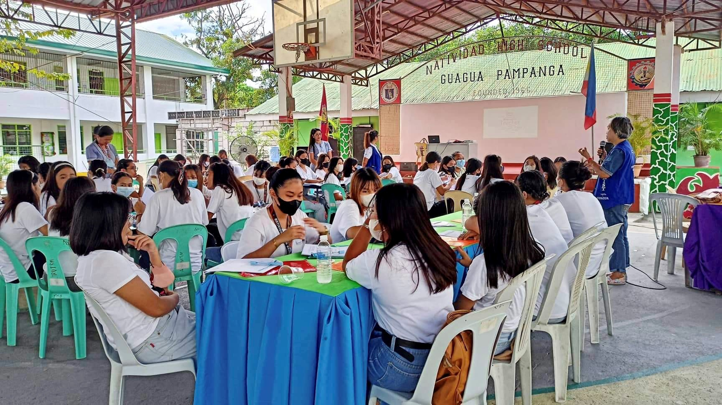

Soroptimist International of Guagua
(Philippines Region)
Partnered with local department of education
50 GIRLS
at
1 SCHOOL
400 GIRLS
at
5 SCHOOLS
2025 SIA REGION CONFERENCE
Notes:
Now we will look at an example of a highly successful Dream It, Be It project from SI/Guagua in the Philippines region.
They partnered with the local department of education office to allow the club to expand the reach of the Dream It, Be It program beyond their immediate community in Guagua. They started with 50 girls at one school and ended up with approximately 400 participants in the final school they visited. The teachers shared the impact of Dream It, Be It through word of mouth, and this made teachers from other schools in the district excited to host the program. They eventually reached six schools with conference-style projects and believe that the powerful and relatable content is what makes Dream It, Be It unique and engaging.

Slide 14


  Consider giving ONE more than last year
    Raise funds to give more awards
    Shift funds in the budget
Find new sponsors
  Ask local business or individuals
    Engage them in the awards process
    Invite them to participate as a judge
TIPS: Increase # of Awards
2025 SIA REGION CONFERENCE
Notes:
Now we will move on to tips related to the Live Your Dream Awards. First, assess how many awards your club gave last year and consider if you can give one more award. Then ensure that your club has enough funds to give more awards and if you need to, consider shifting funds in the budget to support that. You can also ask local businesses or individuals to sponsor an award. Engage them further in the awards process by inviting the business or individual sponsoring the award to serve as judges. You may be pleasantly surprised by their response, and they’ll love the opportunity to participate in judging!

Slide 15
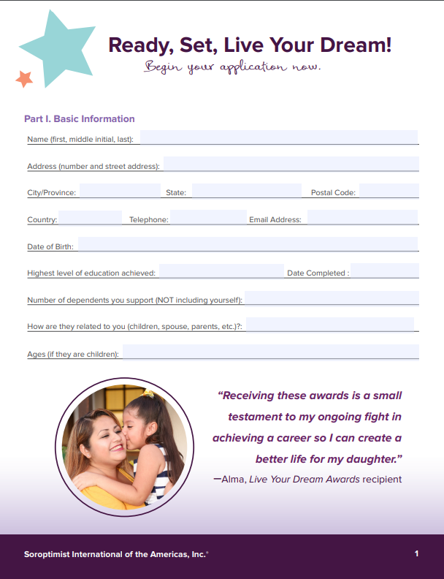
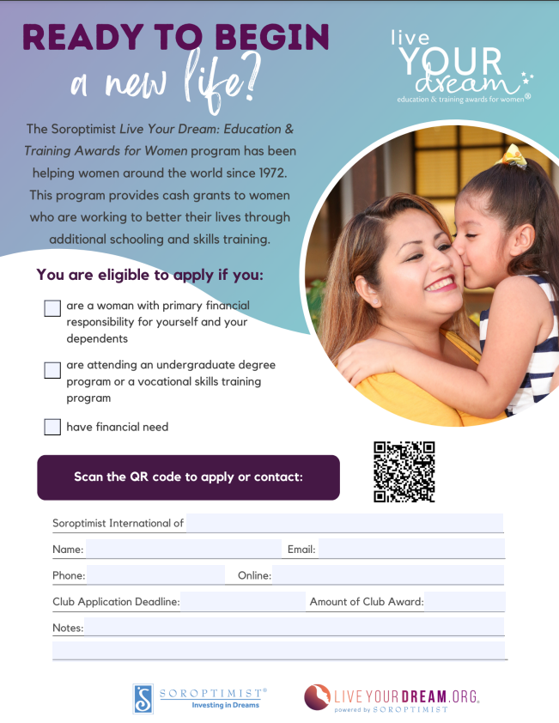
Spread the word!
  Share applications and flyers with nonprofits and schools
  Find personal contacts
  Host application workshops
2025 SIA REGION CONFERENCE
Notes:
Once you’re sure you have the budget to give more awards, you need to make sure that women in your community know about the award and how to apply! Share applications or flyers with nonprofits or schools that reach our target demographic for the award, and make sure you have a personal contact there to help get the word out. Host application workshops at these organizations to help women apply and answer any questions so they feel supported.

Slide 16


Include applications BEYOND your immediate community
There are applications
to share!
  Connect with clubs in your region who have applications to share
  US/Canada - request applications from headquarters
2025 SIA REGION CONFERENCE
Notes:
Our final Live Your Dream Awards tip is to include applications beyond your immediate community. You can connect with clubs in your region who have plenty of applications and ask them to share applications with your club, so more women receive an award. In the US and Canada, you can reach out to SIA headquarters for additional applications. SIA headquarters receives hundreds of applications each year from women who are not local to a club and have goals they want to achieve to live their dreams!

Slide 17

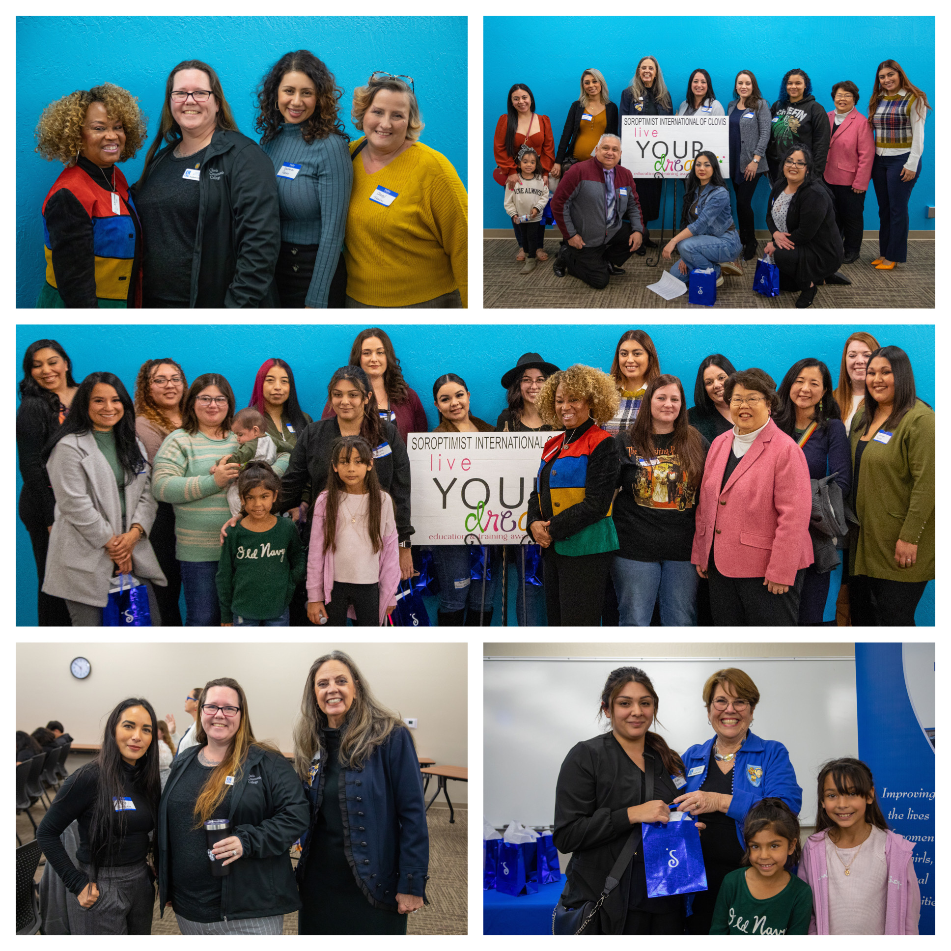
35 Award Recipients
Total $38,000 Award Funds
HOW DID THEY ACCOMPLISH THIS?
Soroptimist International of
Clovis
(Sierra Pacific Region)
Past recipient turned member who collaborated with financial aid department to recruit applications
Local community colleges
Club members worked directly with college staff
Followed up with colleges
Held workshops
2025 SIA REGION CONFERENCE
Notes:
For an example of a very successful Live Your Dream Awards program, we will look at SI/Clovis.
They awarded Live Your Dream Awards to 35 local women, totaling $38,000. They attribute this reach to a few factors. First, they have a few local community colleges with a large population of eligible women, which of course helps recruit eligible applicants. If your club doesn’t have a local community college or similar program, you can always go where the women are to recruit applicants!
Additionally, one of the club’s past Live Your Dream Awardees is now a member and still enrolled in college. She worked personally with the financial aid department to recruit applicants. SI/Clovis also deployed club members directly to the college staff who are responsible for the target demographic of the Live Your Dream Awards to identify possible candidates. The members followed up repeatedly with the colleges, and they held workshops at many of the schools. The club also had local press, social media, and posters around the schools, but it was the diligence in person, by phone and via email that they say made the difference.
Of course, in order to give 35 awards, your club must also be successful at fundraising. SI/Clovis emphasized personal connections for sending invitations for their annual fundraiser, and they also leveraged connections with the local community colleges to increase attendance. Their member who was a Live Your Dream Award recipient previously did a heartfelt call to action at the event, which encouraged two large donors to step up during their auction, resulting in an extremely successful event.

Slide 18

A successful program like Live Your Dream can net public awareness, increase in membership, and net successful fund-raising. The pillars interact and cause each other to grow.
~ Soroptimist International of Clovis
2025 SIA REGION CONFERENCE
Notes:
The club stated that “A successful program like Live Your Dream can net public awareness, increase in membership, and net successful fund-raising. The pillars interact and cause each other to grow.” So, a robust program can help not only with impact but with all other areas of Soroptimist!

Slide 19


TIPS:
Big Goal Accelerator Projects
Buy 2 laptops
versus
Host a class for 50
What can you change or add to existing projects to make it eligible?
Choose a new project that has the potential to reach many women and girls.
2025 SIA REGION CONFERENCE
Notes:
Many of the tips previously shared also apply to Big Goal Accelerator Projects, and we always encourage clubs to look at their existing projects to see what they can change or add to be eligible. But if your club is considering starting a new project, a key tip with Big Goal Accelerator Projects is to choose projects that have the potential to reach many women and girls.
For example, if your club can either buy two laptops for two low-income girls to attend college or can host a class on interview and job skills for 50 low-income girls, the class would have a larger reach in numbers.

Slide 20
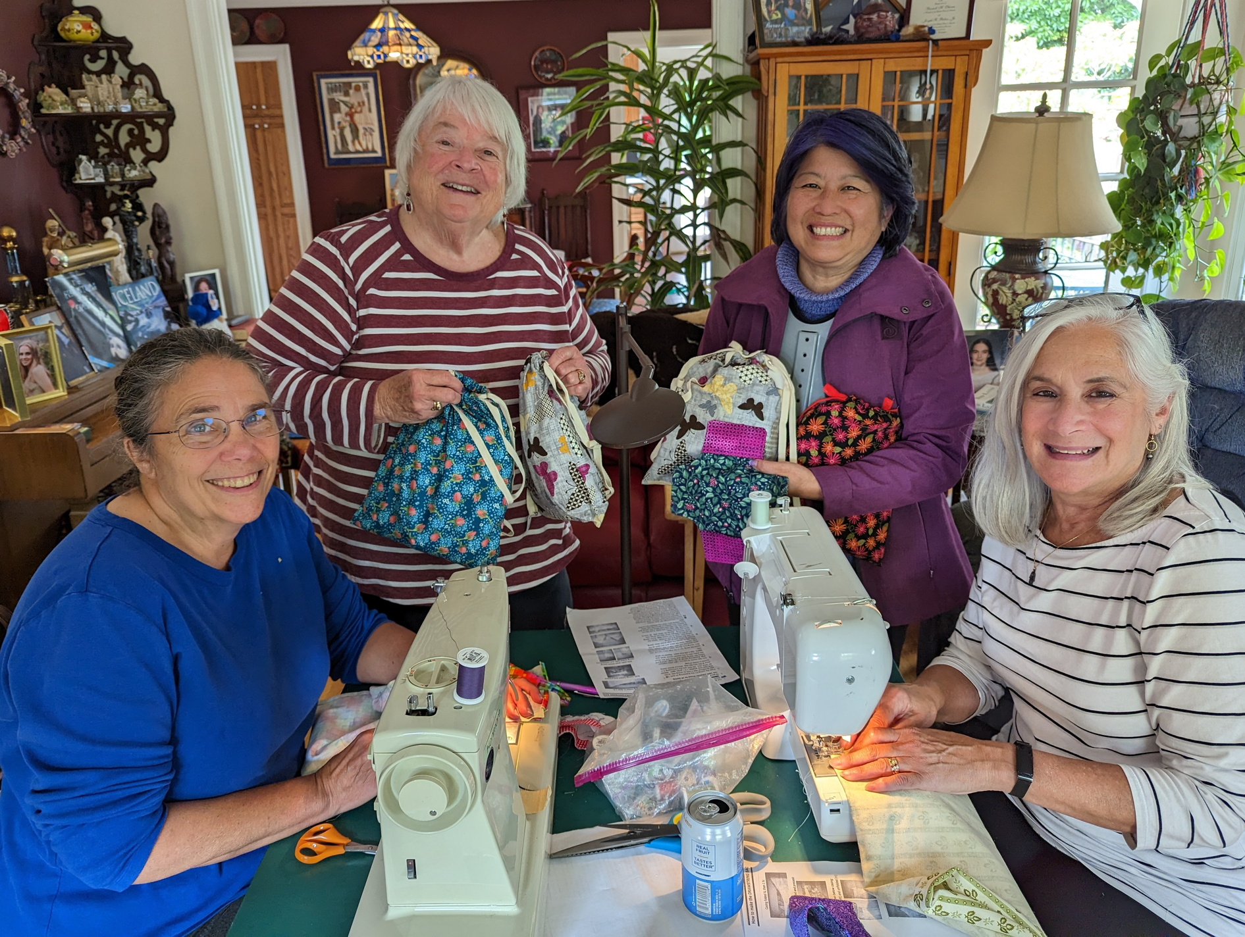
Pick a project that reaches many women and girls!
Soroptimist International of El Cerrito
(Founder Region)
Big Goal Accelerator Project 2022-2023
Menstrual Kits
2025 SIA REGION CONFERENCE
Notes:
Another great project to consider is providing menstrual products directly to low-income schools, foster care facilities, shelters, community colleges, and other organizations in your area. You may have to estimate the number of beneficiaries with this kind of project when you report it to SIA headquarters, but it’s an easy way to reach potentially thousands and to help those women and girls stay in school or attend work.
Of course, if your club has an existing project that you love doing but it doesn’t reach a large audience, such as a scholarship that you can give to one person per year, you do not have to stop doing it! I’d just encourage you to think outside the box about how you can reach more women and girls through that project. What can you take from what you learned today to expand that project?

Slide 21
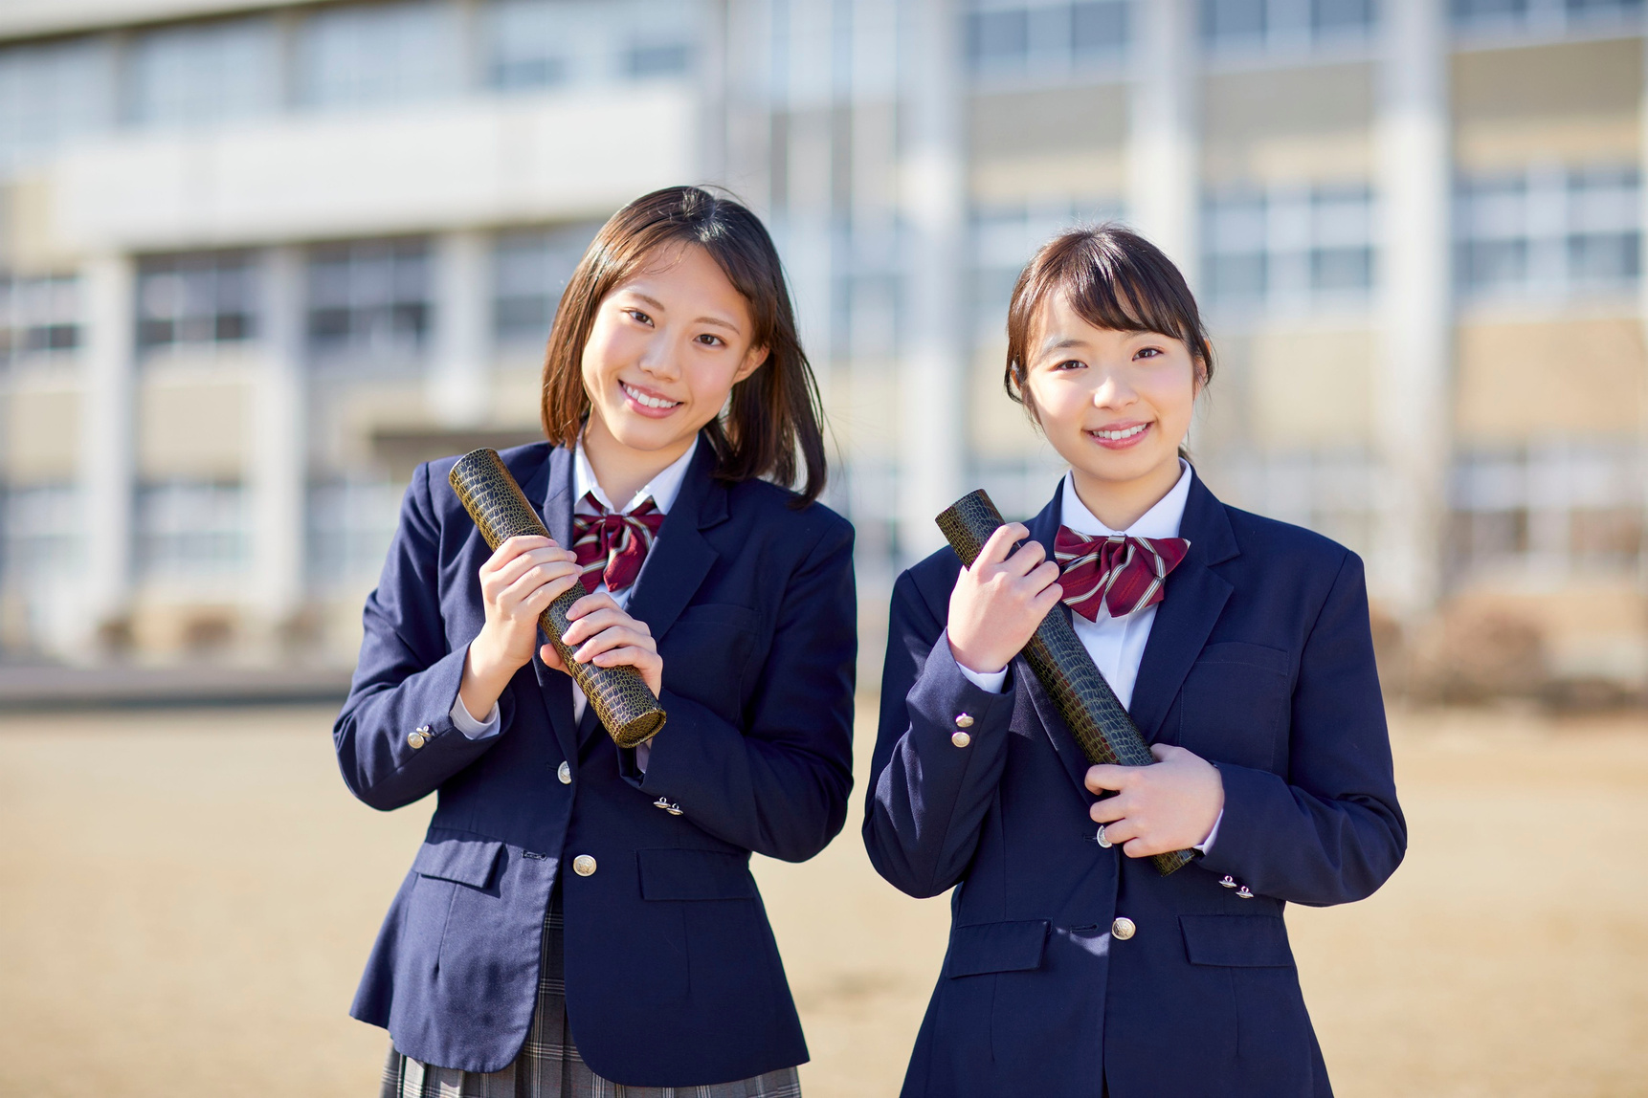
Add a new component to an existing project!
Soroptimist Niigata-Nishi
(Japan Higashi Region)
2 new scholarships for young adult women who lived in a group home
They turned an existing project into a Big Goal Accelerator Project!
2025 SIA REGION CONFERENCE
Notes:
Our example of a successful Big Goal Accelerator Project comes to us from the Japan Higashi Region. SI/Niigata-Nishi had an ongoing relationship with a children’s home for children in foster care where they had offered fun activities for younger children, like taking them on day trips to the aquarium. They wanted to add a component that would be eligible for the Big Goal. Since children typically must leave the group home after they graduate high school, they often have little to no support while in college and are also busy working to support themselves.
The club decided to provide two scholarships for the young adult women who had lived in this group home to provide higher education support, with one scholarship assisting those already enrolled in college and one to provide support for high school seniors with expenses to pay for their entrance exams for college. One recipient reported, “The scholarship was a great help to me as I have no support from my parents, and I have been offered a job after graduation next March.”
This is a great example of a club that has taken what they’re already doing and added a component that is eligible for the Big Goal.

Slide 22

BRAINSTORM
How can your club reach
MORE
women and girls?
  What program will you focus on?
  What tactics will you recommend?
Notes:
Now, I’d like everyone to take a moment and think about what you’d like to recommend to your club to do differently going forward to reach more women and girls. What program will you focus on, and what tactics will you recommend? Take a moment to think about it.

Slide 23


TIME TO SHARE!
  Share your thoughts and ideas
  Ask for help brainstorming!
Notes:
Now, I’d like you to turn to the person next to you and share your thoughts and ideas. Or ask that person for help brainstorming if you’re not sure!
(Give them a few minutes to discuss)

Slide 24

Who would like to share your ideas
or your neighbor’s suggestions?
2025 SIA REGION CONFERENCE
Notes:
Would anyone like to share what they’re planning to do, or something that your neighbor suggested?
(give them a few minutes to share and praise their insights)

Slide 25
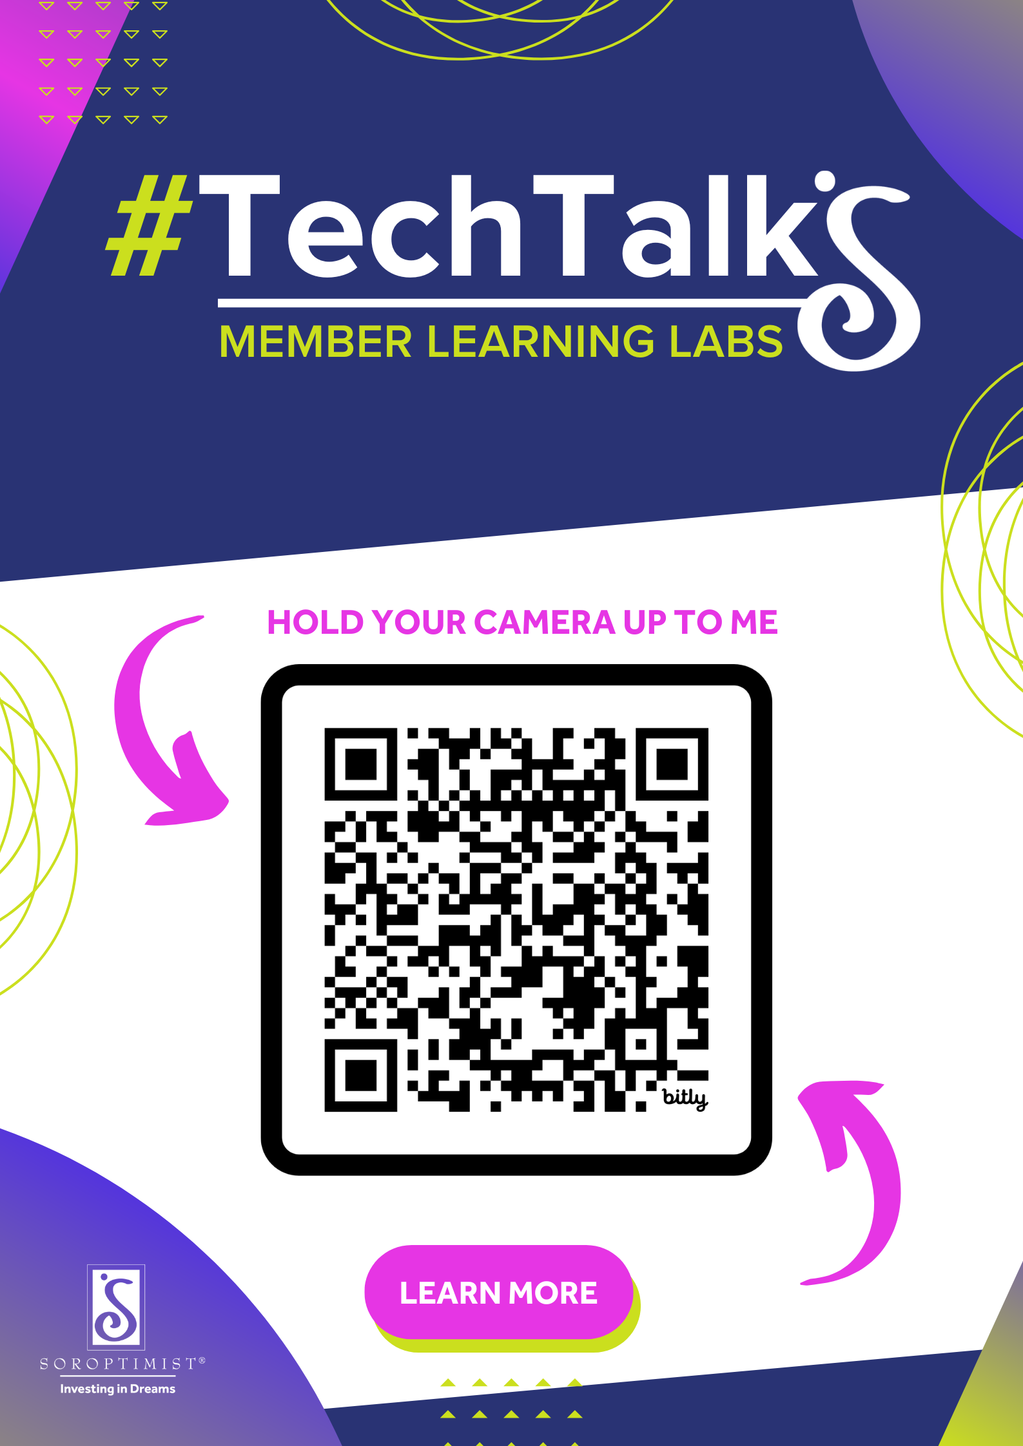
Techie Tools
Keep up with SIA’s Tech Transformation progress by visiting our
#TechTalks Learning Hub.
You’ll find FAQs, Video Demos and How-To Guides to support you as we navigate change and new technology together!
2025 SIA REGION CONFERENCE

Slide 26

THANK YOU!
Name
Your Title
Contact
2025 SIA REGION CONFERENCE
Notes:
Thank you everyone for sharing and participating today! I hope that you’re inspired to bring some tactical ideas back to your club.

