Slide 1


Dream It, Be It:
Career Support for Girls
®
Getting Started or
Expanding to Reach More Girls
PRESENTER NAME, PRESENTER TITLE
SOROPTIMIST INTERNATIONAL OF THE AMERICAS, INC
Notes:
Hello, I’m {NAME AND TITLE} and I’m excited to share the Impact pillar presentation with you today. Our focus is Dream It, Be It – and specifically, how to increase our impact by either getting new projects started or expanding existing ones to reach more girls.

Slide 2

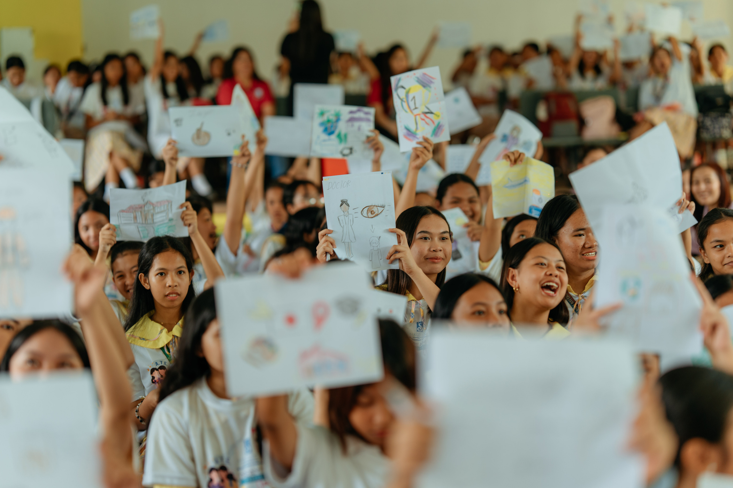

supported
162,000+ girls
since 2015
Notes:
Our signature Dream Program for girls, Dream It, Be It: Career Support for Girls® has supported over 162,000 girls since 2015. Girls have overwhelmingly told us that they feel empowered to live their dreams after participating.
Can I see a raise of hands from everyone in the room who has been part of a Dream It, Be It project?
(Acknowledge responses: thank those who raised their hands.)
Now keep your hands up if your club is currently planning and conducting a project for this club year.
(Note roughly how many hands stay up vs. come down — acknowledge both groups. For example: “So we have a good mix in the room — some clubs with active projects, and some who are just getting started. This session is for all of you.”)
Thank you for helping us make that impact and changing the lives of these girls!

Slide 3
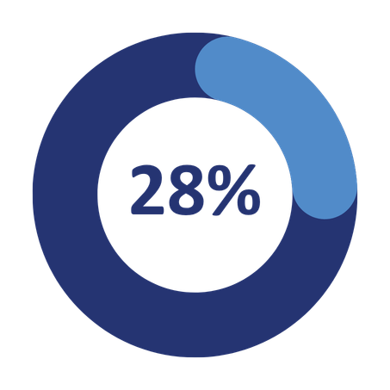
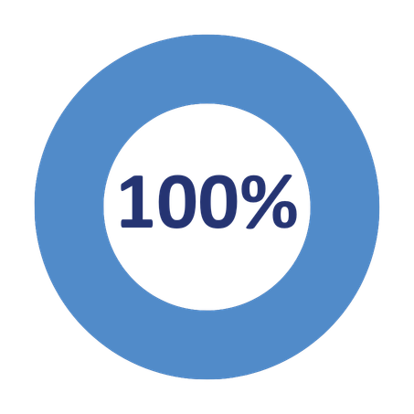

Moving Towards Our Big Goal!
25-26 Club Year
30-31 Club Year
Notes:
Dream It, Be It reaches girls at a critical moment – equipping them with career tools, connecting them with role models, and building a peer support network that helps them face challenges with confidence.
Its group format also makes it one of the most efficient ways for clubs to reach a large number of girls in one project, which is key to helping us meet our Big Goal of investing in the dreams of half a million women and girls through access to education by 2031. As of the end of the 25-26 club year, we are X% of the way there. Every girl your club reaches through Dream It, Be It moves that number forward.
Let’s talk about how to get started — or grow what you’re already doing.

Slide 4
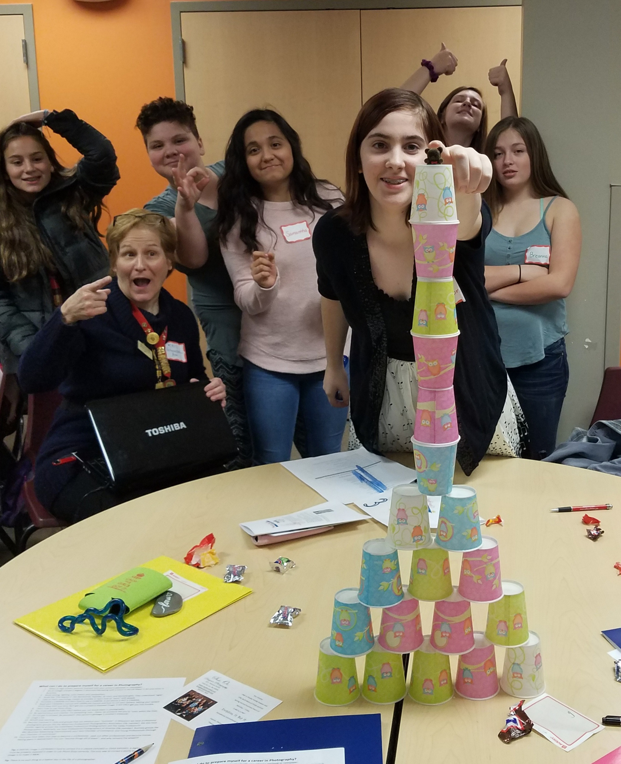
Today, we will:
Identify steps to launch a new Dream It, Be It project or expand an existing one.
Explore strategies for overcoming barriers that keep clubs from launching Dream It, Be It projects.
Identify tools and resources available to help clubs plan their projects and engage more girls.
Notes:
More specifically, we will identify steps to launch a new Dream It, Be It project or expand an existing one.
Explore strategies for overcoming barriers that keep clubs from launching Dream It, Be It projects.
Identify tools and resources available to help clubs plan their projects and engage more girls.

Slide 5

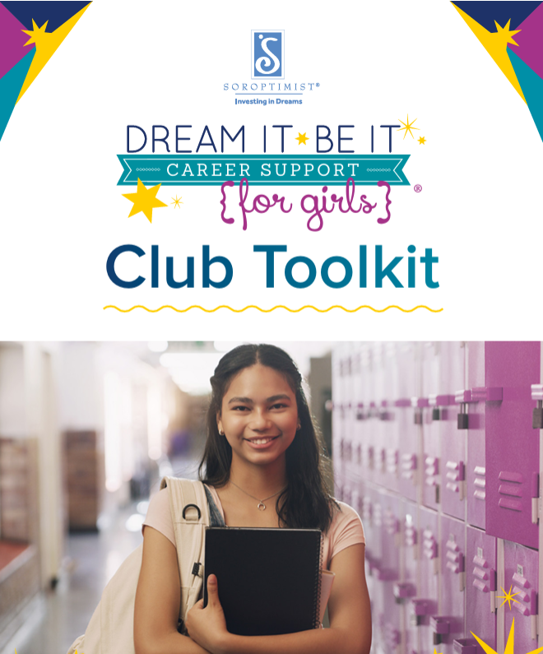
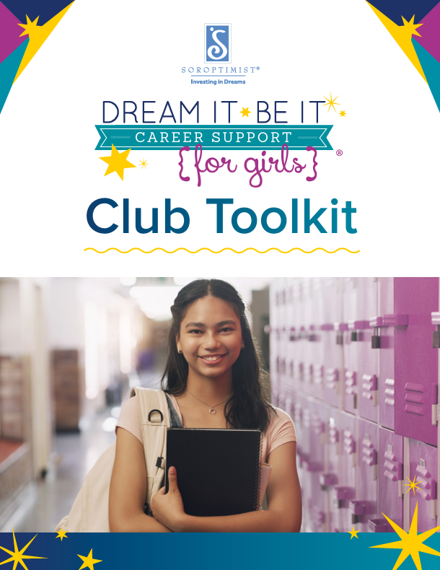
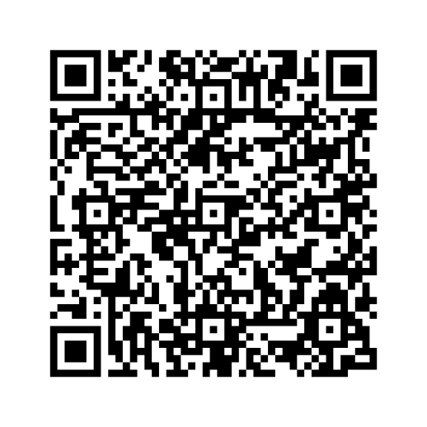
Start with the Toolkit!
Access more
Dream It, Be It resources on the
SIA Website!
Notes:
Whether new or experienced, the Dream It, Be It Club Toolkit is your go-to resource for everything you will need: Frequently Asked Questions, a Planning Guide, Curriculum Guide, Evaluation and Reporting Guide, and links to downloadable, customizable resources. It’s updated each club year, so be sure to use the most current version.
Scan the QR code to access the Toolkit directly on your device.
For anyone starting a new project, your first step is the Quick Start Guide. Download it, print it, or fill it out digitally. Let it keep you organized from day one.

Slide 6
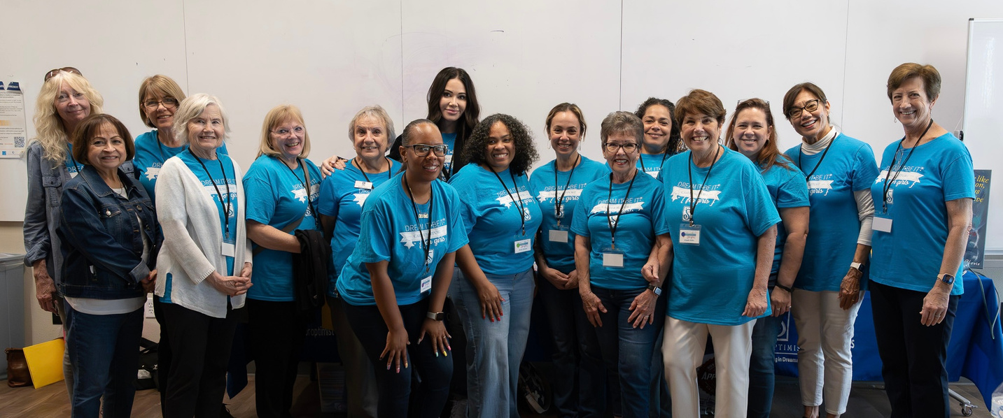
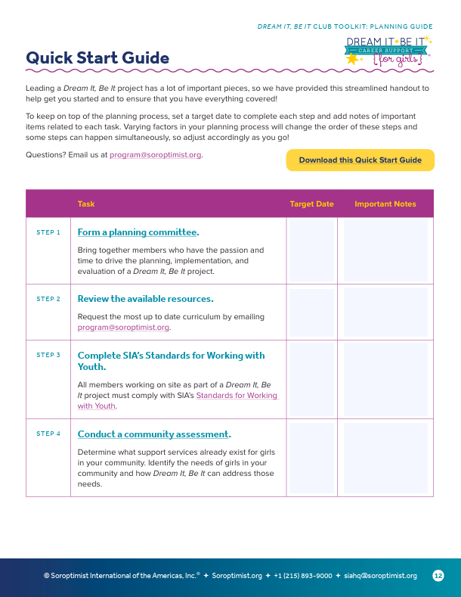

Form a Planning Committee
Notes:
The first suggested step is to form a planning committee. Which club members are interested in participating? Who has the capacity to serve as the Dream It, Be It club chair?
Member capacity is a common barrier to hosting a Dream It, Be It project, especially for smaller clubs. The good news is you don't need a large team. Start small. One session. One group of girls is enough to launch a Dream It, Be It project.
Think about whether there are members who haven't been involved yet who might be energized by this program.
Are there incentives you could offer to get members engaged? And don't limit your volunteer invitations to members - these projects also provide a powerful tool for engaging potential new members, local businesses, or other supporters as volunteers.

Slide 7
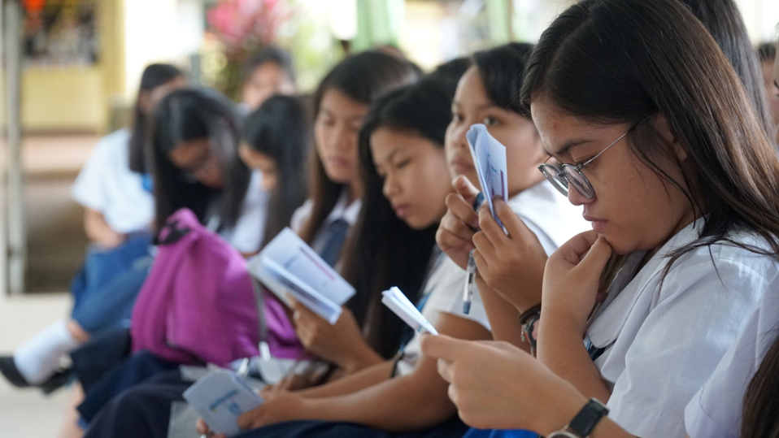
Understanding Your Community
Explore Existing Projects
Do a Community Assessment
Adapt the Curriculum
Email program@soroptimist.org for the curriculum
Notes:
Once you’re ready to move forward, the next step is understanding your community and finding partners.
Start with a community assessment. What do the girls in your community need? How can Dream It, Be It address those needs?
Explore what other projects already exist in your community for teenage girls. Dream It, Be It may be a good complement to an existing program.
We’ve also designed our curriculum to be adaptable. As long as you maintain the core message and objectives, you can adapt the content to fit your community’s needs and local culture.
Email program@soroptimist.org for access to the curriculum.
Is your club already working with teenage girls? You don’t have to start over – add Dream It, Be It components to what you’re already doing. A project only needs to include at least one session to officially count.

Slide 8
Finding Partners
Explore your social networks!
Notes:
Let’s talk about finding partners: start with who you already know. Explore your social networks. Youth organizations, libraries, and community centers are all great places to seek out partnerships. Your region chair can also connect you with clubs that have established partnerships and are happy to share how they got started.
Finding enough participants is another common barrier for first-time projects. Work with partner organizations to spread the word – teachers and counselors are your best recruiters.
Explore whether bringing the program into the school day could guarantee a built-in audience.
Connecting with school officials can sometimes be difficult, and getting your foot in the door to start a partnership might feel challenging. But start first with your club—consider if anyone in your club knows someone (or knows someone who knows someone!) who is connected to your local school or school district.
If you’re able to connect with an administrator or school guidance counselor who is interested but has reservations, do your best to understand their concerns. For example: Do they want to do Dream It, Be It but they don’t have transportation if girls stay after school? Can your club offer to provide bus passes or even pay for a bus driver to transport the girls home safely? Think outside the box!

Slide 9
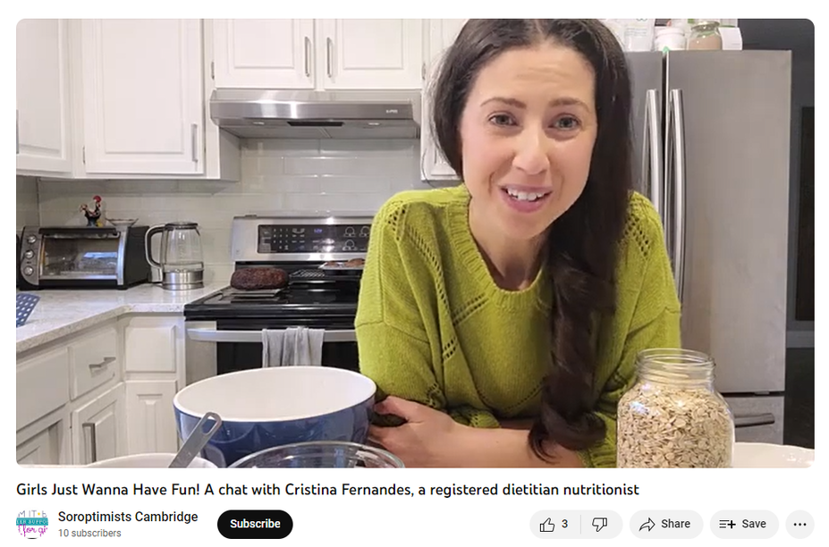
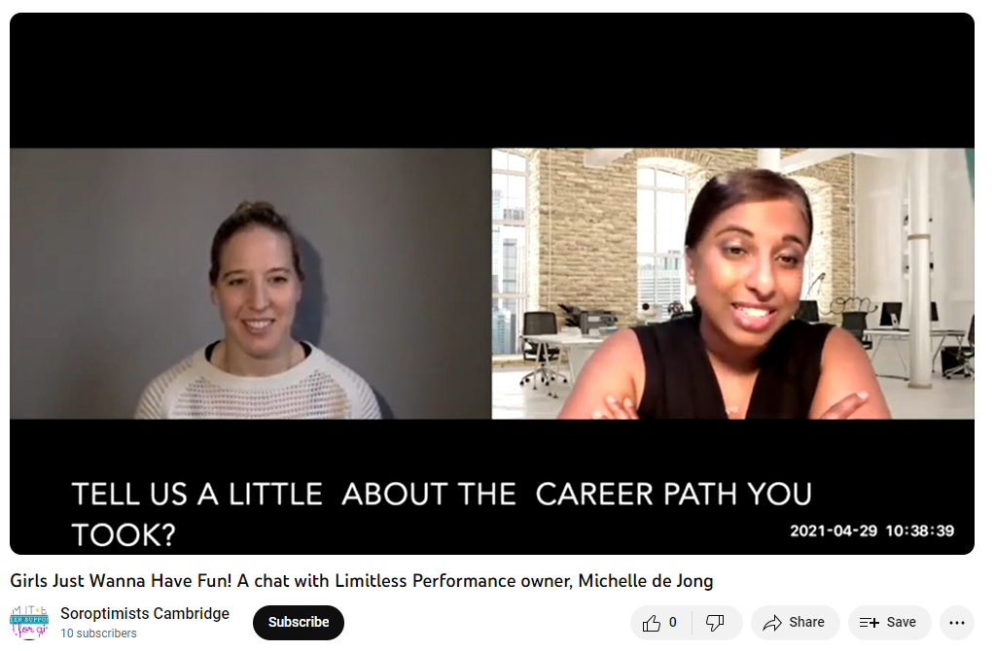
Consider Virtual or Hybrid
TELL US A LITTLE ABOUT THE CAREER PATH YOU TOOK?
Girls Just Wanna Have Fun! A chat with Cristina Fernandes, a registered dietitian nutrionist
Girls Just Wanna Have Fun! A chat with Limitless Performance owner, Michelle de Jong
Notes:
Consider using virtual and hybrid formats to make the program more accessible and scheduling more flexible for both girls and presenters. Virtual presenters and partnerships can bring in a wider range of career perspectives and opportunities for the participants. A virtual program may also allow you to conduct your program at a lower cost.

Slide 10
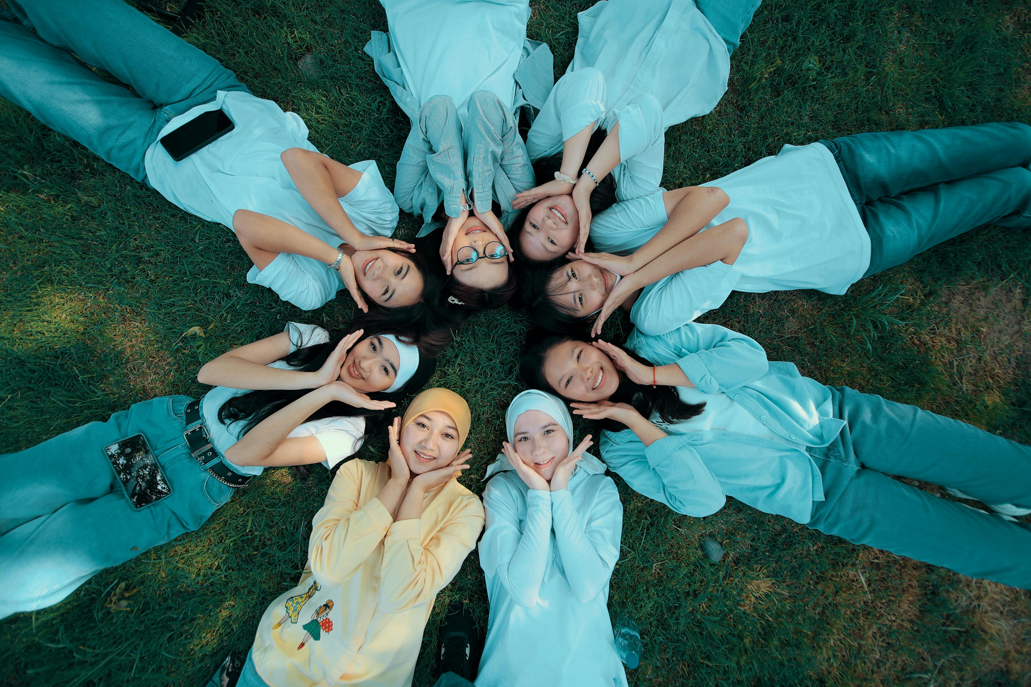
Sourcing Funds
Redirecting club funding
Explore donations, sponsorships, partnerships
Apply for a Soroptimist Club Grant
Applications due April 1
You can conduct a project with minimal expenses!
Notes:
Now let's talk about funding.
Check your club’s budget – can any funds be redirected? Explore local donations, sponsorships, and business partnerships. There are often organizations and companies that love to support these types of projects – we just need to ask!
Clubs are eligible to apply for a Soroptimist Club Grant to help start a new Dream It, Be It project or to add a new dimension to an existing project. Applications are due April 1 each year for projects conducted in the following club year.
With that said, funding shouldn't be what holds you back. As long as you have the curriculum and a group of girls, you can conduct a project with minimal expenses.

Slide 11

Support or Partner
with another club!
Collaboration = More Girls
Notes:
If this feels like a lot for your club right now – that’s ok. A great entry point is supporting another club’s project. Your Dream It, Be It region chair can help connect you with established projects in your region. Observe, support, participate. There’s no need to start from scratch or do it alone – there’s so much experience in this community to learn from.
If you feel like your club is ready for more, consider partnering with another club – sharing equal management of the project. Partnering with or supporting another club’s project is one of the simplest ways to expand your reach. Collaboration means more hands, more connections, and more girls reached.

Slide 12
Expanding Your Reach
Examine Past Projects
Ask Questions
Think Creatively
Consider Mentorship
  What worked well?
  Identify gaps
  New partners?
  Additional events?
  Accessibility?
  How can it be a more meaningful experience?
  Attendance incentives?
  Collaborate with other clubs!
Notes:
Now, for those of you who already have a Dream It, Be It project, let’s talk about expanding your reach.
Look at your past projects: What worked well? What did girls respond to most? Where were the gaps? That reflection is your roadmap.
Here are some questions to ask yourself as you plan for expansion:
• Could you bring the program to a new school or community partner? Maybe work with a new nonprofit in your community.
• Could you run the program more than once a year?
• Is your program fully accessible? Are you offering food, covering transportation, hosting at a location that's convenient for girls?
Think about engagement. The more meaningful the experience is, the more likely girls are to come back and bring others. Consider incentives for girls to bring a friend. Perhaps offer a gift-card or raffle ticket for a basket of items they might like for bringing a friend. Word of mouth is powerful. Think creatively about outreach.
You can also ask current participants for ideas on how they think you can increase the number of girls who participate. Create a planning committee of past participants to plan the next program. They are a fantastic resource and can help make sure the program is relevant, meaningful, and fun for their peers.
If your club has a strong, established project, consider mentoring a club that's just getting started or including them as a supporting or participating club. Collaboration means more volunteers to help increase the capacity of your project.

Slide 13


Moving Towards Our Big Goal!
2021 -2031
BIG GOAL
Together
SIA
Your Region
Each Other
x 500,000
empowered to live their dream
Notes:
The barriers are real, but so are the solutions. Clubs across SIA have faced these same challenges and found ways through them.
The resources exist, the support is here – from SIA, from your region, and from each other.
If your club has a strong, established project and you feel comfortable being a resource to other clubs, could you please stand?
(Pause to allow members to stand.)
Please take a look around. These are your people – your fellow Soroptimist who can offer you support with Dream It, Be It.
We are stronger together. Every project you launch or expand moves us closer to our Big Goal and puts more girls on a path to living their dreams. Thank you – let’s keep investing in dreams!

Slide 14
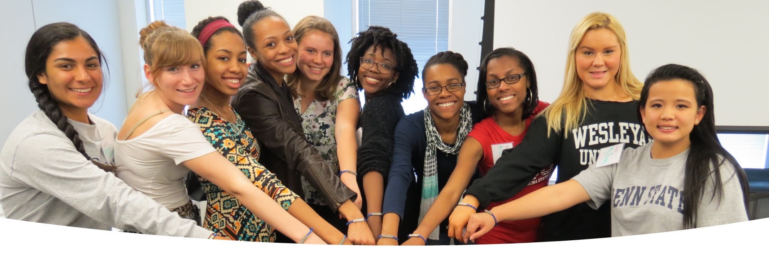
THANK YOU
Name
Your Title
Contact

