Slide 1



Big Goal Accelerator Projects
Eligibility Deep Dive
PRESENTER NAME, PRESENTER TITLE
SOROPTIMIST INTERNATIONAL OF THE AMERICAS, INC
Notes:
Hello, I’m (NAME AND TITLE) and I’m excited to share the Impact pillar presentation with you today.

Slide 2
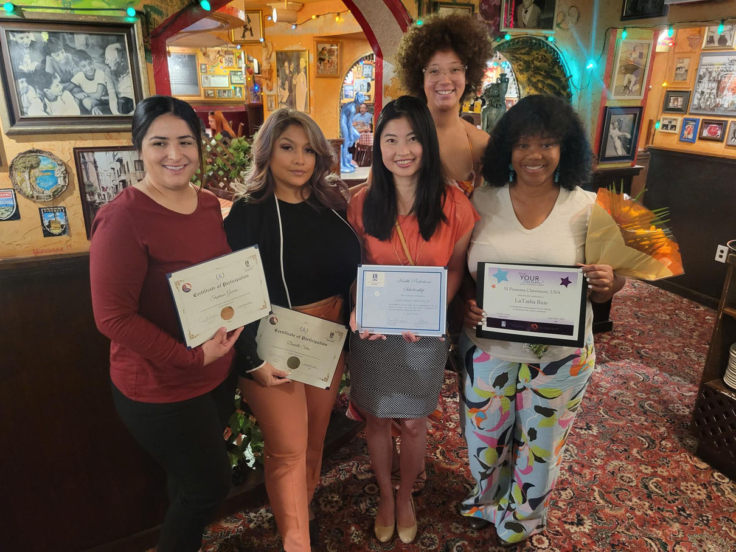


Learning Objectives
Understand the eligibility criteria for Big Goal Accelerator Projects.
Identify common challenges that often lead to project ineligibility.
Apply Big Goal Accelerator Project eligibility knowledge to develop new projects.
Notes:
Today we’ll review what counts as a Big Goal Accelerator Project and how your club can either start a new one or adapt a legacy project so it can count toward the Big Goal.

Slide 3



SIA BIG GOAL
Invest in the dreams of half a million women and girls through access to education.
x 500,000
empowered to live their dreams
Notes:
Across the SIA federation, we have one Big Goal that unites us: to invest in the dreams of half a million women and girls through access to education resulting in economic empowerment by 2031.

Slide 4






What is a Big Goal Accelerator Project?
Serves women and girls who face obstacles
Increases access to education/
economic empowerment
Soroptimist-led
Reported to SIA
Notes:
Our clubs are doing amazing things with Dream It, Be It and the Live Your Dream Awards. But we knew we wouldn’t reach the Big Goal through those programs alone. Many clubs already run local projects that increase access to education or economic empowerment. The SIA Board approved counting these as Big Goal Accelerator Projects—because they help accelerate us toward our Big Goal.
So, what is a Big Goal Accelerator Project?
Big Goal Accelerator Projects are club or region-led projects that directly advance SIA’s Big Goal.
Big Goal Accelerator Projects must:
Serve women and girls with obstacles to their success who are NOT part of the Dream Programs
Increase access to formal education or economic empowerment
Be Soroptimist-led
Be reported to SIA.
Let’s break this down.

Slide 5

Serve Women and Girls Facing Obstacles to Success
More than gender alone
Poverty
Teen parenting
Language barriers
Foster care
Substance use
Homelessness
Notes:
Big Goal Accelerator projects must serve women and girls facing obstacles to their success who are NOT part of the Dream Programs.
Obstacles must be more than gender alone—such as poverty, teen parenting, language barriers, foster care, substance use disorder, or homelessness.
Ineligible example: serving high school girls whose only obstacle is being “undecided about their future” is not a substantial barrier.

Slide 6



Why not the Dream Programs?
GOOD FAITH EFFORT
Try not to double count!
500,000
Individual women and girls
Notes:
So why do we want to make sure that the women and girls served in these projects are NOT part of the Dream Programs already?
The 2031 Big Goal is about reaching 500,000 unique women and girls and we are doing our best avoid counting the same individuals more than once.
If your club buys a Live Your Dream Award recipient a bus pass to help her get to work, that’s wonderful, but she’s already been counted under Live Your Dream Awards.
If your club is offering a large training on interview skills to an entire high school group of girls, we understand there may be some overlap if you partner with a local church to do a Dream It, Be It project in the same town. We’re not looking for perfection—just good faith efforts.

Slide 7
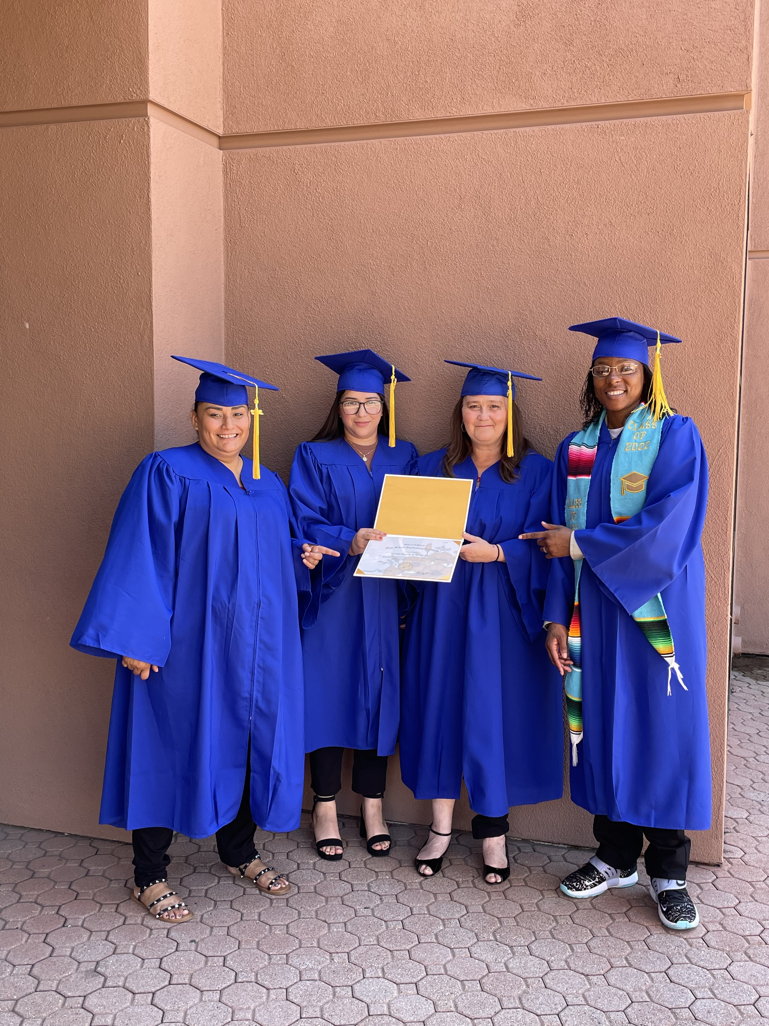
Access to Education or Economic Empowerment
Notes:
Next, let’s talk about the eligibility requirement that the project must increase access to formal education or economic empowerment.
The power of education is that it enables women to earn the kind of money that makes them economically empowered, changing the life of herself and her family, as well as her community. This is the key part of the Big Goal and why projects must connect directly to education or economic empowerment.

Slide 8


Access to Education
or Economic Empowerment
Formal Education = structured program (certificate, diploma, degree)
Education vs. EducationAL
EducationAL = awareness raising, but not increasing likelihood of a credential
Notes:
Let’s look at the difference between formal education and educationAL activities.
When we speak of education, our board of directors has defined this as a formal program that results in a credential. It refers to a structured program that helps women or girls obtain a certificate, diploma, or degree.
Examples include:
Vocational or technical training
High school completion or equivalency
College or university degrees
Workplace training that leads to better job opportunities
This type of education directly increases a woman’s or girl’s ability to get a job, earn more income, and build long-term stability.
Educational activities share information or raise awareness. They may be helpful and informative, but they do not usually lead to a certificate, degree, or job qualification.
These activities can inspire people, but they do not directly increase someone’s chance of finishing school, entering college, or qualifying for a job.

Slide 9


Soroptimist-led
Driven by members
Not a donation to another organization
Hands-on participation from club members
Notes:
Next, let’s talk about the eligibility requirement that the project must be Soroptimist-led.
Projects must be driven by your club—not just donations to another organization. If it’s a partnership, Soroptimists should be the ones driving the project with hands-on participation of club members.
Can clubs sponsor a child in another country? Typically, this is not eligible, because these are usually funds sent to another organization, so that organization is the one leading the project as they distribute the funds or provide the services.
However, if your club has a scholarship for a school in another country, this could be considered eligible if your club is in charge of reviewing applications, choosing the girl/woman with obstacles, and the scholarship funds are applied directly to her tuition. The scholarship efforts must be led by your club with the knowledge that it will increase her ability to continue her education.

Slide 10


Report to SIA
BY JUNE 30
Questions? Email program@soroptimist.org
Notes:
The final eligibility requirement is an easy one: Report your project to SIA!
Reports must be submitted through the online reporting form before June 30 of each club year. If you need any help with the form, or you know your club missed the deadline and you need help, please email program@soroptimist.org for assistance.

Slide 11





Not Eligible Projects
Awareness raising projects
General social empowerment
Dream Programs
work
Beautification projects
Supporting other orgs
Notes:
Now that you’re familiar with the eligibility requirements, let’s talk about what is NOT eligible.
Some examples:
Awareness raising projects
Beautification projects
General social empowerment
Supporting projects for other organizations, including monetary donations or grants
Dream Programs work
Planting trees with scouts to raise awareness of environmental issues? Sounds like great work! But unfortunately, not a Big Goal Accelerator Project.

Slide 12
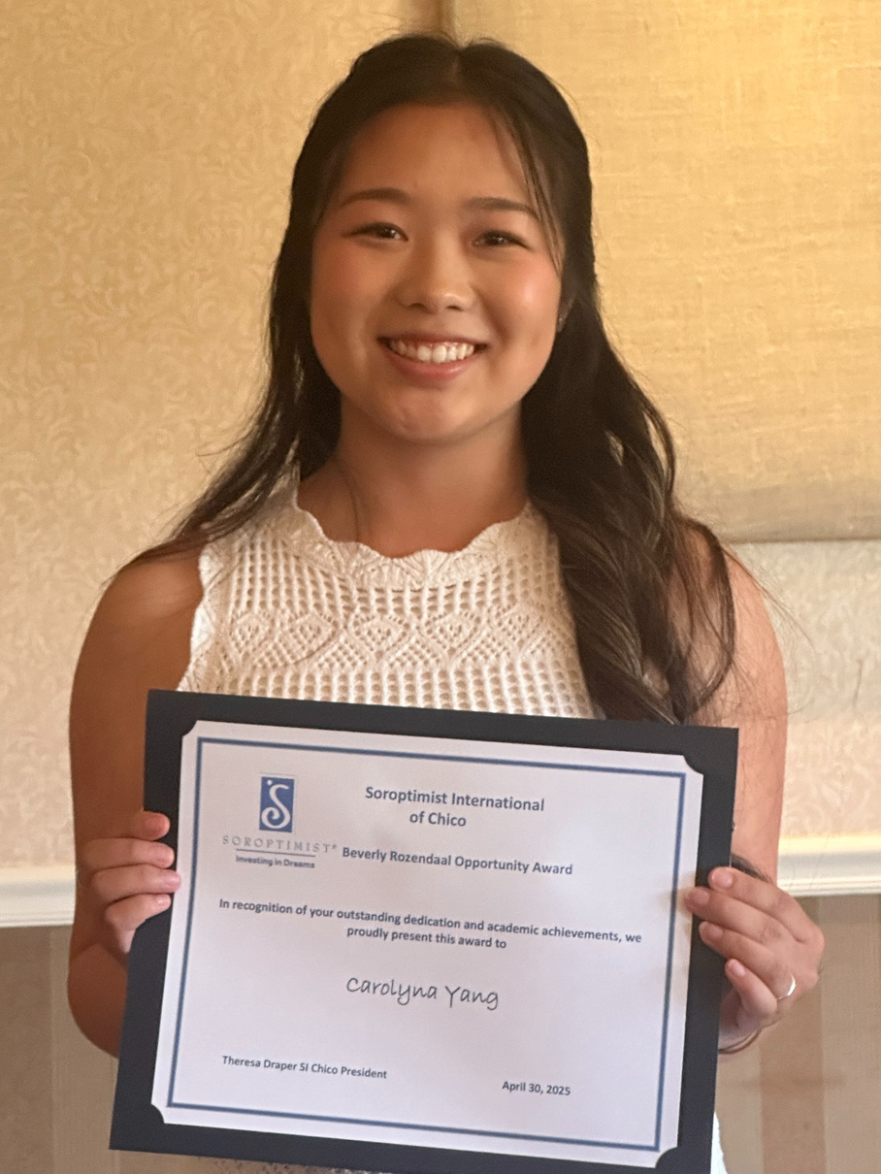
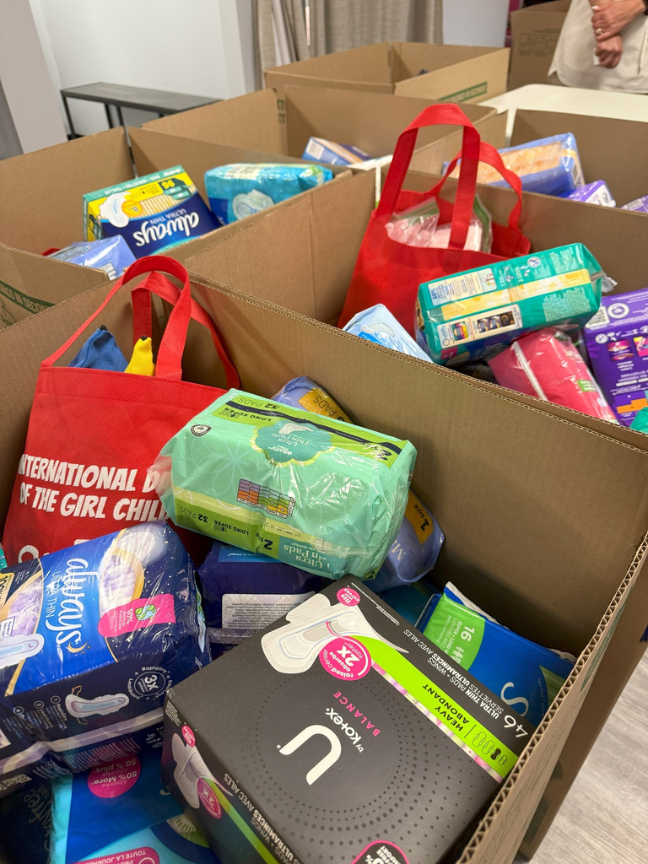

New Project?
Start with one of these projects!
Give a scholarship
or award
Remove obstacles
Provide a class
Notes:
Is your club interested in starting a Big Goal Accelerator Project and you want to help start one? Not quite sure where to begin? I’ve got some ideas for you!
There are three general categories of eligible Big Goal Accelerator projects:
Giving scholarships or awards to provide funding for college, technical/vocational school, advanced degrees.
Removing obstacles by providing necessary items for education like computers, internet, transportation; paying fees for college-preparation exams, college applications, entrance exams, or professional licensure.
Providing education or classes focused on job training, skills training, applying for financial aid/college, computer training, career mentorship
The easiest projects to get started are either scholarships or providing necessary items.

Slide 13

Give a SCHOLARSHIP or AWARD
Not eligible
Live Your Dream Award applicant?
Give a different scholarship!
Notes:
If your club gets strong Live Your Dream Award applicants who aren’t eligible—maybe they’re not the primary provider or don’t have dependent—you can support them through a different scholarship. Give it a different name and report it as a Big Goal Accelerator Project!

Slide 14


Remove Barriers
Bonus: Participate in May’s UpliftHER focus - Period Poverty!
  Menstrual products
  Licensure or testing fees
  Textbooks
  Gas cards
  Professional clothing or uniform pieces
Provide items required for education
or
work
Ask local agencies what women and girls need
Notes:
Another easy way to start a new project is to provide items required for education or work.
You could provide:
Licensure or testing fees
Textbooks
Gas cards or bus passes
Professional clothing or uniform pieces
Menstrual products
You could take a woman shopping when she graduates from a training program to help her get started with her professional wardrobe—both fun and impactful!
Ask local agencies what women and girls need to access education or work.

Slide 15





Consider Project Reach
Laptops for 2 girls
Skills workshop for 50 girls
Notes:
When planning new Big Goal Accelerator Projects, think about reach. If you can help two low-income girls with laptops or host a skills workshop for 50 low-income girls, the class has broader reach. But don’t abandon projects you love – just think creatively about how you can reach more women and girls through Big Goal-eligible projects.

Slide 16
Legacy Projects
Consider adapting projects to be eligible for our Big Goal
What’s missing?
Population
Focus
Soroptimist-led
Who are we serving?
Do they face obstacles?
Does this project
focus on increasing access to education or work?
Are Soroptimists
leading this project?
Notes:
Think about a legacy project that your club has that you believe has the potential to be adjusted to fit the parameters.
Ask yourself these questions:
(Population) Who are we serving? Do they face obstacles?
Change your project so it focuses on women and/or girls who have obstacles to their success.
For example, if your club gives a scholarship for high school girls focused on community service projects, add a requirement for financial need or consideration of another obstacle to continuing their education.
(Focus) Does this project focus on increasing access to education or work?
Change the focus to one of the eligible project areas: classes, scholarships, or providing items required for education.
For example, if your club refurbishes rooms at a domestic violence shelter ask the shelter staff if there is a way you can help meet the education needs of the women residing there—do they need laptops? Textbooks? Bus passes? Professional clothing? If the shelter is open to it, perhaps some members could provide workshops focused on interview skills or career mentorship.
(Soroptimist-led) Are Soroptimists leading it?
Make sure your project is member-driven and not fundraising for another organization’s mission.
If your project involves donating funds to another organization that provides education to girls living in poverty, consider diverting those funds into a scholarship that involves your club members in the selection process.

Slide 17

Self-defense and trafficking awareness classes to low-income girls
WHAT TO CHANGE?
Notes:
Let’s explore some other examples:
SI/Anytown is currently providing classes to girls at their local low-income high school that are focused on self-defense and raising awareness of trafficking.
How could they make this project eligible?
(take suggestions from the audience)
They could add components to the classes that are more focused on education and economic empowerment, including job skills training, interview skills, or assistance applying for financial aid.

Slide 18

Donation to local agency providing GED classes
WHAT TO CHANGE?
DONATE
Notes:
SI/Anytown sends a generous donation to their local agency that provides GED classes.
How could they make that eligible?
(take suggestions from the audience)
Consider paying for the GED testing fees or application fees for college instead. Or offer other scholarship support.

Slide 19

Laptops for boys and girls as an award for community service
WHAT TO CHANGE?
Notes:
SI/Anytown has been providing laptops to boys and girls as an award for amazing community service projects.
How could they make that eligible?
(take suggestions from the audience)
They would need to change the focus to women or girls with obstacles and possibly add a requirement for financial aid or other obstacles to their selection process.

Slide 20


Thank You!
Notes:
Before we wrap up, I’d like to encourage everyone here to reflect on two questions:
Are there any current projects your club could adapt so they meet Big Goal Accelerator eligibility criteria?
What’s one new project idea your club could launch this year that would qualify as a Big Goal Accelerator Project?
(Time permitting, ask for some volunteers to share.)
Thank you for your commitment to women and girls and to our shared Big Goal. I hope you leave with ideas you can take back to your club—whether that’s starting something new or adapting something you already love to count toward our Big Goal.

