Slide 1


SOROPTIMIST INTERNATIONAL OF THE AMERICAS, INC.®
STRONGER TOGETHER
Building the
Soroptimist Brand
SIA | FALL 2025
Notes:
Hi everyone, and welcome to Stronger Together: Building the Soroptimist Brand. Today, we’ll talk about how consistent branding helps all of us amplify Soroptimist’s impact and build stronger connections in our communities.

Slide 2
A brand is not just a logo—it’s how people recognize, trust and connect with you.
SIA | FALL 2025 | STRONGER TOGETHER
Notes:
Branding is more than using the right logo. It’s about creating a consistent look, feel and message that helps people instantly recognize who we are and what we stand for. When clubs use the same logo, colors and key messages, it creates trust. It also strengthens our visibility, so people know Soroptimist is a global force, not just a local group.

Slide 3
WHY IT MATTERS FOR CLUBS
Builds trust and recognition
Shows we’re part of something bigger
Helps attract members, donors and partners
Makes our impact visible and shareable
SIA | FALL 2025 | Presentation Title Here
SIA | FALL 2025 | STRONGER TOGETHER
Notes:
For clubs, staying on brand helps in many ways: it builds public trust, makes your work look polished and professional, and reinforces that your club is part of a powerful, global movement. When we all speak with one voice and show up consistently, we become impossible to ignore—in the best way.

Slide 4
SIA BRAND ASSETS
Official “S” logo with “Investing in Dreams” tagline
Dream Program and mission-focused messaging
Customizable templates
Brand fonts and color palette
Editorial style guide and messaging toolkit
SIA | FALL 2025 | STRONGER TOGETHER
Notes:
In addition to the logo, SIA also provides guidance on our brand messaging, fonts and color palette. Being consistent across the board helps all materials—from flyers to social media graphics—feel cohesive and immediately recognizable as Soroptimist.

Slide 5
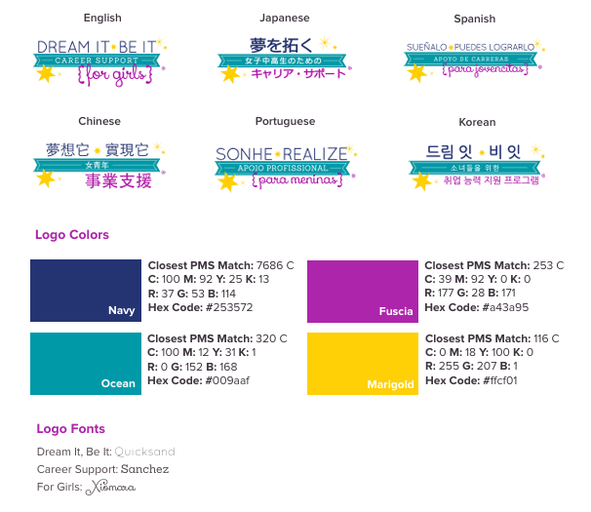
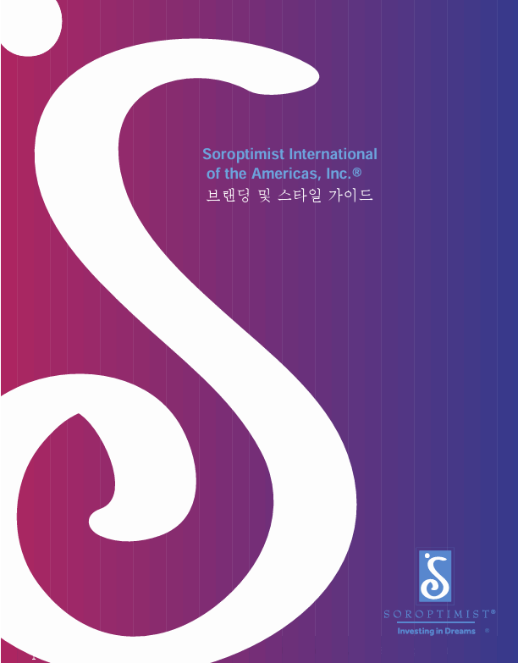
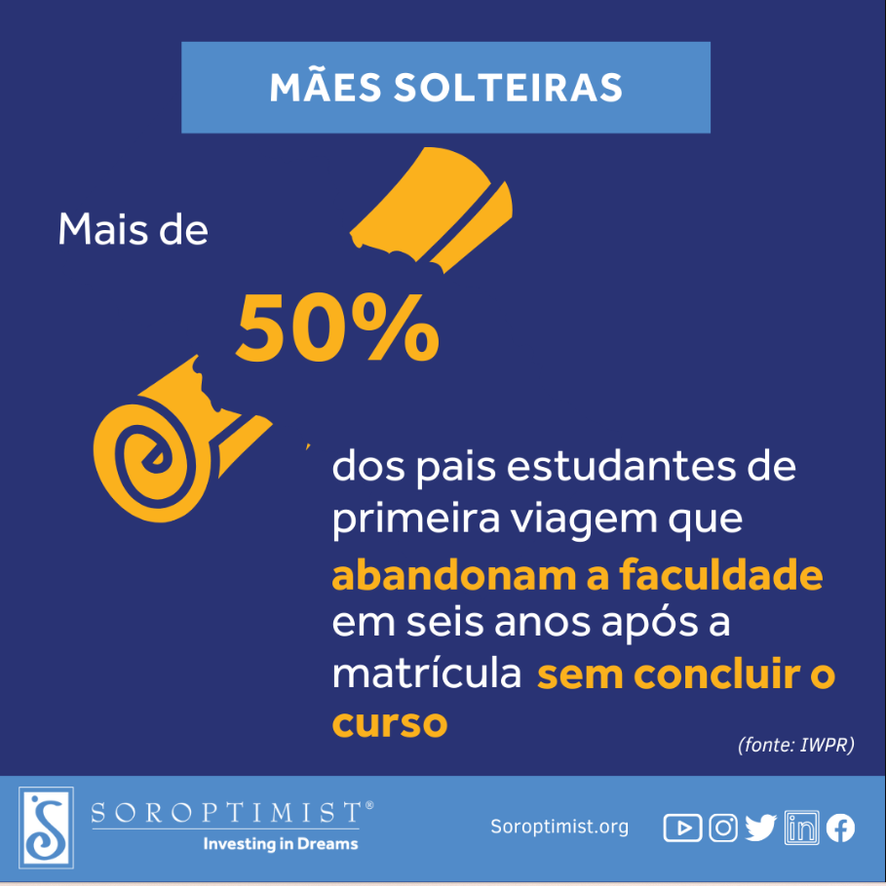
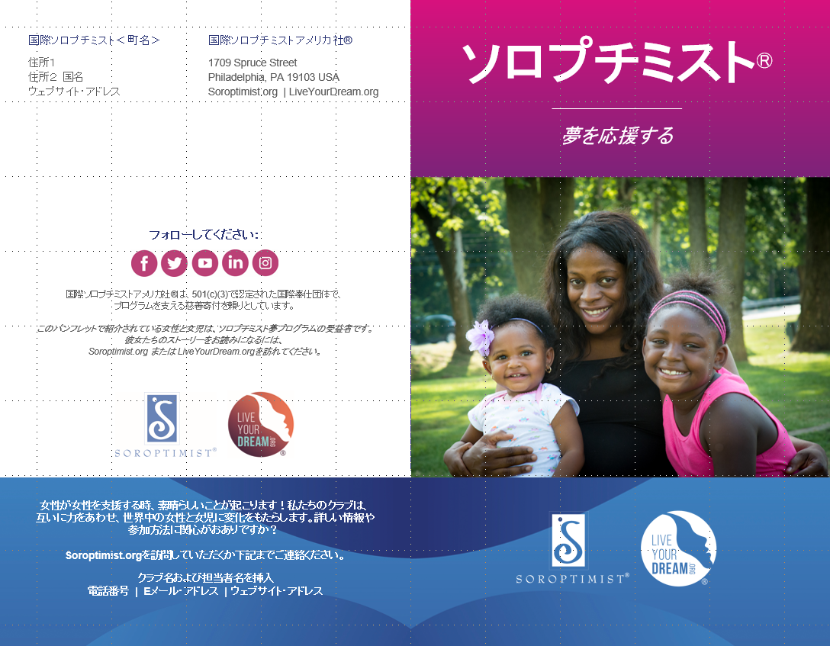
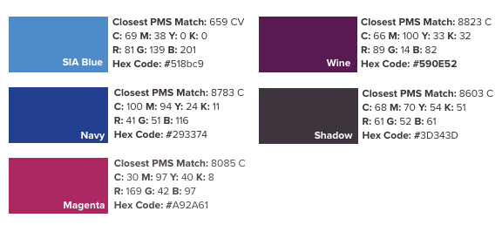
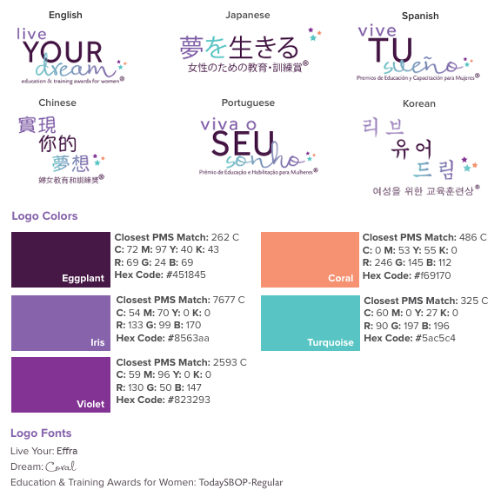
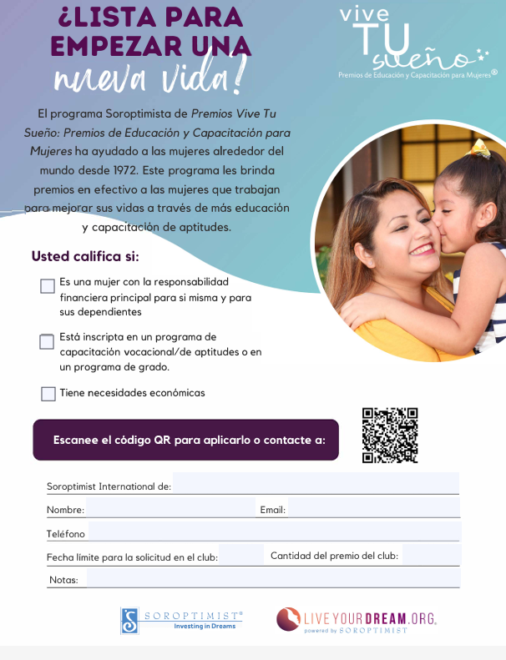
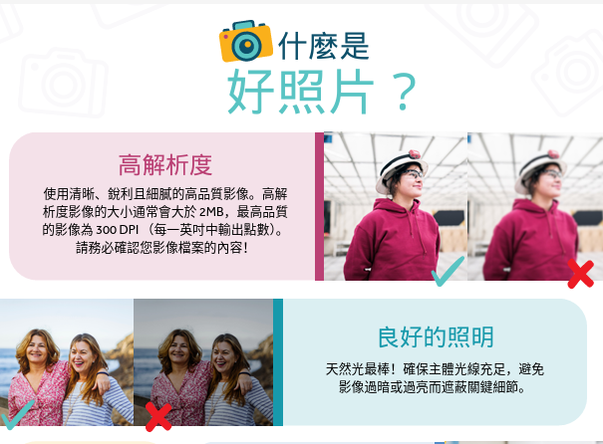
FONTS, COLORS, TEMPLATES!
Notes:
The fonts and colors are built into our downloadable templates, but you can also access the full palette, brand messaging and guidelines on the Recognition & Branding section of the website if you’re creating something new.

Slide 6

COMMON PITFALLS TO AVOID
Using outdated logos (like “Best for Women” or SI emblem)
Creating new/unapproved logos
Skipping the brand messaging in club materials
Mixing visual styles or tones
SIA | FALL 2025 | STRONGER TOGETHER
Notes:
Sometimes your club can fall off-brand without realizing it. If your banner, website or social media still shows the old “Best for Women” tagline or the SI emblem, it’s time for an update. Creating new or custom logos might seem creative, but it can confuse our audience and weaken our unified identity. Even great events or stories lose impact if they don’t clearly connect back to our mission or Dream Programs. And when materials use different styles, colors or tones, it creates an inconsistent look that doesn’t reflect the strength of our organization.

Slide 7
It’s impossible to build a global brand empire when all 1,100 clubs each do their own thing!
SIA | FALL 2025 | STRONGER TOGETHER
Notes:
Remember: it’s impossible to build a global brand empire when all 1,100 clubs each do their own thing!

Slide 8

“IS IT ON BRAND?” CHECKLIST
Are we using the current “S” logo with “Investing in Dreams”?
Does our content reference our mission or Dream Programs?
Is the tone clear, hopeful and aligned with SIA messaging?
Are we using the right fonts, colors and templates?
Can people easily tell this is from Soroptimist?
Save this list to use with your club materials!
SIA | FALL 2025 | STRONGER TOGETHER
Notes:
Let’s do a quick activity. Think of a flyer, social media post or newsletter your club has shared recently. You can pull it up on your phone or just picture it in your mind.
Now, take a moment to write down—or take a picture of—our “Is it on Brand?” Checklist. These five quick questions help ensure your content is aligned before sharing it with the public. Does the piece you thought of pass the vibe check?
Are we using the current “S” logo with “Investing in Dreams”?
Does our content reference our mission or Dream Programs?
Is the tone clear, hopeful and aligned with SIA messaging?
Are we using the right fonts, colors and templates?
Can people easily tell this is from Soroptimist?
[Pause for a moment to let attendees write down or take a picture.]
Use this checklist with your club’s materials throughout the year. It’s a simple way to keep our message consistent and impactful.

Slide 9
What’s one thing your club is doing well when it comes to branding?
What’s one thing your club could improve?
SIA | FALL 2025 | STRONGER TOGETHER
Notes:
Would anyone like to share something your club does well when it comes to branding? Or what about something your club could improve based on the checklist?
[Take 1–2 responses.]
Great! Thank you for sharing. Even small improvements—like updating a logo or aligning a flyer with the mission—can make a big difference.

Slide 10
WHEN CLUBS STAY ON BRAND
Known for education and empowerment of women and girls
Build trust and credibility
Tell a unified story of impact
Grow our visibility, support and membership
SIA | FALL 2025 | STRONGER TOGETHER
Notes:
In short: branding helps our local efforts shine as part of something bigger. It builds trust, inspires action and makes Soroptimist known for who we are—champions of the education and empowerment of women and girls.

Slide 11
READY TO STRENGTHEN SIA BRAND?
Download branding tools
Use the checklist regularly
Encourage your club to update materials
Reach out if you need help!
SIA | FALL 2025 | STRONGER TOGETHER
Notes:
So, what can you do next to strengthen our brand? Visit the Recognition & Branding section of the SIA website to download branding tools. Use the brand checklist before sharing publicity materials. Encourage your club to make any necessary updates, and don’t hesitate to reach out if you need support.

Slide 12

You’re helping to build a stronger, more visible Soroptimist.
THANK YOU!
https://bit.ly/SIA-Branding-Tools
SIA | FALL 2025 | STRONGER TOGETHER
Notes:
Thanks so much for being here. The link to the Recognition & Branding section of our website is on the screen so you can explore more tools anytime.
Your commitment to branding helps make Soroptimist stronger, more visible and more impactful. Let’s keep showing the world what we can do—together!

