Slide 1

BEYOND TRADITIONAL OUTREACH
Creative Ways to Promote Your Club in 2026-2027
2026 Fall Meeting
SOROPTIMIST INTERNATIONAL OF THE AMERICAS, INC

Slide 2
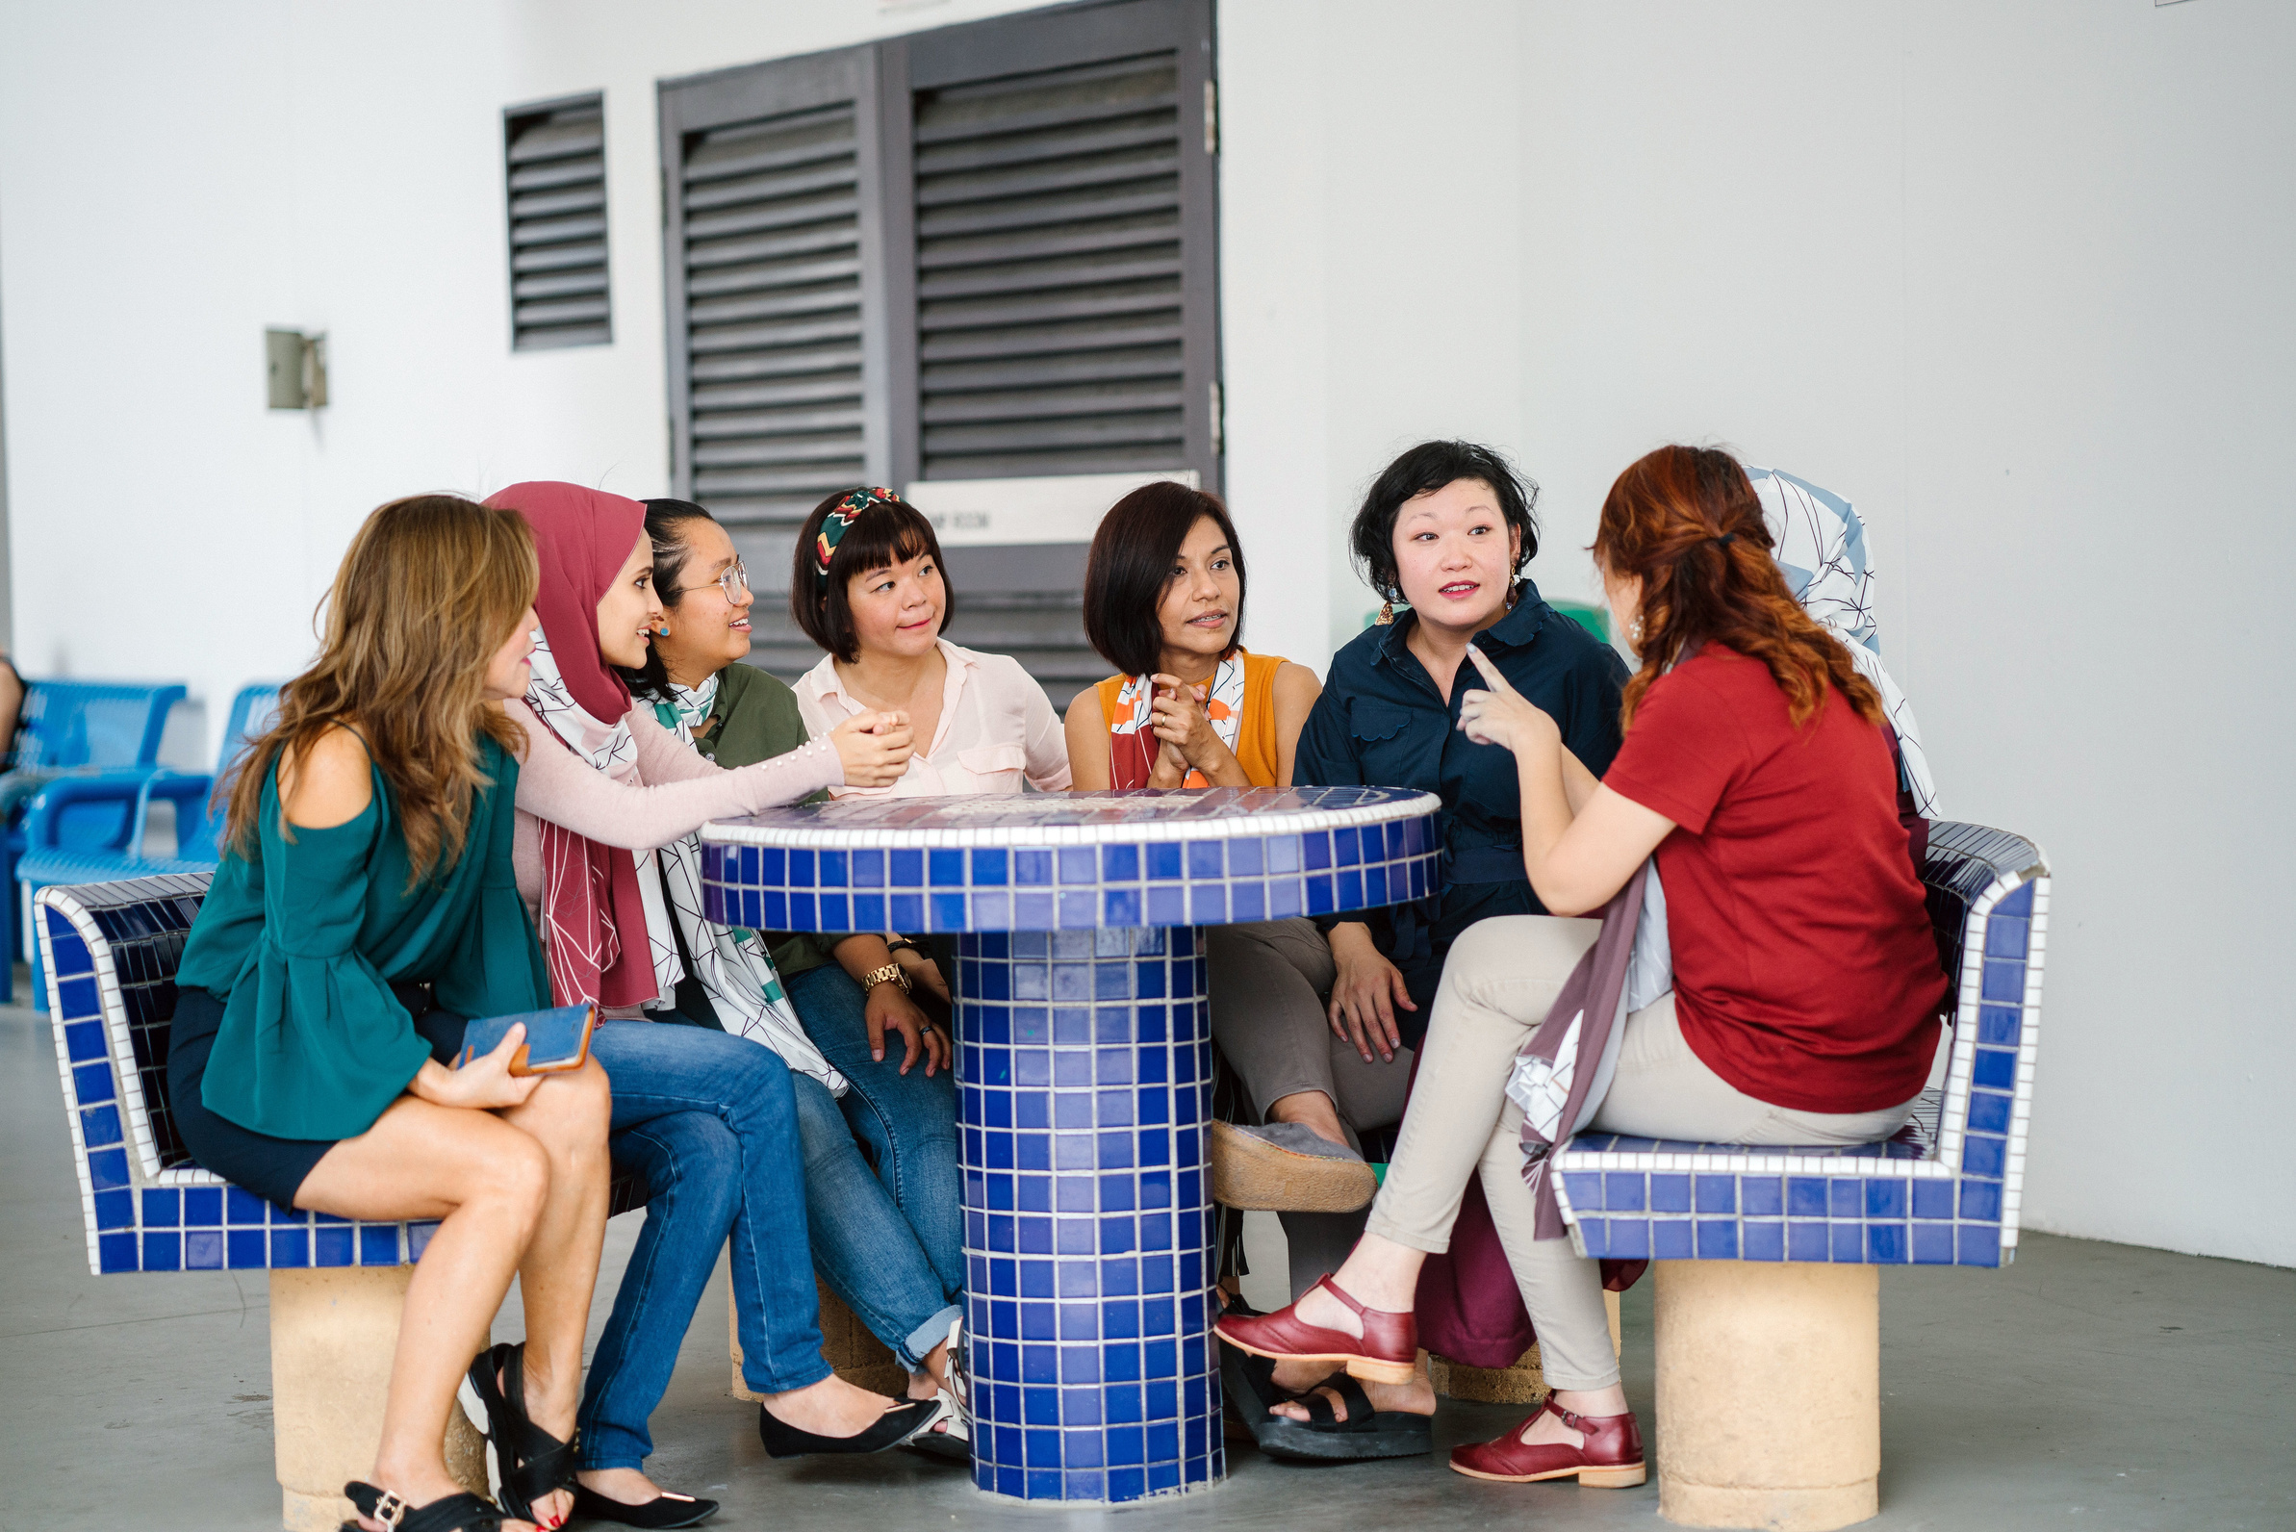

Let’s Learn From
Each Other!
Share ideas
Inspire one another
Build a collection of promotional ideas
Notes:
Welcome, everyone!
Today we're going to do something a little different. Instead of a traditional presentation, this is going to be an idea exchange.
Every club is unique. You serve different communities, try different approaches, and every club has discovered something worth sharing. You may have found a promotional idea that worked really well, or you may have seen another organization do something that made you think, "We could do something like that."
By sharing those ideas today, we can learn from one another and build a collection of practical ideas that clubs across our federation can use.
How it will work: I'm going to ask a few questions about how your club promotes itself and connects with your community. As you share your ideas, I'll jot them down and send them to the Marketing & Communications Team at SIA Headquarters. They'll combine ideas from all participating regions, and some may be featured on the SIA blog or inspire future resources for clubs.
So don't worry about having the "perfect" answer. Today's goal isn't to find the best idea—it's to collect as many ideas as we can. You never know which suggestion might inspire another club's next great PR success.

Slide 3



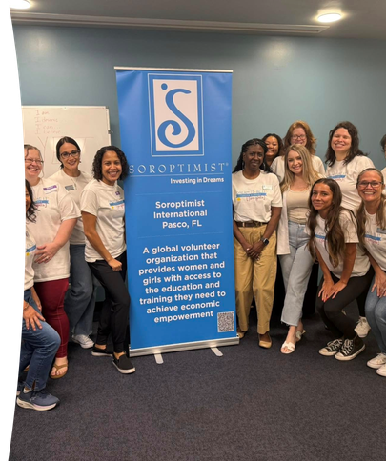
We Often Use...
Social Media
Local Media
Flyers
Community Events
What other possibilities are there?
Notes:
When we think about promoting our clubs, many of us naturally think about Facebook, local newspapers, flyers, or community events.
Those are all valuable tools and should absolutely remain part of our communications toolbox.
But communities are adapting to the world around them. Technology is evolving. And the ways people find out about new organizations are changing, too.
That gives us an opportunity to think a little differently.
Maybe it's partnering with another organization instead of hosting an event on your own.
Maybe it's creating a short video instead of posting another photo album on social media.
Or maybe it's sharing the story of one woman or girl whose life was changed because of your club's fundraiser, instead of simply reporting how many people attended your fundraising event.
Sometimes the biggest impact comes from telling a familiar story in a new way or reaching people in a place you hadn't considered before.
And that's hopefully what we're going to figure out together today.

Slide 4


Rapid-Fire Idea Exchange
One idea. One sentence.
What’s one promotional idea that worked well for your club?
What's something you've seen another organization do that could work for your club?
What’s one new promotional idea your club would like to try?
Notes:
Let’s begin! I'm going to ask three questions. For each question, simply raise your hand and share one idea in one sentence. We aren't looking for long explanations—we're trying to collect as many ideas as possible.
I'll pause briefly after each response so I can capture the key idea, and then we'll keep the conversation moving.
Are you ready?
Question 1
What's one promotional idea that worked well for your club? Something you did that was successful.
(Allow a few responses.)
Wonderful! Look how many ideas we've already collected.
Question 2
What's something you've seen another NGO, school, business, or community organization do that could work for your club?
(Again, collect several responses.)
Great! Some of the best ideas come from simply noticing what others are doing and adapting it to fit our own communities and club goals.
Question 3
What's one new promotional idea your club would like to try this year?
Try to think of something that was not already mentioned today. It could be something simple or something ambitious. If it’s an idea you think could improve your club’s visibility, we'd love to hear it!
(Collect several responses.)

Slide 5




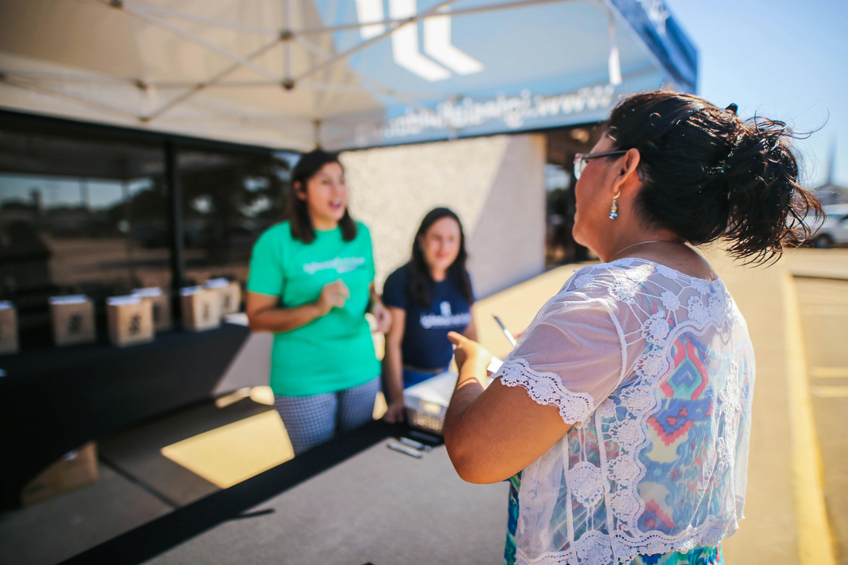
Every
  Story
  Partnership
  Media Mention
  Social Post
Community Event
...helps more people discover Soroptimist!
Notes:
Great job, everyone! Look at what we've accomplished—together, we've created a great list of ideas, which I hope are helpful and productive.
Show of hands—how many of you heard at least one idea today that you'd like to take back and share with your club?
(Pause and acknowledge the responses.)
That's wonderful—and that's exactly what today's conversation was all about.
Everything we've talked about today comes back to one important goal: helping more people learn who we are and the difference Soroptimists make in our communities.
Every story you share...
Every partnership you build...
Every media mention...
Every social media post...
Every community event...
...helps raise awareness of your club and the incredible work you're doing to advance women's and girls' economic empowerment through access to education.
When more people know who we are and understand our mission, more people want to partner with us, support our projects, volunteer alongside us, and become members.
And with the recent launch of our Driven by Dreams membership campaign, this is a great time to think about how increased visibility can support your club’s membership efforts. Every time you promote your club and show the impact Soroptimists are making, you’re giving potential members another opportunity to discover who we are—and imagine themselves as part of it.
Sometimes the biggest results don't come from doing something extraordinary—they come from telling your story in a new way, trying something different, or reaching one new audience.

Slide 6

Together, We Grow Our Impact!
Notes:
Thank you all for your enthusiasm and willingness to share your ideas today.
One of the greatest strengths of Soroptimist is that we learn from one another. Every club has experiences, successes, and creative ideas that can inspire another club. Today, we've seen just how much we can accomplish when we share those ideas.
I'll compile the wonderful ideas shared today and send them to the Marketing & Communications Team at SIA Headquarters. They'll combine ideas from all the regions, and some may be featured on the SIA blog or help shape future resources for clubs across the federation.
I hope that, as these ideas are shared back with clubs throughout our federation, you'll discover even more ways to increase your club's visibility, strengthen your community presence, and inspire others to learn more about Soroptimist.
Thank you again for your participation, your creativity, and your willingness to learn from one another. I hope you leave today with renewed inspiration—and at least one new idea to help your club tell its story, expand its impact, and help even more women and girls live their dreams.

