Slide 1




2026-2028 Governors Orientation
Incheon, South Korea
July 22, 2026
SOROPTIMIST INTERNATIONAL OF THE AMERICAS, INC

Slide 2
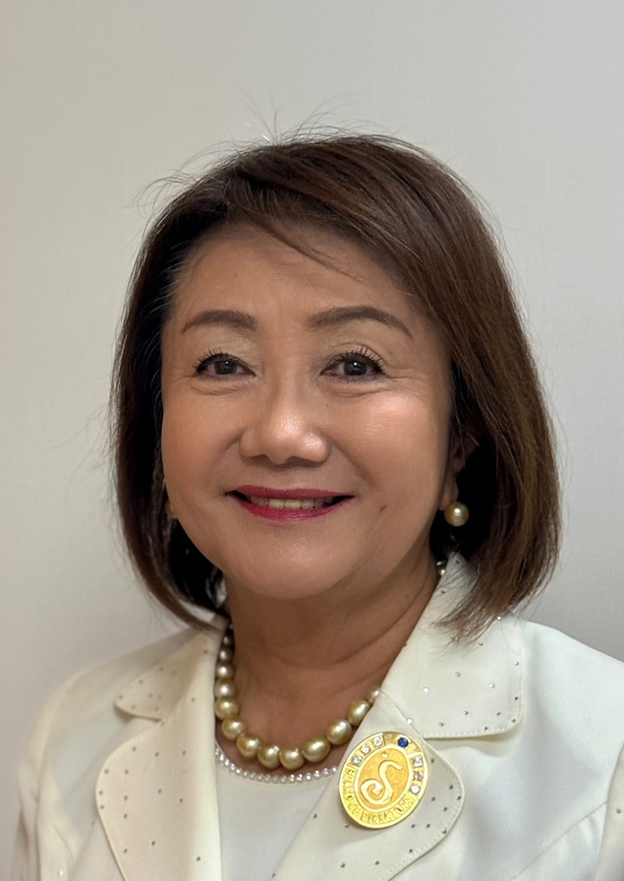

Welcome
환영합니다!
Bienvenidas
Bem-vindas
ようこそ
歡迎
Madoka Ushio
2026-2027 SIA President
Notes:
Hello! Welcome to the 2026-2028 Governors Orientation.
I am your 2026-2027 SIA President Madoka Ushio. Good morning! It’s so wonderful to see you.
And welcome to beautiful Incheon, South Korea! I hope you all had a good night’s rest and are ready for the eventful and inspirational days ahead of us.

Slide 3


Our Big Goal
To invest in the dreams of half a million women and girls through access to education by 2031.
Notes:
Thank you for your dedication and commitment to serving in this important leadership role. You make a difference in transforming the lives of women and girls around the world.
Each day we move closer to reaching our Big Goal of helping half a million women and girls achieve economic empowerment through access to education by 2031.
We absolutely cannot do that without you. Thank you!

Slide 4

Agenda
8:00 AM - Welcome & Opening Remarks
8:05 AM - Teambuilding/Icebreaker
8:25 AM - Role of the Governor
8:55 AM - Resources that Support Governors
9:05 AM - Navigating Member Code of Conduct Process
9:25 AM - Break
9:40 AM - Finance, Insurance & Risk Awareness
10:10 AM - Collaborative Culture of Philanthropy
10:30 AM - Branding & Recognition
10:55 AM - Closing
Notes:
This morning, we have a full agenda of material to present to you.
These sessions are designed to get you talking and prepared to work with your clubs in the direction of our organization.

Slide 5
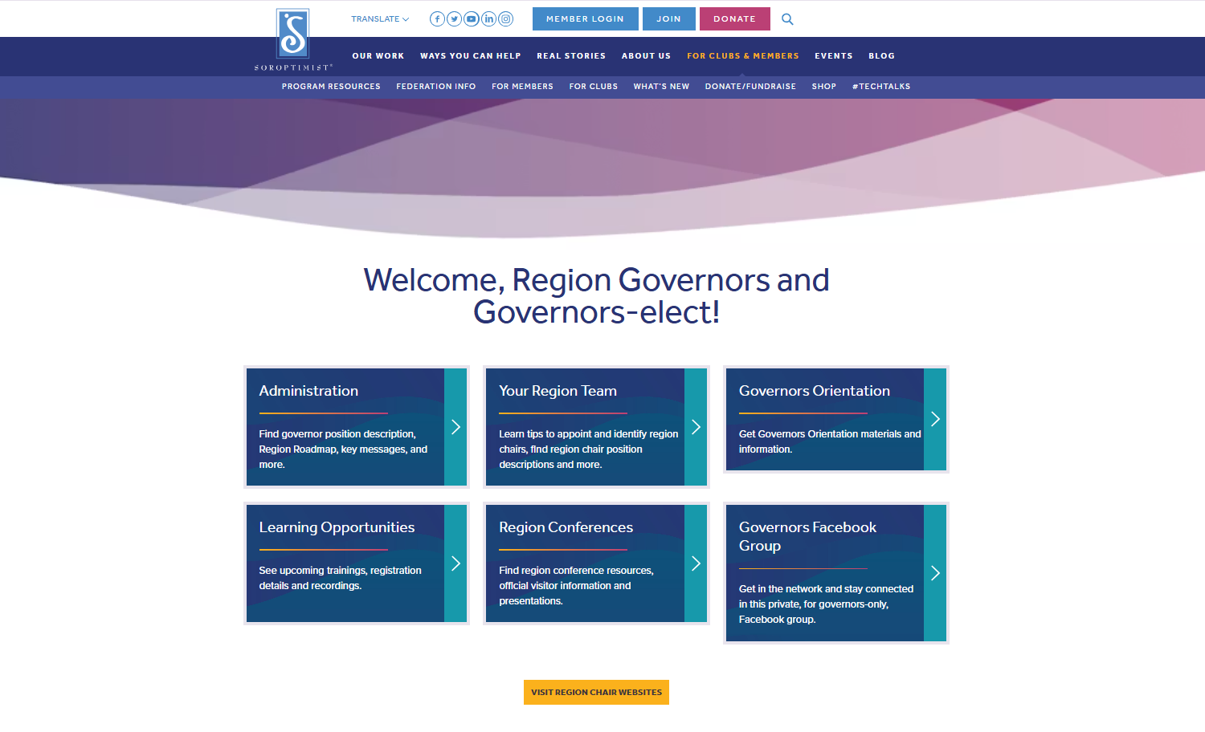
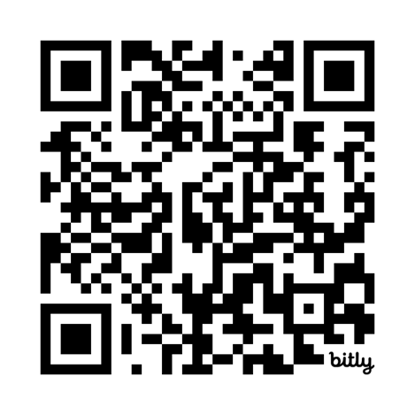
Governor Resources
Notes:
Before we get started with today’s program, I want to touch on a few housekeeping items:
First, you can find the resources for today by scanning this QR code.
This will send you directly to the section of our website that is set aside for Governors and Governors-elect.
There you will find a sub-section for the Governors Orientation, where you can find the resources from today.
This is the section where we will also post the PowerPoint presentations after the convention.

Slide 6

PLEASE SILENCE ALL DEVICES.
Notes:
We want to avoid as many distractions as possible, so I am requesting you to silence any phones or computer/electronic devices you have with you.

Slide 7
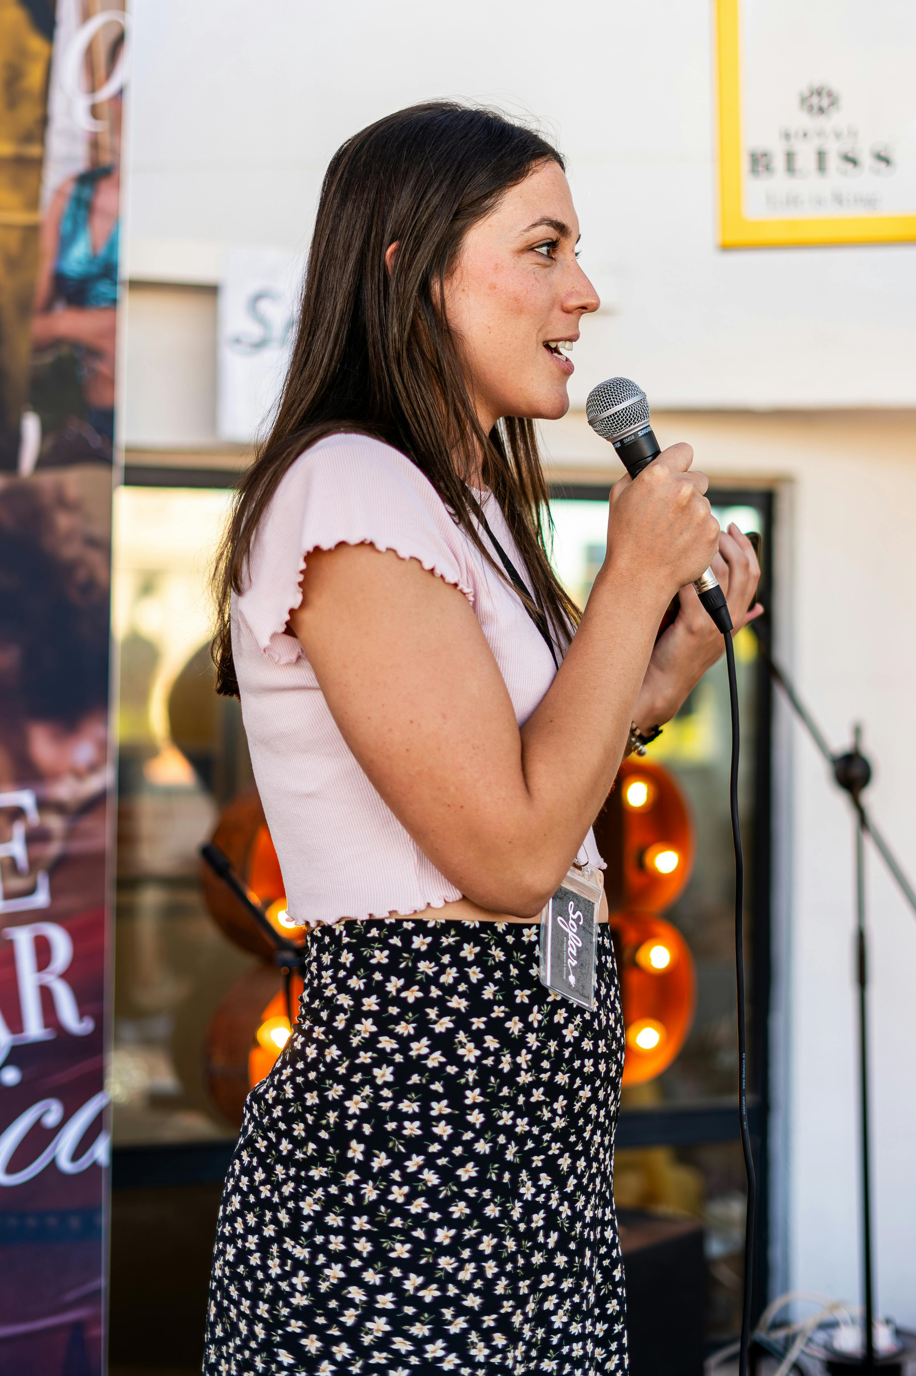
PLEASE WAIT FOR MICROPHONE AND SPEAK SLOWLY.
Notes:
We have interpreters with us in the back of the room. Members requiring interpretation have the equipment needed in order to hear our messages.
If you are called upon to speak, we ask that you wait for a microphone as that is how the interpreters will be able to hear you.
Also, when you speak, a good general rule to follow is to speak slowly and pause between sentences.

Slide 8

10-MINUTE BREAK
AT 9:25 A.M.
Notes:
We have a 10-minute break scheduled this morning. Around 9:25am.
This allows you to stretch and attend to any personal matters.
To find the women’s restroom, turn right when leaving this room and walk down the hallway.
This time also allows our interpreters to rest their voices. We ask that you let the interpreters take advantage of this short break.

Slide 9
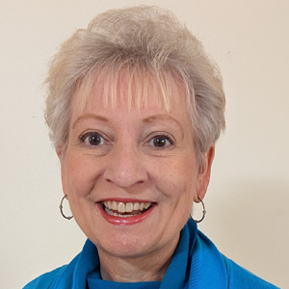
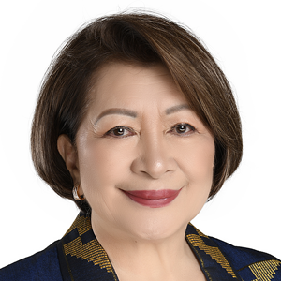
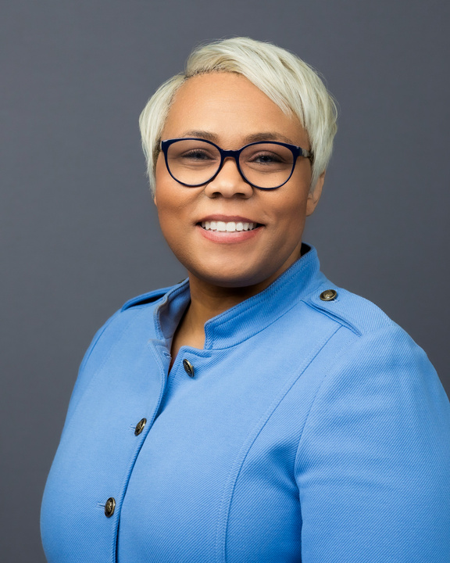
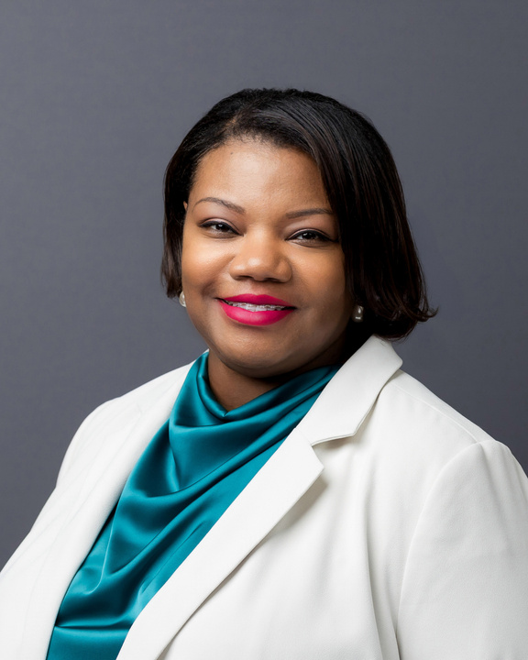
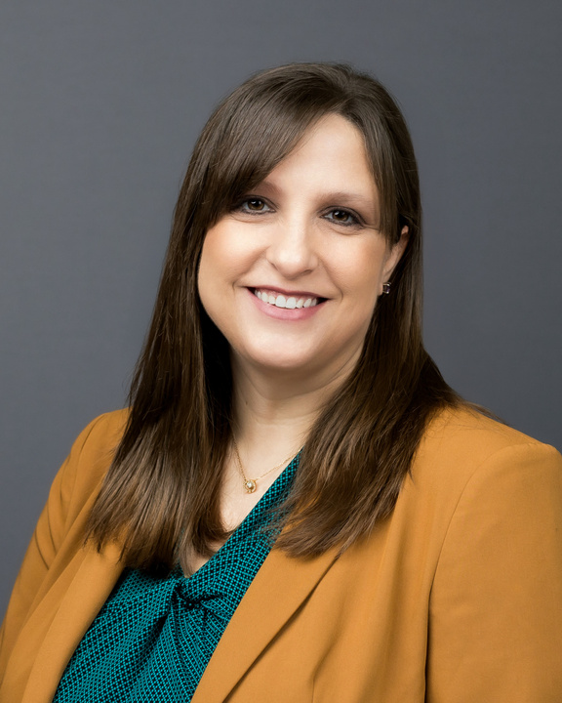
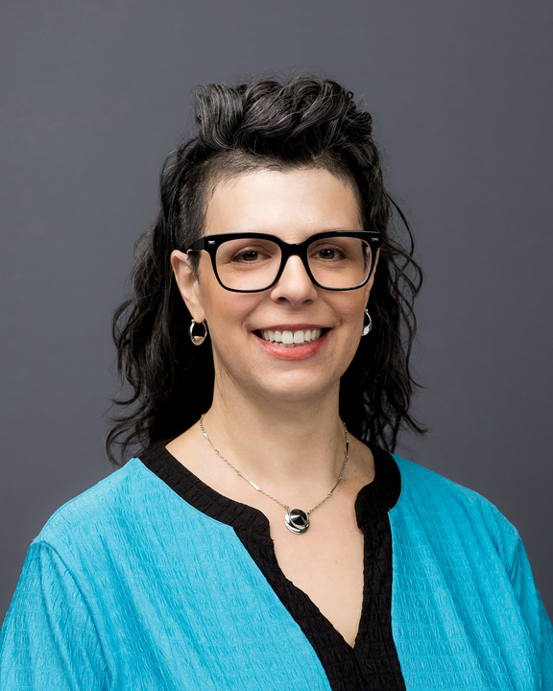
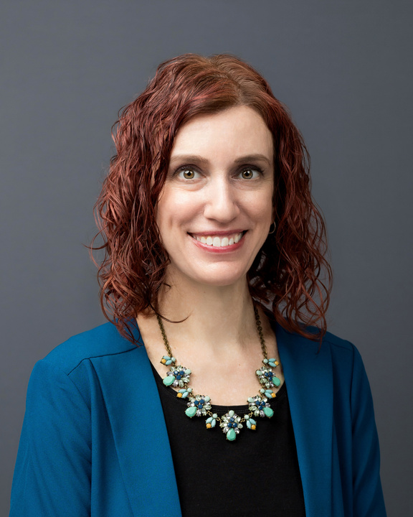
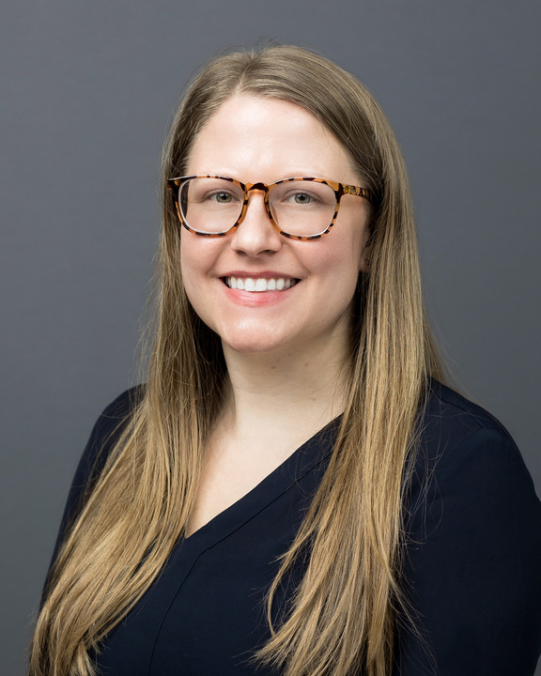
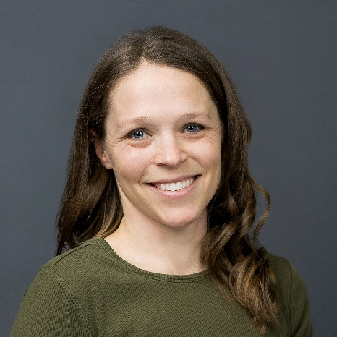
Soroptimist Leaders and Staff
Sue Riney
Virginia “Gigie” Penalosa
Michelle Burnett
Iesha D. Brown
Kim Grossman, CPA
2025-2026
SIA President
2026-2027
SIA President-elect
Executive Director/CEO
Chief Impact and Engagement Officer
Chief Financial Officer
Nicole Simmons
Erica Cheslock, CFRE
Jackie Schrauger
Laurie Sutton
Assoc. Senior Director, Leadership and Volunteer Engagement
Director,
Donor Relations
Director, Membership
Manager, Marketing and Communications
Notes:
Before we go too much further, I’m delighted to introduce our Soroptimist leaders who have been invited to join us. If you would stand and wave when I call your name.
Sue Riney, 2025-2026 SIA President
Virginia "Gigie" Penalosa, the incoming President-elect
Michelle Burnett, Executive Director/CEO
Iesha D. Brown, Chief Impact and Engagement Officer
Kim Grossman, CPA, SIA Chief Financial Officer
Nicole Simmons, Associate Senior Director, Leadership and Volunteer Engagement
Erica Cheslock, CFRE, Director, Donor Relations
Jackie Schrauger, Director, Membership, and
Laurie Sutton, Manager, Marketing & Communications
Thank you everyone, please be seated.

Slide 10

Together, we can transform the lives of women and girls!
Notes:
I look forward to seeing you throughout the week. I can’t wait to say hello to you at one of our receptions, or at a workshop, or one of the sessions. It’s going to be an inspiring convention – I can feel it!
But this morning is really about you — making sure you leave here feeling clear, confident, and ready to lead your regions and support your clubs.
So let’s lean in. Let’s connect. Let’s ask questions.
We are here to set you and your regions up for success. Together we can transform the lives of women and girls.
So, let’s get started!
Please welcome Nicole Simmons, Associate Senior Director, Leadership and Volunteer Engagement.

Slide 11




Teambuilding:
Speakers and Builders
Nicole Simmons
Associate Senior Director
Leadership & Volunteer Engagement
SOROPTIMIST INTERNATIONAL OF THE AMERICAS, INC
Notes:
Good morning everyone.
As Governors, each of you will spend the next two years leading across different perspectives, communication styles, languages, cultures, and experiences.
Today’s activity is designed to highlight just how important communication, listening, trust, and teamwork are in leadership.
This activity is called The Speakers and the Builders.
Don’t worry — this is meant to be lighthearted and fun. There is no perfect score and no winning table. The goal is simply to experience how we work together.

Slide 12


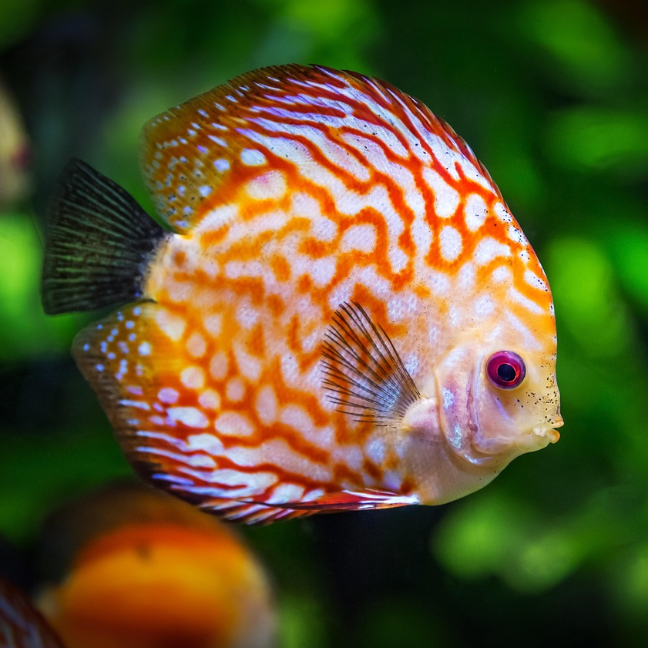
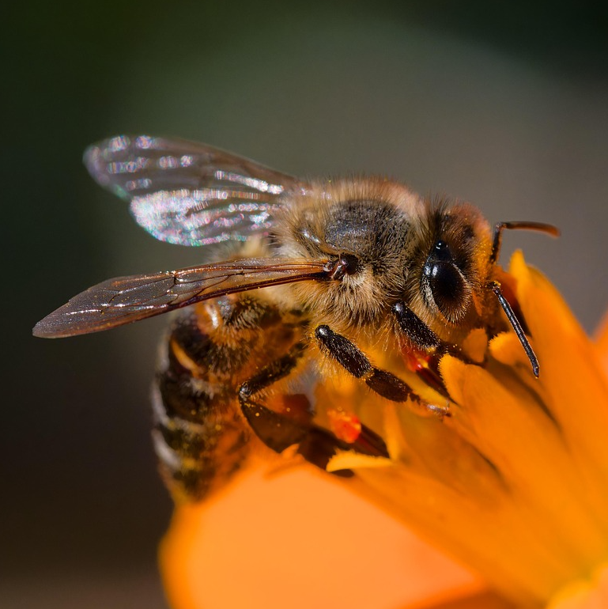


Notes:
Let me explain what we are going to do.
We are going to build today. What are we building? A tree, a train, a fish, a bee, and a caterpillar.

Slide 13
Notes:
What will we use to build them? Little wooden colorful shapes.
How will we build them? We have supplies! Each table will have
One set of wooden geometric shapes: hexagons, trapezoids, triangles, rhombuses, parallelograms, and squares.
Shape descriptions: a list of the shapes, which may be useful to describe what you need to build.
Pictures the items we are building: tree, train, fish, bee, and caterpillar. These are face down – no peeking!

Slide 14

Speakers and Builders
One person will be the SPEAKER
Others are the BUILDERS.
Speaker
Sees the picture and instructs Builders.
Will not show the picture to anyone else.
Cannot touch any of the pieces or point to them.
Guides the Builders using only verbal instructions.
Builders
Do not look at pictures
Listen to the Speaker instructions
Arrange the pieces based on what they hear.
Rotate Speaker once a picture is complete.
Notes:
Here is how to play. One person will be the SPEAKER and the rest of the table will be the BUILDERS.
Choose your first Speaker. That person will look at the picture. They will not show the picture to anyone else. They can say what you are building, but not show you the picture. The Speaker cannot touch any of the pieces or point to them. The Speaker must guide the Builders using only verbal instructions.
You may communicate in any language at your table, and interpreters may assist if needed.
When we start the first Speaker will begins giving instructions. Builders pick up pieces and arrange them based on what they hear.
When you finish the picture, the next person at the table becomes the Speaker. They flip over their picture and repeat the process. (Look at the picture, don’t show the picture to anyone, give verbal instruction.)
Continue on – your table may be able to build one of these – or all five – we’ll see!

Slide 15

Example
Kite
凧
연
Pipa
Cometa
風箏
Notes:
Let’s see an example:
Here is what the Speaker will see – we are going to build a kite.
Then the Speaker will instruct the builders and say something like:
We need four parallelograms. Or we need four green pieces.

Slide 16

Example
Kite
凧
연
Pipa
Cometa
風箏
Notes:
Put them in a shape of a diamond at the top.
Now we need four triangles – and so on to make the picture.
Ok – let’s get started.
Count off 1-4 or 1-5 at your table and that is the order of the Speakers.
Remember….

Slide 17
Speakers and Builders
Rotate Speaker once a picture is complete.
Speaker cannot touch the materials.
Builders cannot look at the pictures.
Everyone should participate.
Communication is key – not perfection.
Notes:
Speaker cannot touch the materials.
Builders cannot look at the pictures.
Everyone should participate.
Communication is hey – not perfection.
Don’t forget to rotate speakers once a picture is complete!
Now – you have 7 minutes. Begin!

Slide 18






Notes:
Let’s take a moment to reflect together.
How many tables created all 5 pictures?
What made communication easier at your table?
Clear directions?
Patience?
Asking questions?
Slowing down?
What made communication more difficult?
Different interpretations?
Too much information?
Not enough information?
Language barriers?
Assumptions?
How did listening affect the outcome?
You may have noticed that leadership is not only about giving instructions. It is also about listening carefully, checking understanding, and adapting.
What parallels do you see between this activity and serving as a Governor?
Working across cultures
Communicating with clarity
Different perspectives
Building trust
Patience and flexibility
Shared goals

Slide 19

Communication Trust Partnership
Notes:
I hope this activity reminded us that leadership in Soroptimist is very much like this exercise.
We each bring different languages, experiences, communication styles, and perspectives to the table.
Sometimes our message is perfectly understood.
Sometimes it changes along the way.
And sometimes we realize we need to explain differently, listen more carefully, or ask better questions.
But when we stay patient, collaborative, and focused on the same goal, we can still build something meaningful together.
As Governors, you do not lead alone. You lead through communication, trust, and partnership.
Thank you all for participating — and for being willing to learn together.
Up next, we have Iesha D. Brown, Chief Impact and Engagement Officer.

Slide 20



Leading Through Others
The Governor's Role in Advancing SIA's Mission
Iesha D. Brown
Chief Impact and Engagement Officer
SOROPTIMIST INTERNATIONAL OF THE AMERICAS, INC

Slide 21


Congratulations!
Welcome to Leadership at the
Highest Regional Level
Notes:
Hello everyone, and congratulations on your election as Region Governor!
Today marks an important transition—from being a leader within Soroptimist to serving as one of the federation's key region leaders.
As Governor, you serve as the Chief Administrative Officer of your region and the primary link between SIA's Board of Directors, Headquarters staff, region leaders, and clubs.
Over the next two years, your leadership will influence how effectively clubs engage in our mission, how members experience Soroptimist, and how successfully we advance our strategic priorities.
This is an important leadership role—not because of the title, but because of the impact you can have on women and girls through the strength of your region.
Today, we'll focus on how Governors successfully lead regions that deliver meaningful results. But before we do, I'd like to share a bit about myself.

Slide 22
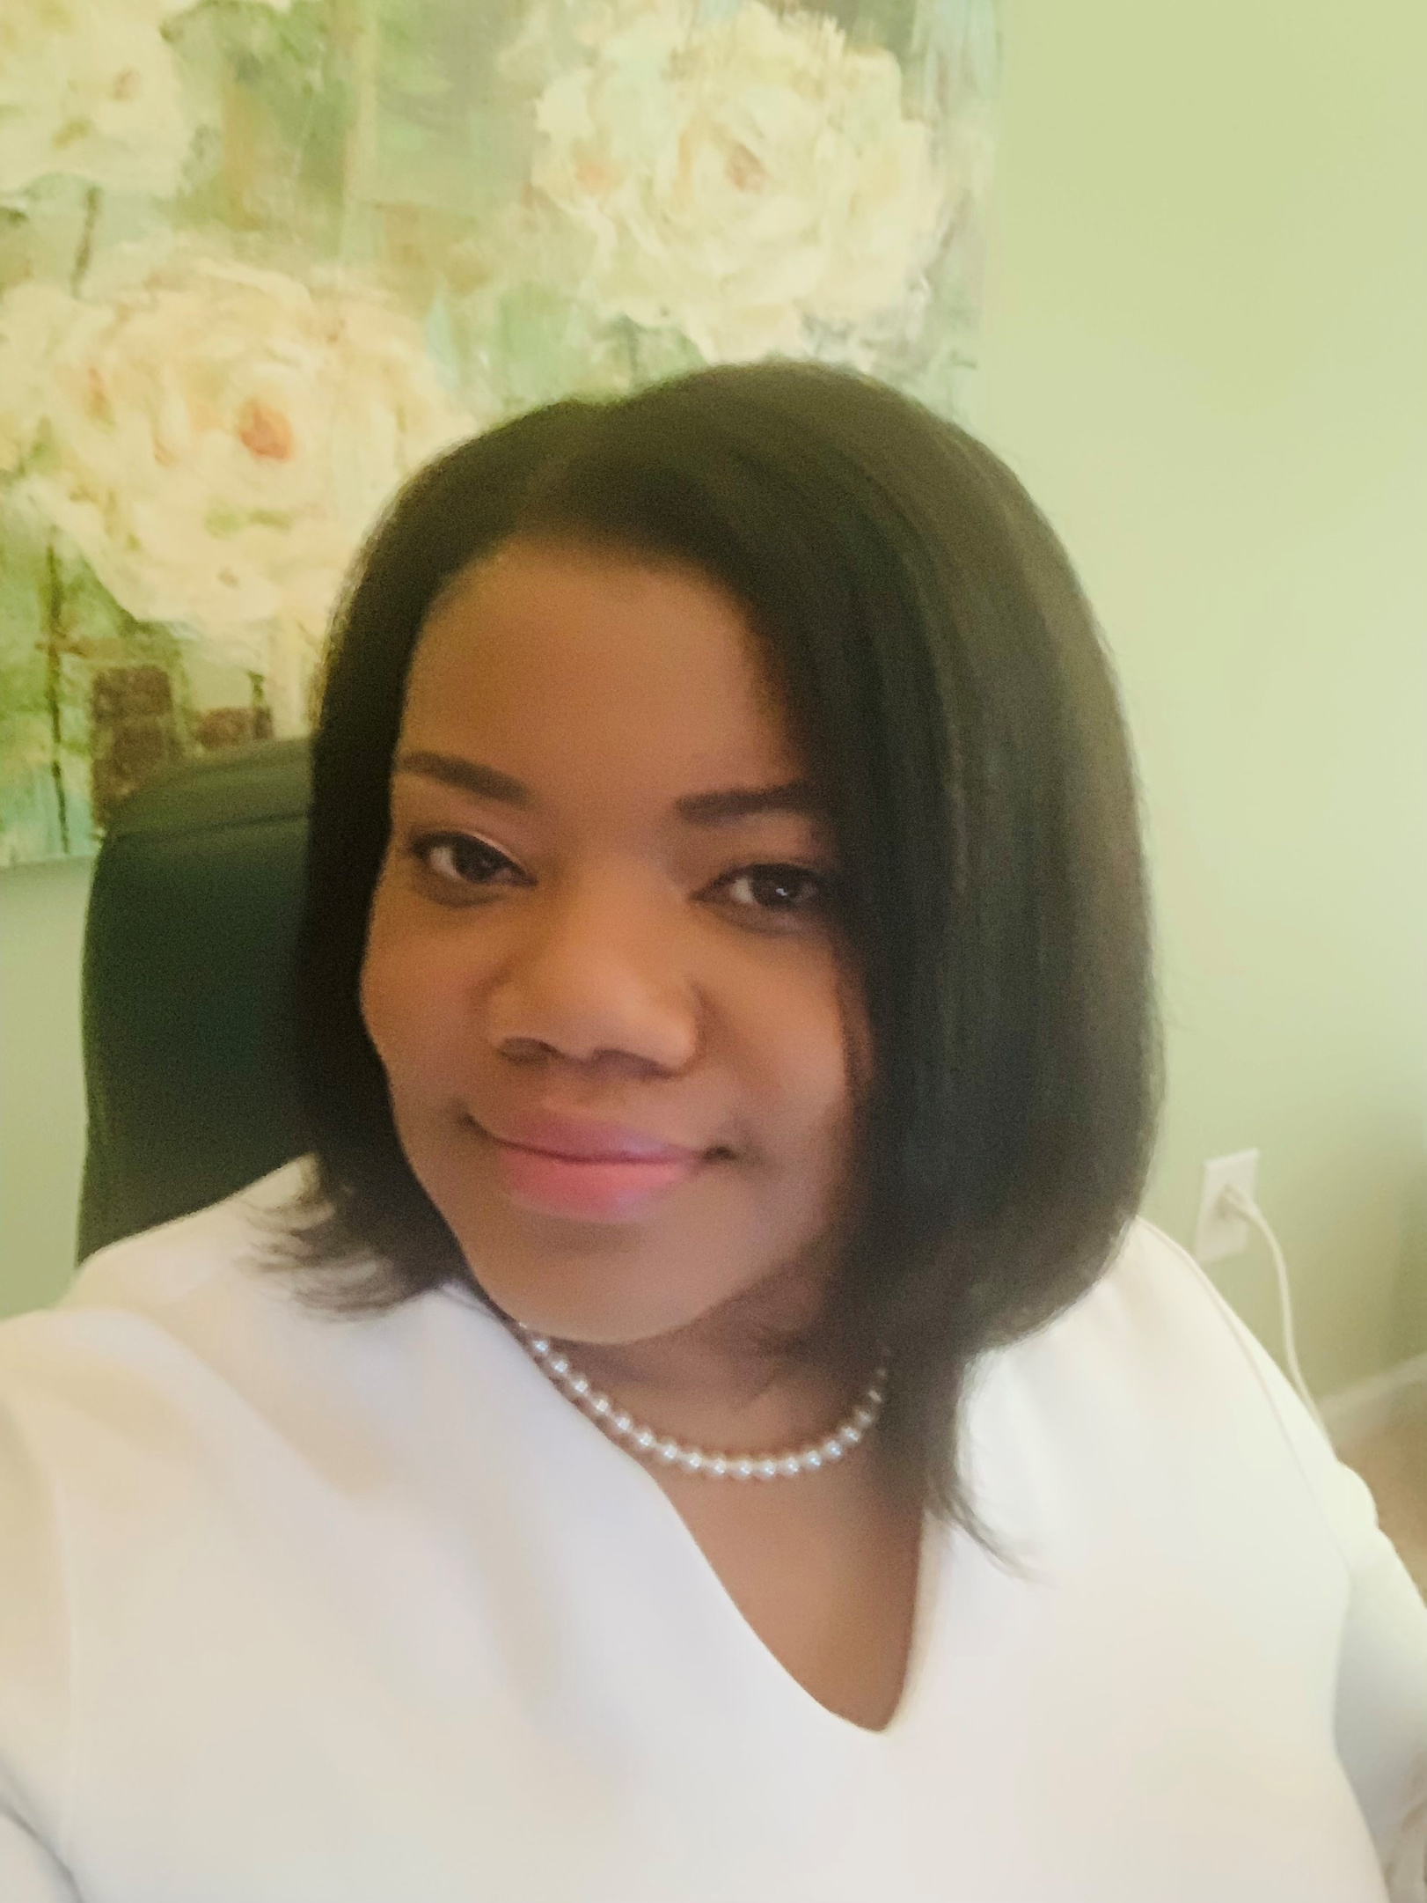
About me
  SIA’s Chief Impact and Engagement Officer
  Hired September 11, 2017
  30+ Years of Experience
  Joiner, leader, and volunteer like you
Notes:
I joined Soroptimist International of the Americas in 2017 and currently serve as SIA’s Chief Impact and Engagement Officer. In my role, I have the privilege of leading our membership, programs, leadership development and volunteer engagement teams.
I’ve spent more than 30 years working with organizations like SIA.
I’m truly delighted to spend this time with you today, and I look forward to our conversation.

Slide 23

Understanding Your Leadership Responsibility
Ensure the goals of the Region and Club Roadmaps are achieved in the following areas:
    Impact
    Engagement
    Brand Awareness
    Philanthropy
Notes:
One of the biggest misconceptions about the Governor role is that it revolves around conferences, meetings, and administrative responsibilities.
Those responsibilities matter, but they are not the purpose of the role.
The purpose of the Governor role is to lead the region in advancing SIA's mission and strategic direction.
Your responsibility is to ensure:
-More women and girls are reached through SIA's programs and Big Goal Accelerator Projects.
-Membership and club strength grow through increased engagement and retention.
-Philanthropic support increases, expanding resources for mission delivery.
-Brand awareness grows, increasing visibility and connection to SIA's mission.
At the end of your term, success will not be measured by how busy you were.
Success will be measured by whether your region is stronger than when you began.

Slide 24

Region Conferences
  Move beyond “the way we’ve always done it” thinking
  Respond thoughtfully to members’ needs - LISTEN
  Region conference CAN be held virtually and be successful
Notes:
Planning a Region Conference requires a significant investment of time and energy from Region Governors and their leadership teams. Many past governors have shared that the planning process consumed an extraordinary amount of volunteer time, often limiting their ability to focus on other strategic priorities. As Region Governor, one of your most important responsibilities is to be a good steward of your region's volunteer capacity by managing resources wisely and ensuring your leadership team remains focused on the work that advances our mission.
Equally important is listening to your members. Feedback consistently indicates that members value attending Region Conferences during years when SIA is not holding a biennial convention. For many, the financial commitment of attending both a Region Conference and an SIA Convention in the same year is simply not sustainable. As leaders, we have a responsibility to move beyond "the way we've always done it" and respond thoughtfully to the needs of today's members. SIA listened to this feedback, and in response, the Board approved a format that allows each region to hold one virtual Region Conference during its biennium. This decision reflects our commitment to reducing the burden on both volunteers and members while maintaining meaningful opportunities for education, connection, and governance.

Slide 25

Alignment Creates Organizational Strength
Alignment means that once a direction is established, we move forward together, with shared commitment and a clear focus on maximizing our impact for women and girls.
Notes:
As Governors, one of your most important responsibilities is ensuring alignment.
Alignment does not mean everyone always agrees.
Alignment means that once a direction is established, we move forward together—with shared commitment and a clear focus on maximizing our impact for women and girls.
The Board establishes strategic direction.
Headquarters develops tactical plans to carry out the Board’s strategic direction and ensures the availability of resources, training, support, and systems.
Governors help translate strategy into action.
Members look to Governors for cues.
When Governors support organizational priorities, members are more likely to engage.
When leaders create competing priorities or inconsistent messaging, confusion follows.
Our members deserve a consistent Soroptimist experience, no matter which region they call home. That is why SIA staff invest significant time developing mission-focused content and key organizational messages for the Spring and Fall conferences, ensuring every member has access to the same strategic priorities, resources, and direction. This is your responsibility as Region Governor.
By delivering shared content across the federation, we create a consistent member experience, synchronize communication among clubs, regions, and SIA, and enable leaders to work from the same foundation—strengthening our collective impact for women and girls.

Slide 26

More About Alignment:
SIA’s Communication Policy
The purpose of this policy is to support communication practices that protect organizational stability, reinforce governance, and advance our mission.
Notes:
SIA’s Board of Directors approved a new Communication Policy designed to strengthen alignment between the SIA Board of Directors, Region Governors, and Headquarters. The purpose of this policy is to support communication practices that protect organizational stability, reinforce governance, and advance our mission.
Region Governors are the primary point of contact for clubs and help to operationalize strategic direction while ensuring local understanding and support.
Clear expectations around who communicates, when communications occur, and how messages are delivered help build trust across the organization. Strong alignment reduces organizational risk, strengthens decision-making, and ensures consistency across the federation.
In recent months, there have been instances where Board decisions were communicated in ways that created confusion and fragmented messaging. While these efforts may have been well-intentioned, some communications occurred outside established protocols.

Slide 27
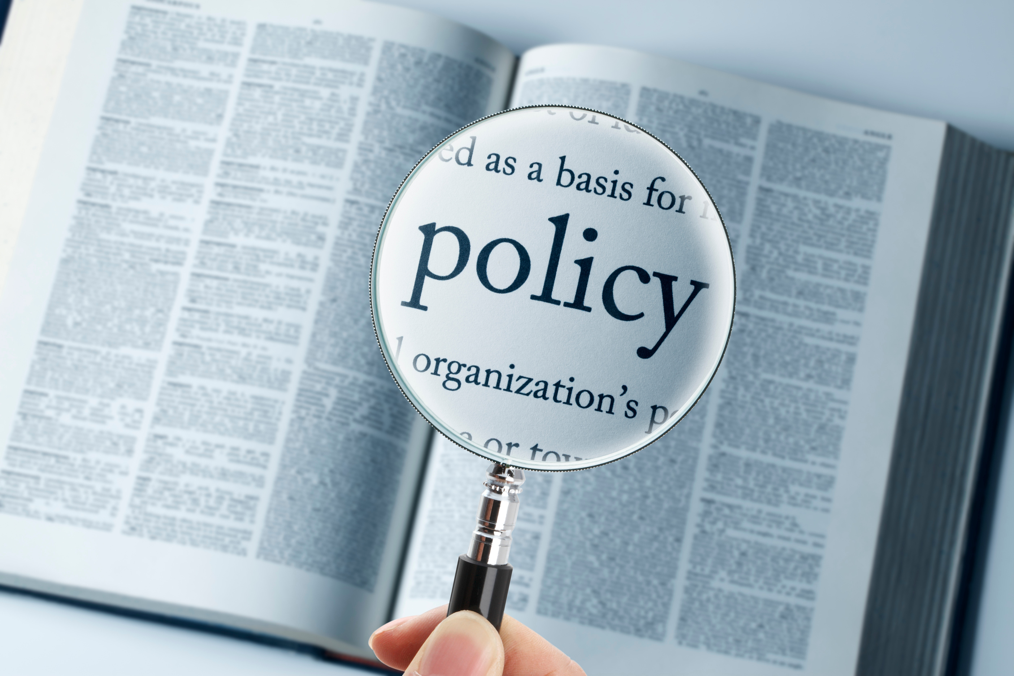
More About Alignment:
SIA’s Communication Policy
...leaders are expected to present a unified message and work together to support member understanding and adoption.
Notes:
Constructive disagreement is a natural and healthy part of the Board’s deliberation process. However, once the Board has decided, leaders are expected to present a unified message and work together to support member understanding and adoption.
Staff will continue to engage leadership early in change-management processes, gather data-informed feedback, and coordinate messaging through established leadership channels. Communication coordination with Regions will also become more proactive and structured.
Improved alignment will strengthen project execution, build trust with Regions, enable earlier conflict resolution, encourage innovation, and protect SIA’s reputation through consistent and transparent communication.
This new policy formalizes the expectation that Region Governors coordinate with Headquarters before initiating communications that could impact governance, organizational structure, strategy, financial stability, or federation-wide unity.
Importantly, this communication policy is not intended to limit dialogue. Rather, it is designed to safeguard organizational integrity, ensure unified leadership, and reinforce SIA’s commitment to transparent and aligned communication.

Slide 28


Our Shared Purpose:
The Big Goal
investing in the dreams of half a million women and girls through access to education
Notes:
Everything we do ultimately supports one purpose: investing in the dreams of half a million women and girls through access to education.
This goal is bigger than any individual club, region, Board member, or staff member.
Achieving it requires every level of the organization working together.
As Governor, you play a critical role in helping clubs understand how membership growth, Dream Program participation, fundraising, public awareness, and leadership development all contribute to that larger goal.
One of your responsibilities is helping members connect their work to our mission.
When members understand “why," engagement increases.

Slide 29

You Cannot Lead
the Region Alone
Governors who attempt to do everything themselves quickly become overwhelmed.
Governors who build leadership capacity create sustainable success.
Notes:
One of the most important lessons for a new Governor is this: You are accountable for results.
But you are not responsible for doing all the work. Your success depends on your ability to lead through others.
The Region Chair structure exists for a reason.
Your Membership Chair, Program Chair, Fundraising Chair, Public Awareness Chair, and Education Chair each play an important role in advancing regional priorities.
These are not simply volunteers helping with tasks. They are leaders who help clubs achieve meaningful outcomes.
One of your first responsibilities as Governor was to select, develop, and support these leaders.
Strong Governors create clarity. They build capable teams. And they resist the temptation to solve every problem alone.
Instead, they ask:
-Who owns this?
-What support do they need?
-How can I help them succeed?
Governors who attempt to do everything themselves quickly become overwhelmed.
Governors who build leadership capacity create sustainable success.

Slide 30

Mobilizing Your Region Chairs
...connect activities to outcomes
Notes:
Once your leadership team is in place, your role shifts from managing activities to leading people.
Start by creating clarity.
Early in your term, meet individually with each chair and discuss:
-What outcomes are expected?
-What goals are we trying to achieve?
-What support do you need?
-How will we measure progress?
-How often will we communicate?
Use the Region Roadmap to guide these important conversations and then move the discussion beyond activities.
Instead of asking: "What did you do?“
Ask: "What changed?"
For example, a Membership Chair is not successful because she delivered a report. She is successful if clubs are recruiting, retaining, and engaging more members.
Program Chairs are not successful simply because they give presentations. They are successful when more clubs participate in Dream Programs and increase their impact.
A Fundraising Chair is not successful simply because an event was held. She is successful when donor engagement increases and support for our mission grows.
Your responsibility is to continually connect activities to outcomes.

Slide 31

Accountability and
Leadership Conversations
Ask these questions when meeting with your leadership team:
  What did we agree to accomplish?
  What progress has been made?
  What challenges are emerging?
  What support is needed?
  What are the next steps?
Notes:
Many leaders are comfortable supporting people. Fewer leaders are comfortable holding people accountable.
Yet accountability is essential to leadership. It is not about criticism. It is about keeping commitments visible and helping people move forward.
When meeting with your leadership team, consider these questions:
-What did we agree to accomplish?
-What progress has been made?
-What challenges are emerging?
-What support is needed?
-What are the next steps?
These conversations create transparency, trust, and forward momentum. The goal is not perfection; the goal is progress.
As Governor, your responsibility is to create an environment where leaders can succeed while remaining accountable for commitments.

Slide 32

Partnership, Stewardship, and Operational Excellence
Successful Governors understand they are part of a larger leadership team.
Notes:
Successful Governors understand they are part of a larger leadership team.
Partnership with Headquarters, the Federation Board, fellow Governors, region leaders, and clubs is essential.
Partnership requires communication, responsiveness, a willingness to ask questions, openness to guidance, and a commitment to sharing information. It also requires stewardship. That means showing up for Federation Volunteer calls, trainings such as the Leadership Round Table, biennial conventions, and opportunities beyond Governors’ Orientation.
Governors are entrusted with:
Regional resources.
Financial oversight.
Compliance responsibilities.
Strategic implementation.
Member trust.
Meeting deadlines, attending required trainings, submitting reports, following the Region Roadmap, and maintaining sound financial practices are not just administrative tasks.
They are leadership responsibilities.
They ensure that we remain effective, accountable, and focused on our mission.

Slide 33

Notes:
At the end of your term, your legacy will not be measured by the number of meetings you chaired.
It will be measured by:
Whether more women and girls were reached through SIA's programs and Big Goal Accelerator Projects.
Whether membership and club strength grew through increased engagement and retention.
Whether philanthropic support increased, expanding resources for mission delivery.
Whether brand awareness grew, increasing visibility and connection to SIA's mission.
Perhaps the most important question to ask yourself throughout your term is this: Am I leaving behind a stronger leadership team, regions and clubs than the ones I inherited?
If the answer is yes, your influence will continue long after your term ends.

Slide 34

Closing Leadership Charge
    Champion our mission
    Support our strategic direction
    Develop leaders
    Strengthen clubs to achieve meaningful outcomes
    Partner and collaborate
Notes:
As Governors, you are entrusted with one of the most important leadership roles in our organization.
You are expected to champion our mission, support our strategic direction, develop leaders, strengthen clubs, and help regions achieve meaningful outcomes as outlined in the club roadmap.
Most importantly, you are expected to do this through partnership, collaboration, and service to something larger than any one of us.
The Board, Headquarters team, and your fellow Governors are committed to partnering with you throughout your term.
We are excited to support your success.
Thank you for your willingness to lead, for your commitment to our mission, and for the impact you will help create for women and girls around the world.
Please remember that the Headquarters team is here to support you and your region’s success. Thank you for your time. More importantly, thank you for volunteering your time and talents in service to our members and the women and girls we serve.

Slide 35

Q & A
iesha@soroptimist.org
Notes:
Up next – let’s welcome back Nicole Simmons….

Slide 36
Overview of Resources that Support Governors
Nicole Simmons
Associate Senior Director, Leadership & Volunteer Engagement
SOROPTIMIST INTERNATIONAL OF THE AMERICAS, INC
Notes:
To lead effectively and with confidence, you need access to the right tools, information, and support systems.
Today, I’ll walk you through key resources designed to help you make informed decisions, strengthen your region, and create meaningful impact.

Slide 37

Web Resources
Governors & Governors-elect
Website
• Administration
• Your Region Team
• Governors Orientation
• Learning Opportunities
• Region Conferences
• Governors Facebook Group
Notes:
Your first and most important resource is the Governors and Governors-elect website.
You can access it by this QR code on the screen.
Here, you’ll find:
Administration tools
Region team resources
Orientation materials
Learning opportunities
Region conference guidance, and a link to the
Governors FaceBook group
Think of this as your central hub—if you’re not sure where to start, start here.

Slide 38
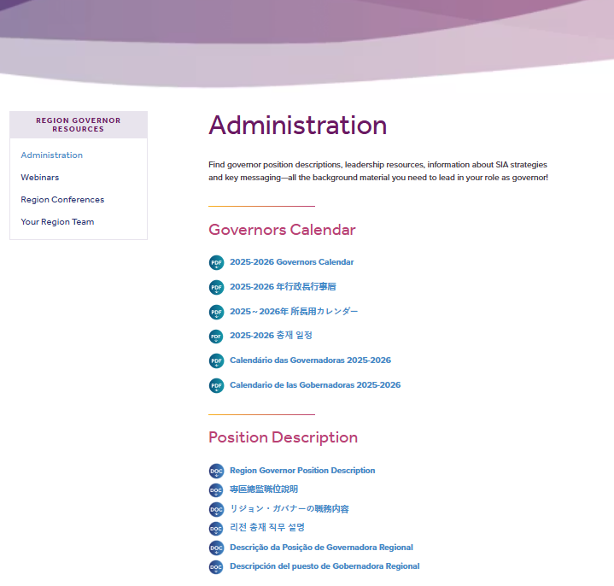
Web Resources
Administration
Essential Tools!
Notes:
Under Administration, you’ll find essential tools to guide your work:
Governors Calendar
Position description
Region Roadmap and Metrics, and
Key messaging
The Governors Calendar is especially important—it keeps you aligned and ahead of deadlines.
The Region Roadmap and Metrics connect your region’s work directly to our strategic priorities, helping ensure consistency and impact across the federation.

Slide 39
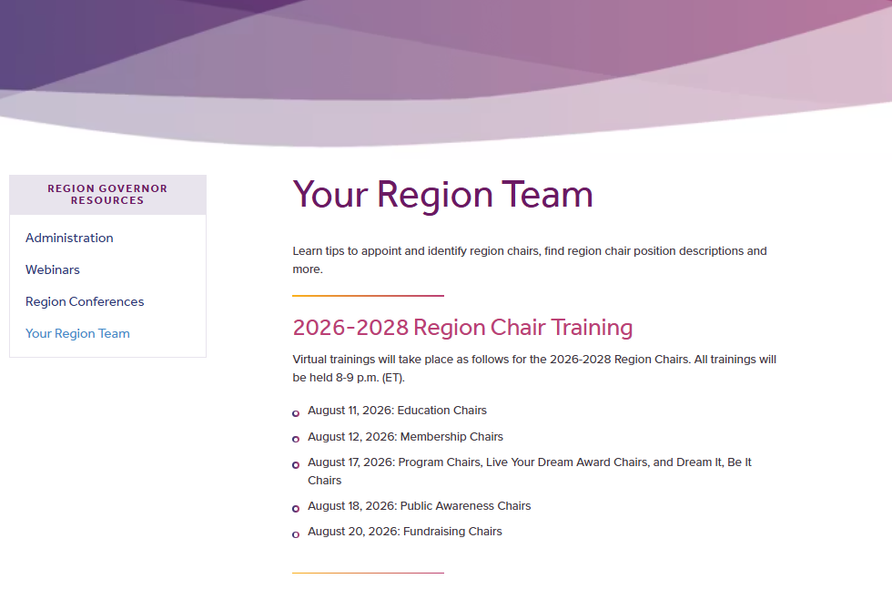
Web Resources
Your Region Team
2026-2028 Chair Trainings
Region Chair Position Descriptions
Notes:
The Region Team section supports you in building and leading a strong leadership team.
We have the dates of the upcoming virtual chair trainings that are happening in August, as well as a link to the region chair position descriptions
Please note, you are welcome to attend these trainings as well.
The July Governor & Governor-elect email had the link to each training. That was sent to you on July 17.
These sessions will be interpreted and recorded and available for viewing.
Please encourage your chairs to attend as these sessions are designed to set your team up for success.

Slide 40
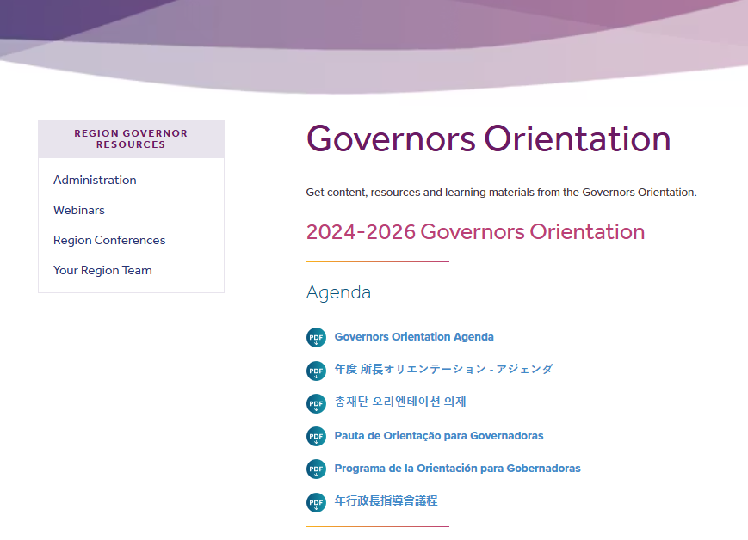
Web Resources
Governors Orientation
Agenda
PowerPoints
Supporting
Materials / Handouts
Notes:
The Governors Orientation section houses:
Today’s agenda
Presentation slides
Supporting materials and handouts
Everything will be available here for easy reference.

Slide 41
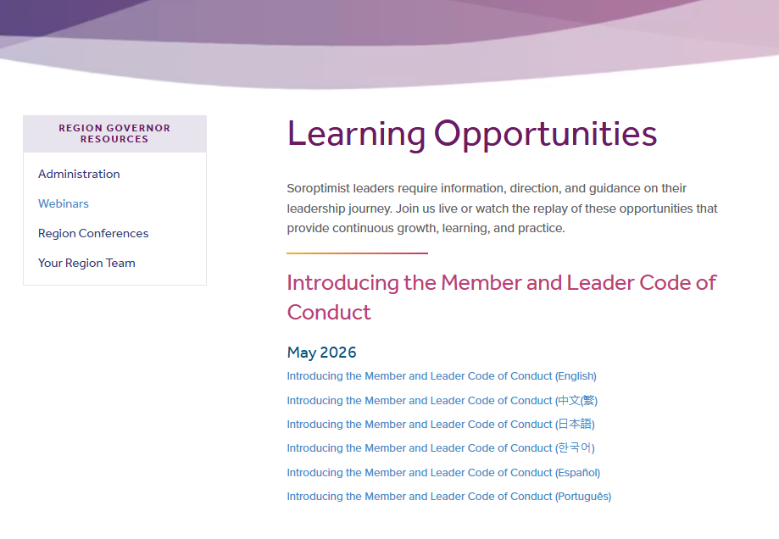
Web Resources
Learning Opportunities
Find Past Recordings
Notes:
Our Learning Opportunities library includes on-demand trainings such as:
Dream Programs trainings
New Club Orientation, and
Club operations

Slide 42
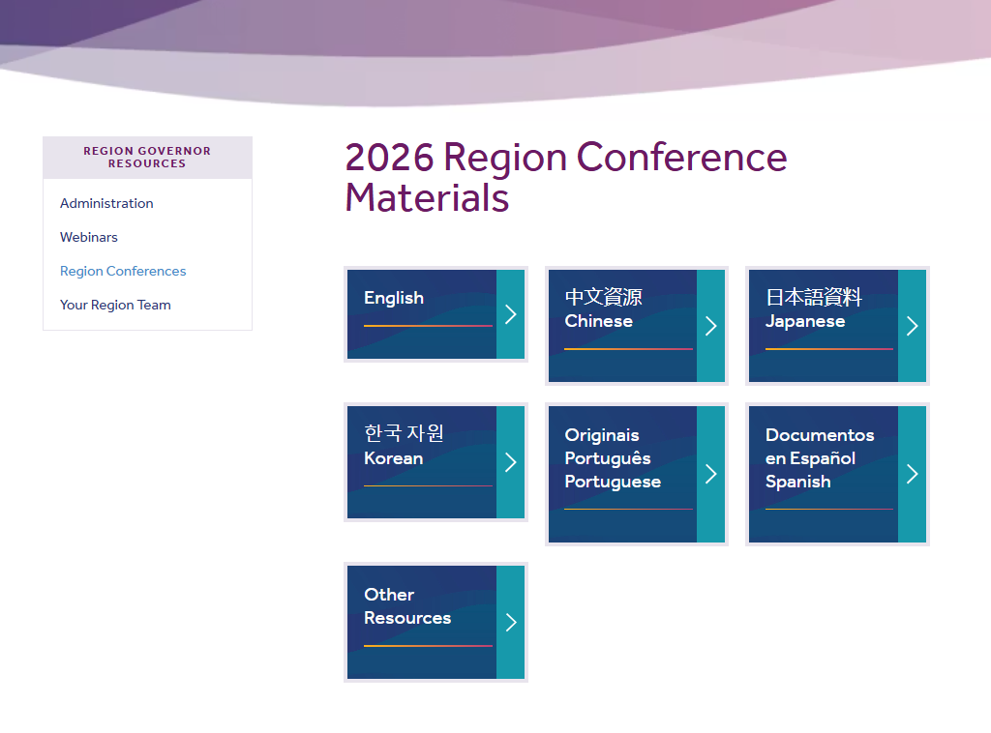
Web Resources
Region Conferences
Go-to area for materials SIA HQ staff will provide
Notes:
The Region Conferences section is the go-to area for materials SIA headquarters staff provides to assist in developing your agendas and for the messaging that should be shared with members across the federation.
You can expect to have a listing of what will be provided for the 2027 region conference season in December or January.

Slide 43

Notes:
You can also find a link to the Governors FaceBook Group. This a place Governors can talk and share. This is a private group of 2026-2028 Governors, so you will receive a personal invitation to join.
Some of your best solutions will come from each other—use this space to share ideas and learn from one another.
.

Slide 44
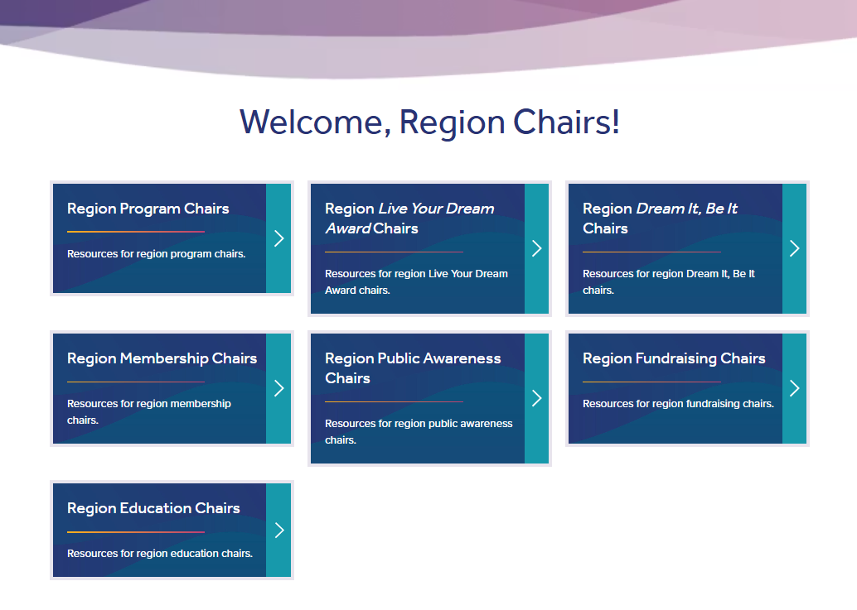
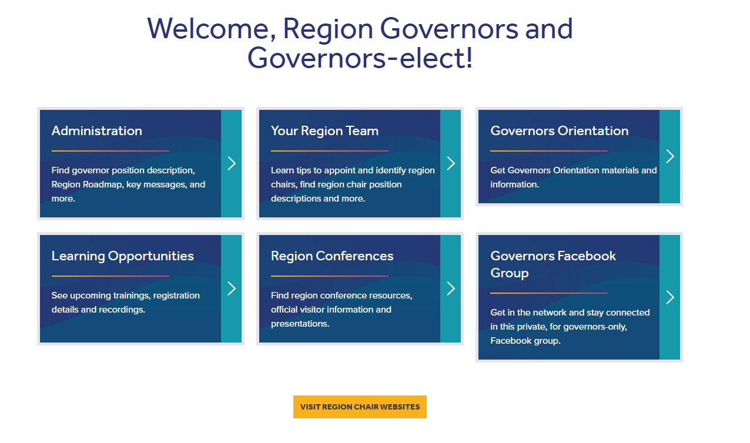
Web Resources
Notes:
Finally, there is also a dedicated area for Region Chair resources, where staff liaisons provide role-specific tools and updates.

Slide 45

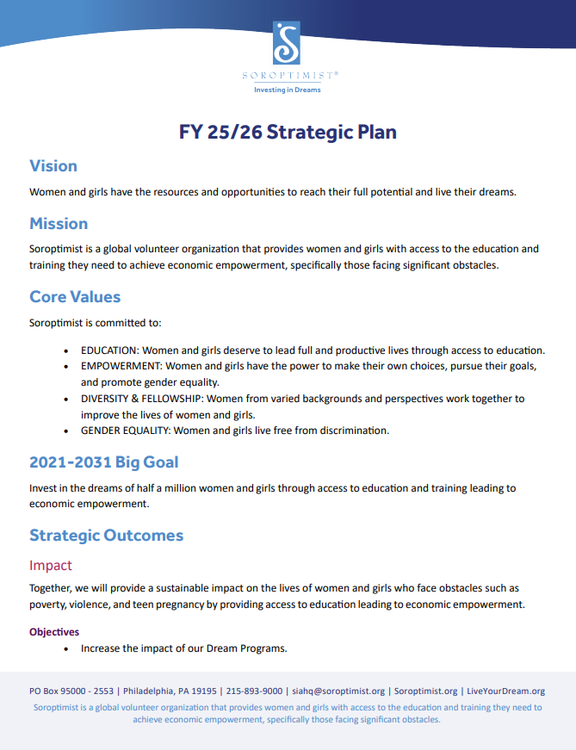
SIA Strategic Plan
Key Messaging
Federation Info
For Clubs & Members
Notes:
A few other resources not on the Governor & Governors-elect page are …. the SIA Strategic Plan.
The 26/27 plan was just approved at the Board of Directors meeting a few days ago. The plan will be translated and posted online soon.
You can find it under…
Federation Info
Key Messaging
On the left hand side you will see “Strategic Plan”
Everything we do—from programs to membership should align with this plan.

Slide 46
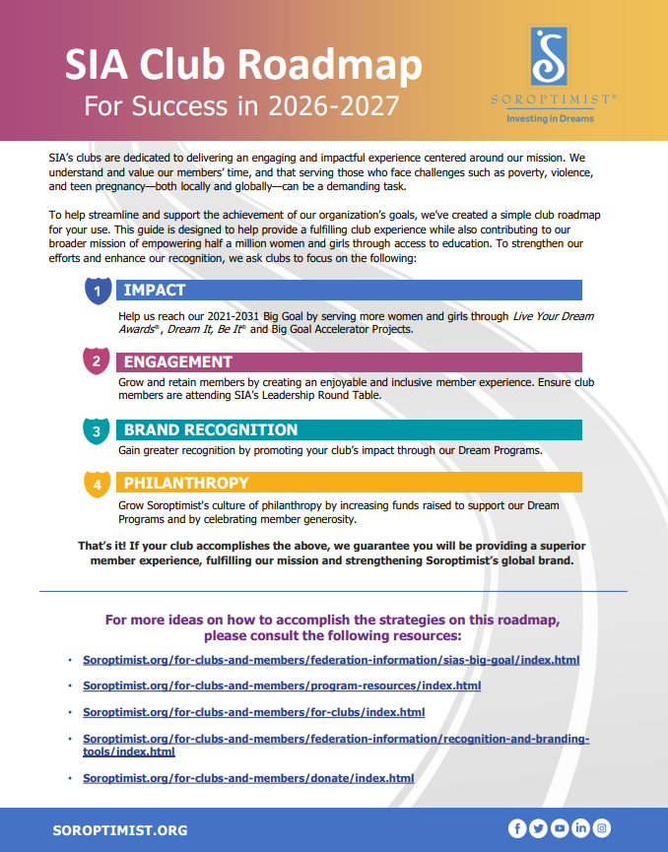
Club Roadmap & Metrics
Club Administration
For Clubs
For Clubs & Members
Notes:
The Club Roadmap and Metrics help clubs align their work with our strategic direction.
Find this under:
For Clubs
Club Administration

Slide 47

Monthly
Emails
Notes:
Be on the lookout for our monthly email created specifically for Governors and Governors-elect.
These emails arrive around mid-month and are packed with key updates, practical resources, and helpful reminders to keep you informed and supported all year long.

Slide 48
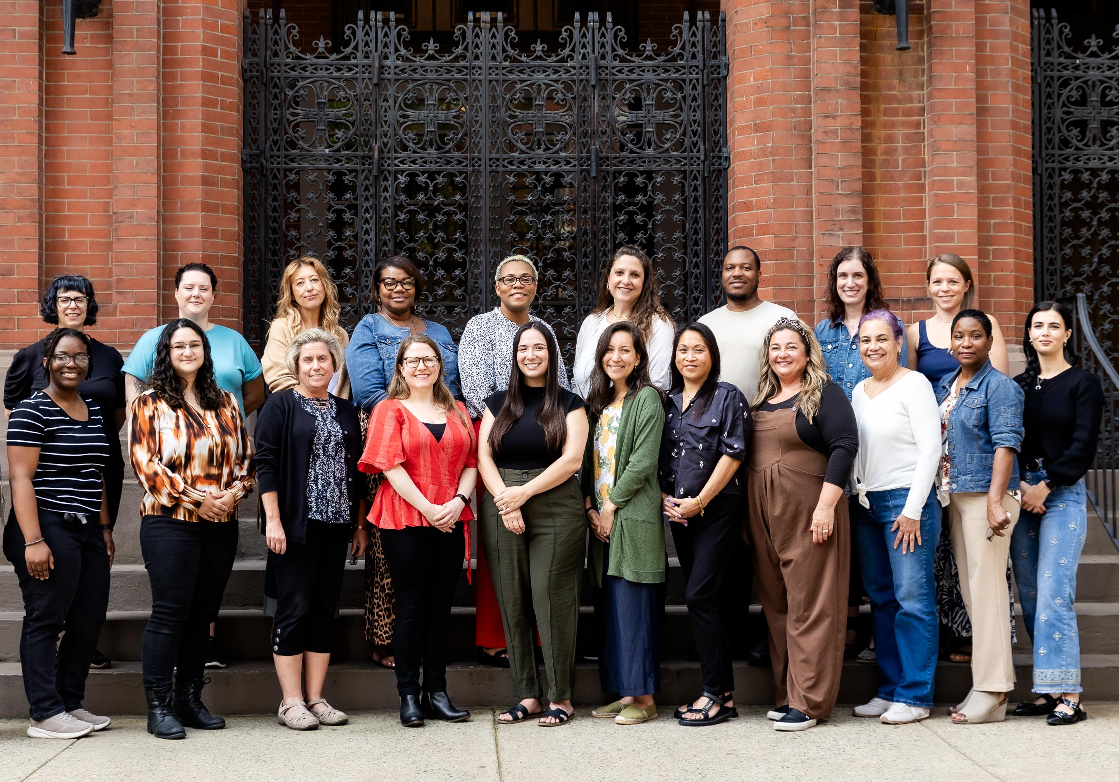
SIA Headquarters
siahq@soroptimist.org
Notes:
Then of course we have the staff at Soroptimist Headquarters – the people power!
Your SIA headquarters staff are ready and able to assist you, your leadership team, and clubs and members.
View the support contacts resource online for who to contact.
Staff are here to help you succeed. You’ll also see staff here at convention – don’t be afraid to say hello!
If you have questions or want to schedule time to meet with a staff member – reach out – emails and phone numbers are listed in the resource.
For general questions or if you are not sure where to start, reach out to siahq@soroptimist.org and they’ll be happy to connect you to the right person.

Slide 49


Federation Leaders
Virtual Meetings
November 11, 2026
March 17, 2027
Notes:
Save the date for the next time we meet!
This will be virtual. We have two meetings scheduled for Federation Leaders this fiscal year:
November 11, 2026
March 17, 2027
These meetings are for Board of Directors, Federation Committees, and Region Leaders – Governors, Governors-elect, Region Treasurers, Region Secretaries, and the Pillar Chairs.

Slide 50

Thank You
감사합니다
Obrigada
ありがとう
Gracias
謝謝你
Notes:
As you can see, we have a number of key resources for region leaders, club leaders and members.
I encourage you to use and refer to them often.
These tools are here to help you:
Lead with clarity
Strengthen your region, and
Advance our mission
Thank you—and we look forward to working with you!
Any questions? (9:04am)
Next, let’s welcome Jackie Schrauger to the microphone.

Slide 51
Living the Code:
Navigating the Member and
Leader Code of Conduct Process
Jackie Schrauger
Membership Director
SOROPTIMIST INTERNATIONAL OF THE AMERICAS, INC
Notes:
Welcome everyone! My name is Jackie Schrauger, and I am the membership director at SIA. I will be sharing information about the enforcement and administration of the Member and Leader Code of Conduct.

Slide 52
Code of Conduct
Address civility issues
Retain and grow membership
Instill confidence in addressing situations
Notes:
SIA’s Board tasked staff with developing a Code of Conduct to address the civility issues which were causing many members to leave the organization as they felt unwelcome, unengaged, and treated poorly. It is crucial for the future of our organization and our mission that all members feel welcome and respected so that we can work together to make a difference in our communities for women and girls.

Slide 53

Volunteer Leader Groups
Code of Conduct Review Committee
Reviews submissions of a more serious nature and recommends a course of action
Notes:
Before we begin to go through the process, I want to give you an overview of two new kinds of Soroptimist volunteer leader groups.
The Code of Conduct Review Committee, or CCRC, reviews submissions for violations of the Code that are repeated or more serious in nature. They will review all submissions within 30 days and provide a written recommendation, which may include escalating the submission to the Board.

Slide 54
Volunteer Leader Groups
Code of Conduct Review Committee
Appeals Review Panel
Reviews submissions of a more serious nature and recommends a course of action
Reviews member appeals after a CCRC or Board consequence
Notes:
The Appeals Review Panel will review appeals submitted by members who have received a formal sanction for Code violations and will render a final decision. Members can submit appeals in writing via email to SIAHQ within 14 days of receiving a sanction.

Slide 55
Code of Conduct
Responsibility
Respect
Fairness
Honesty
Leadership
Notes:
While we will not review the Code in detail here for time purposes, I do encourage you to read it yourself. It explains our commitment to our shared values that guide how we act and provides examples of each of those values at work in our Soroptimist experience. These values include responsibility, respect, fairness, honesty, and leadership.

Slide 56
Types of Issues
Personality conflicts
and
inappropriate behavior
Governance-related Grievances
Severe Violations
Notes:
We will now review the escalation process for the Code.
Generally, conflicts at Soroptimist fall into the following categories:
• Personality Conflicts/Inappropriate Behavior,
• Governance-related Grievances, and
• Severe Violations.
Each category has its own process to guide leaders on what to do.
In the event an urgent issue with potential legal or reputational risk to the organization is made known to staff, the Board has given staff the authority to address the matter in a manner that may jump ahead on some of these steps if required. Staff will ensure that club and region are involved at the earliest opportunity of course.

Slide 57
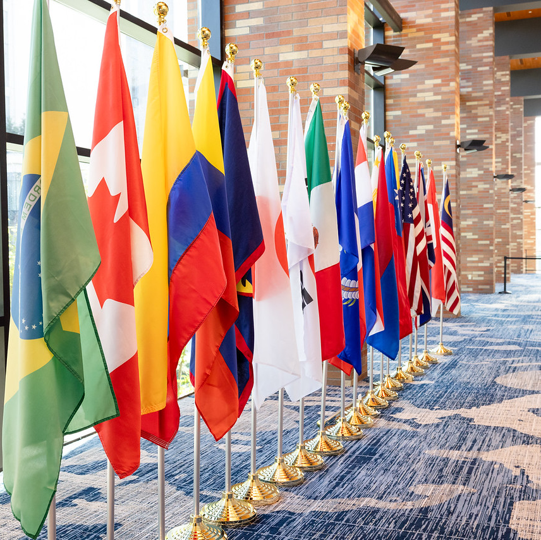
Personality Conflicts
Leaders should help members if requested
Provide coaching or facilitate a discussion
Document
Notes:
SLIDE
Our first category is Personality Conflicts and Inappropriate Behavior.
These may be situations involving misunderstanding, lack of awareness, or interpersonal conflicts.
Members are encouraged to first address personality conflicts directly with one another and to find an agreeable solution for everyone.
If a member feels uncomfortable, they should seek guidance from leadership before discussing the matter with the other party. The chart describing who they can turn to can be found in the escalation document.
Leaders may provide advice to help members navigate the conversation or mediate the conversation. At this stage, leaders should provide a verbal or written reminder of the Code and referral to training on appropriate conduct if available. They should also document the conversation.

Slide 58
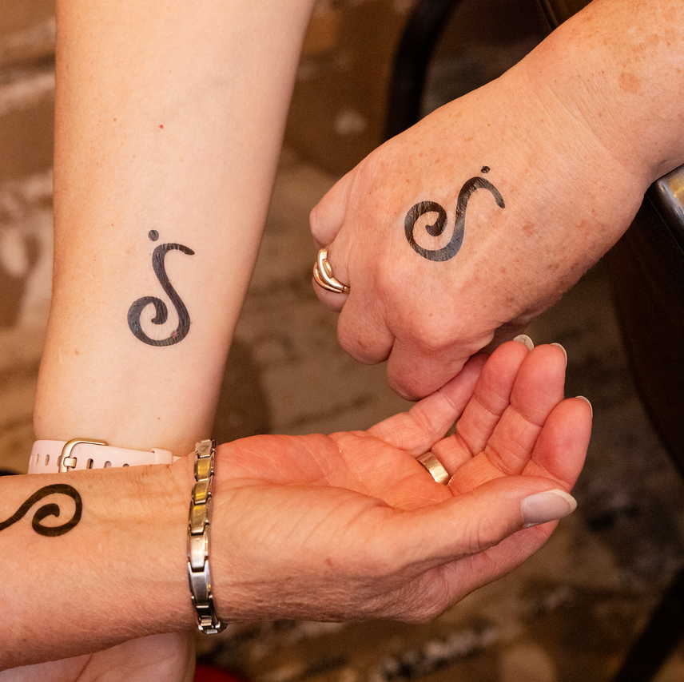
Continued Conflicts
Provide written warning
Set expectations for improvement
Provide training if available
Notes:
If these issues persist, leaders should take the following steps:
Provide a written warning outlining the violation and reference the initial conversation.
Set clear expectations for behavior improvement.
Require participation in specific training if available.

Slide 59
Persistent Personality Conflicts or Inappropriate Behavior
Complete CCRC submission form to trigger a review
CCRC will investigate and recommend a course of action (including escalation to Board of Directors)
Consequences will be communicated in writing
Notes:
If these issues continue, the leader or the aggrieved member should complete the CCRC submission form to start a review.
The CCRC will investigate and determine a course of action. Escalation to the SIA Board is required for serious misconduct or risks to SIA’s reputation or safety.
Consequences at this level could be suspension from leadership roles, committee participation, or membership for a specified period of time.
The decision will be communicated in writing to the member and with notification to relevant clubs or regions within 30 days of submission of the complaint. More serious allegations will be investigated more swiftly.
Enforcement actions will be carried out by SIAHQ and local leadership as appropriate. Retaliation will result in immediate revocation of membership.
Clubs and regions that have the authority to remove a member within their governing documents should still complete a CCRC submission form so that SIAHQ can be kept informed of the situation and provide support.

Slide 60
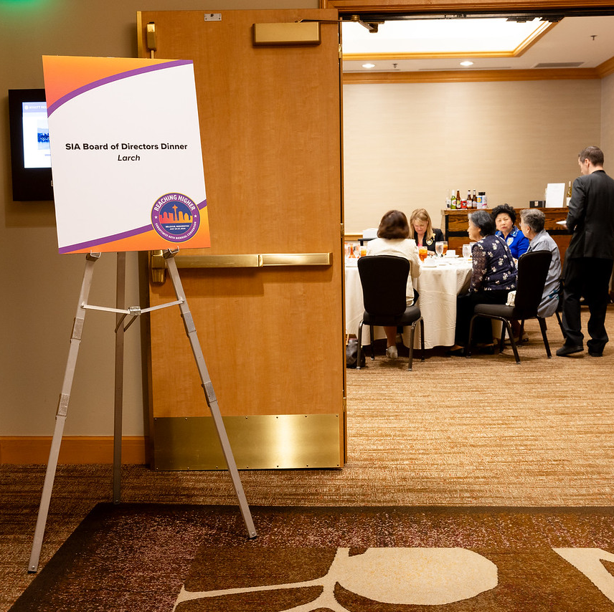
Governance Grievances
Confer with governing documents and strengthen if needed​
Engage club/region Parliamentarian or SIAHQ for clarity​
Document violations if needed
Notes:
Next, we will look at Governance-Related Grievances, which are situations involving misunderstanding or misinterpretation of governing documents or a lack of awareness of procedures.
Members are encouraged to review their governing documents to confirm that a breach has occurred. You can engage the club or region Parliamentarian if needed for clarity or consult with SIA headquarters for assistance.
If the Parliamentarian cannot provide clarity, the governing documents need to be strengthened, and the correct interpretation should be recorded.
If a member is violating the governing documents, leadership should have a conversation with the member with an explanation of what occurred and document that conversation.

Slide 61
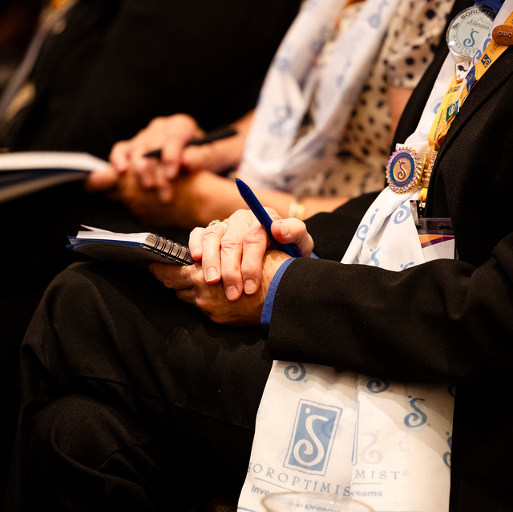
Repeated Governance Grievances
Provide written warning​
Set clear expectations for behavior improvement​
Require participation in specific training or education if available
Notes:
What should leadership do if a member consistently violates governing documents?
Provide a written warning outlining the violation and reference the initial conversation.
Set clear expectations for behavior improvement.
Require participation in specific training or education if available.
If these issues are persistent, the leader or impacted member should complete the CCRC submission form to begin a review of the situation, just as I explained previously in the Personality Conflicts section. The same process, consequences, and appeal rights will follow.

Slide 62
Severe Violations
CCRC Form
Investigation
Consequence
Notes:
Now we will move on to Severe Violations of the Code. This would be criminal behavior such as physical abuse, harassment, embezzlement, risk to safety or organizational reputation, etc.
Leadership or the aggrieved member should complete the CCRC submission form to prompt a review of the situation. The CCRC will review the situation and determine whether to investigate or escalate to the Board, which will be done immediately in the case of allegations of serious misconduct or criminal behavior as law enforcement may need to be notified.
Consequences at this level may be immediate termination of membership and its privileges.

Slide 63
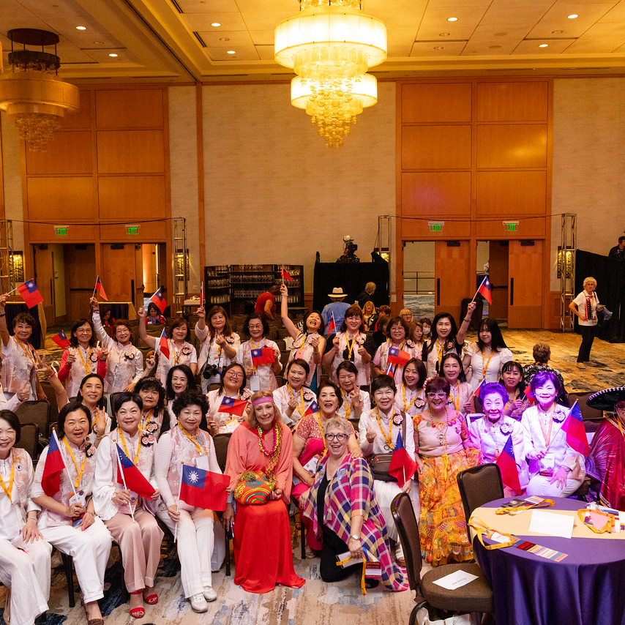
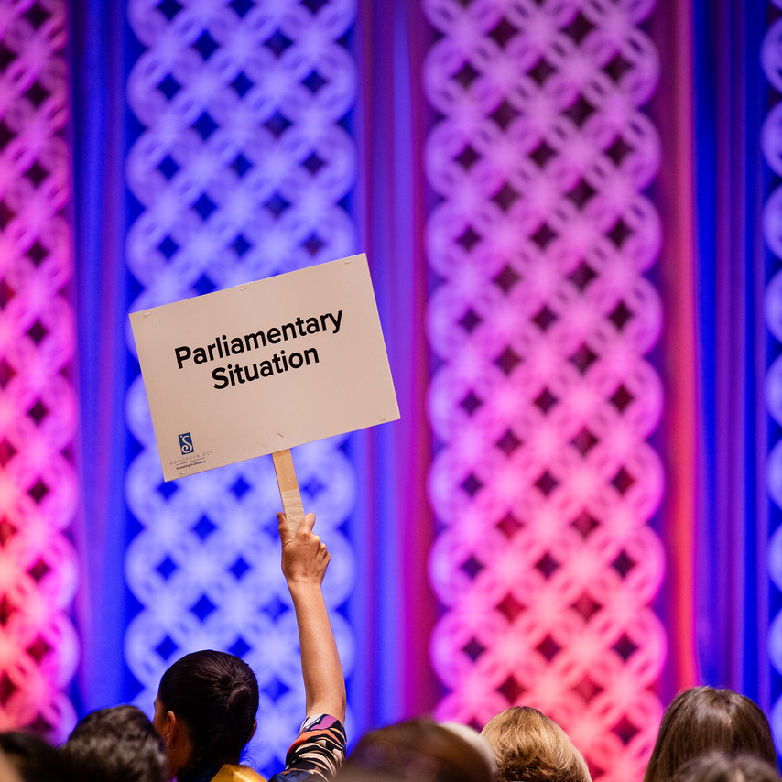
Documentation Tips
Fact based​
Focused on relevant details​
Keep it secure!
Notes:
Documentation is a crucial part of this process—thorough, non-biased documentation can help serve as a learning tool for members by creating plans to change behavior. It can also help show evidence of a pattern if behavior issues are persistent.
Be sure to keep documentation fact-based—even if feelings are running high, it is most helpful to state what occurred without judgment or emotion-driven words.
Note relevant details—dates, times, who was involved, who witnessed it, and what occurred that was a violation of the Code.
Keep all documentation secure (in a locked filing cabinet or password protected file) to maintain member privacy.
If incidents are persistent with the same member(s), be sure to continue documenting them as they occur as it will be necessary to submit a form for consideration by the CCRC.
Now, we will take a look at a few scenarios to see how they should be addressed based on the process we just covered. All of these situations were invented from my imagination and not based on any members or real situations! They will also feature fake names, mostly pulled from SIA staff members so please do not be offended if I use your name.

Slide 64

Scenario
Club President Sally Soroptimist comes to you for advice.
She has a long time member in her club named Jackie who is very resistant to change and new ideas. Jackie tends to shoot down ideas from other members, especially new members who she perceives as not knowing how things work.
It is discouraging to the new members, and President Sally is concerned that Jackie is driving away members.
Notes:
Scenario:
Club President Sally Soroptimist comes to you, the governor, asking for advice. She has a member in her club named Jackie who is very resistant to change and new ideas. She tends to shoot down ideas from other members, especially new members who she perceives as not knowing how things work. It is discouraging to the new members and President Sally is concerned that Jackie is driving away new members.
How should this be addressed?
(Give some time for people to react and share)
The correct answer is that if this is the first time that this member has had a conflict, it should be handled by the club president or directly between the members. The club president should also document the situation. You can provide the club president some tips on how to help have that conversation with Jackie.

Slide 65
Scenario
A region leader named Nicole is using time during region conference to make announcements to promote her printing business and implies that all clubs in the region are supposed to only go to her for their printing needs.
Sarah, another member, mentions to her club president Sally Soroptimist that it makes her uncomfortable. The club president discloses the complaint and Sarah’s name to Nicole.
Notes:
Scenario: A region leader named Nicole is using time during region conference to make announcements to promote her printing business and implies that all clubs in the region are supposed to only go to her for their printing needs. Sarah, another member, mentions to her club president Sally Soroptimist that it makes her uncomfortable. The club president discloses the complaint and Sarah’s name to Nicole.
How should this be addressed?
(Give some time for people to react and share)
There are a few issues here that can be clarified by checking the governing documents, and strengthening if necessary—is there a conflict of interest policy? Is there a whistle blower policy? Once the governing documents have given some clarity, next steps would include addressing and documenting a breach if it occurred. Further, it would be good for you, the Governor, to review with the club president that they have a responsibility to take complaints seriously and confidentially.

Slide 66

Scenario
A member of your club named Iesha calls you to share that she is leaving Soroptimist and wants you to know why.
She is very upset because at a recent fundraiser, the fundraising chair named Luz was yelling at her for moving too slowly during set up for the event, and at one point Luz smacked the tablecloths that Iesha was holding out of her hands and grabbed them to set up herself.
Notes:
Scenario:
A member of your club named Iesha calls you to share that she is leaving Soroptimist and wants you to know why. She is very upset because at a recent fundraiser, the fundraising chair named Luz was yelling at her for moving too slowly during set up for the event, and at one point Luz smacked the tablecloths that Iesha was holding out of her hands and grabbed them to set up herself.
How should this be addressed?
(Give some time for people to react)
If this is the first time, the Governor should have a conversation with Luz and document it. While this is not at all appropriate behavior, it is possible that Luz may be able to correct it and learn from it. However, if this sort of thing has occurred before, this would require escalating to the CCRC.
Thanks for playing along! We will move on to discussing the signing process for the Code.

Slide 67
Code Signing
Aug. 31
Ongoing
June 1
Next
JotForm opened for signatures
Leaders promote the Code
Signature form closes
New members onboarded with Code
Notes:
June 1 is when the online signature form became available. This Jotform will be available in all our languages, and will include the Code, its process, and a space for members to sign to indicate they agree to uphold the Code. This will then be tracked in our database.
Our goal is to have as many members as possible sign the Code by August 31, 2026. After that point, we will share which regions had the highest rate of signatures and celebrate the clubs who did so as well on our blog and social media. New members will sign the form as part of their onboarding process with SIA.

Slide 68
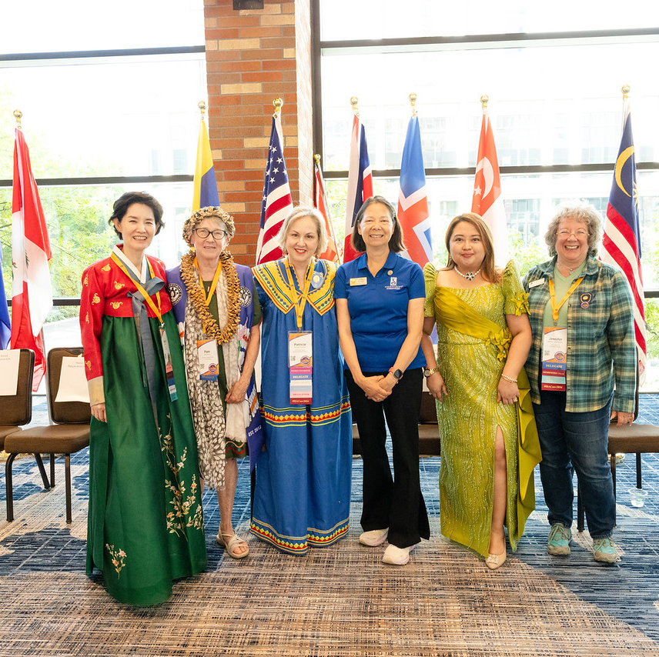
We need YOU!
Spread the word!
Model signing and upholding the code
Encourage others to sign
Share how it will help all members
Notes:
We are relying on YOU as our leaders to spread the word about the Code and its process in your area and to encourage other members to sign!
Include the ways that the Code will benefit you and the membership when you communicate about it—like how it will make membership recruitment and retention easier by providing a more civil experience.
Share the signing form link in your newsletters, social media, and any other communications during the signing period.

Slide 69
Q & A
Email SIAHQ@soroptimist.org or code@soroptimist.org
for support
Notes:
SLIDE
If at any point in this process you need assistance, please email SIAHQ@soroptimist.org or Code@Soroptimist.org and we will be happy to assist.
Now we have a few minutes for questions.
Thank you!
We now have a 15 minute break. (Nicole will announce the time)

Slide 70
Leading with Accountability:
Finance, Insurance & Risk Awareness
Kim Grossman, CPA
Chief Financial Officer
SOROPTIMIST INTERNATIONAL OF THE AMERICAS, INC

Slide 71

Introduction
  Kim Grossman, CFO
  U.S. Certified Public Accountant (CPA)
  Experience
  Member of SIAHQ Executive Team
Notes:
Before we dive into the really fun stuff, let me just start my introducing myself.
I am a Certified Public Accountant in the United States, and before joining SIA about three and a half years ago, I spent my entire career doing audits and tax work exclusively for nonprofit organizations. My clients ranged from museums and schools to foster care agencies and social service organizations. I tell you this because the advice I share today doesn't come only from SIA -- it comes from everything I've seen across a lot of different organizations, the good and the bad.
My job as CFO is to make sure SIA's finances are in order at every level.
That means financial reporting, compliance, audit, and budgeting, but it also means being a partner to leaders like you, so that the organization's resources are always pointed at our mission.\

Slide 72
Agenda
Introduction
Financial Reporting Requirements
Financial Oversight & Governance
Financial Tools and Resources
Financial Controls
Risk Management & Insurance
Notes:
Here's our plan for today: we'll cover Financial Oversight and Governance, Financial Controls, Financial Reporting, Tools and Resources, and then wrap up with Risk Management and Insurance.
Yes, that is a lot of finance topics. I did warn you I was an accountant.
But the reason the agenda is weighted this way is intentional.
Your role as governor -- as the chief administrative officer of the region and the primary link between SIA headquarters, the federation board, and your clubs -- means financial stewardship is a core part of your job.
Not the treasurer's job alone. Let's talk about what that actually looks like in practice.

Slide 73

Financial Oversight & Governance
Region Roadmap – financial alignment
Mission-focused region spending
Timely submission of financial reports
Appropriate insurance coverage
Notes:
I want to be clear about something, because I know some of you are thinking it.
The governor is not the treasurer. But the governor IS responsible for making sure good financial practices are in place and are actually happening.
Think of yourself as the financial oversight layer that sits above the treasurer. The treasurer does the work; you make sure the work is being done correctly.
What does that look like specifically?
There are four financial duties that sit squarely with you as governor.
First, Region Roadmap alignment. Parts of the Region Roadmap have direct financial implications -- making sure clubs are reporting all eligible Big Goal Accelerator Projects, providing financial support for Dream It Be It club projects where possible, and ensuring the annual budget is actually pointed at reaching more women and girls. That is a financial decision the governor drives.
Second, timely financial reporting to headquarters. Even though you may not be the one preparing the reports, you are responsible for making sure they get submitted on time. We will go over exactly what those are in a few minutes.
Third, appropriate insurance coverage. I know -- exciting stuff. But it is genuinely one of the most important things you are responsible for, and we will cover it in detail toward the end.
And fourth -- and this one is subtle but important -- you and your treasurer should operate as a real team. I partner with SIA’s ED/CEO Michelle on financial decisions.
We are hand in hand. That is the model. You should know the finances well enough to be a true partner to your treasurer, not just a signature.

Slide 74

Financial Guidelines
  Good transfer of duties
  Written financial policies and procedures
  Clearly defined roles
  Annual Budget – development & monitoring
  Timely and accurate reporting
  Audit review
Notes:
Let's talk about the fundamentals of sound financial management.
This is where I spend a lot of time because getting these basics right prevents most of the problems I've seen over the years.
Start with a solid handoff. When you take over from the previous board, make sure you actually receive everything -- books, records, bank access, login credentials, open contracts, everything.
Once you and your treasurer take possession of those records, they are yours. There is no return policy. Your team needs to be set up for success from day one.
Written policies and procedures. I cannot stress this enough. Document how money is handled in your region.
I always ask my HQ team: what happens if you win the lottery, pack your bags, turn off your phone, and get on a year-long cruise?
How does anyone continue your job? The answer is: documented, accurate, up-to-date procedures. Written policies also protect you as a leader –
if a process is documented and you are following it, a disgruntled member cannot accuse you of doing it wrong.
They might want to change the procedure, but they cannot say you violated it. And it signals strong governance to potential donors.
I'd also add: everyone should have access to these documents -- a shared drive, something that doesn't disappear when someone leaves.
Clearly defined roles. HQ provides position descriptions for governors, treasurers, and chairs, but those are high-level and apply to everyone.
Your region operates a little differently than the one next to it. Document the specific roles in yours. It protects you, it prevents conflict, and it makes transitions much smoother.
Budget. Have one. Know it. Monitor it. This is near and dear to my heart -- Michelle Strawser and I are actually presenting a full budgeting workshop later this week, and I encourage you to attend.
But the short version: create a budget that reflects your mission priorities, review actual-versus-budget at least quarterly, and share that information with your board.
The more people that are involved in monitoring the budget, the more accountable everyone feels and the more invested they are in staying on track.
Timely and accurate reporting. You need current financial information to make good decisions. Reviewing results a year after the fact doesn't help you course-correct when you still have time.
Reports also need to be accurate -- not perfect, we are all human -- but mostly accurate. If something doesn't make sense to you, ask the question.
If a report isn't presented in a way that's useful to you, ask for it differently. You are the governor; the information should work for you.
Annual audit or review. Know your region's plan for this, understand how it works, and make sure it happens

Slide 75
Financial Controls → Why?
Assurance
Prevent & Detect
Protect
Notes:
Let's move into financial controls -- I usually call them checks and balances. Why do we put these in place?
Three reasons.
One: assurance. You want members, donors, and prospective supporters to feel confident that the region's assets are safe and being managed responsibly.
Two: prevention and detection. Good controls may prevent fraud and theft from happening in the first place -- and if something does go wrong, they help you catch it quickly before the damage gets worse.
None of our clubs or regions have unlimited resources to build a perfect control environment, but there are practical things you can do with the limited resources you may have.
Three: protection. Proper controls protect your volunteers and program participants from unnecessary harm.

Slide 76
Key Controls
Segregation
of Duties
Bank Procedures
Regular & Shared Reporting
Conflict
of Interest
Notes:
Here are the specific controls I want you to know about and make sure are happening in your region.
Segregation of duties. No single person should control every step of a financial transaction.
The classic example: the person who writes the checks shouldn't also be the one reconciling the bank account.
If your region is small and you can't fully separate those, at minimum have a second board member -- often the governor -- review the reconciliation as a second set of eyes.
Bank procedures. Require dual authorization for payments or transfers above a certain threshold.
Have bank reconciliations completed monthly and reviewed by someone other than the treasurer.
And make sure that more than one officer has banking access -- you do not want the treasurer to be the only one who can log in.
When they eventually move on, what would you do? At the same time, you don't want everyone in the bank account. Balance access with oversight.
Regular shared financial reporting. The Treasurer's Guidelines ask for a monthly cash rollforward and quarterly budget monitoring.
Sharing the quarterly reports regularly -- with the board and with the broader membership at conferences -- creates transparency, builds trust, and adds more eyes on the numbers.
Accountability increases when people feel informed.
Conflict of interest policy. Every board member should sign a conflict of interest form annually.
This is a question on the US Form 990 -- it asks whether the organization has a policy and whether it's actually monitored.
Signing it once and filing it away doesn't count. Review it every year. It protects the organization and it is simply good governance practice everywhere, not just in the US.
SIA’s Leadership Commitment Tool includes conflict of interest wording as well. I have a link to that later in the resources.

Slide 77


Be Aware!
Financial reports inadequate
Bank reconciliations not in compliance
Resistance to sharing financial reports
Spending not aligned with the budget
Missing conflict of interest forms
Notes:
As a former auditor, I practiced what we call professional skepticism. You never accuse anyone outright, but you follow the facts wherever they lead.
Here's what I want you to stay alert to:
Financial reports that are vague, incomplete, or not being presented at meetings without being asked for.
Bank reconciliations that aren't happening on time or aren't being shared with a reviewer.
Resistance when someone on the board asks to see financial records. Spending that's significantly off from the budget with no board discussion or approval.
And an unwillingness to sign a conflict of interest form -- that one sometimes signals a deeper issue.
Again, most of the time these are honest mistakes. People get busy, things fall behind.
But if you notice a pattern, trust your instincts, ask the questions, and expect answers supported by actual documentation.

Slide 78
Financial Reporting
Treasurer Reports
SIA Reports
External Reports
Region
Communications
Notes:
Let's go through what financial reporting actually looks like for your region. As governor, you may not be the one preparing all of these, but you need to know they exist, review them regularly, and make sure they are filed correctly and on time.
Internal reports -- Treasurer's responsibilities: An approved annual budget, quarterly budget monitoring comparing actual results to the plan, monthly bank reconciliations, and monthly cash rollforward reports as outlined in the Treasurer's Guidelines.
SIA Headquarters reports: Two things come directly to me: your upcoming year's budget, including the conference budget, and your year-end financial reports.
Both are due by October 31st each year. I want to flag that there are some coming changes related to US tax law that will affect US regions and clubs by requiring some additional reporting to headquarters.
We don't have the full details finalized yet, but as soon as we do, we will communicate proactively. I don't want anyone to be caught off guard.
External and government reports: Tax returns and any charitable registration requirements specific to your country or state. In the US, most regions file some version of Form 990 annually.
Also check your state's charitable solicitation registration requirements -- many states have them and the penalties for non-compliance can add up.
Outside the US, verify your local requirements with an accountant or legal advisor who knows your country's nonprofit laws.
Region communications: This one often gets overlooked, but it matters. Submitting program reports, Big Goal Accelerator Projects, and LYDA data to HQ builds the evidence base that attracts donors and funders.
Reporting LYDA by club means your region gets credit for what your clubs are doing -- and there are financial recognitions tied to those levels.
And sharing financial updates with your membership at region conferences and district meetings builds trust and transparency. Don't skip it.

Slide 79
Risk Management
“Life is inherently risky. There is only one big risk you should avoid at all costs, and that is the risk of doing nothing.”– Denis Waitley
Notes:
We've actually been talking about risk management this entire session -- every control we discussed, every policy recommendation, every report.
All of it is risk mitigation. Now let's call it what it is.
As a leader, your job is to be proactive -- identify potential problems, decide which ones to reduce and which to accept, and act.
This quote sums it up: 'Life is inherently risky. There is only one big risk you should avoid at all costs, and that is the risk of doing nothing.'

Slide 80
Types of Organizational Risk
Safety
Financial
Reputational
Notes:
The main risk categories for your regions:
Safety -- injuries to members, event attendees, or property.
Financial -- scams, cybercrime, internal theft.
And Reputational -- this is the one that keeps me up at night. A reputational hit potentially reduces member retention, donor support, and event attendance.
It potentially reduces revenue. And it may not stay in your region -- it can affect the whole federation. All three of these are interconnected.

Slide 81
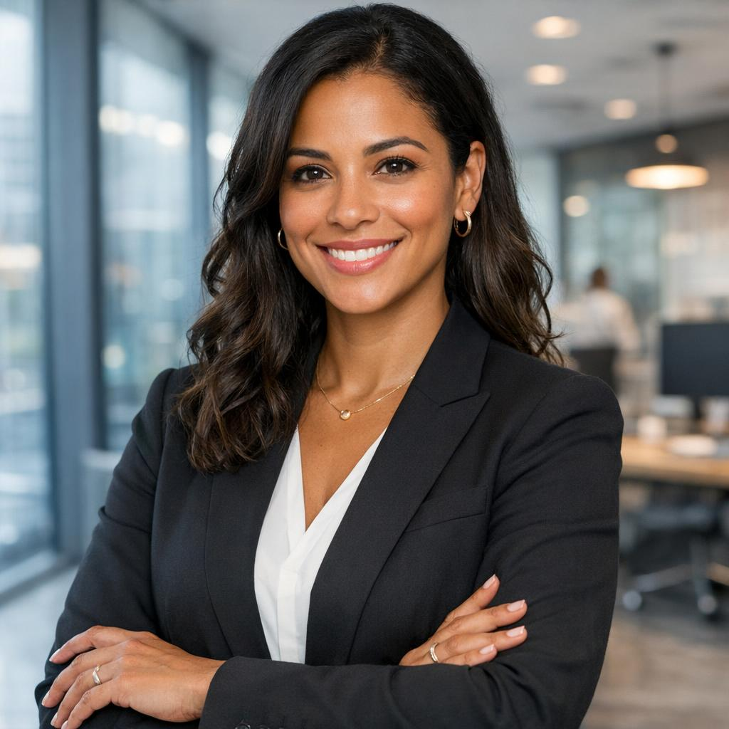

Manage Risk
Understand and acknowledge
External assistance
Strong policies and procedures
Notes:
Now that I have appropriately terrified you about the risks your regions face, what do you do now?
Three things:
acknowledge the risks you face -- you can't manage what you haven't identified.
Build strong policies and procedures around your known risks, like SIA's Standards for Working with Youth.
And use external assistance -- meaning insurance -- where it makes sense.

Slide 82

Insurance Requirements
  All Regions - required to purchase all appropriate insurance
  U.S. Regions
    General Liability Insurance → SIA policy
        Shared by all U.S. Regions and clubs
    Directors & Officers → Individual policy
        Required for regions, strongly encouraged for clubs
Notes:
All regions are required to purchase appropriate insurance for their country.
For US regions, SIA carries General Liability insurance on your behalf -- that per-capita cost is included in your dues.
Directors and Officers insurance is required for all regions and is contracted separately by each region.
That is your responsibility as governor to make sure it's in place.
We strongly encourage clubs to carry D&O as well.

Slide 83
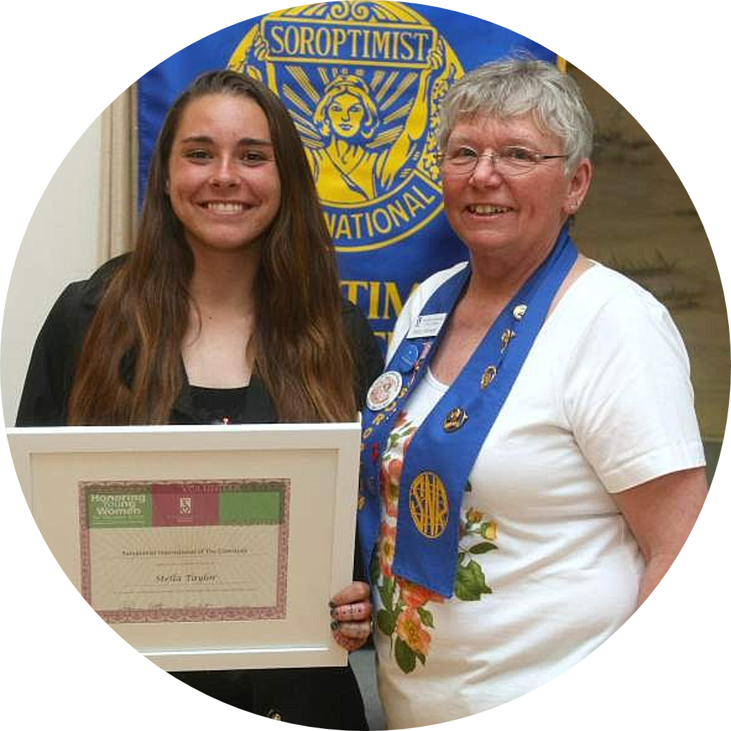
Types of Insurance
  General Commercial Liability *
  Abuse and Molestation*
  Liquor Liability*
  Professional Liability *
  Directors and Officers
  Cyber
  Crime
  * For U.S. Regions, included in SIA issued policy
Notes:
Let me quickly run through the main coverage types.
As I go, if you're outside the US, ask yourself whether your region has an equivalent:
General Liability: Covers accidental injuries at Soroptimist events. Foundational for any organization that gathers people.
Abuse and Molestation: Covers claims involving youth and vulnerable populations. Given our work with youth through Dream It Be It, this one is directly relevant to our activities.
Liquor Liability: Protects the region if a claim arises from alcohol at an event. Local laws vary significantly -- know what applies in your area.
Professional Liability (Errors and Omissions): Protects the organization if a decision is later challenged in a civil lawsuit. Even volunteer organizations get sued.
Directors and Officers: Protects the personal assets of your board members and officers. Required for US regions. If you're outside the US, find out if an equivalent is available, your volunteers deserve this coverage.
Cyber: Covers losses from ransomware or data breaches. A growing risk everywhere.
Crime: Covers intentional financial theft directed at the organization -- the modern replacement for bonding.

Slide 84
Best Practices
Contacts Transferring Risk
Events
Youth & Vulnerable Populations
Cyber & Financial Security
Notes:
A few best practices before I move to resources:
Never sign a contract that shifts liability to your region without talking to your Gallagher service center or legal counsel first.
US regions -- for events with 500 or more attendees, alcohol sales without venue coverage, or events on the exclusions list, make sure to file a Special Events Application well in advance and obtain the proper coverage.
If members serve alcohol, they must be TIPS-trained and the certificates must be on file.
If you are outside the US, make sure you know your local laws surrounding events and any coverage needed.
Follow SIA's Standards for Working with Youth with no exceptions.
Use multi-factor authentication on financial accounts, make sure more than one officer has account visibility, and if something looks wrong, call your bank's fraud department and law enforcement immediately.

Slide 85

Q&A
Notes:
That is everything I have for you today. Thank you for your attention and, more importantly, for the commitment you've made to stewarding your regions well.
The women and girls we serve depend on all of us doing this right.
There are some resources on the next 2 slides that will be available when this is published for you.
And know everyone at HQ is available to assist you and I am always available as well.
Please don't hesitate. I'd much rather answer a question early than see a problem come up later
Now -- what questions do you have?

Slide 86

Resources
SIA Procedures, F. Procedures Governing Regions,
8. b. All regions outside of the U.S. and its territories are required to purchase all appropriate insurance policies as is necessitated by the country they operate in. These insurance policies are to be purchased by the region with an insurance broker of their choice. All regions (whether within or outside the U.S.) are to forward certificates of insurance (in English) to SIA headquarters when each insurance policy issues or is renewed or upon request of SIA headquarters.

Slide 87

All Regions - Resources
Leadership Commitment Tool
Standards Working with youth
TIPS (Training Intervention Procedures Training (for events serving alcohol

Slide 88

U.S. Regions Only - Resources
Changes for SIA’s U.S. Club and Region Insurance Program
Club & Region Insurance Overview & Handbook
Certificate of Insurance Request Instructions and Form
Directors & Officers/Management Liability Insurance Information
Notes:
Next up: Erica Cheslock

Slide 89
SIA Collaborative Culture of Philanthropy
The Governor’s Role
Erica Cheslock
Director of Donor Relations
SOROPTIMIST INTERNATIONAL OF THE AMERICAS, INC
Notes:
Hello, my name is Erica Cheslock and I am the Director of Donor Relations. On behalf of the Fund Development team, I am happy to share with you today about how your role as Governor supports successful fundraising. It's important for me to note that what I am sharing today is consistent with the messaging we are sharing with the region fundraising chairs. This will help us to all work together as one team committed to empowering a culture of philanthropy.

Slide 90
Agenda
Review the Fund Development Team structure and responsibilities
Overview of how funds support Soroptimist’s local and global impact now and in the future
Soroptimist’s fundraising strategy, best practices, and fundraising ideas
Highlight how Region Fundraising Chairs can be supportive of our goals
Notes:
In today’s orientation, we want to help you champion fundraising in your region and support your region’s fundraising by:
Reviewing all the teams supporting fundraising and their role at SIA.
Giving you a review of Soroptimist’s local and global impact. We will talk about how contributions and dues, as well fundraising initiatives that are supporting and making an impact today and, in the future, as we reach strive towards our 2031 Big Goal.
Talking through Soroptimist’s year-round, multi-channel fundraising strategy, along with some best practices from the fundraising sector.
And, finally, providing you, as Region Governors, with some specific and actionable ideas about how you can support Soroptimist’s fundraising goals and our shared impact.

Slide 91

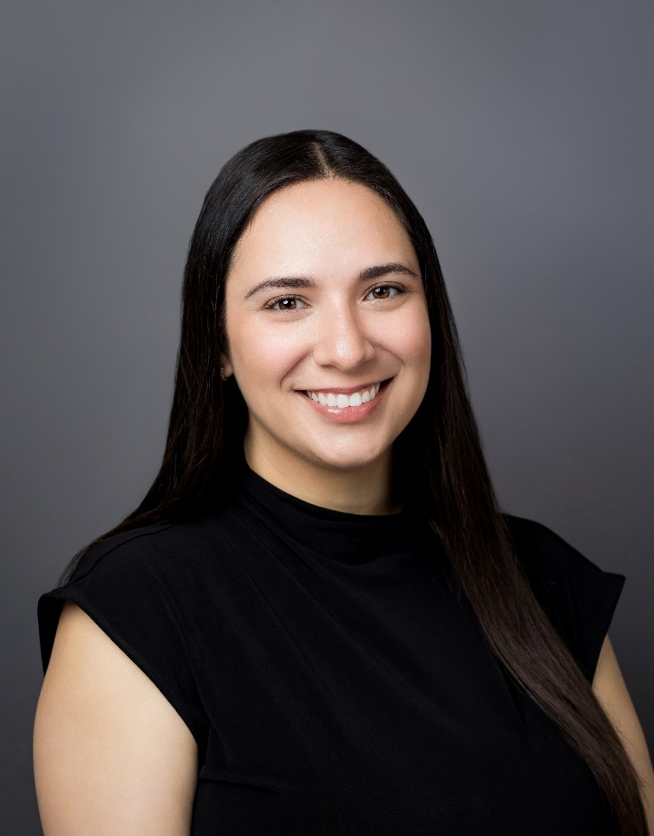
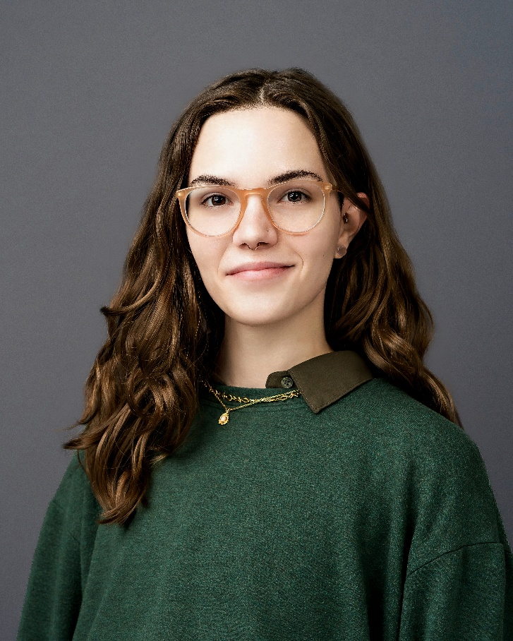
Fund Development Team
Erica Cheslock
Ilana Hirsch
Brooke Todd
Director of Donor Relations
Associate Director of Fund Development
Fund Development Associate
Notes:
Let’s start with brief staff introductions. In my role as the Director of Donor Relations at SIA I work closely with the Fund Development team to raise annual funds for our programs, including individual, major, planned and club gifts. I collaborate with the Federation Fundraising Council a committee of volunteer leaders focusing on raising funds to support our global mission.
My colleague Ilana Hirsch, our Associate Director of Fund Development, focuses on creating fundraising strategies for Individual Giving, Corporate partnerships, and fundraising campaigns that support our global Dream Programs. Ilana works closely with the Region Fundraising Chairs, who are our volunteer leaders focusing on raising funds to support our global mission.
brooke todd, Fund Development Associate, is our team member who focuses on all things reporting, donor stewardship, Stargazer monthly giving, and providing excellent service to our members by responding to inquiries that come into the department.

Slide 92
Fund Development Team
Executive Director
SIA Staff
Federation Fundraising Council
Region Fundraising Chairs
Region Governors
Board of Directors
Note: This diagram outlines only the direct reporting lines. In addition, success depends on communication/coordination lines extending between all groups.
Notes:
Our team has six different groups from the board of directors to the SIA staff. First, we have the Board of Directors. The board has the ultimate responsibility to ensure we have the resources to achieve the strategic goals they set.
They do this by modeling the way with gifts to the organization of personal significance. They are also our ambassadors and spokespeople for our mission and impact, sharing their Soroptimist why and encouraging others to give generously to support our impact.
Next is the Federation Fundraising Council. This is a committee of the board and is responsible for strategies to meet annual giving revenue goals through club and individual giving. The FFRC has a close relationship with you, the Region Fundraising Chairs, to build support for contributions and are always available to support your efforts.
Next, you, our Region Governors. You are the main point of connection between the federation board of directors, headquarters staff, and the clubs within their region. They work to ensure that all the clubs have the support and resources they need to carry out the SIA mission.
Next, we have the Region Fundraising Chairs, who are appointed by the region governors. They are responsible for promoting financial support for the Dream Programs through individual and club contributions. In a recent Governors survey, region fundraising chairs were the most visible fundraisers in the region and the people the governors go to first when they have questions. You need to stay informed about annual campaigns and be knowledgeable about connecting donors and supporters to key members of the Fund Development team.

Slide 93


What does it mean to empower a culture of philanthropy?
Notes:
I'll start with a question. Please feel free to raise your hand and we'll take a few responses from the group.
What does 'empowering a culture of philanthropy' mean to you?

Slide 94
The Culture of Philanthropy
Prioritize
Collaboration
Support
Empower
Valuing and prioritizing fundraising.
Recognizing that fundraising enables the organization to put our mission in motion.
Fostering a collaborative environment where fundraising ideas and strategies are openly shared.
Ensuring the development staff has the support and resources they need to succeed.
Empowering those involved to see themselves as a part of the impact from fundraising.
"Fundraising isn't just about raising money; it's about sustaining the heartbeat of an organization, fueling its mission, and empowering its impact."
Notes:
Now, let's talk a bit about Soroptimist's culture of philanthropy.
According US based fundraising coach, Joe Garecht:
“A culture of philanthropy is a non-profit culture that values and prioritizes fundraising. Non-profits that have such a culture in place offer the fund development team the support and resources they need to succeed and recognize that fundraising enables the organization to do everything else that it does. Without fundraising, there is no money for programs, staff, overhead, or anything else.
The best fundraising organizations in the world don’t compartmentalize their fundraising… they see fundraising as integral to everything they do. The fund development team interacts regularly with (and are seen as equals by) the program team, and everyone works together to make sure both programs and fundraising succeed.”
This is what we hope that you, as the incoming Region Governors, will help us build at SIA. Our goal is to empower you to see yourself as a part of the impact through fundraising efforts. This Culture of Philanthropy will be key as we work together to achieve our 2031 Big Goal!

Slide 95

Contributions
Live Your Dream Awards
Resource Development
Dues
Member Services & Translations
Governance & Administration
Technology
International Partnerships
Notes:
One of the most common questions, we are asked by members is “What do our dues and donations to Soroptimist International of the Americas go toward?”
Our individual and club contributions fund our global Dream Programs and their expenses, including resource development. This includes LYDA for newly chartered clubs, awards for women who don’t live near a club, and federation level awards. Each year thousands of women apply for a Live Your Dream Award but are not within 75 miles of a Club. These women still apply and are eligible for a Federation Award. Additionally, top Live Your Dream Awards recipients from each region are eligible to be chosen to receive an additional federation award. Contributions also cover materials for Dream It, Be It and ongoing work to provide relevant program content for our members and clubs.
Membership dues pay for the administrative costs, governance, and overall operating expenses associated with running the organization. Dues do not fund the Live Your Dream Awards, Dream It, Be It or Soroptimist Club Grants. They do fund things like member services which includes leadership development opportunities such as the Leadership Round Table and Federation Leaders Meetings; as well as club recruitment tools and translations for our non-English speaking members so that they may participate fully in the life and leadership of our organization.

Slide 96
Your Involvement in Today’s Impact
Local and Global Impact
Club and Region Fundraising
Individual and Club Support
LiveYourDream.org
Corporate and Foundation Support
Notes:
Clubs and members are hard at work in their communities fundraising, building public awareness, and investing in women and girls through the Dream Programs. This local impact- stories of women and girls who have been uplifted through the Live Your Dream Awards and Dream It, Be It, happens in clubs all throughout our organization. When we unite all the local efforts of our over 1,200 clubs throughout our federation we are able to see our collective impact.
Financial support raised each year through annual contributions, from both individuals and clubs, is dedicated to funding our Dream Programs- the Live Your Dream Awards and Dream It, Be It today. Annual support is put to work right away to meet the immediate needs of women and girls through the Dream Programs.
LiveYourDream.org has also helped our organization to grow our nonmember donor base. As individuals who are interested in our mission learn more about how they can advocate for our work on LYD.org, they are becoming repeat donors and part of our growing base of supporters. We are continuing to build wonderful corporate and foundation partnerships with companies who find out about us through LYD.org. The online platform is also helping us to grow and support impact!

Slide 97
Feeling Comfortable Fundraising
Asking for money is not the only way you can be an active part of the fundraising process
Open the door and make introductions
Stewardship of Donors
Notes:
Let’s dive into ways we can feel comfortable fundraising.
The top 3 reasons why people do not like to fundraise:
1. Many view this as a negative experience
2. The fear of rejection
3. They think that soliciting gifts is the only way to participate in fundraising
Did you know- Asking for money is not the only way you can be an active part of the fundraising process?
Open the doors and make introductions. By making an introduction for SIA staff to make the direct ask or join you on a donor call.
Stewardship of donors is another role both governors and region fundraising chairs can assist in. This is as simple as picking up the phone and making a call to say thank you to a member in your region or sending a quick email expressing gratitude for their support.
You have a powerful sphere of influence.. Leverage it in support of your regions! Share your why.. People intrinsically like to give, and many don’t because they are never asked directly.

Slide 98

Support SIA Fundraising Goals
Speak Positively
Share your Soroptimist Why
Ask for Time on Agendas
Connect with the Federation Fundraising Council
Like and Share on Social Media
Engage your Club in SIA Initiatives
Notes:
Creating a culture of philanthropy is something we can all do to help SIA achieve its fundraising goals year after year. I'd like to share with you some ideas you can begin putting into practice today to help increase donor engagement and therefore fundraising success.
One of the most impactful ways to help is to speak positively about fundraising. Rather than viewing it as a necessity, emphasize that fundraising is essential to advancing our mission and supporting our Dream Programs. Sharing your personal Soroptimist “why” can also inspire others to give and stay engaged. Another important step is ensuring fundraising has a place on Region Conference and other major meeting agendas. These conversations help educate members about fundraising initiatives and the impact their support makes.
You can also stay connected with the Federation Fundraising Council and fundraising leaders throughout the year. Share resources, training, and ideas so you feel confident communicating fundraising messages with clubs across your Region. And if you need support, SIA staff are here to help.
Finally, help amplify our message by sharing Soroptimist and LiveYourDream.org content on your Region and personal social media channels. This not only engages current members but also introduces new audiences to our mission. It can even help identify potential members, donors, and supporters who want to make a difference. This could include our annual Giving Tuesday, International Women's Day and Walk for Women, and 100 Stargazers campaigns.
Walk for Women is a wonderful example of how fundraising and awareness-building work hand in hand. By participating, sharing, and encouraging others to join, you help strengthen our community of supporters and advance our mission throughout the year.
Furthermore, every new Stargazer strengthens our ability to create sustainable change. Together, through the 100 Stargazers in 100 Days campaign, we can expand our impact and ensure more women and girls have the opportunity to achieve their dreams.
These are just a few ways you can help strengthen our culture of philanthropy and support our fundraising success.

Slide 99
Resources
Federation Fundraising Council Members
District and Region Meeting Presentations
Monthly and District/Region Meeting Reports
Forms and other resources
Laurel Society Recognition
Federation Leaders Meetings
SIA Staff
Notes:
Now let's talk about some of the resources that are available to you as a Governor to both support your region fundraising chairs and take an active role in fundraising:
As mentioned earlier, the Federation Fundraising Council U.S. Country Leader will be your closest ally in helping you with your role. For 2026-2027, the Federation Fundraising Council Members are Charlie Rodgers, Chair; Jennifer Erickson, Chair-Elect; Susan Gilbey, US Country Leader; and Junko Ayabe, Japan Country Leader. We also plan to bring on an additional country leader in 26/27.
SIA provides presentation content for both district and region meetings so that you can share on topics relevant to philanthropy with members in your region. We are always looking for your input to help make these presentations relevant to your needs.
SIA staff provides reports to help you fundraise, recognize members in your region, and help them reach a new Laurel Society level. These reports are typically provided to the RFCs by the 15th of each month for all gifts the previous month. We also provide reports for in-person meetings and encourage the regions to recognize donors (both individuals and clubs) at all meetings.
We have a variety of downloadable resources and forms for Laurel Society, Stargazers, Club Giving and Laurel Legacy are also available on this page.
Our Federation Leaders Meetings serve as additional training and informational session for you. It’s a great opportunity to learn about current fundraising projects and how we work collectively to make a larger impact for those we serve.
As mentioned earlier, don't hesitate to reach out to SIA Fund Development staff to work with you on fundraiser ideas and brainstorm any challenges you may be having. I'll share more information on the next slide about how to set up a time to chat with us.

Slide 100
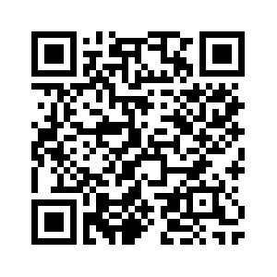

Contact Us
Erica@soroptimist.org
Ilana@soroptimist.org
brooke@soroptimist.org
Or
development@soroptimist.org
Scan the QR Code to
Book a Meeting with Us!
Notes:
Thank you all so much for joining us today to talk about working together to build a culture of philanthropy and reach our fundraising goals.
If you have any questions, please feel free to reach out to us via email. Staff email addresses are provided on the screen. Additionally, you can scan this QR code and book a 30-minute call with a member of our team.
As always, thank you for all that you do.

Slide 101
Q&A
Notes:
Now, we will take a few moments to answer questions you may have. While we may not have time for every question, please be sure to write your questions down and I am happy to chat with you after our meeting today and throughout convention.
Up next: Laurie Sutton

Slide 102
Branding & Public Awareness:
Strengthening Our Voice Together
Laurie Sutton
Manager, Marketing & Communications
SOROPTIMIST INTERNATIONAL OF THE AMERICAS, INC
Notes:
Welcome everyone. My name is Laurie Sutton, and I am part of the SIA’s marketing and communications team. Congratulations on your new role as region governors. We’re excited to partner with you over the next two years as we continue strengthening and growing the Soroptimist brand around the world.

Slide 103
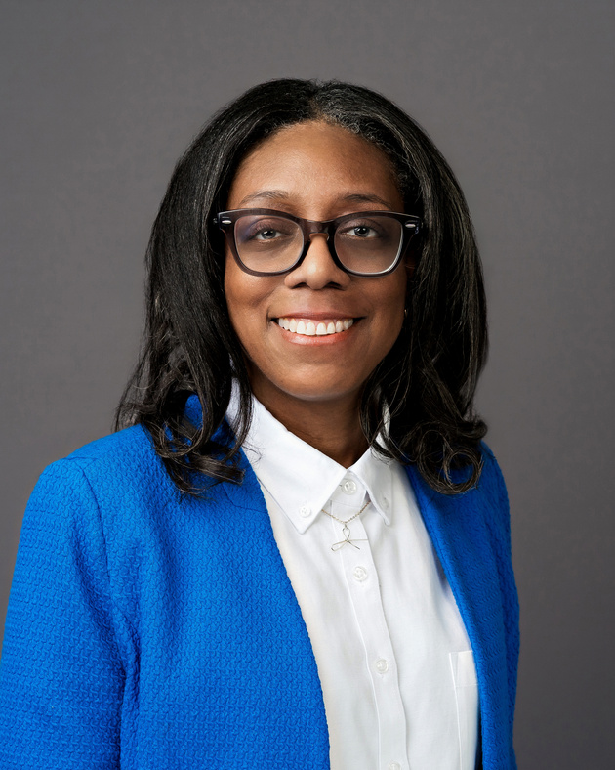
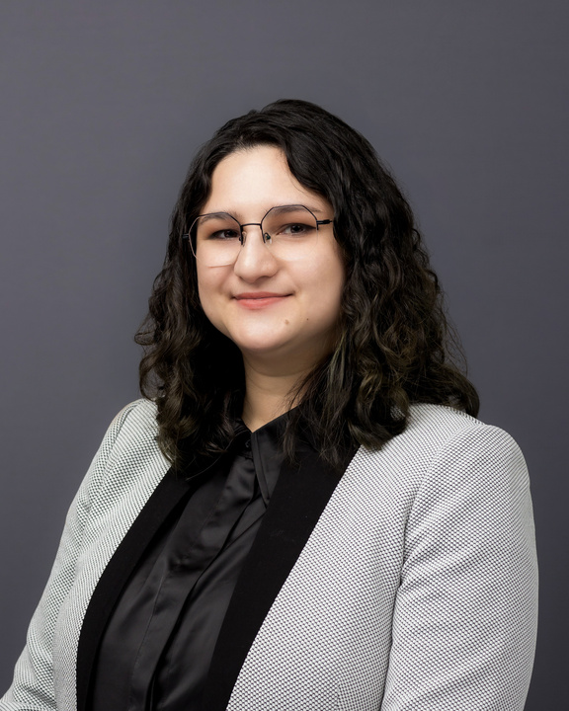

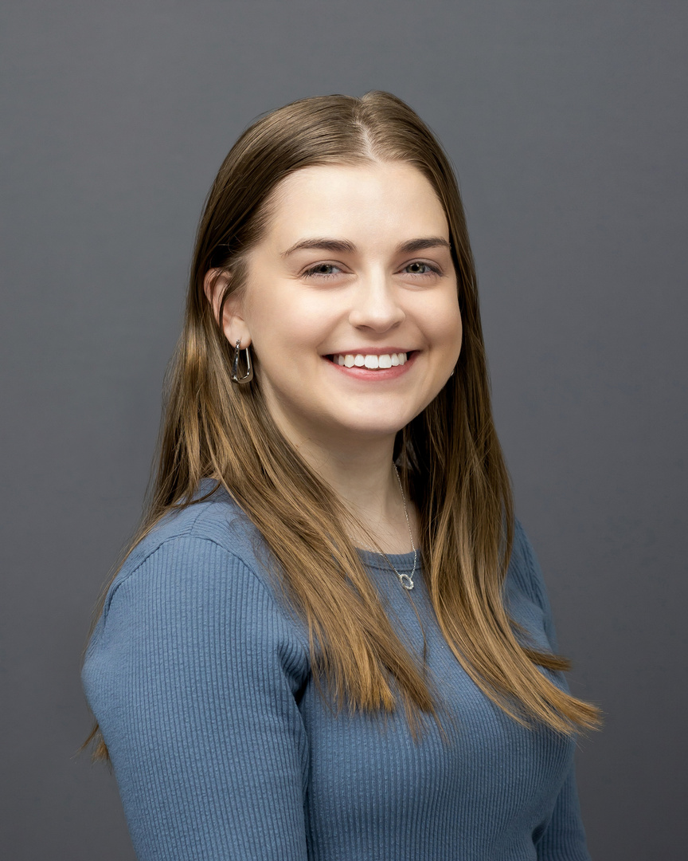
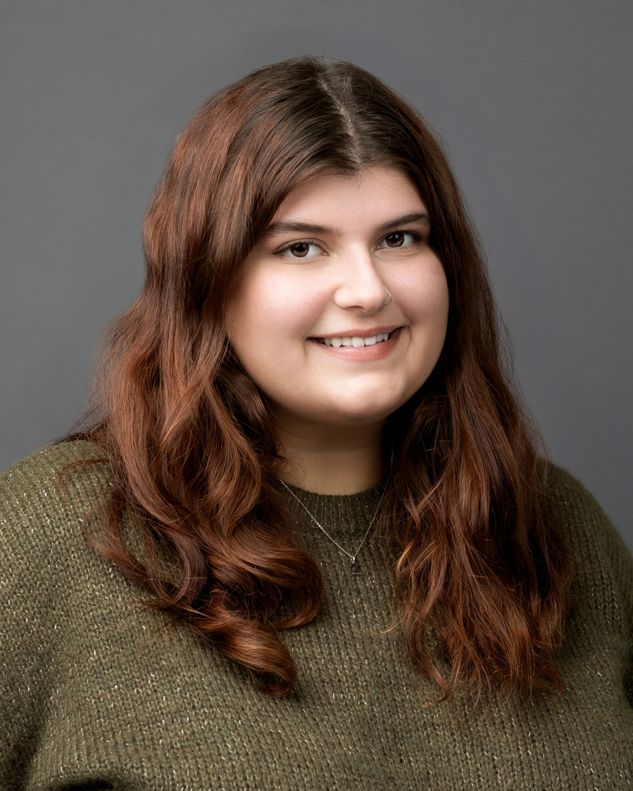
SIA’s MarComm Team
Kamali A. Brooks
Karen Rauppius
Laurie Sutton
Associate Senior Director of Global Marketing
Manager of Digital Growth
Manager of Marketing Communications
Sierra Carey
Zoe Wainer
Global Marketing & Engagement Associate
Marketing Engagement Specialist II
Notes:
This is our Marketing and Communications team:
Kamali Brooks, Karen Rauppius,
Sierra Carey, and Zoe Wainer.
Together, we bring a mix of creative, technical and strategic expertise to support SIA’s mission. Our work includes everything from branding and graphic design to websites, email communications, social media, BFW, digital marketing, video and much more.
But while our team develops the tools, resources, and communications that support the federation, we can’t build our brand alone. Every governor, region, and club plays an essential role in shaping how Soroptimist is seen and experienced in communities around the world.

Slide 104

One Brand. One Goal.
Drive meaningful actions to increase impact through global marketing and communications.
Notes:
One of the goals of our strategic plan is to strengthen SIA’s brand recognition and visibility. That’s a goal no one can accomplish on their own.
Building a strong, recognizable brand takes all of us working together—staff, federation leaders, regions and clubs—to consistently tell our story, present ourselves professionally and help more people recognize who we are and the impact we make.
As governors, you’re in a unique position to influence the clubs throughout your region. The guidance you provide, the examples you set and the resources you encourage clubs to use all help move us toward this shared goal.
Today is not about getting you to do the work of the MarComm team. It’s about preparing you to be ambassadors for a strong, unified Soroptimist brand so that, together, we can increase recognition and amplify our impact worldwide.

Slide 105

Today’s Roadmap
How governors can champion clear, unified communications
How clubs can leverage existing resources and tell compelling stories
Why a strong, consistent brand builds trust, recognition and credibility
Notes:
So how do we get there? Today, we'll focus on three key areas:
Why a strong, consistent brand builds trust, recognition and credibility.
How you, as governors, can champion clear, unified communications throughout your region.
How clubs can leverage existing branding resources and tell compelling stories without reinventing the wheel.

Slide 106
Why Consistency Matters
Trust
Recognition
Familiarity
Trust
Credibility
One consistent brand. Hundreds of clubs. One global impact.
Notes:
Let’s start with the “why.”
When people see or hear about Soroptimist, we want them to immediately recognize who we are and what we stand for.
That doesn't happen by accident. It happens when clubs, regions and the federation consistently use the same logo, visual identity and messaging. Over time, those consistent communications build familiarity, and familiarity builds trust.
The same is true for Soroptimist. Every time a club follows our brand standards and presents a consistent message, it strengthens our collective identity and makes it easier for people to recognize and remember our organization.
These may seem like small details, but across hundreds of clubs, they add up to one powerful, recognizable Soroptimist brand.
As governors, you have the opportunity to help put these principles into practice throughout your region, with the help of your region public awareness chair. By encouraging clubs to use approved branding, leverage existing resources and share their stories consistently, you'll help strengthen the Soroptimist brand and advance our shared goal of increasing recognition and visibility.

Slide 107

One Brand. One Focus.
Themes can be a great way to create excitement, but Soroptimist already has a unifying focus—our mission.
Notes:
One way we build consistency is by aligning around one shared message.
Show of hands—how many of you are considering a theme for your biennium?
(Pause.)
Themes can be a great way to create excitement, but Soroptimist already has a unifying focus—mission.
When every region communicates the same strategic focus, we present one clear direction for our organization. Creating separate biennium themes can unintentionally compete with that message and make it harder for members—especially new members—to understand our collective direction.
Themes are still a great fit for conferences, leadership trainings and special events. But for your biennium, the strongest example you can set is keeping your region's communications aligned with Soroptimist's mission, strategic plan and brand.

Slide 108
One Global Brand
DO:
DON’T:
  Use Soroptimist logo
  Use customizable logo templates
  Keep Soroptimist front and center
  Create separate region logos
  Alter the Soroptimist logo
  Create a separate visual brand
Notes:
Our messaging is only one part of a strong brand. The way we visually represent Soroptimist matters just as much.
One area where governors can make a significant impact is helping clubs and regions avoid creating separate visual identities.
Conference and event themes are perfectly appropriate. But regions should continue presenting themselves under one Soroptimist brand. Creating separate logos or visual brands for external use weakens recognition of the organization we've spent more than a century building.
Instead, encourage clubs to use the approved Soroptimist logo—including our new customizable club logo templates—which allow clubs to celebrate their local identity while strengthening one recognizable global brand.
The goal is simple: celebrate what's unique about your region while always keeping Soroptimist front and center.

Slide 109

Champion the Brand.
Make clear, consistent communications the priority.
Notes:
One of the most important ways governors strengthen the Soroptimist brand is by making clear, consistent communications a priority.
The good news is that you don't have to be the marketing expert.
Think of your role as the champion for consistent communications. You set the tone by encouraging clubs to use approved resources and supporting a unified Soroptimist brand. Your region public awareness chair is your communications partner, helping clubs use available resources and stay aligned with our brand standards.
Together, you help create a stronger, more recognizable Soroptimist brand throughout your region.

Slide 110
3 Questions Every Club Should Ask
Is this on brand?
Is there a template for this?
Should we share this story with SIA?
Your region public awareness chair can help put this into action!
Notes:
One of the simplest ways to champion clear, unified communications is to encourage clubs to pause and ask a few simple questions before creating something new.
Your region public awareness chair can help reinforce these habits by reminding clubs to ask:
1. Is this aligned with the Soroptimist brand?
2. Do we already have a template or resource we can use?
3. Is this a story or success we should share with SIA?
As governor, you champion the importance of these practices. Your region public awareness chair can help clubs put them into action.

Slide 111
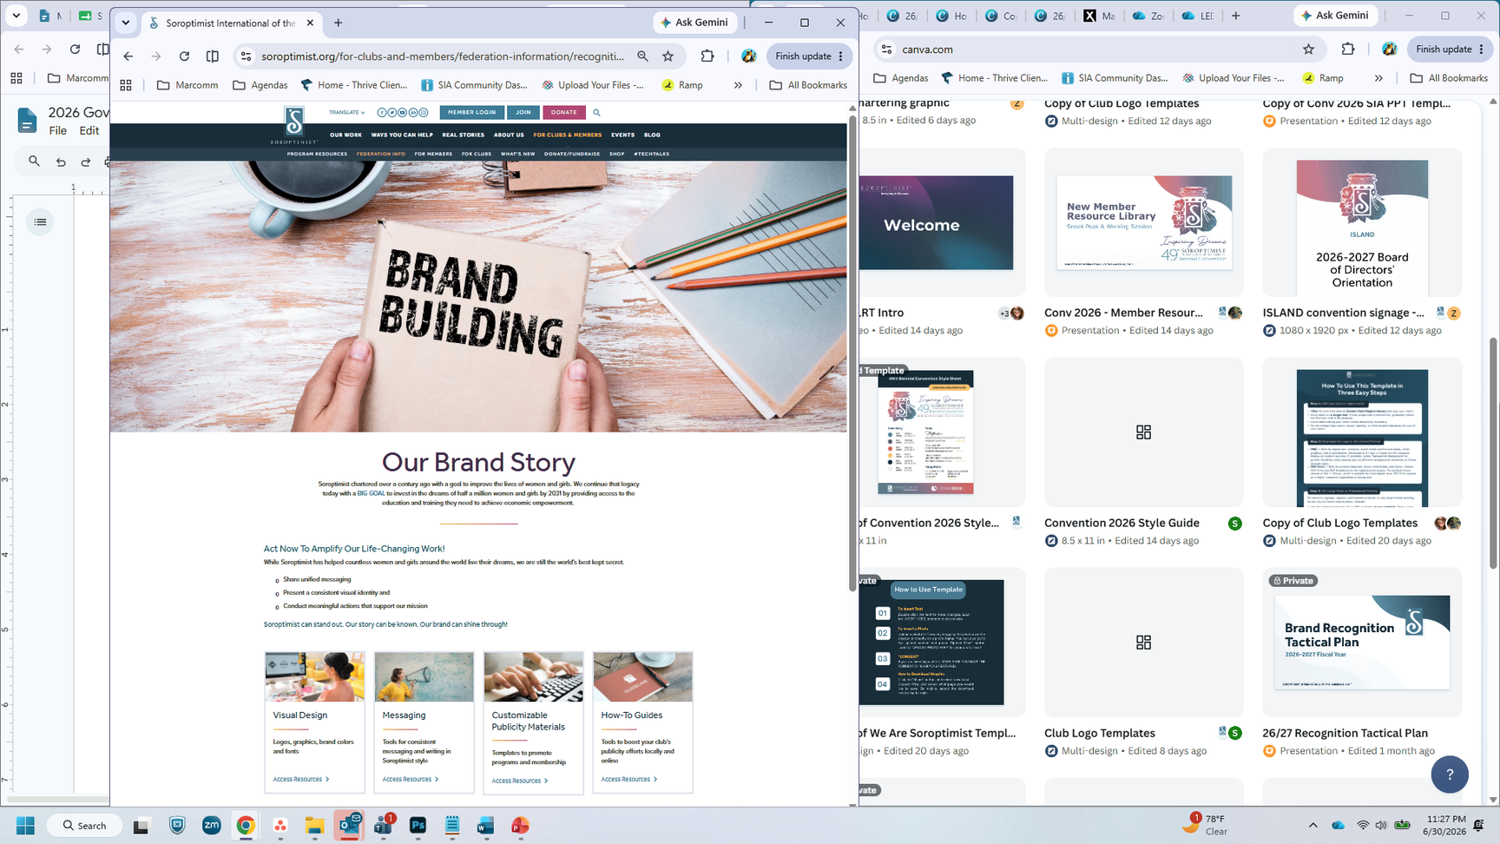
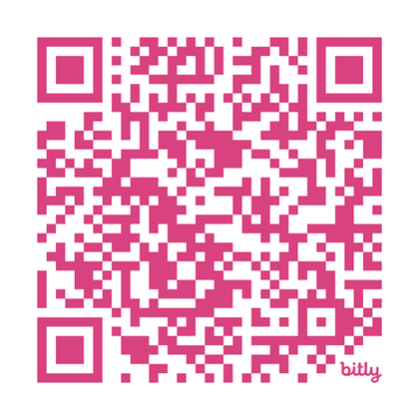

Don’t Reinvent. Leverage What We Have!
  Logo templates
  Social media tools
  Brand guidelines
  Customizable materials
  Canva templates
  Website guidelines
  Key messaging
  Style guides
Notes:
We've talked about why consistency matters and how you can champion it throughout your region. Consistency is much easier to achieve when clubs don't have to create everything themselves.
The good news is that clubs don't have to start from scratch.
One of the best ways you and your region public awareness chair can support clubs is by connecting them with the resources that already exist. The Recognition & Branding section includes tools and templates designed to save time, maintain consistency and help clubs communicate with confidence. Show of hands—how many have had the chance to visit this section of the website?
(Pause)
Whether a club needs a logo, presentation, social media graphic or branding guidance, chances are we've already created a resource to help. The goal isn't to make every club look exactly the same. It's to make sure every club is unmistakably Soroptimist.
When clubs begin with approved resources, they spend less time creating materials and more time advancing our mission in their communities.

Slide 112



NEW! Customizable
Logo Templates
  Personalize with club/region name
  Maintain brand consistency
  Canva & Adobe Illustrator files
  Blue, black and white
  Vertical & horizontal
Notes:
One example I’d like to highlight is our new customizable logo template.
These templates allow clubs or regions to personalize the Soroptimist logo with their own name while maintaining a consistent global brand. These templates are available on the Recognition & Branding page and can be customized using Canva or Adobe Illustrator.
It's the best of both worlds—clubs and regions can celebrate the communities they serve while strengthening one recognizable Soroptimist brand.

Slide 113

Powerful stories
aren’t about programs.
Powerful stories are about people.
Notes:
While consistency helps people recognize us, stories help people connect emotionally with our mission. The most powerful stories aren't about programs—they're about people.
Who was helped?
What challenge did they face?
How did Soroptimist make a difference?
What changed because we were there?
Those are the stories that inspire others to join, give and support our mission.

Slide 114
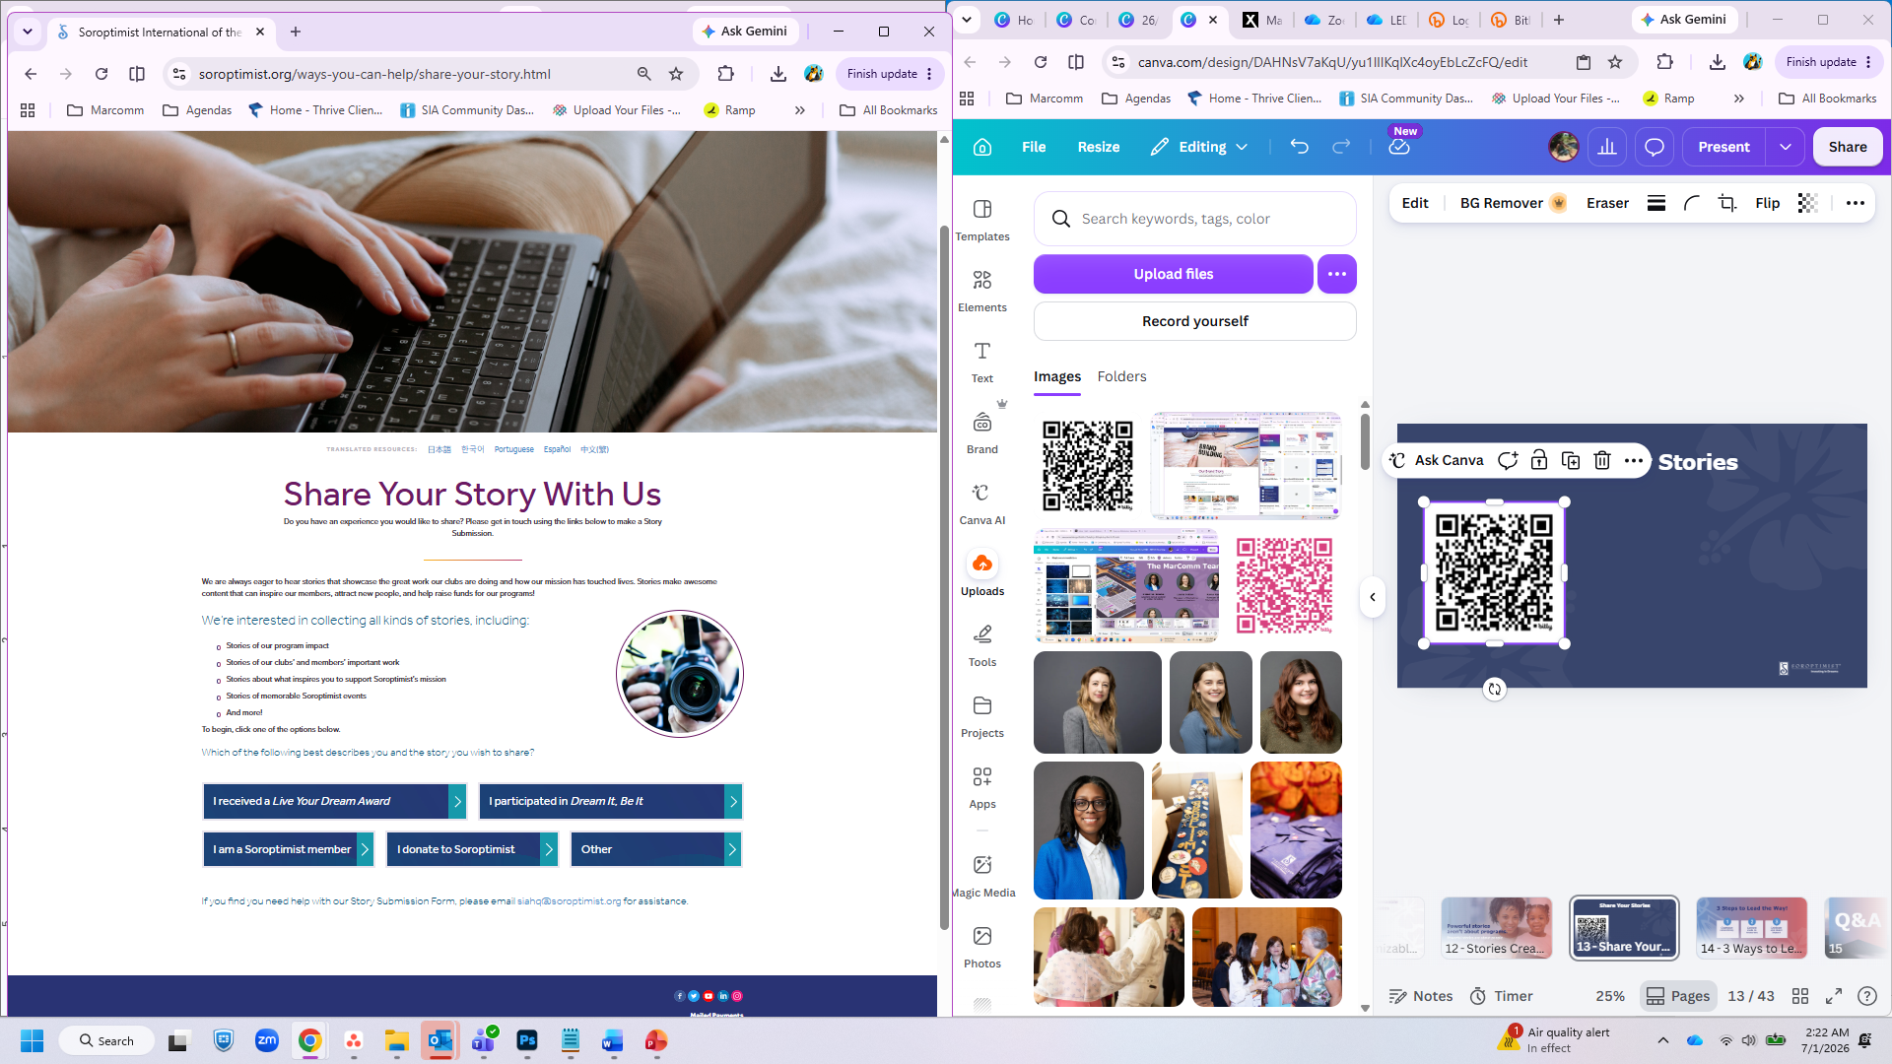
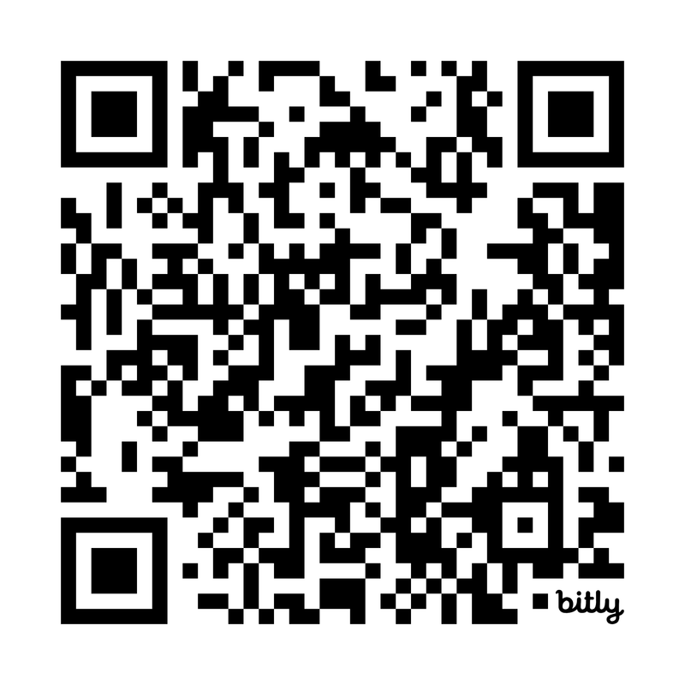
Share Stories
Notes:
Amazing work is happening in clubs every day—but if those stories aren't shared, we miss opportunities to inspire others and increase Soroptimist's visibility.
As governors, you can encourage clubs to make storytelling a regular habit, and your region public awareness chair can help remind clubs to submit their stories and photos through the Share Your Story form on SIA’s website.
Many of our most engaging communications begin with stories submitted by clubs. We are always eager to hear stories that showcase our program impact, clubs’ and members’ important work, memorable Soroptimist events and more. Every story shared helps showcase our collective impact and strengthens the Soroptimist brand.

Slide 115
3 Steps to Lead the Way as Governors!
Champion consistency
Connect clubs to resources
Celebrate and share impact
Every communication, every resource, every story is an opportunity to strengthen the SIA brand!
Notes:
As you begin your biennium, here are three ways you can strengthen the Soroptimist brand in your region.
Champion consistency:
Encourage clubs to align their communications with Soroptimist's mission and brand.
Connect clubs to resources:
Work with your region public awareness chair to help clubs use the Recognition & Branding resources instead of creating materials from scratch.
Celebrate and share impact:
Encourage clubs to submit stories and photos through the Share Your Story form so we can showcase the incredible work happening throughout the federation.
Every communication, every resource and every story is an opportunity to strengthen the Soroptimist brand. And you are helping lead the way.

Slide 116

Q&A
Notes:
Thank you for your leadership and your commitment to strengthening the Soroptimist brand. The MarComm team is excited to partner with you throughout your biennium.
Lastly, I’d like to ask if anyone has any questions.
Thank you again for your time. Next, I would like to welcome back Incoming President Madoka.

Slide 117

Notes:
Well! It’s been a full morning – don’t you agree?
First, Associate Senior Director Nicole took us through a collaborative leadership exercise. It was fun and challenging and helped us see the benefits of working together to reach a goal. She also shared key resources available to us so we can lead with confidence.
Chief Impact & Engagement Officer Iesha talked about the role of governors and the responsibilities you are taking on.
Chief Financial Officer Kim talked to us about leading with accountability in finance, risk management and insurance.
Director Jackie explained our new member and leader code of conduct.
Director Erica shared the governor’s role in our culture of philosophy.
And finally, we just heard about branding and awareness to strengthen our voice from Manager Laurie.
Not too bad for three hours! I hope you feel good about what you have heard today. I hope you have made connections with your fellow governors.

Slide 118
IF YOU WANT TO GO FAST,
GO ALONE.
IF YOU WANT TO GO FAR,
GO TOGETHER.
Notes:
There’s a proverb that says, “If you want to go fast, go alone. If you want to go far, go together.”
And what we are doing as Soroptimists is not fast work.
It’s meaningful work.
It’s sustained work.
It’s generational work.
Reaching our Big Goal … investing in the dreams of half a million women and girls through access to education … requires alignment. It requires collaboration. And it requires leaders who are willing to bring people together.
That’s you.
When we are unified … clear about our priorities and supportive of one another … we build regions that are strong, clubs that are thriving, and an organization that is positioned to grow.
And through that growth, more women and girls gain access to education. More families experience stability. More communities are strengthened.

Slide 119
Reminders
11:30 a.m. Delegates Briefing, Inspire Ballroom
1:30 p.m. &
2:45 p.m.
Korean Cultural Event, Inspire Ballroom
Korean Cultural Crafts & Game, Mountain 1 & 2
4:30 p.m. Opening Friendship General Session &
Reception, Inspire Ballroom
Notes:
Thank you again for your commitment to Soroptimist and to being a leader in your region.
I am really looking forward to working with you in the next year.
And, more immediately – I can’t wait for this convention. I am so excited!
A few reminders, the Delegates' Briefing is in the Inspire Ballroom at 11:30 a.m.
At 1:30 p.m. in the INSPIRE Ballroom, don't miss an exciting cultural celebration — a chance to experience rich traditions, explore the depth of Korean history, and connect with fellow members who share a love of Korea's vibrant heritage. This session repeats at 2:45 p.m., so there's plenty of opportunity to join in.
During the same time, head to Mountain 1 and 2 for hands-on Korean cultural crafts — a fun way to create something beautiful and bring a handmade souvenir home with you.
And whenever you're ready, go to the store — online or in person — to get a head start on your shopping!
But don’t forget, at 4:30 p.m. in the Inspire Ballroom we really kick it off with the “Opening Friendship General Session” followed by the reception.

Slide 120

THANK YOU!
Notes:
With that, we conclude our Governors Orientation.
I sincerely thank you for stepping into this leadership role. Your willingness to serve matters. Your leadership matters.
Over the next two years, you will guide conversations, strengthen clubs, support members, and help align your regions around our shared priorities.
So as you leave this room, I hope you leave feeling prepared. I hope you leave feeling connected.
And most of all, I hope you leave feeling confident in the difference you are about to make.
Let’s embrace this biennium with clarity, collaboration, and courage.
Let’s continue investing in the dreams of women and girls.
And let’s lead in a way that ensures Soroptimist remains strong … not just for today … but for the generations of women and girls who are counting on us.
Let’s have an amazing … and impactful … biennium together.
Thank you.

