Slide 1


Combating the Great Membership Decline
Your Region
PRESENTER NAME, PRESENTER TITLE
Notes:
Hello and welcome!
I am “Your Name”, your Region Membership Chair.
In today’s presentation we will discuss Combating the Great Membership Decline.

Slide 2



Session Overview
Hear and share what clubs in your region are grappling with that may contribute to their membership decline.
Examine membership benefits and Soroptimist’s value proposition.
Build successful membership campaigns.
2025 SIA REGION CONFERENCE
Notes:
Like many service clubs, Soroptimist is facing a decline in membership. In this session, we will explore some reasons behind this trend and then discuss strategies to help attract and retain members.
We will review the benefits of membership and assess Soroptimist’s value proposition.
And we will discuss creating effective membership campaigns.
10 – 15 mins – members share their thoughts/have discussion.
Region Membership Chairs to the audience: I’d love to hear from you on why you believe membership is declining in your club.

Slide 3


Declining Membership
Increase efforts to attract new members.
Enhance club sustainability and growth support.
Survey members.
2025 SIA REGION CONFERENCE
Notes:
Increase efforts to attract new members, especially by targeting underrepresented demographics or regions.
Here are some of the ways you can do that:
Identify and reach out to potential members who align with our organization’s mission.
Use social media, email newsletters, and community events to connect with individuals likely interested in our organization’s offerings.
Ensure all communication, whether on social media, newsletters, or website content—is inclusive and representative of diverse backgrounds, experiences, and perspectives. Use language that speaks to a broad audience and makes everyone feel welcome. This will help potential members see themselves in your organization and feel more likely to join.
Highlight testimonials, member achievements, and public recognition your club has received. Social proof helps build trust and credibility with potential new members.
To demonstrate to prospective members how their contributions lead to real, tangible change, it’s important to showcase the impact of SIA’s Dream Programs: Live Your Dream Awards and Dream It, Be It, and actively engage them in these programs from the start.
Provide centralized resources and targeted incentives to ensure long-term stability and prevent potential disbandment. This could include creating a system of recognition and rewards to motivate ongoing involvement and retention.
Examine the underlying reasons for the decline in reinstated and charter members to identify areas for improvement in retention strategies. Conduct a comprehensive survey of your current membership to gather insights and feedback on their experiences, motivations, and potential barriers to continued involvement. Use this valuable data to refine engagement approaches, address concerns, and create tailored solutions that foster long-term commitment and satisfaction.

Slide 4

Membership Benefits
Make a Tangible Impact
Build Meaningful Connections
Access to Leadership Development
2025 SIA REGION CONFERENCE
Notes:
Soroptimist’s value proposition lies in its commitment to empowering women and girls through education, advocacy, and community service. By joining Soroptimist, members gain the opportunity to:
Make a Tangible Impact. Soroptimist’s programs, such as the Live Your Dream Awards and Dream It, Be It, directly support women and girls in achieving their goals. Members have the satisfaction of knowing their time, efforts, and resources are making a real difference in the lives of others.
Build Meaningful Connections. Soroptimist provides a unique space for members to build strong, lasting relationships with like-minded individuals who share a passion for service and social change. Networking opportunities extend both locally and globally, creating a supportive community of women dedicated to personal and professional growth.
Access Leadership Development. Members are encouraged to take on leadership roles within the club. Strengthen leadership by offering training or mentorship programs and create a clearer structure for leadership roles to ensure sustainability. This hands-on experience helps women develop their leadership potential while making a meaningful contribution to the organization’s mission.
Soroptimist offers members leadership development opportunities and resources to help members become effective leaders who can deliver our programs, attract and retain members, grow our philanthropy, and build our brand recognition. This environment nurtures continuous learning and development. You can find these opportunities and resources on our website under “For Clubs” area (located on the top blue bar). See the “Club Administration” and “Developing Your Leadership Skills” for more information.

Slide 5

Membership Campaigns
Example Campaign Message
  "Join Soroptimist today and be part of a global movement empowering women and girls. Enhance your leadership skills, create lasting change in your community, and build meaningful connections with a network of inspiring women worldwide.“
2025 SIA REGION CONFERENCE
Notes:
Building successful membership campaigns for an organization like Soroptimist, which focuses on empowering women and girls through community service and leadership opportunities, requires a strategic approach that resonates with both potential and existing members.
Here’s a guide to building effective membership campaigns:
Define Campaign Goals. Clarify the campaign's primary goals, such as increasing membership, retaining existing members, raising awareness, and attracting specific demographic groups.
Understand Your Target Audience. Women interested in Social Impact, Young Women, and Community Leaders.
Craft a Compelling Message. Focus on Empowerment and Impact, Personal Growth and Leadership, Networking Connection, and Support for Women and Girls.
An example campaign message: "Join Soroptimist today and be part of a global movement empowering women and girls. Enhance your leadership skills, create lasting change in your community, and build meaningful connections with a network of inspiring women worldwide.“
Create Engaging Content, such as Social Media Campaigns. Use platforms like Instagram, Facebook, LinkedIn, YouTube, and TikTok to share stories, testimonials, and behind-the-scenes content. Create compelling visuals and videos featuring members discussing their experiences and Soroptimist’s impact on their lives. You should also consider creating Email Campaigns, Website and Blog Content, and Flyers.
Community Engagement. Expand your reach to partner with local businesses, collaborate with universities/schools, and your workplace if they offer membership benefits to their employees.
Highlight Tangible Results and Impact. Share success stories from Soroptimist programs such as the “Live Your Dream” awards or “Dream It, Be It” to demonstrate the organization's tangible impact on the lives of women and girls. Provide statistics on the number of women and girls Soroptimist has helped, such as how much money has been awarded or how many local projects have been completed. Ensure every communication has a clear and actionable next step, whether joining, attending an event, or signing up for a newsletter.
Plan Events and Activities. Events can drive membership by giving people a taste of what Soroptimist is about. Some ideas are an Open House and Information Session, Volunteer and Community Service Days, and Leadership and Empowerment Workshops.
In conclusion, building successful membership campaigns for Soroptimists involves understanding the organization's values and potential members' specific needs. By crafting a compelling message, offering incentives, using targeted outreach, and focusing on engagement, you can attract and retain members who are passionate about empowering women and girls and positively impacting the world.

Slide 6
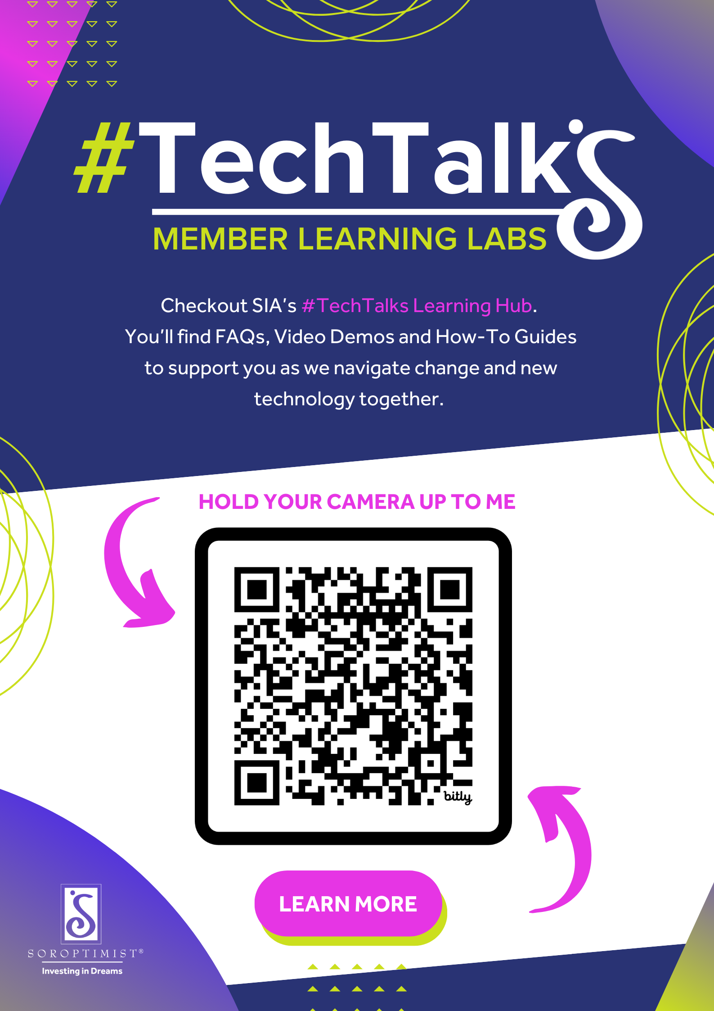
Techie Tools
Keep up with SIA’s Tech Transformation progress by visiting our #TechTalks Learning Hub.
2025 SIA REGION CONFERENCE
Notes:
Here’s a reminder to keep up with SIA’s Tech Transformation progress by visiting our #TechTalks Learning Hub.
You’ll find FAQs, Video Demos and How-To Guides to support you as we navigate change and new technology together!
You can hold your camera up to this QR code and it will directly take you to SIA’s Portal Information page. (Region Membership Chair, if you have time, have members hold their camera up to the QR code to access the page.)

Slide 7



Please Contact me or SIA Headquarters with any questions.
Thank you!
Your name and title
Your email address
SIA Headquarters
siahq@soroptimist.org
2025 SIA REGION CONFERENCE
Notes:
Thank you for your time. Please contact me or SIA Headquarters with any questions.

