Slide 1


THRIVING THROUGH CHANGE
2025 SIA REGION CONFERENCE
, PRESENTER TITLE

Slide 2



Change is inevitable.
"The only constant in life is change." - Heraclitus
Notes:
There is a famous quote by Heraclitus.
"The only constant in life is change." – and it has been confirmed over the last decade. Think about life as you know it pre and post Covid. Who would have ever imagined that a large number of workers would be working from their homes and meeting with one another via Zoom. I think it would be difficult to find anyone who would say they saw this coming in 2019.

Slide 3
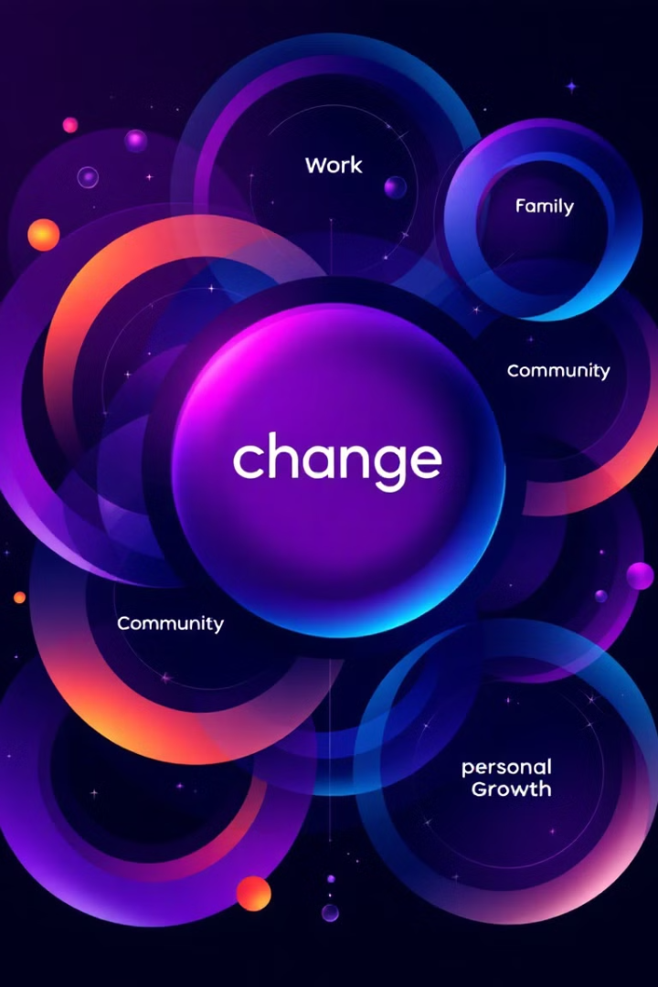
The Common Thread: Change
2025 SIA REGION CONFERENCE
Notes:
However, just like every other challenge we face in life, whether its Covid, Retirement, or increased gas prices – they are all ultimately a manifestation of change. And, our ability to adapt and thrive is key to overcoming these obstacles.

Slide 4

A personal perspective on change.
Notes:
While many change management strategies focus on organizations or businesses as a whole, we need to consider how we, as individuals, navigate change. This personal perspective is crucial for both personal growth and organizational success.
That growth, like many other things often comes in stages. Think about a recent change you had to make. No matter how big or small.

Slide 5
Change: A Journey of Personal Growth
Anger
Acceptance
Adaption
Denial
1
1
2025 SIA REGION CONFERENCE
Notes:
If you research it, you may find a number of psychologists who have identified the – quote/unquote- stages of change. One that stands out, breaks it down into four stages. Denial, Anger, Acceptance and Adaptation.
Let’s use an example to walk through the stages. Say you go to the market one day to buy your favorite brand of (insert product). You walk in the market, head straight to isle 7 (because that is where it always is), walk to the middle of the isle and look on the second shelf- then WOW! Its not there. What is your first thought? Denial. Well it just can’t be. This is where it always is. It must be me. I need to look a little harder. Maybe even ask someone for help finding it. Denial is the initial reaction we have to changing circumstances.
Next phase could be Anger. As the reality of change sets in, the store no longer sells (insert product) or the company has gone out of business- we may experience anger and frustration, even questioning why things are changing. That’s the anger phase.
Ok, after we have ranted and raved and embarrassed ourselves in the market (ANGER) over (insert product). We finally just accept the fact that it’s not there and may never be again. Acceptance the next phase- is when we come to terms with the change and begin to accept the new reality.
Now, here comes the hard one. Adaptation, not to be confused with Acceptance. Adaptation, is when we adapt to the new circumstances and embrace the opportunities that change brings. Using our shopping trip example, we look for another brand or flavor and are introduced to something different. We realize that there are other brands or flavors out there and stretch ourselves.
Sound familiar?

Slide 6


Embracing Change.
Reflect
Share
Connect
2025 SIA REGION CONFERENCE
Notes:
At this time, I am going to ask you to grab a partner next to you and spend four (4) minutes each to talk about a time when you had to change. Keeping in mind the four phases I just talked about.
(once they partner up- restate instructions)
Reflect
Think back on a time when you had to adapt to a significant change in your life.
Share
Discuss your experience with your partner, focusing on the stages of change.
Connect
Recognize the universal nature of change and its potential for growth.

Slide 7

Change as an opportunity for growth.
2025 SIA REGION CONFERENCE
Notes:
Change can be disruptive, but it also presents opportunities for growth, creativity, and innovation. By fostering a culture of openness to change and providing support for our members, we can unlock the full potential of our organization and achieve greater impact.
Understanding the stages of individual change helps us to be more empathetic and supportive of one another as we navigate personal challenges. Providing resources and tools for adapting to change can foster a culture of resilience and growth not only individually but also within our organization.

Slide 8

Applying change management to our organization.
Notes:
Just like, individuals, organizations like Soroptimist also find change necessary. However, organizations are made up of individuals and without individual willingness- change is not possible.

Slide 9

Applying Change Management to Clubs.
Inclusivity
Communication
Engagement
Reflect
Share
Connect
2025 SIA REGION CONFERENCE
Notes:
Examples of this are the changing ways we communicate with one another over time. We went from mailing letters, to fax machines, to text messages and emails. How we engage, if you all remember the virtual convention we had in 2022 and how that was completely different from anything we had ever done before. But it opened up the opportunity for clubs and regions to follow suit as a viable option. And the shift to being more inclusive – many of our clubs have male members or members from varying backgrounds.
Its through these changes, our organization has grown and evolved. And we are stronger for it.

Slide 10

Group Discussion:
15 New Members
2025 SIA REGION CONFERENCE
Notes:
Let’s take some time now for a table discussion. Imagine your club gets a VIRTUAL knock on the door and on the other side are 15 new members who can’t wait to join your club. They all come from diverse backgrounds, genders, education, and economic status.
Now here is the question, what will your club need to change in order to welcome and retain those members. I want you to dig deep, take a hard look and have an honest discussion.
Designate a scribe for each table and document what you come up with. I will ask each table to present when we are done, so you will also have to designate a spokesperson.
Presenter Notes:
-You may want to give them a few examples to get them started
-The discussion should be 10 minutes. Give them a 2 minute warning before their time is up.
-Once they are done ask each table to report out what they came up with to the group.
-Ask for someone to document the examples given by each table and report that on your OV report to SIAHQ

Slide 11

Moving forward,
Embracing change.
Notes:
I hope you walk away from here with a better understanding of the stages of change and create opportunities for you to identify and recognize when you are experiencing personal challenges during change.
Let's embrace change as a catalyst for positive growth, both individually and as an organization. We are stronger together, and by supporting each other through the stages of change, we can create a more resilient and impactful future.

