Slide 1


Embracing Change, Celebrating Success & Committing to Inclusivity: A Call to Action for Soroptimists
2025 (region name) Region Conference
PRESENTER NAME, PRESENTER TITLE

Slide 2




Hello my fellow Soroptimists.
Embracing change.
Celebrating successes.
Creating a welcoming club experience.
Need an icon? Search GRAPHICS in the Elements tab and change the color to #f69170.
2025 SIA REGION CONFERENCE
Notes:
Hello, my fellow Soroptimists!
Thank you all for gathering here today. It is a true honor to stand before you as we explore three vital actions that can transform our community and empower women and girls: embracing change, celebrating successes, and creating an inclusive club experience.

Slide 3
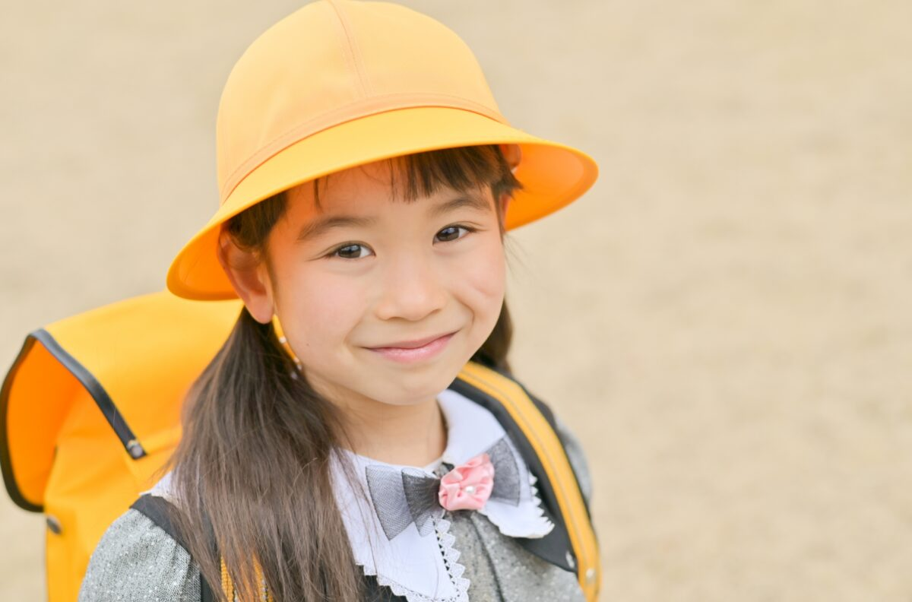
Importance of embracing change.
Vital for growth.
Diverse voices build innovation.
Notes:
To kick things off, how many of you feel that embracing change is important for growth? Please raise your hands!
[Pause for response]
Wonderful! My journey as a board member has revealed just how powerful embracing change can be. In a world where barriers still exist for women and girls, our global board brings together diverse voices and viewpoints. This diversity fosters a culture that not only welcomes change but also enhances our strategic vision.

Slide 4

Facing Change
Can be daunting.
Challenges our comfort zones.
Opens doors to opportunities.
2025 SIA REGION CONFERENCE
Notes:
Now, let’s be honest: change can be daunting, can’t it? It challenges us and pushes us beyond our comfort zones. Yet, it also opens doors to new opportunities for growth. As we strive to empower more women and girls, we must embrace change wholeheartedly. This means adapting our programs, policies, and even our ways of working to meet the evolving needs of our organization.

Slide 5

Adapting our Approaches.
TEXT
Stay relevant to the needs of women and girls.
TEXT
Notes:
Let’s consider the rapid advancements in technology, the shifts in our economic landscape, and the diverse challenges faced by women and girls today. By being open to change, we can spark innovation in our initiatives, ensuring we remain relevant and effective in our mission.
So, let’s approach change not with fear, but with excitement!
[OPTIONAL: Share an example of how a personal experience with Soroptimist or club created new opportunities]

Slide 6



Contact Us
email@soroptimist.org
Let’s Celebrate!
26,000 women and girls helped.
750 new members.
40,000 volunteer hours!
Notes:
As we embrace change, it’s equally important to celebrate our successes—both big and small. Each achievement marks a significant step forward and reflects the hard work and dedication of our members.
And today, we have so much to celebrate! In the last fiscal year, we proudly supported nearly 26,000 women and girls through our Dream programs, providing over 3 million dollars in awards.
But that’s not all! We also welcomed more than 750 new members into our community and contributed an astonishing 40,000 volunteer hours together!
[OPTIONAL: Share a personal club win or success]

Slide 7

Recognition for our Efforts
Let’s applaud our collective dedication!
Inspiring others through recognition.
2025 SIA REGION CONFERENCE
Notes:
These achievements highlight our collective dedication and impact. So, let’s take a moment to acknowledge the strides we’ve made together.
Can I please get a round of applause for our efforts?
[Pause for applause]
Thank you! Your hard work and commitment are what make our mission possible!
Celebrating these milestones fosters a culture of positivity and motivation. When we acknowledge our successes, we inspire others to strive for their goals. Whether it’s a successful workshop, a mentorship match, or a financial award, every victory deserves recognition. Let’s share our stories and uplift one another, creating a ripple effect of empowerment that reaches beyond our club.

Slide 8

Creating a Welcoming Club
Every member should feel valued and heard.
2025 SIA REGION CONFERENCE
Notes:
Finally, and perhaps most importantly, we must commit to creating an inclusive club experience. An inclusive environment is one where every member feels valued, heard, and empowered to contribute.
Let me ask you all a question. How many of you believe that everyone should feel welcome in our clubs? Please raise your hands!
[Pause for response]
Great! It’s wonderful to see so many hands raised. Now, let’s dive a little deeper.
Inclusivity means creating an environment where everyone feels valued and respected, regardless of their beliefs, ideas, or background. When we foster inclusivity, we not only enhance our club’s culture but also encourage diverse perspectives that can lead to more innovative ideas.

Slide 9
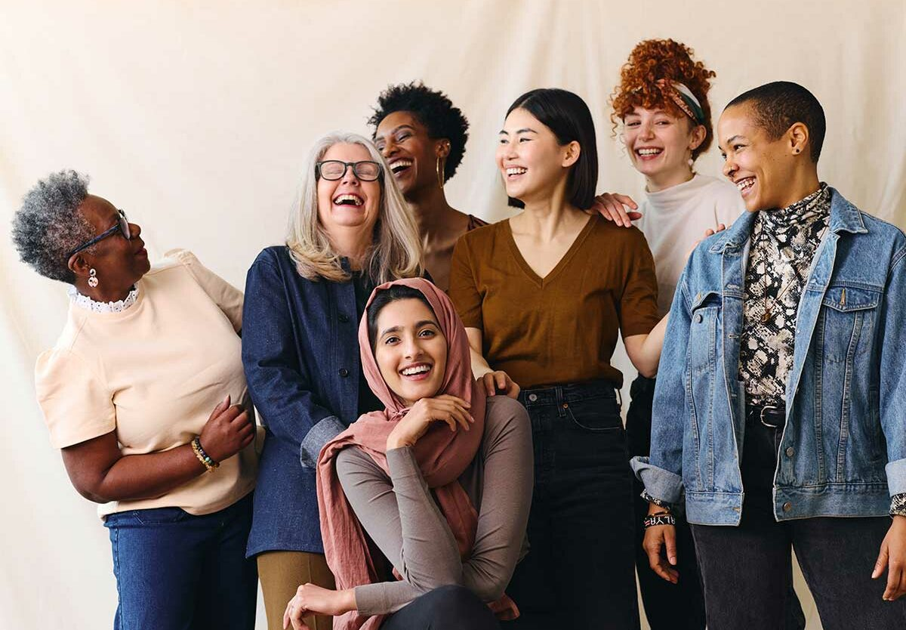
Taking Action Together.
TEXT
Listen actively.
Be respectful.
Speak up.
TEXT
Notes:
Now, how many of you have ever felt excluded or witnessed someone being treated unfairly in a club setting? Please raise your hands.
[Pause for response]
Thank you for your honesty. It’s crucial that we acknowledge these experiences—they remind us that our actions matter.
Inclusion is not just a goal; it’s a practice. As Soroptimists, we must cultivate a culture where everyone feels safe and encouraged to share their ideas. By doing so, we create a rich tapestry of experiences that enhances our collective wisdom and effectiveness.

Slide 10
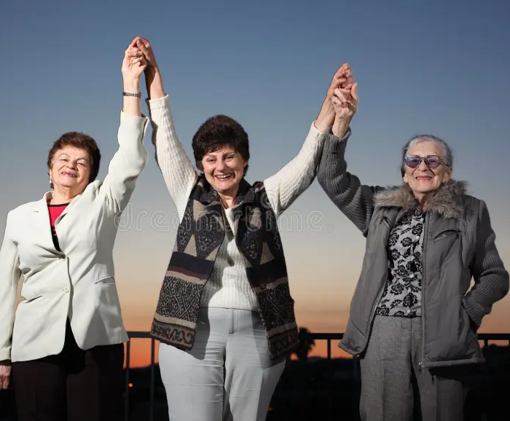
Our Commitment Matters
Raise your hands if you commit to:
  Listening
  Kindness
  Standing up for others
Notes:
So, what can we do? Here are three simple actions I encourage you to take:
The first is to listen actively. When someone speaks, give them your full attention. Now, how many of you commit to really listening to others? Raise your hands!
[Pause for response]
Excellent!
Number two, be respectful. No matter our differences, let’s treat each other with kindness. Hands up if you agree that civility is key!
[Pause for response]
Great, thank you.
Now our final action, and this is a big one, is to speak up. If you see someone being excluded or disrespected, don’t hesitate to speak up and let others know that such behavior is not acceptable in our clubs. Who here will pledge with me to stand up for others? Let’s see those hands!
[Pause for response]
Thank you!
If we all commit to these simple actions, we have a powerful opportunity to create clubs that are not just inclusive but also thriving communities. Together, we can make a real difference!

Slide 11
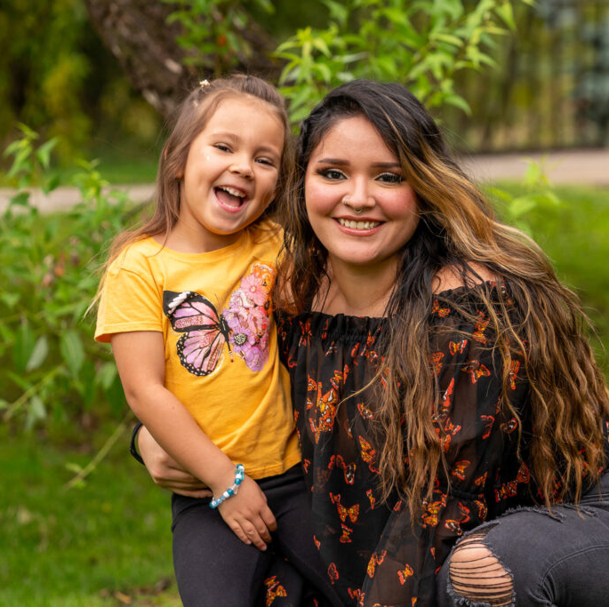
Together We Can Make a Difference
(o to elements > photos/videos and choose media to place here)
2025 SIA REGION CONFERENCE
Notes:
In closing, let us embrace change with open arms. Let us celebrate our successes with pride. And let us commit ourselves to inclusivity in every aspect of our club. Together, we can create a nurturing environment that empowers even more women and girls to reach their dreams!
Thank you!

Slide 12
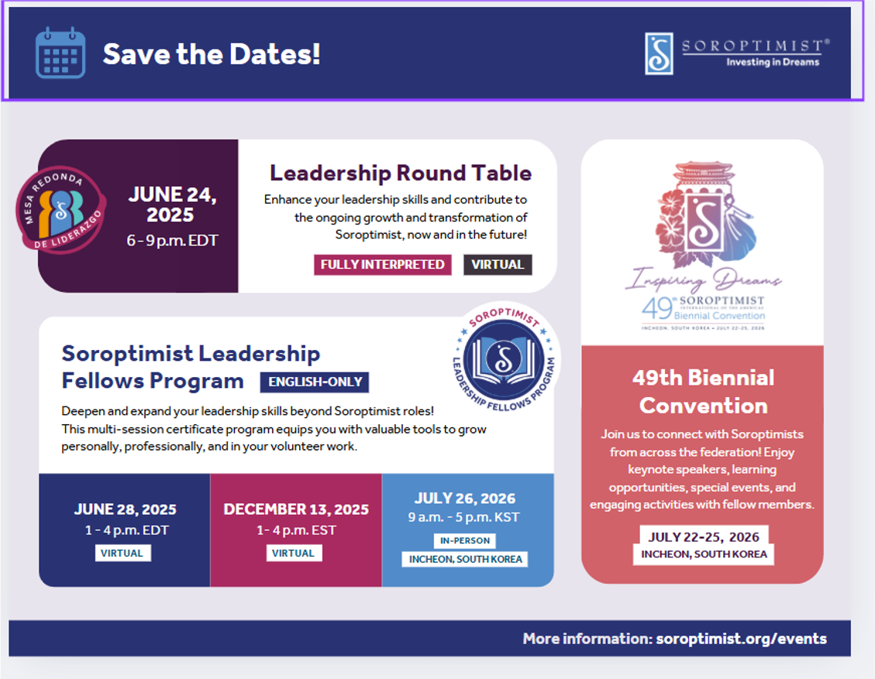
Notes:
Before you go, I encourage everyone to take advantage of our upcoming events: the Leadership Round Table, the Soroptimist Leadership Fellows Program, and our 49th Biennial Convention in Icheon, South Korea! Thank you all once again for your participation!

