Slide 1



Overcoming Your Fear of the Ask
Building Fundraising Confidence
SOROPTIMIST INTERNATIONAL OF THE AMERICAS, INC.®
2025 (region name) Region Conference
PRESENTER NAME,REGION FUNDRAISING CHAIR
Notes:
My name is [Your Name], and I’m thrilled to be here with you today to discuss a topic that many of us can relate to- overcoming the fear of fundraising. Asking others to financially support our programs can sometimes feel intimidating, but it’s also one of the most impactful ways to ensure the success of the incredible work we do to empower women and girls.

Slide 2


Presentation Objectives
Strengthen your approach
Overcome common fears and barriers
Inspire potential donors
Foster a culture of gratitude and donor relations
Notes:
Today, my goal is to provide you with strategies and tips to build your confidence when asking for support. We’ll focus on techniques to strengthen your approach, overcome common fears, and inspire potential donors to join you in making a difference.
Many of you may already have experience in fundraising or stories of success, and I encourage you to share those. Let’s dive in!

Slide 3


Why Does “The Ask” Matter?
Drives funding for our programs
Helps build stronger connections
Raises awareness of our mission
Opens the door for partnership opportunities.
2025 SIA REGION CONFERENCE
Notes:
The Ask is about more than just fundraising, it’s the foundation for advancing our mission and creating impact.
First, it drives the funding needed to deliver our programs, like the Live Your Dream Awards and Dream It, Be It.
Second, it builds stronger relationships. Asking opens a dialogue that fosters trust and long-term connections with members, donors, and partners.
Third, it raises awareness of our mission. Every ask is an opportunity to share our story and broaden our reach.
Finally, it opens doors to partnerships. Businesses and organizations want to engage in meaningful work, and your ask can create new opportunities for collaboration.
Remember, The Ask isn’t just about money, it’s about building relationships, inspiring others, and creating lasting change.

Slide 4


Common Barriers to Fundraising:
Fear of rejection
Lack of confidence
Negative views on fundraising
Notes:
Fundraising can feel challenging, but understanding the common barriers can help us overcome them.
First, there’s the fear of rejection. Hearing a ‘no’ can feel discouraging but remember, it’s NOT personal. Every ask plants a seed for future opportunities!
Second, a lack of confidence can hold us back. Confidence grows with preparation and passion. When you believe in our mission, others will too.
Lastly, negative views on fundraising and talking about money can make the process feel uncomfortable. Instead of focusing on the ask as a transaction, think of it as an invitation to create meaningful change together. Sometimes we can talk ourselves out of asking all together because we preliminarily make decisions for the donor with thoughts such as- "They will say no, they gave last year." Or "They told me they were giving to another nonprofit organization."
By recognizing these barriers, we can shift our mindset and approach fundraising with confidence and purpose.

Slide 5
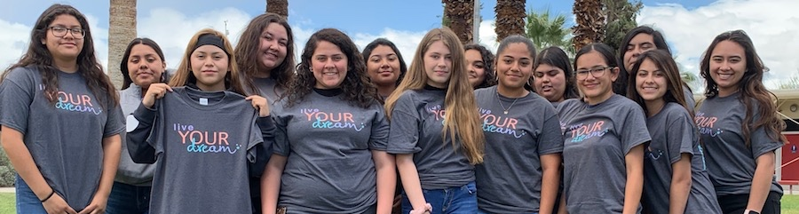
Reframing the Ask
Opportunity to be a part of the Soroptimist mission
Make an impact
Alignment with values and passion
How do they want to be involved?
2025 SIA REGION CONFERENCE
Notes:
Shifting how we view The Ask can make all the difference. Instead of seeing it as asking for a favor, think of it as offering an opportunity: an invitation for someone to join our mission and be a part of creating meaningful change.
Remember, donors want to make an impact. People give because they believe in something bigger than themselves. Your job is to show them how their support directly contributes to our programs.
It’s also important to align the ask with their values and passions. Take time to understand what matters most to your potential donors, and tailor your ask to reflect that connection. This makes the ask feel personal and meaningful.
Finally, don’t assume how someone might want to help. Ask them how they’d like to get involved. Whether it’s through a donation, volunteering, or partnership, giving them options ensures they feel engaged in a way that resonates with them.

Slide 6


Strategies for a Confident Ask
Know Your “Why”
Practice your Pitch with Peers
Be Authentic and Passionate
2025 SIA REGION CONFERENCE
Notes:
Confidence is extremely important when it comes to making the ask. Let’s explore a few strategies to help you feel prepared and empowered.
First, know your “why”. Take time to reflect on why you’re passionate about our mission and the impact it has. When you’re clear about your purpose, it’s easier to communicate your message with conviction. Think of your favorite SIA story, why you joined, or why you’re still here!
Next, practice your pitch with peers. Rehearsing what you’ll say helps you refine your approach and work through any nerves. Peers can provide valuable feedback and help you feel more comfortable.
Lastly, be authentic and passionate. People respond to sincerity. When you speak from the heart and let your passion for SIA’s mission shine through, your enthusiasm will inspire others to join you.
Remember, a confident ask isn’t about being perfect. It’s about being prepared, genuine, and passionate about the change you want to create.

Slide 7

Tools You Can Use
Storytelling
Networking
Transparency
SIA Resources
2025 SIA REGION CONFERENCE
Notes:
To make your ask more effective, it’s important to use the right tools. These strategies will help you connect with donors and inspire them to support our mission.
First, there’s storytelling. Sharing a compelling story about a Dream It, Be It, workshop, LYDA recipient, or favorite SIA memory. Stories create an emotional connection, showing donors the real impact of their support and what is means to be a part of our mission.
Next, focus on networking. Building relationships within your community both in-person and online helps expand your reach. Networking creates opportunities to connect with people who share your passion and want to get involved. Utilizing your current network is also a great option to help spread awareness of your club’s work!
Transparency is also key. Be clear about where donations go and how they directly support our programs. When donors see the tangible results of their contributions, they’re more likely to stay engaged and continue giving.
Don’t forget to use SIA resources. From templates and guides to fundraising toolkits, Soroptimist provides a wealth of materials to support your efforts. These tools are designed to make your fundraising easier and more effective.

Slide 8
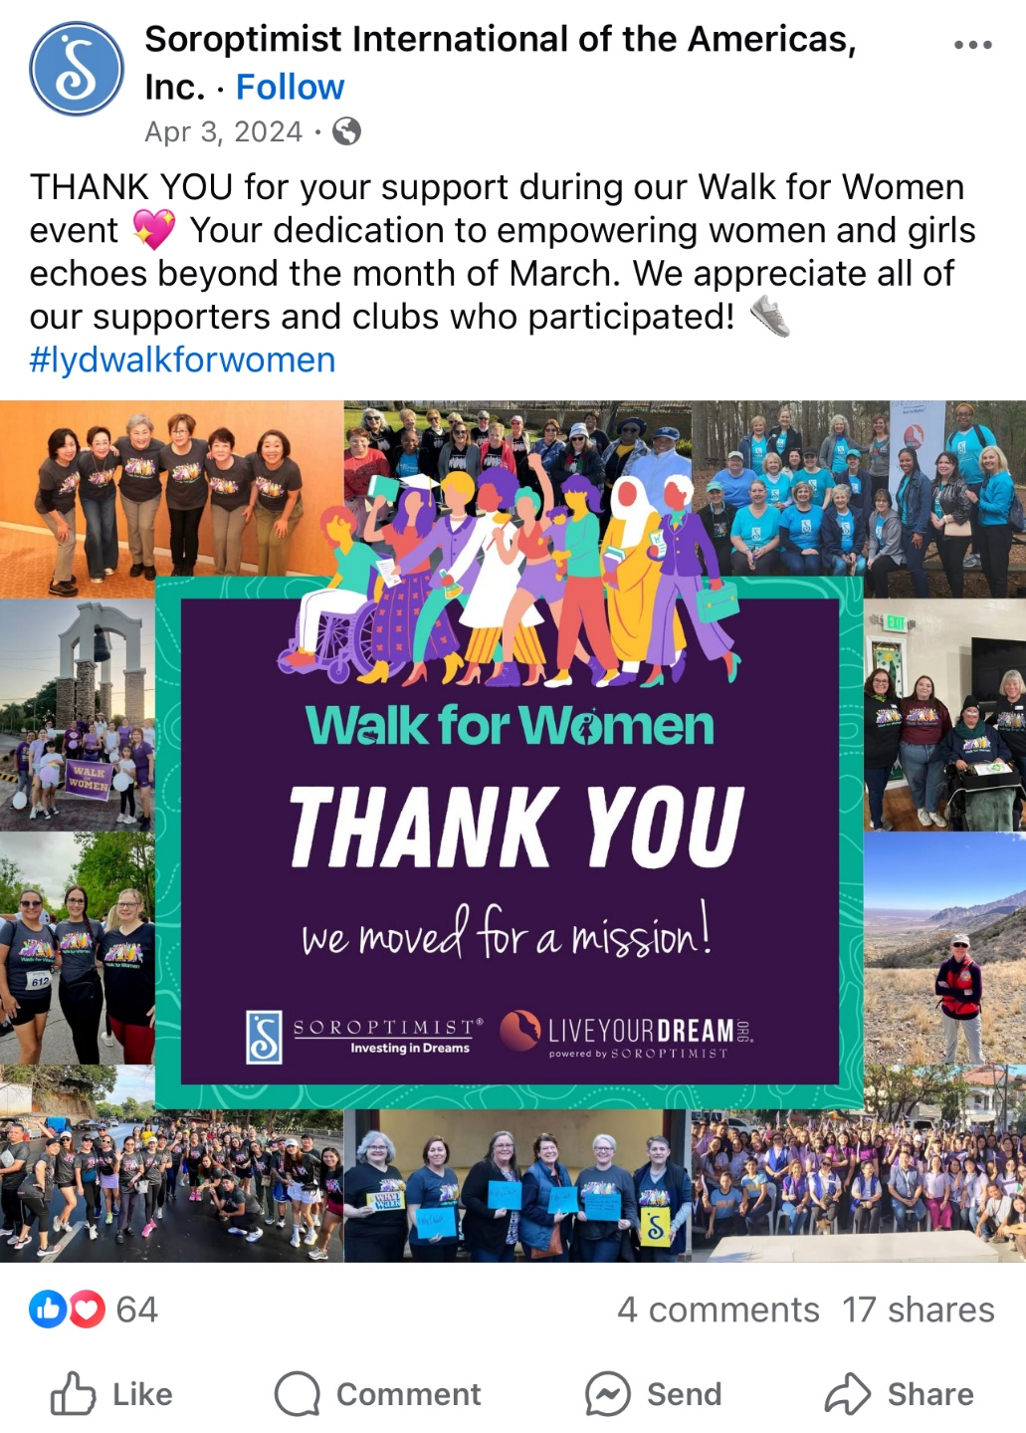
Recognizing Donor Contributions
Social Media Shout Outs
Newsletter Recognition
Personalized Thank-You Notes
Highlighting Impact Through Stories
2025 SIA REGION CONFERENCE
Notes:
Recognizing donors is a vital part of the fundraising process. It shows appreciation, builds stronger relationships, and inspires continued support. Let’s talk about some effective ways to acknowledge the generosity of our donors.
Utilize your club’s social media pages for social media shout-outs. Publicly thanking donors on platforms like Instagram, Facebook, or LinkedIn not only shows your gratitude but also raises awareness about their support and inspires others to give. If they are a company, make sure to tag them which will help your post reach further!
Another great option is newsletter recognition. Including donor names or spotlighting their contributions in your club's newsletter gives them well-deserved acknowledgment while showcasing how their support makes a difference. Make sure to add them to your mailing list before doing so! This will also keep them in the loop for new opportunities to support your club.
Personalized thank-you notes are incredibly meaningful. Taking the time to write a heartfelt, individual message shows donors that their contribution is valued and appreciated.
Finally, highlight the impact of their support through stories. Share specific examples of how their donation has helped transform the lives of women and girls. When donors see the direct results of their generosity, it reinforces the importance of their contributions.
By incorporating these methods you’re not just recognizing donors, you’re building deeper connections and inspiring continued involvement in our mission.

Slide 9

Key Points to Remember
  YOU have a powerful sphere of influence… Leverage it in support of your club!
  People intrinsically like to give, and many don’t because they are never asked.
  Overcoming the ask leads to greater impact.
2025 SIA REGION CONFERENCE
Notes:
As we wrap up, let’s focus on a few key points to keep in mind as you approach fundraising with confidence and purpose.
First, remember that you have a powerful sphere of influence. Your network of friends, family, colleagues, and community connections is an incredible resource. Leverage these relationships to share Soroptimist’s mission and invite others to support your club’s efforts.
Second, people intrinsically like to give. Many want to make a difference but don’t because they’ve never been asked. By taking the step to make the ask, you’re giving them an opportunity to align their generosity with a meaningful cause. Having the courage to receive either a yes or no means you are on your way to successful fundraising!
Finally, overcoming the ask leads to greater impact. Every time you step out of your comfort zone to ask for support, you help strengthen our programs, broaden our reach, and create lasting change for women and girls around the world.
Remember, YOUR efforts matter. Our collective impact continues to grow because of YOU!

Slide 10

RESOURCES
How to Ask for Donations
Building Confidence to Make “The Ask”
Fundraising 101: Ted Talk
SIA Fund Development Team
2025 SIA REGION CONFERENCE
Notes:
There are plenty of resources available to support you in building your confidence and overcoming the ask. From SIA materials to advice from your peers, you have everything you need to succeed in your fundraising efforts.
Listed here are a few suggested websites and resources to spark ideas and provide tools for success.
Please don’t hesitate to reach out to me or the SIA Fund Development staff with any questions. They’re here to guide and support you every step of the way.
Thank you for your dedication to our mission!
{If time allows, ask the group: 'Would anyone like to share a success story or strategy they’ve used to feel more confident in their fundraising efforts?'}"

