Slide 1



Building a Club Website:
From Vision to Launch
SOROPTIMIST INTERNATIONAL OF THE AMERICAS, INC.®
2025 Region Conference
PRESENTER NAME, PRESENTER TITLE
Notes:
Welcome, everyone! Today, we’re diving into one of the most impactful tools your club can have: a website that’s professional, user-friendly and aligned with our mission.
We know building a website from scratch can feel overwhelming, but if you approach it with a clear plan, it does not have to be overwhelming at all. To keep things interesting, we’ll kick off with a fun quiz to test your knowledge and introduce key concepts. No pressure—this is all about learning together!
After each question, we’ll take a moment to explore the answer and share practical tips. By the end of the session, you’ll walk away with clear ideas to start or improve your club’s website. Let’s begin!
NOTE: UP TO PRESENTER TO DECIDE HOW THEY’D LIKE TO DO THIS. Participants can raise their hands or call out answers if appropriate.

Slide 2



What is the first step to building a website?
A. Buying a domain name
B. Defining your goals and audience
C. Designing the homepage
2025 SIA REGION CONFERENCE
Notes:
Question 1: What is the first step to building a club website?
A. Buying a domain name
B. Defining your goals and audience
C. Designing the homepage

Slide 3

What is the first step to building a website?
Answer:
B. Defining your goals and audience
2025 SIA REGION CONFERENCE
Notes:
Correct Answer: B. Defining your goals and audience
Planning and setting goals are essential for creating a website that aligns with your club’s mission. Think about what you want visitors to do on your site—join, donate or learn about your work. Having that clarity helps shape the website’s content and design and makes the rest of the process easier.

Slide 4


What is an important quality of a user-friendly website?
A. Flashy animations
B. Simplicity and professionalism
C. Lots of pages and features
2025 SIA REGION CONFERENCE
Notes:
Question 2: What is an important quality of a user-friendly website?
A. Flashy animations
B. Simplicity and professionalism
C. Lots of pages and features

Slide 5

What is an important quality of a user-friendly website?
Answer:
B. Simplicity and professionalism
2025 SIA REGION CONFERENCE
Notes:
Correct Answer: B. Simplicity and professionalism
The simpler your website, the more effective it is in communicating your message. A clean, uncluttered design helps visitors navigate easily and find what they need.
Also, having consistent branding that reflects the club and SIA's identity helps elevate the professionalism of your site as well.

Slide 6

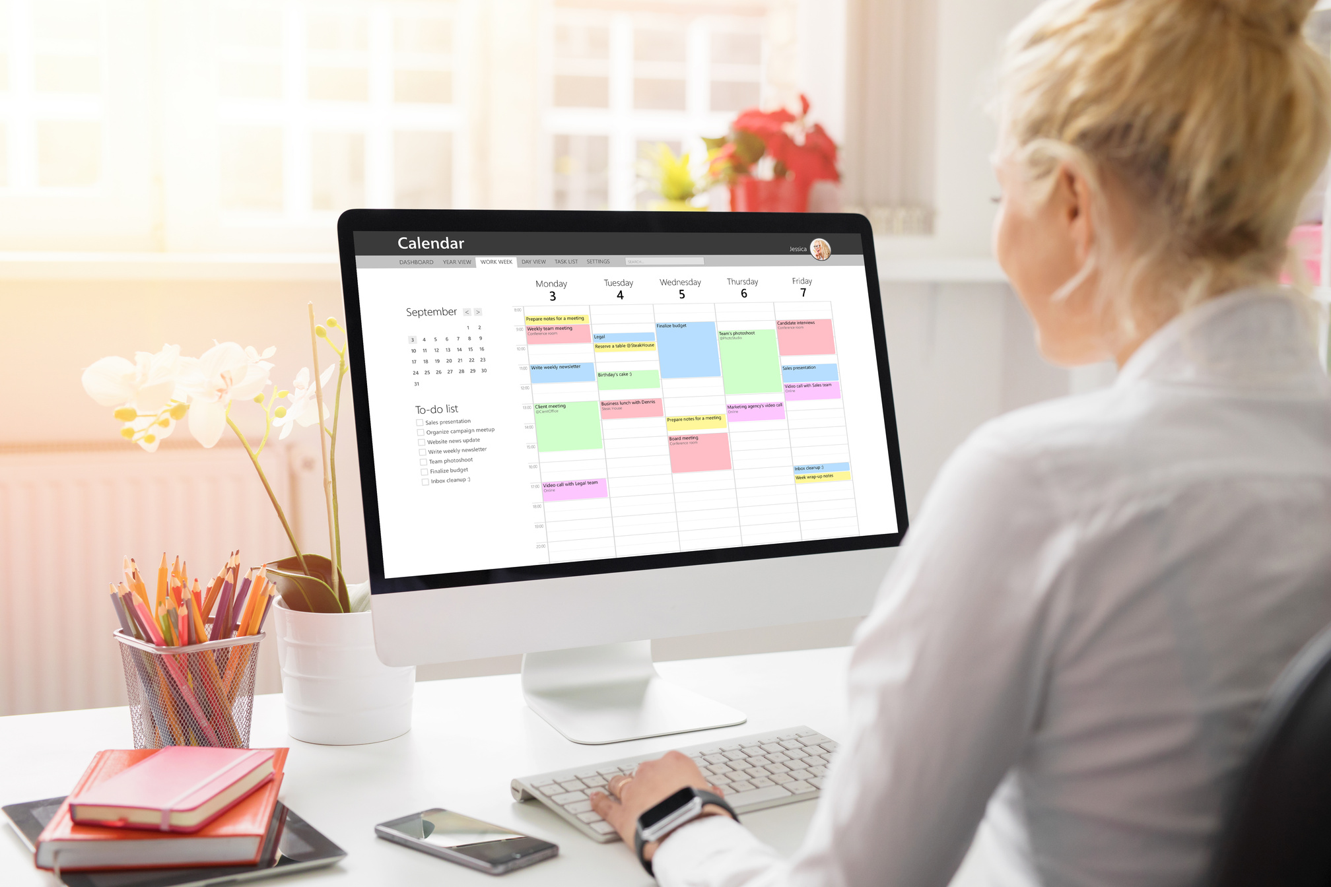
How often should you update your website?
A. Monthly
B. Once a year
C. Only when there’s a major event
2025 SIA REGION CONFERENCE
Notes:
Question 3: How often should you update your website?
A. Monthly
B. Once a year
C. Only when there’s a major event

Slide 7


How often should you update your website?
Answer:
A. Monthly
2025 SIA REGION CONFERENCE
Notes:
Correct Answer: A. Monthly
Websites should be updated at least once a month to keep information fresh and relevant. Set a routine to review pages, fix broken links, and update forms.
An outdated website can give the impression that your club isn’t active, which is something we all want to avoid.

Slide 8

What is a critical security measure for a club website?
A. Posting member passwords
B. Sharing your login credentials for easy access
C. Using secure hosting platform and updating software
2025 SIA REGION CONFERENCE
Notes:
Question 4: What is a critical security measure for a club website?
A. Posting member passwords
B. Sharing your login credentials for easy access
C. Using a secure hosting platform and updating software

Slide 9

What is a critical security measure for a club website?
Answer:
C. Using secure hosting platform and updating software
2025 SIA REGION CONFERENCE
Notes:
Correct Answer: C. Using a secure hosting platform and updating software
Security is essential for protecting your website, visitor data and club information. Using a secure hosting provider ensures your site has built-in security features, such as firewalls and encryption.
You'll also want to update your software regularly to help keep hackers out,
improve performance and fix bugs so that your site runs smoothly.
A lot of times you can set up automatic updates and many hosting providers provide automatic security monitoring, which you'll definitely want to take advantage of.

Slide 10


How to ensure your website is well-managed?
A. Assign one person to manage
B. Form a small committee
C. Hope it updates itself
2025 SIA REGION CONFERENCE
Notes:
Question 5: What’s the best way to ensure your website remains well-managed?
A. Assign one person to manage
B. Form a small committee to share responsibilities
C. Hope it updates itself

Slide 11

How to ensure your website is well-managed?
Answer:
B. Form a small committee to share responsibilities
2025 SIA REGION CONFERENCE
Notes:
Correct Answer: B. Form a small committee to share responsibilities
Forming a committee ensures diverse input that is more reflective of your club's goals and makes the workload more manageable.
You can assign roles such as content creator, designer and maintenance lead to ensure ongoing success.

Slide 12

Name a way to make website more accessible and ADA-compliant?
A. Ensure all images have alt text
B. Add decorative fonts to make site more visually appealing
C. Limit website colors to black and white for simplicity
2025 SIA REGION CONFERENCE
Notes:
Question 6: Name a way to make your website more accessible and ADA-compliant?
A. Ensure all images have alt text
B. Add decorative fonts to make site more visually appealing
C. Limit website colors to black and white for simplicity

Slide 13

Name way to make website more accessible and ADA-compliant?
Answer:
A. Ensure all images have alt text
2025 SIA REGION CONFERENCE
Notes:
Correct Answer: A. Ensure all images have alt text
An accessible website isn’t just good practice—it broadens your audience and reflects your club’s commitment to inclusivity. Being ADA compliant means designing your website so that everyone, including people with disabilities, can use and interact with it.
Key practices include adding alt text for images to describe visuals for screen readers; using clear navigation and labels; and making sure videos have captions or transcripts for hearing-impaired users.

Slide 14


Tools
WordPress
Squarespace
Wix
Weebly
Google Sites
Canva
Google Analytics
Mailchimp
Constant Contact
  It serves a variety of purposes, making presentations powerful tools for convincing and teaching.
What tools do you recommend?
2024 SIA REGION CONFERENCE
Notes:
Now that we’ve covered the essentials of creating an effective club website, let’s take a moment to discuss the tools that can help bring your site to life.
There are many website-building platforms available, and each has its own strengths. Some popular choices include:
WordPress – is one of the most widely used platforms, offering flexibility and customization. Great for clubs that want control over their site’s design and functionality.
Squarespace – is known for its sleek templates and ease of use, perfect for clubs that want a professional-looking site without dealing with complex coding.
Wix and Weebly – are both drag-and-drop website builders that are user-friendly and allows for quick setup.
Google Sites – is free and easy-to-use option for clubs that don’t need advanced features.
Beyond website builders, there are other tools that can help manage and maintain your club’s website including:
Canva for creating eye-catching graphics and banners.
Google Analytics to track website visitors and understand how people are engaging with your site.
And Mailchimp or Constant Contact if you want to integrate email sign-ups and newsletters.
Does anyone have a favorite website builder or tool to recommend? (Pause for audience responses and engagement.)

Slide 15



Recap & Takeaways
View SIA Website Guidelines in Recognition & Branding section of SIA website!
Define your goals and audiences before building your website
Keep it simple and professional
Update regularly
Prioritize security
Form a small team to manage website
Make accessible to everyone
2024 SIA REGION CONFERENCE
Notes:
Let’s quickly recap the key takeaways.
Define your goals and audience before building your website. Having a clear vision ensures your website serves your club’s mission effectively.
Keep it simple and professional. A clean, user-friendly design makes it easier for visitors to navigate and engage with your club.
Update your website regularly. A fresh, active website signals that your club is engaged and thriving.
Prioritize security. Use a secure hosting provider and keep your software up to date to protect your club’s information.
Form a small team to manage the website. This ensures long-term success without overloading one person.
Make your website accessible to everyone. Ensure it’s ADA-compliant so all visitors can interact with your content.
By applying these principles and using the right tools, your club can create a website that is not only effective but also an asset for your mission.
For additional guidance, I encourage you to check out the website guidelines available in the Recognition & Branding section of SIA’s website. These guidelines offer best practices, branding tips, and technical recommendations to help you build a site that aligns with our organization’s standards
Thank you all for your participation today! If you have any further questions, feel free to reach out.

