Slide 1




Driven by Dreams
2026-2030 Campaign
SOROPTIMIST INTERNATIONAL OF THE AMERICAS, INC
Notes:
Welcome to our webinar! I’m Jackie Schrauger, SIA Membership director. I’m excited to share more information about our 2026-2030 Soroptimist Membership Campaign: Driven by Dreams. We’re using the title and the imagery of driving SIA into our future to get everyone inspired here today!

Slide 2

Objectives
Explain key components of campaign
Understand support & resources
Identify how you, your club, and region can get involved
Notes:
After this workshop, you will be able to:
• Explain the key components of SIA’s new membership campaign.
• Understand the support and resources available from SIA, and
• Identify ways you, your club, and your region can get involved.
So, let’s dive in!

Slide 3

Why a new campaign?
Driving forward and strenghening our future together!
Notes:
Why are we launching a membership campaign?
SIA has not had a dedicated membership campaign since our Diamond Campaign began in 2019, which helped membership shine into the second century of Soroptimist. We’re excited to really focus on growing our membership over the next two biennia. Growth is essential for the future of our organization that we know and love.
We have all heard that Soroptimist is often called the best kept secret—let’s shed that identity and make sure everyone knows our name and more people are proud to be members!

Slide 4
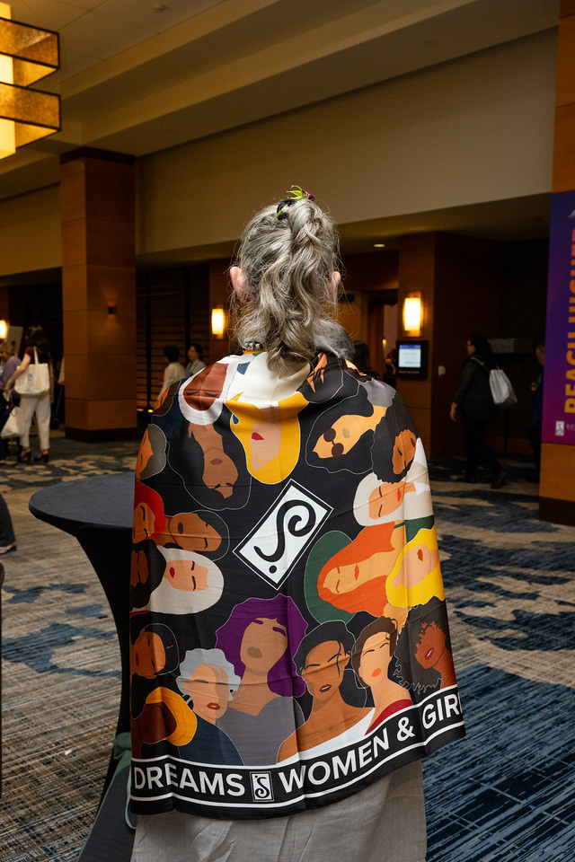
Our Goal
Grow and diversify membership by attracting, retaining, and engaging members who are committed to our mission.
Notes:
The overarching goal of Driven by Dreams is to grow and diversify SIA membership by attracting, retaining, and engaging members who are committed to the SIA mission. We will have a focus on inclusion, generational renewal, and relevance in a changing world.
We know our mission is engaging and speaks to so many people—if we can share a persuasive message enticing them to join us, we can reach our Big Goal and impact the lives of countless women and girls.

Slide 5
Goal
26-27: Achieve 98% net membership through retention of existing members and recruitment of new members.
Notes:
Have you ever heard the old saying, “if you don’t know where you’re going, any road will take you there?” To avoid that kind of fate, we will have clear goals for this campaign because we know we’re driving along the road to growth!
For the first year of the campaign, every club and region's goal will be:
2026-2027 Goal: Achieve 98% net membership through retention of existing members and recruitment of new members.
Goals will be set and shared each year after assessing the prior year’s performance. This will allow us to be agile and keep on track year-to-year. These goals will be shared with region governors and membership chairs as soon as they’re available and will also be shared in our social media, email, and Best for Women communications. There aren’t any penalties if the goals are not met, but we hope that they will provide an inspiring metric to move towards together.
Our ultimate goal is to retain our members by providing a fun, meaningful, and welcoming membership experience, and to bring even more wonderful members into it too!

Slide 6
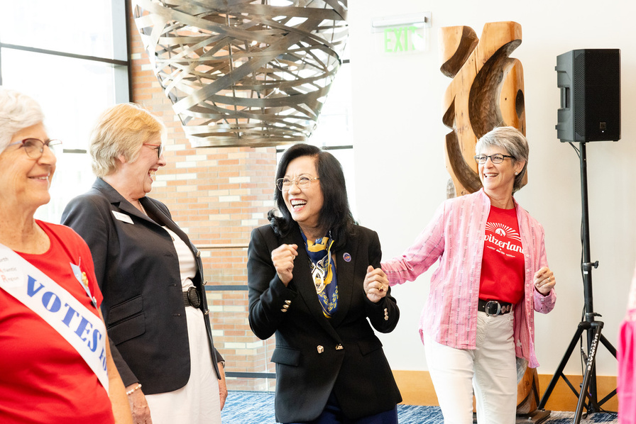
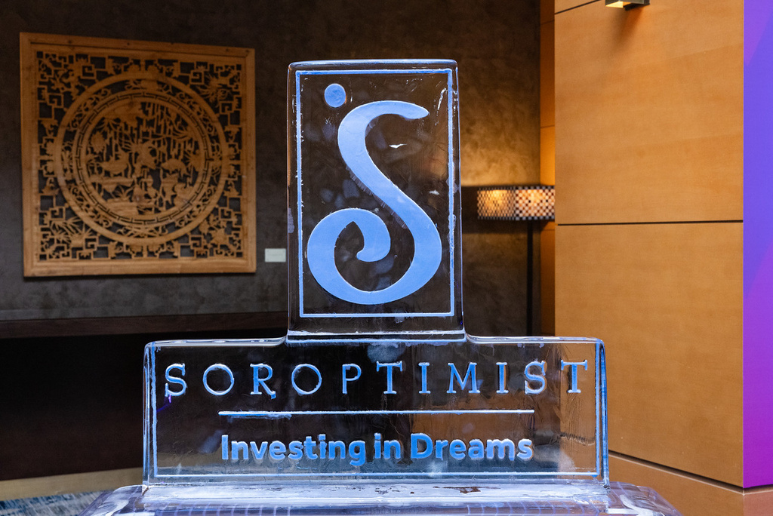
Club & Region Incentives
  Regions who hit their goals in either biennium are eligible for a drawing for $1,500 to use for membership.
  Clubs who reach their goals either biennium or who help charter a new club are eligible for a drawing for $1000 to use for membership.
Notes:
I know many Soroptimists enjoy a little friendly competition so of course there will be incentives and awards at both the club and region level. They will be structured very similarly.
Regions who hit their goals in either biennium are eligible for a drawing for $1,500 to use for membership recruitment and retention efforts, with a drawing occurring at the end of each biennium.
Clubs who reach their goals either biennium or who help charter a new club are eligible for a drawing for $1000 to use for membership recruitment and retention efforts.

Slide 7
Awards
Start Your Engines
Staging a Comeback
Crossing the Finish Line
Notes:
Of course, Soroptimists also love a theme, so all of the Awards are themed to our Driven by Dreams campaign title. We’re all in this race towards reaching our goals together! There will be a region award and a club award for all of these categories.
Start Your Engines Award: For Regions or Clubs who hit their goal for the first biennium,
Staging a Comeback Award: For Regions or Clubs who didn’t reach their goal for the first biennium but turned it around for the second biennium.
Crossing the Finish Line Strong Award: For Regions or clubs who achieve their goals in both biennia
Regions and clubs who receive this award are eligible for an additional opportunity to win a drawing for funds to support membership work!

Slide 8

Strategies
Win back
Member Get a Member
General New Member Recruitment
Notes:
Now, we all want to grow our membership. But HOW can we actually do that? We know it takes more than just wanting it to make it happen. What strategies can you use?
We’re going to cover three major strategies:
Win back
Member get a member
General new member recruitment

Slide 9
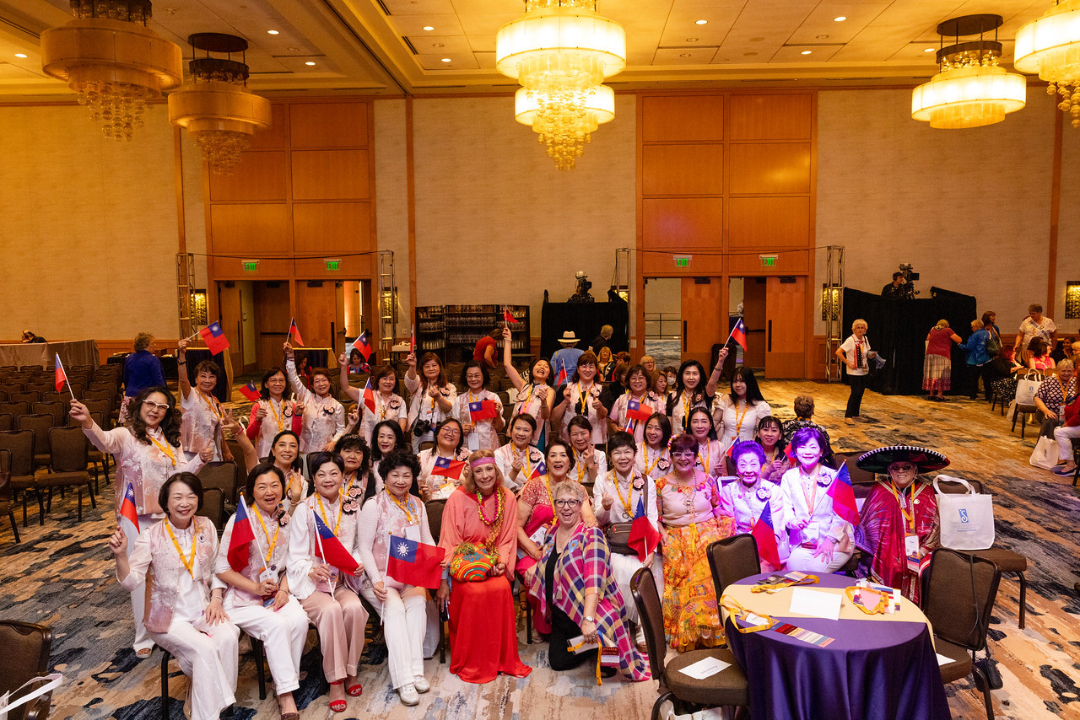
Win Back Strategy
Grow and diversify membership by attracting, retaining, and engaging members who are committed to our mission.
Notes:
Let’s start with the win back strategy. What does this mean? It’s all about winning back lapsed members, meaning those who have left your club or are about to leave your club.
The best time to connect with these members is before they actually leave. While we will definitely work to find new members in this campaign, retaining our current members is extremely important. They already know and understand Soroptimist, so you can start by asking someone you know who is considering terminating their membership about it. What’s making them consider leaving? Is there anything you or your club can do to help? What do they value about their membership, and how can you work to keep them connected to that?

Slide 10
Reasons for Leaving
Civility Issues
Code of Conduct process and ask for help from leaders
Notes:
Here's some common reasons that members consider leaving and what you can do to help them reconsider and stay:
Personality and civility conflicts --> This is one of the top reasons that members consider leaving. SIA has rolled out the Code of Conduct, which provides a framework for how to address these kinds of conflicts with support. Remind that member that they do not have to endure it alone and can ask their club president or region governor for help!

Slide 11
Reasons for Leaving
Civility Issues
Lack of Time
Code of Conduct process and ask for help from leaders
Consider hybrid meetings and offer flexible/short-term tasks to keep them engaged​
Notes:
Lack of time à If a member is considering leaving because their life has gotten busy, or their health has changed and it’s difficult to attend meetings, work with your club to see how they can stay connected. Could they attend meetings virtually? Can they help with club activities more flexibly--for example, could they call local businesses to solicit donations for fundraisers or research grants your club can apply for to support your Dream Programs work, but attend in-person meetings less often? There are lots of ways to accommodate their changing needs and still keep them connected to the club so they can resume when life calms down.

Slide 12
Reasons for Leaving
Civility Issues
Lack of Time
Lack of Funds
Code of Conduct process and ask for help from leaders
Consider hybrid meetings and offer flexible/short-term tasks to keep them engaged​
Consider sponsorships, dues relief, reach out to SIA if it’s a broader issue
Notes:
Lack of funds for dues à each club and region charges their own dues so there is no universal answer here, but if a member is struggling to pay dues and considering leaving because of it, there are several options to consider
Could another member sponsor them for the year (either in full or in part)?
Could your club work to establish a fund with donations from members to allow those who are struggling to have some relief? Some clubs call this a sunshine fund!
If the issue is more widespread for the club, SIA does offer dues relief for clubs experiencing extreme situations, like countrywide economic suffering or an environmental disaster. These relief funds can help sustain your club through a difficult time and help keep our membership strong and connected.

Slide 13
Reasons for Leaving
Civility Issues
Lack of Time
Lack of Funds
Mission Disconnect
Code of Conduct process and ask for help from leaders
Consider hybrid meetings and offer flexible/short-term tasks to keep them engaged​
Consider sponsorships, dues relief, reach out to SIA if it’s a broader issue
Ensure your club is focused on women and girls and doing at least one Dream Program​
Notes:
Misson disconnect à this can happen when clubs are focused mostly on projects that fall outside of the mission of SIA, and makes members feel like they aren’t getting the experience they joined for. Encourage your club to focus on women and girls in all their projects, and to participate in at least one of the Dream Programs, Dream It, Be It and the Live Your Dream Awards or a Big Goal Accelerator Project.

Slide 14
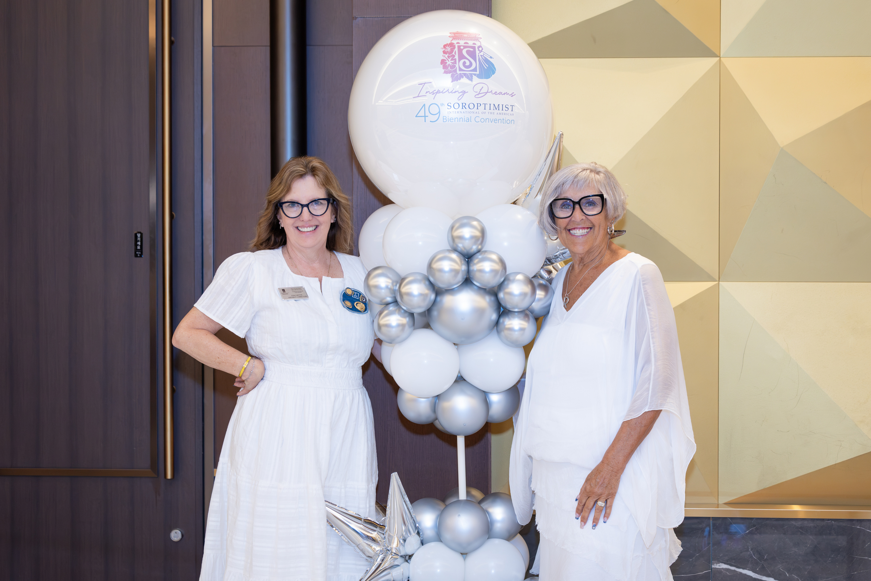
Member Get a Member
Share in person and online!
Notes:
The next strategy we will discuss is called “member get a member.”
This can be a powerful way to find new members. They may already be familiar with Soroptimist because they’ve heard you talk about your amazing volunteer experiences and how much your club accomplishes in your community. That goes a lot further to paint a picture of what being a Soroptimist might mean compared to just seeing a poster in the grocery store. You can do this in person of course, but you also can share on social media about why you’re a Soroptimist and encourage anyone who is interested to reach out to you.
There’s no better spokesperson for Soroptimist than a current member sharing what membership means to them!

Slide 15
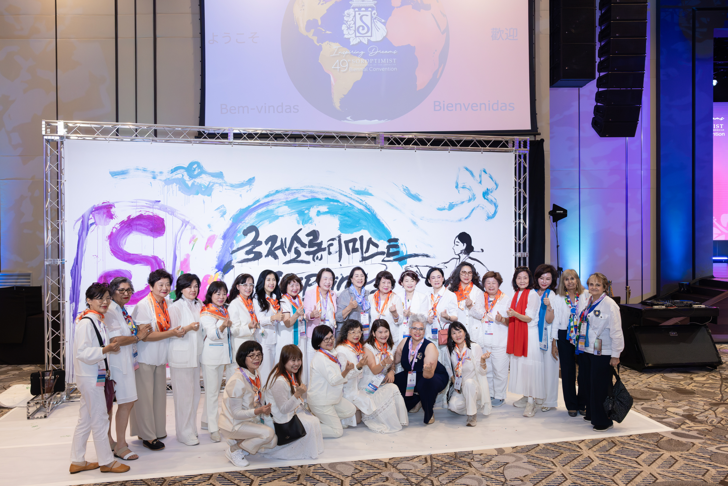
Individual Incentives
  A discount to the SIA store of 15% off.
  Drawing for a $250 gift card to the SIA store.
  In the Driver’s Seat Award: for the member who recruits the largest number of new members each biennium!
Notes:
SIA will offer incentives to Soroptimists who recruit new members to join as a thank you for sharing your experience with others and enriching our federation.
Members who recruit any new members receive a discount to the SIA store of 15% off.
Members who recruit more than two new members will be entered into a drawing for a $250 gift card to the SIA store with one drawing occurring each biennium.
Finally, there will be award called the In the Driver’s Seat Award given to the member who recruits the largest number of new members each biennium! If you've got a bit of a competitive streak, hopefully snagging that title will be motivating to some of you.
If you recruit members, be sure to encourage them to complete our new member information form (which will be emailed to them), so that we can track that you referred them.

Slide 16
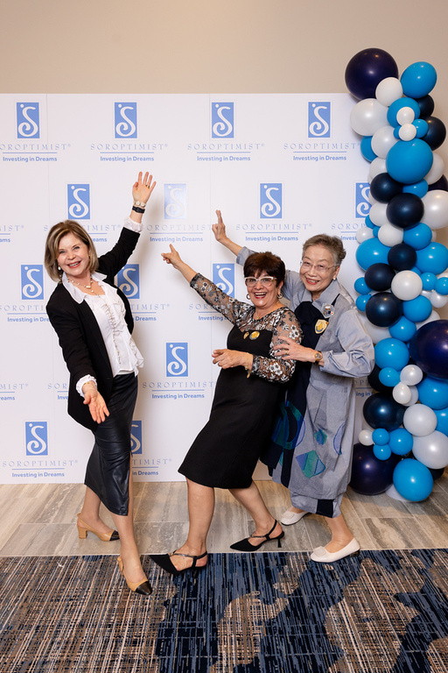
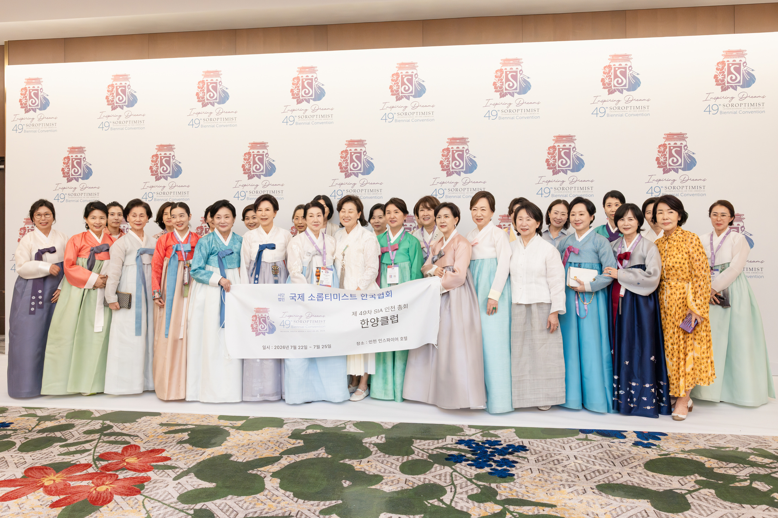
New Member Recruitment
Support new club charters
Help them consider the options:
  Traditional in-person
  Online
  Offering hybrid meetings
Notes:
Our final new member strategy that we will discuss today is general new member recruitment.
This could be your club helping a new club to get started. If you’re able to support a new club charter, that’s fantastic! Be sure to encourage them to consider different models—do they want to be an online or hybrid club, so that they can ensure people can participate in different stages of life? This flexibility can be key for longevity after their initial excitement of chartering fades a bit.
SIA has resources to support these different models, so encourage them to consult those resources for tips and suggestions.

Slide 17
Mission-Aligned Members
Collleges, including older students and staff
Workplaces, especially partner nonprofits
Events--women’s, community/volunteer fairs
Notes:
Our reporting tools indicate that the number one reason new members join our organization is because of our mission and our Dream Programs. You can help grow your club’s membership by recruiting members who reflect their communities and are invested in our mission.
But where do you find these mission-motivated members?
Consider any organization that your club might partner with such as:
Colleges, including targeting older students and staff
Workplaces, especially nonprofits that you partner with
Women’s professional networks and events
Community fairs or volunteer fairs
These locations all provide a group that is likely to be connected to our mission and may just not know how to get involved.
Perhaps you can do a lunch and learn at a local nonprofit and share about Soroptimist with their staff, or table at a women’s professional event. You know your community best and can surely find some fantastic opportunities to connect with these motivated potential members!

Slide 18
Other Ways to Engage
Micro-engagements
Mentoring
Check In
Notes:
Encourage your club to offer “micro-engagements” like service challenges, short-term committees, or day-of volunteer engagement for events. These can keep members involved without overcommitting, particularly for newer members or members going through life changes like young children or illness.
Consider adding a mentoring component for new members to help them navigate the ins and outs of your club, region, and the broader organization. It can be a lot to learn with over 100 years of history, and a mentor can act as a GPS system to help them stay engaged and learn all the quirks!
And finally, don’t lose touch of prospective or interested members—keep in touch with them to show that you want to involve them.

Slide 19
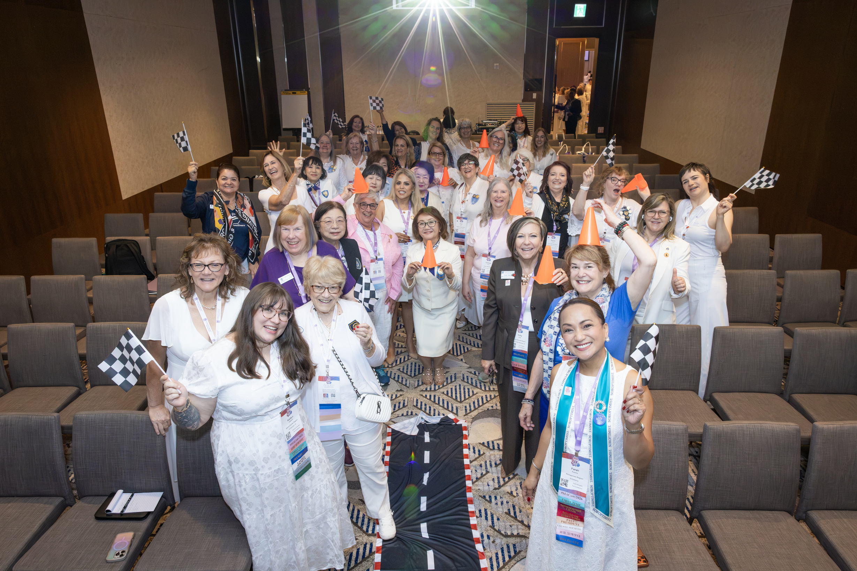
Kick-Off Events
  Props
  Themed food/drink
  Songs
Notes:
Now, as we said before, we know that Soroptimists love a theme. A great way to incorporate the Driven by Dreams theme is to hold a club kickoff event! There are endless ways to make this feel fun and special, including having some racing themed props, perhaps a checkered flag or a steering wheel to show that you're in the driver's seat with this campaign! That's what we did at our workshop in Korea and it was a lot of fun.
At the club meeting where you share ideas for this campaign and get everyone excited, you could have racing or driving themed food and drink as well as a station to take photos with any props period.
You could even create a playlist for the event with some driving themed songs to make people excited. Period. Now this will vary depending on your language and part of the world, but here in the United States, an example might be the song “Life is a highway,” “Little red corvette,” or “running down a dream.” I’m sure there are lots of other ideas that you can pull from to make this a fun event and to get the ideas flowing!

Slide 20
Discussion Questions
  How can YOU help get your region and club excited?
  Can you think of any recently lapsed members who you might be able to win back?
  Who do you know who isn’t a member yet but could be?
  What kinds of events can your club, district, region host or attend to engage potential new members?
  What are some kinds of things that your club has NOT yet tried that might help grow membership? What of those are low or medium effort or cost?
Notes:
Now we will move on to our discussion questions. These make a great discussion for a club meeting.
How can YOU help get your region and club excited?
Can you think of any recently lapsed members who you might be able to win back? Can you plan a plan to address their reasons for leaving and encourage them to rejoin?
Who do you know who isn’t a member yet but could be? How could you reach out to them to talk to them about joining?
What kinds of events can your club, district, region host or attend to engage potential new members?
What are some kinds of things that your club has NOT yet tried that might help grow membership? What of those are low or medium effort or cost?
So start your engines and consider these questions with your fellow members!

Slide 21
Thank you!
Notes:
Thank you so much for all your time and attention! We look forward to working together to make Driven by Dreams a roaring success. you can always reach us at SIAHQ@soroptimist.org if you have any questions that we don't get to address today.

